Slide 1
Health Care in the 21st Century
Electronic Health Records

Slide 2
Health Care Costs
In the United States, healthcare is very expensive.
The World Health Organization (WHO)”noted that the United States ranked number one in health expenditure” in the year 2000. (Pipersburgh, 2011 p.55). The spending in that year was about $1.3 trillion dollars (Pipersburgh, 2011 p. 55).
The National Health Expenditure was estimated to be $2.6 trillion dollars last year and will likely continue to rise (Pipersburgh, 2011).
Despite the expense, the US does not lead the way in health care. Other countries perform better in areas such as “life expectancy, access to care and demographic disparities” (Gaylin, Moiduddin, Mohamoud, Lundeer & Kelly 2011 p.921)
It is thought that incorporating more technology (including electronic records) into healthcare could alleviate some of these costs and improve the system.

Slide 3
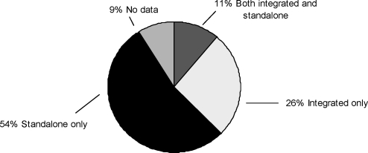
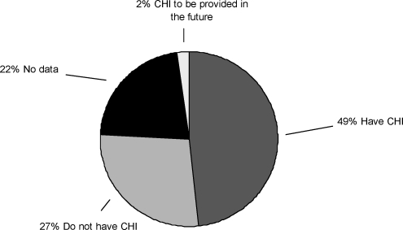
Health Records
PHR Information
Most health information is still kept on “paper medical records stuffed into folders” in doctors’ offices (Bau, 2011, p. 15).
There is a “greater interest in access to personal health information” (Jones, Shipman, Plaut & Sheldon, 2010, p. 243).
Personal Health records (PHRs) are a way for consumers to keep track of their medical data. There are many different kinds with various features.
Some are integrated while others are standalone (Jones, Shipman, Plaut & Sheldon, 2010, p. 245).
Some feature Consumer Health Information.
Electronic Health Records (EHRs) are defined in various ways, usually considered a central portable sharable site for all past and current medical information (Pipersburgh 2011) (Bau 2011).
They have been talked about but slow to catch on in the US.

Slide 4
HITECH Act
Passed as part of the American Recovery and Reinvestment Act, the Health Information Technology for Economic and Clinical Health (HITECH) seeks “to bring U.S. medicine into the digital age” (Bau, 2011 p.15).
There are several goals and bylaws for the new law, including the widespread implementation of electronic health records and better healthcare for all Americans (Bau, 2011) (Pipersburgh, 2011).

Slide 5
Better Care (Bau, 2011, p. 15) (Pipersburgh, 2011)
Job Creation (Bau, 2011, p. 16)
Patient Engagement (Bau, 2011, p. 16)
Better Informed Patients (p. 16-17)
Increased “efficiency and portability” (Pipersburgh, 2011, p. 56)
Improve “coordination of patient care” (Pipersburgh, 2011, p. 56)
Decrease medical mistakes (Pipersburgh, 2011, p. 57)
Eliminate the “disparities of heath care” seen in minorities and non native speakers (Bau, 2011, p. 17)
Increased Consumer confidence in health care (Gaylin, Moiduddin, Mohamoud, Lundeer & Kelly 2011 p.933)
EHR Benefits

Slide 6
Complex systems (Pipersburgh, 2011, p. 57)
High start up costs for new systems (Pipersburgh, 2011, p. 57)
Privacy issues and security of personal data (Gaylin, Moiduddin, Mohamoud, Lundeer & Kelly 2011 p.928)
Compatibility issues with different healthcare systems (Pipersburgh, 2011, p. 58)
Many negative issues can be easily addresses or are exaggerated (Pipersburgh, 2011, p. 59)
Problems with EHRs

Slide 7
Future
The technology is rapidly evolving in healthcare. Things are changing quite fast in the world of PHRs and EHRs. It remains to be seen whether the HITECH Act will succeed but it does seem likely that EHRs and other forms of information technology will catch on, at least in the more urban/advanced hospitals and doctor offices.

