Slide 1
Victoria Beckham (1974-present)
Celebrity Endorsements
Brittany Predmore
Mass Media & Politics

Slide 2
Personal Info
Born April 17th, 1974.
Originally from Hertfordshire, England.
Married to David Beckham.
Mother to Brooklyn, Romeo, Cruz, and Harper

Slide 3
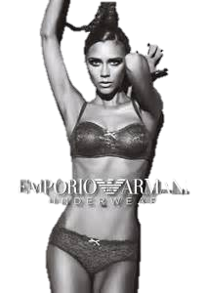
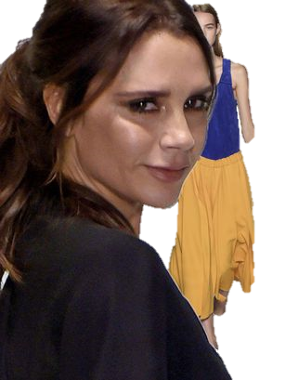
Career Info
Spice Girls, “Posh Spice” - Singer (1997-2000, 2007-2008, 2012) .
Model – Emporio Armani (2008-present)
Fashion Designer - “VB Rocks” Rock & Republic Collection (2004-present)

Slide 4
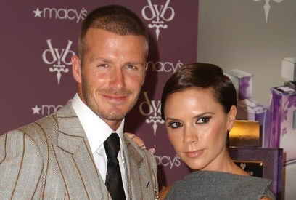
Major Charities
Victoria and David Beckham Charitable Trust
Malaria No More
Cancer Research UK
BeatBullying
Love Our Children USA
Full List of Charities:
https://www.looktothestars.org/celebrity/victoria-beckham#causes

Slide 5
Major Causes
AIDS/HIV
Children
At Risk/Disadvantaged Youth
Cancer
Education
Health
Human Rights
Poverty
Women
Full List of Causes: https://www.looktothestars.org/celebrity/victoria-beckham#causes

Slide 6
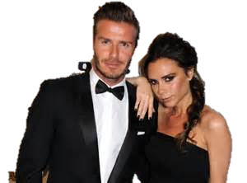
The End

