Slide 1
ePortfolio Assessment: From Rubrics to Contests
Rubrics, Reflection, Peer Feedback, Contests
Best Practices Conference 2012

Slide 2
Assessment rubrics used as aids to guide the development of student ePortfolios and to provide timely and standardized feedback from both peers and instructors (graduate + undergraduate)
Rubrics were also created to evaluate individual assignments

Slide 3
ePortfolio rubric
Located on ePortfolio

Slide 4
My feedback
Comments: __Very impressive eportfolio. I would love for you to make the whole thing public for Pace to see as an example of excellent work! And of course you should enter the contest! Very strong reflections – keep those up. Watch typos in 3rd line of reflections use vulnerability instead of venerability and I instead of 1. I suggest adding Tom Lynch’s website to your description below his letter. Your pages are balanced and you thoroughly describe each artifact. Include where your work was published on your activities page. I liked your “blast from the past” graphics! This shows your evolution as a designer which is what eportfolio is all about. Good caption under your wordle (I am going to borrow the idea from you!). Just make the link active. Your pages were well balanced. Great work overall.__________________________________________________________

Slide 5
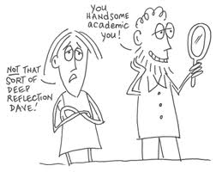
Reflection
Reflection on learning in an important component in assessment
Through reflection, students make connections --between class assignments and learning outcomes
-between peer and faculty feedback and learning
-across course content
-between college learning and future goal setting

Slide 6
My Reflection (Reflection on growth, future goals and connections between courses)
Life can only be understood backwards; but it must be lived forwards.
Soren Kierkegaard Danish philosopher (1813 - 1855)
In reflecting on my ePortfolio I’ve come to appreciate the opportunities I’ve been granted and the life I’ve experienced thus far. The introduction is the beginning of who I am, who I am becoming –the foundation of my dreams if you will. It’s a digital handshake, the opening of a front door, an honest moment of vulnerability that l trust you will respect. The theme of this ePortfolio is emerged in the world of graphic design, my world of graphic design. The field of communication studies has been the consistent, reliable vehicle in my need to truly understand this world. When I reflect on the lessons I’ve learned in sub disciplinary subjects like gender, women’s studies, and advertising my heart and mind are full – full of knowledge and concerns because nothing is perfect and each of these fields have their issues.
In reflection, I humbly can only think of three things.
One. I’ve done more graphic design than I’ve ever realized and perhaps it’s more than just a “side thing” I do. It brings me unprecedented content and a voice – a visual, creative way to express myself. I, after creating this ePortfolio, will stop denying who I am and use my skills to advocate for what I am passionate about.
Two. I have amazing, inspiring people in my life. Besides family support, I without a doubt, have the greatest cheering section an aspiring young woman could ever ask for. With unquestionable support from grade school teachers, high school teachers, music mentors, college professors, and company CEOs I don’t question my abilities to successfully succeed in this cut-throat world.
Three. I am a graphic designer and no career will ever make me completely happy if I’m not advocating for a worthy cause and/or designing graphics in some fashion. I, if I could think of my dream job, would enjoy being a graphic design teacher. The thought of teaching the joy I experience day after day is something that always puts a smile on my face.

Slide 7
Reflection illustrating student connections with course material and future exploration
Many of the assignments have caused me to look at new, untested realities, both sensational and perplexing, and I’ve had many questions I’d love to explore in greater depth. As an example, I have been fascinated by the power of the public to demand and steer news coverage via social media. I’ve seen live television shows switch gears on account of viewer emails and tweets. It wasn’t that long ago when we had to write and snail-mail a “letter to the editor,” if we wanted a chance to be heard, but social media is giving audiences a seat in news and editorial rooms. Often, the public owns events before the media. The public has the information, the images, the video and forwards it to the media channels well before they can arrive at the scene or receive the information through the industry news feeds.

Slide 8
Individual Assignment Rubric
Located on ePortfolio

Slide 9
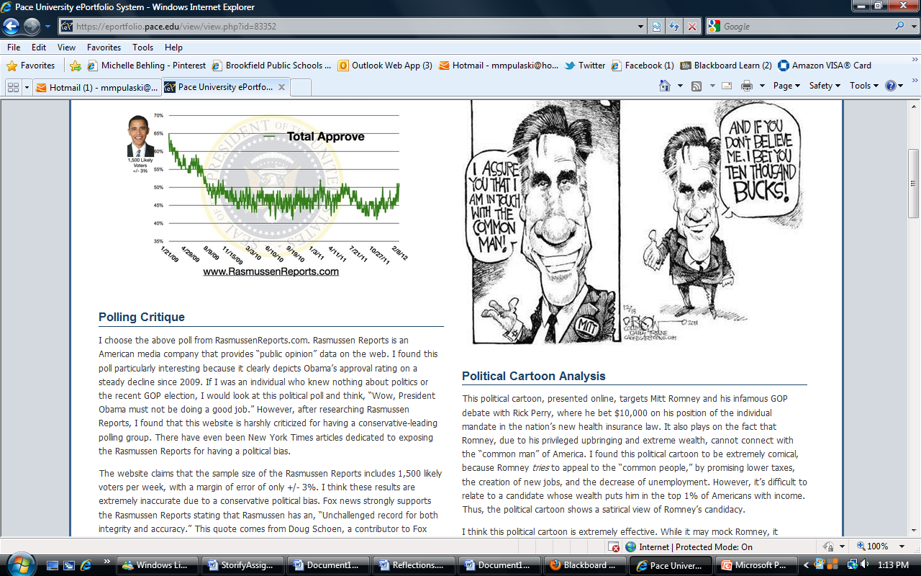

Slide 10
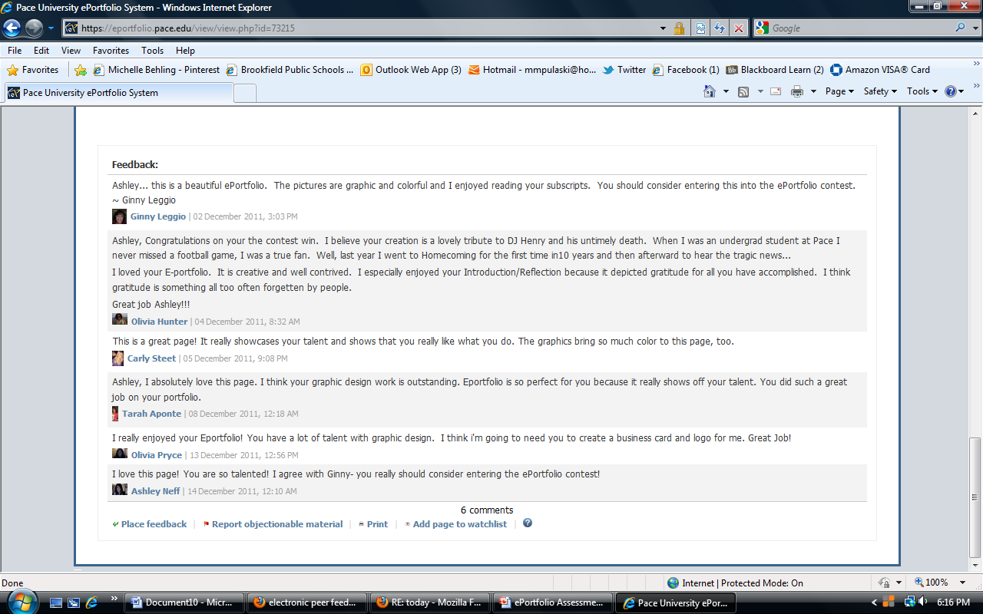
Peer Feedback

Slide 11
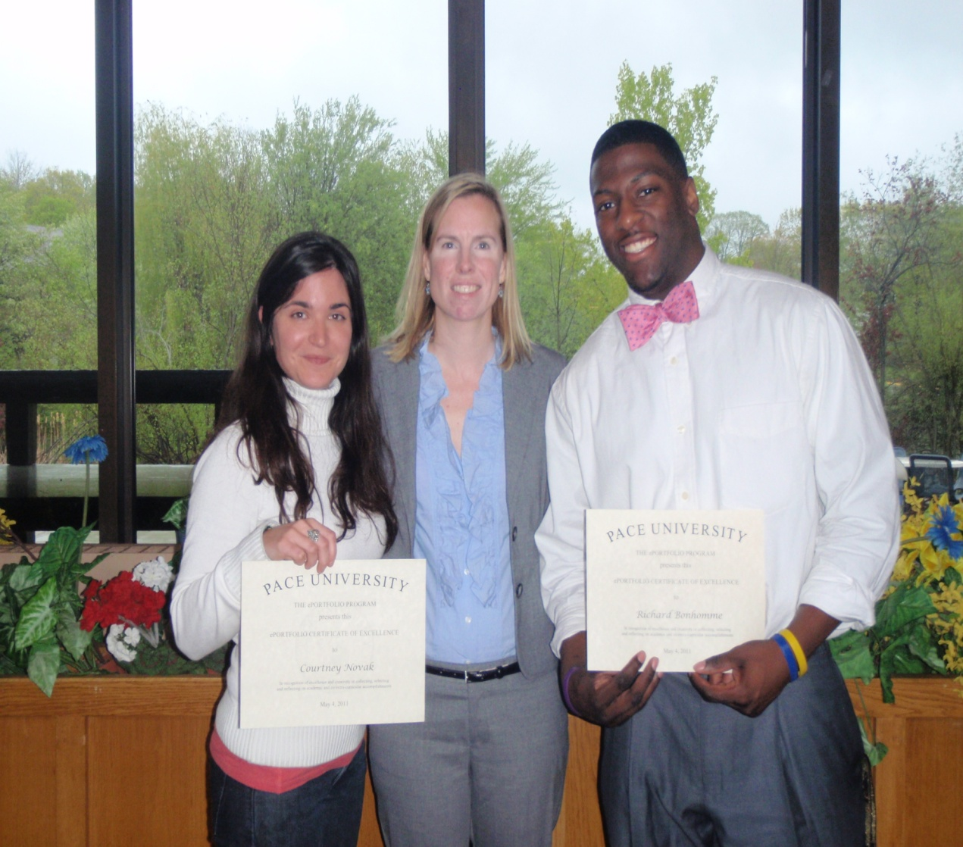
Contests
Held in the spring to encourage students to create and share their eportfolios
2011winners https://www.pace.edu/ctlt/eportfolios/contest-winners
2012 – April 9 deadline
MCA winners recognized at the ePortfolio Student Showcase with their Excellence in ePortfolio Awards

Slide 12
Contest Rubric
Located on eportfolio

