Slide 1
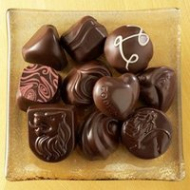
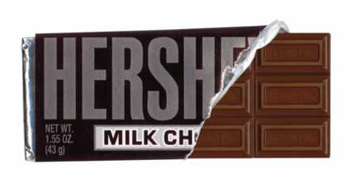
The Hershey Company
Hershey vs. Godiva

Slide 2
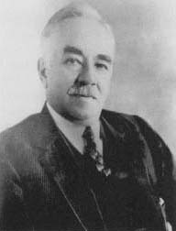
History of Hershey
The Hershey Company was founded in 1894 by Milton Snavely Hershey as a subsidiary of his Lancaster Caramel Company.
Hershey made his way back to Lancaster where he opened a caramel shop which was later on sold in 1900 for one million dollars, a company that would be worth in the range of 27 million in today’s society.
Hershey’s creation of chocolate bars began and continued in his hometown in Pennsylvania, and from then on out, the Hershey Company began to expand.

Slide 3
Sales and Acquisitions
 | More Sales/ Acquisitions
1969 | Hershey received a license from Rowntree's to manufacture and market Kit Kat and Rolo in the United States
1977 | Hershey acquired Y&S Candies, founded in 1845, and became the makers of Twizzlers licorice candies
1988 | Hershey's acquired the rights to manufacture and distribute many Cadbury-branded products in the United States (imported Cadbury crème eggs)
2002 | Hershey trustees tried selling their controlling interest to the William Wrigley Jr. Company for 12billion (Offer was dropped, trustees were forced to resign)

Slide 4
Revenue and Income
Revenue | US$5.671 billion (2010)
Operating income | US$905 million (2010)
Net income | US$510 million (2010)
Total assets | US$4.273 billion (2010)
Total equity | US$938 million (2010)

Slide 5
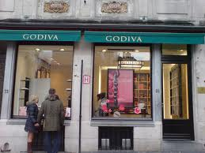
History-Godiva
Godiva Chocolatier is a gourmet chocolate company founded in Belgium in 1926 by Joseph Draps.
Godiva opened its doors and was named in honor of the legend of Lady Godiva, a woman known to ride through the streets naked in order to gain a remission on the tax which her husband imposed on tenants.

Slide 6
It wasn’t until 1958 that the first Godiva shop opened right outside of Belgium. The location was in Paris, France.
During the late 1960’s, products had begun to ship out to the United States, where they were sold in strip malls.
Campbell’s Soup Company later bought the Godiva company and had ownership until 2007, when they announced they had come to terms to sell Godiva to Yıldız Holding, which is based in Istanbul, Turkey.

Slide 7
Demographics- Hershey
Consumers of Hershey’s products are of both genders and all ages, geographic areas, income levels & ethnicities. (they are marketed to appeal to everyone)
Evidence of this was their “Great American Chocolate Bar” campaign in the 80s which featured people of different ages & backgrounds enjoying Hershey’s chocolate.
http://www.youtube.com/watch?v=Pa8D9dLiRQ0

Slide 8
Demographics- Godiva
Godiva has a primary target market which consists of women & men aged from 30 to 62 whose incomes are approximately $75k per year, so it is both older and more upscale than Hershey’s public.
This includes wedding planners, party planners, special event caterers, people who use these services, and individuals.

Slide 9
Psychographics- Hershey
Consumers of Hershey products are diverse psychographic ally.
Though the prevailing image is that they are family-oriented, conservative and hold strong traditional values.

Slide 10
Psychographics- Godiva
Godiva consumers are known to be “busy but content.”
They “love to indulge yet are health conscious.”
They “consider themselves generous and giving.”
Godiva chocolate is in the place of items of great luxury, value, and recognition.

Slide 11
Messages and Delivery
GODIVA
HERSHEY
Message: Chocolates can be the gifts that can impress when made with care.
Delivery:
Word of mouth
Websites
Packaging
Boutiques
Social networking sites: Facebook, Twitter, pintrest, Youtube
Message: Enjoyable chocolate can be affordable for the average person.
Delivery:
Commercials
Websites
Stores available
Social networking sites: Facebook, Twitter, pintrest, Youtube

Slide 12
Latent Public: Godiva
Private Institution
Rewards Cards
Lady Godiva Scholarship
Active Public: Hershey’s
Theme Park
Interactive Flagship Stores

Slide 13
Products
Godiva
Brownies
Truffles
Signature Cakes
Coffee & Cocoa
Biscuits
Chocolate Bars
Hershey
Chocolate Bars
Reeses
Syrup
Baking Chocolate
Dessert Toppings
Milk & Milkshakes

Slide 14
Communication with Publics-Hershey
INTERNAL
Hershey communicates with its employees, stockholders & business partners through its website, stock holder reports, internal employee communications, & through its Corporate Social Responsibility Reports which summarize there efforts to do their business in a socially responsible & environmentally sustainable manner.

Slide 15
Internal (cont..)
The company has a long history of supporting charitable organizations such as the Milton Hershey School for disadvantaged children.
It is also addressing such issues as human rights, climate change & resource scarcity.

Slide 16
External
It communicates with its customers externally through advertising, special events, promotions its engagement in the town of Hershey, Pennsylvania.

Slide 17
Communication with Publics-Godiva
Godiva communicates with consumers through its website, six seasonal mail order catalogues a year, advertisements both in print and television.
Most of the ads are selling sex/romance with the chocolate.

Slide 18
State of Activity-Hershey
Hershey Foods is North America's largest chocolate producer with 42.5% of the US chocolate market.
Hershey sells products in 50 countries under 60 brand names including, Hershey's, Reese's, and Kisses. In 2010, the company's net revenues were $5.67 billion with net income of $510 million.
Additionally, Hershey maintains the right to manufacture and sell competitors' products, such as Kit-Kat bars, through licensing agreements with foreign Nestle (NSRGY) and the former Cadbury Schweppes (now part of Kraft Foods (KFT))

Slide 19
Chart of Market Share
http://www.google.com/imgres?hl=en&tbo=d&tbm=isch&tbnid=r4gjxk1Qir5KoM:&imgrefurl=http://www.wikinvest.com/stock/Hershey_Foods_(HSY)&docid=Qj-QjtcAYEBk8M&imgurl=http://www.wikinvest.com/images/thumb/5/57/U.S._Chocolate_Market_Share.png/500px-U.S._Chocolate_Market_Share.png&w=500&h=331&ei=zqW7UMu5Bcq80AGAwICwBQ&zoom=1&iact=rc&dur=1&sig=102986933102369314666&page=1&tbnh=145&tbnw=219&start=0&ndsp=19&ved=1t:429,r:2,s:0,i:94&tx=160&ty=102&biw=1366&bih=601

Slide 20
State of Activity-Godiva
Since Godiva Chocolatier, Inc. is a wholly owned subsidiary of Yildiz Holding of Turkey, it does not publish financial statements, and does not discuss total sales, advertising costs or financial performance.
However, according to the Wall Street Journal in 2011, the total sales in 2011 for Godiva estimated to be approximately $650, with nearly a third of that coming from items developed in the past two years, being introduced to grocery stores.

Slide 21
http://www.hersheys.com/ads-and-videos.aspx
(how to make chocolate)
(commercials)

