Slide 1
iPads in the Classroom Michelle Pulaski Behling
Media and Politics Seminar
18 iPads

Slide 2
Apps Used
Bb Mobile
News outlets: AP, Reuters, CNN, Huffington Post, Fox News, ABC, WSJ, NYT, USA Today
NPR “its all politics” podcasts
Politico
Slate
Storify

Slide 3
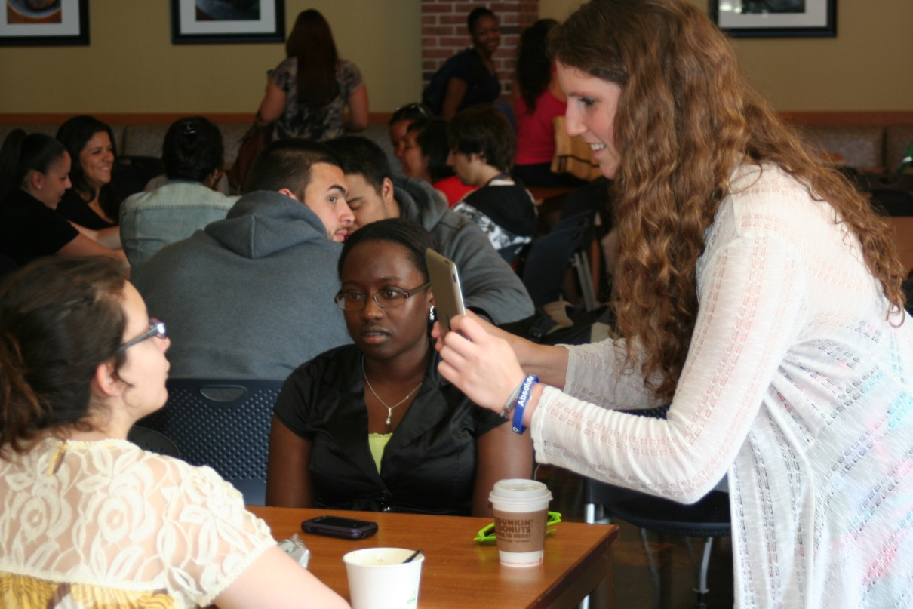
iPad Activities
Research media coverage of politics; analyze blogs
Case studies on crisis news – include videos and images to upload to eportfolio
Compare Obama + Romney Facebook, Twitter + YouTube pages
Final Project http://storify.com/

Slide 4
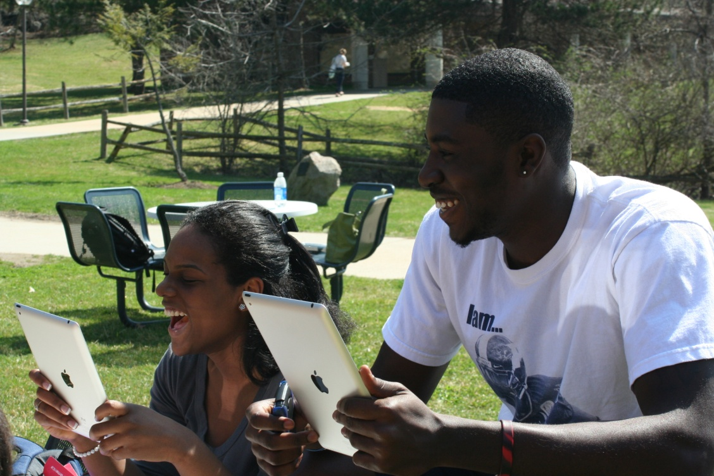
Educational Benefits
By providing students with highly interactive learning experiences, they become more engaged with the material ( Blended Learning Approach)
Using iPads in class allows for easy access to Web 2.0 tools like eportfolios, Facebook, Flickr and Youtube

Slide 5
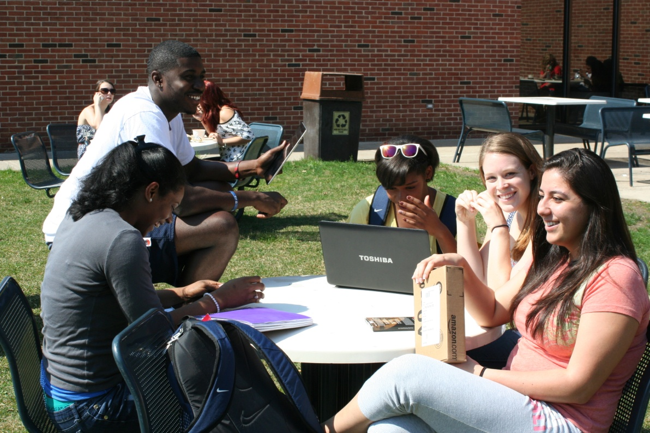
Educational Benefits
Using Web 2.0 resources to keep track of political events and analyze real world situations allows students to use the technologies they are already familiar with in new ways.
Providing engaging technology like iPads in class results in student centered learning

Slide 6
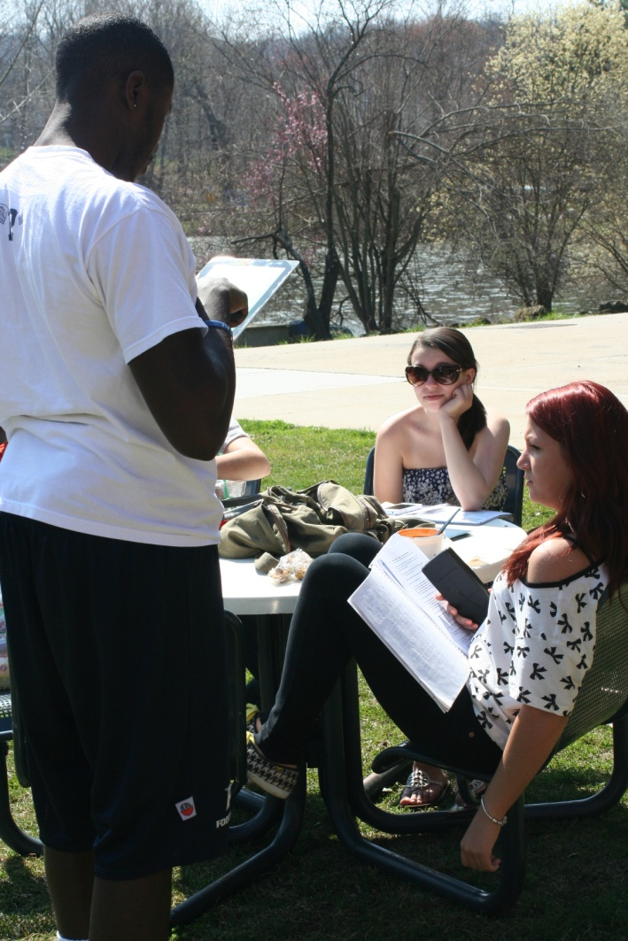
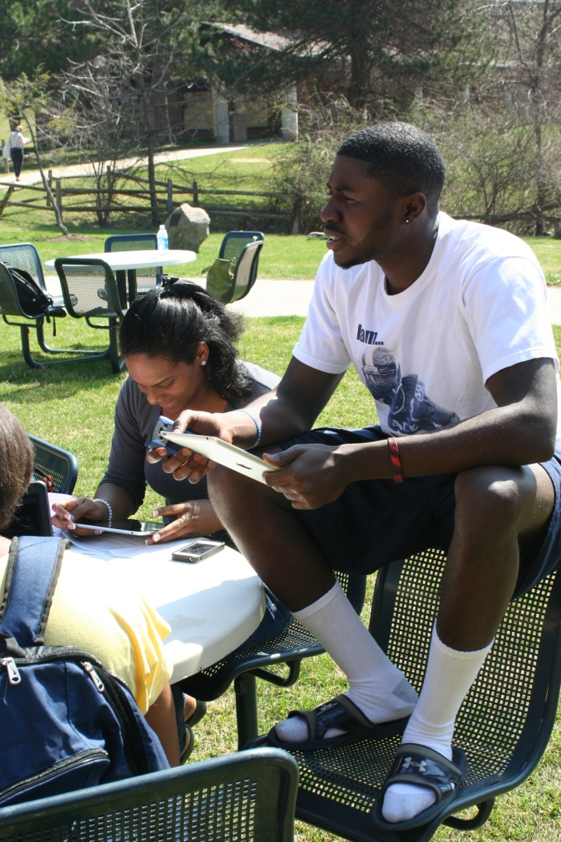
Engaging Students
Students cited enjoying their use of ipads instead of laptops in the class
Easier to capture photo + video for final project than other devices + high quality
Made group work easy

