Slide 1
Critical Discourse Analysis
Hana Ljubicic

Slide 2
Student Information
Age: 7 years old
Grade: 2nd grade
Developmentally on “Grade Level”
Linguistic Status: L1 is English, but also speaks Spanish at home

Slide 3
Writing Samples:

Slide 4
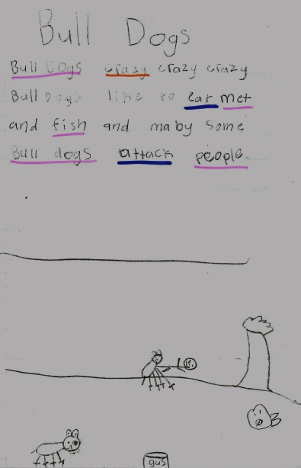

Slide 5
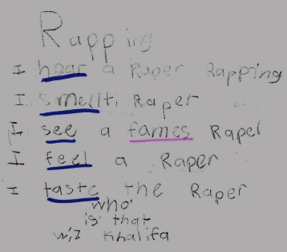

Slide 6
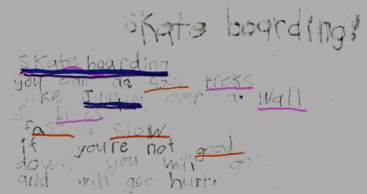

Slide 7
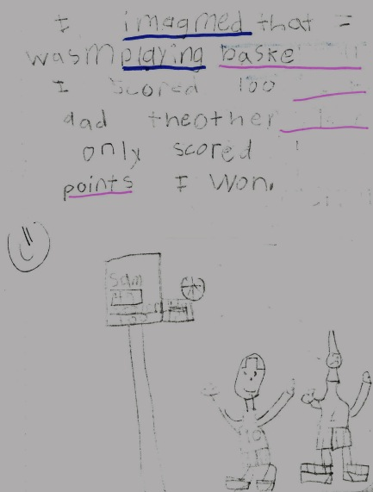

Slide 8
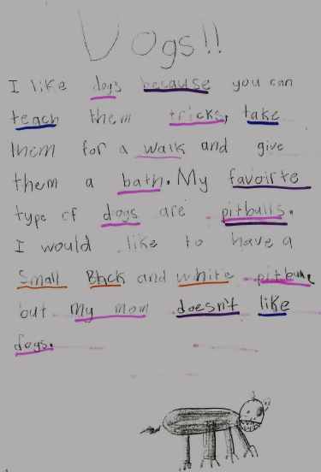

Slide 9
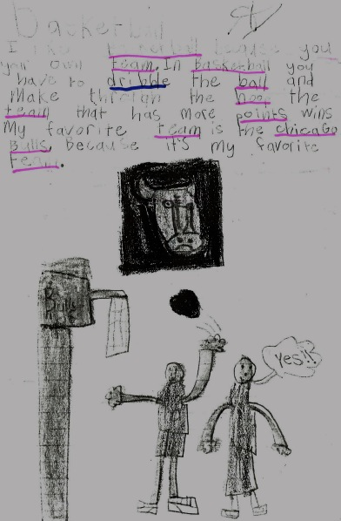

Slide 10
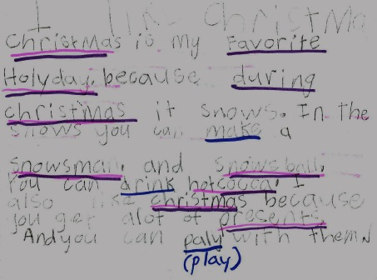

Slide 11
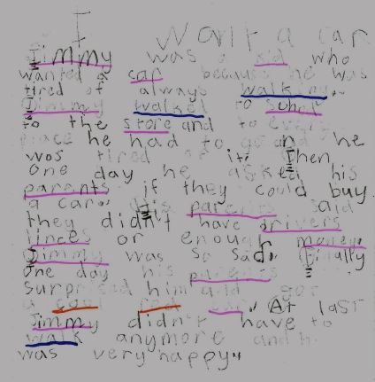

Slide 12
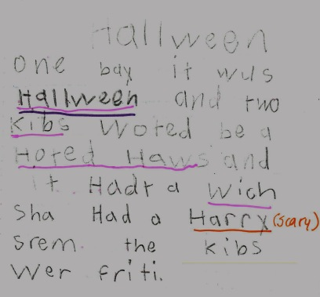

Slide 13
Lexicon
Lexical density: 35% density (nouns, adjectives, verbs)
Lexical diversity: Diverse sentence starters “I imagine…, I think…, I like…”
Lexical complexity: 13%complexity (monosyllabic words)

Slide 14
Morphology
Suffix and prefix understanding
(i.e. “skateboarding”, “playing”, “walking”, “scored”, “walked”)
Needs improvement of understanding: Future verb tense: i.e. “When I grow up I want to be “tattooded”

Slide 15
Syntax
Consistent in presenting proper syntactic understanding
Often uses T-Units, which are full sentences
The student rarely uses C-Units (incomplete sentences).
Only one writing sample is very different in syntax understanding/ability than the rest (Halloween)

Slide 16
Pragmatics
Student has a strong “authors voice”
Uses vocabulary such as “during”, “I imagine”, etc. to entice the reader
Allows his readers to understand his opinion and parts of himself

Slide 17
Mean Length Of Utterance
# of words / # of utterances = MLU
# of utterances = 116 within NUMBER pieces of writing
# of words= 874 words within NUMBER pieces of writing
MLU = 874/116=7.534
Shows this child is at a grade 1-grade 2 development of mean number of words.

Slide 18
“Big D” Analysis
Chosen Writing sample: “I want a car”
Significance: The student was asked to write a narrative with a setting, character, and a problem
Identity: This student wants a car or needs a car in the family. He tried to make it seem like a fictional story, but it seems that it is a desire of him and those close to him.
Practices/Activities: The student is expressing that he does not like walking everywhere and would rather drive

Slide 19
“Big D” Analysis Continued
Relationships: The student shows that his parents are affectionate and would surprise him with a car if they had the chance to
Connections: The student or someone close to the student connects to the character’s problem
Politics: n/a
Sign Systems/Knowledge: This piece shows that many families from Latino backgrounds struggle to make ends meet in this country. This can cause a lot of distress in family and home life.

Slide 20
“Big D” Analysis Continued
The student is an English Language Learner and this is portrayed through her oral and written language. The language used in this specific piece of writing enables readers to perceive her father as this loving person in which she sees as somewhat of a role model or important figure in her life.

