Slide 1
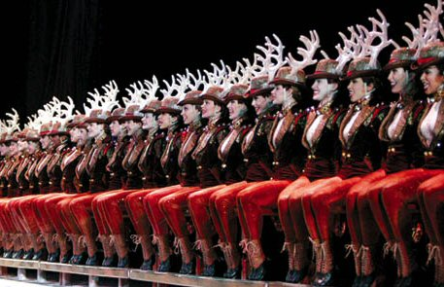
The Radio City Rockettes
By: Jackie Saviano

Slide 2
Radio City Ambassadors
For more than three quarters of a century, the Radio City Rockettes, the world’s most famous precision dance troupe, have been a legendary force in entertainment with a rich history of skill and dedication to their craft.

Slide 3
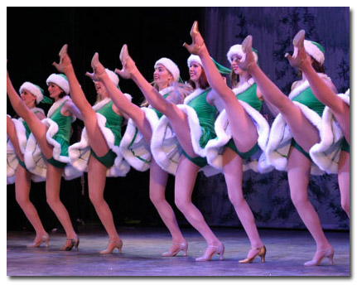
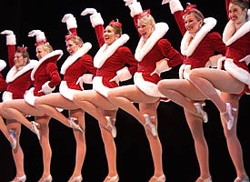
Throughout their history, the dance group has participated in numerous historical events including;
Memorable USO Tours during WWII
Show-stopping Super Bowl Halftime appearances where they performed before television audiences of 150 million viewers
The 2001 Presidential Inauguration Ceremony where they performed on the steps of the Lincoln Memorial.

Slide 4
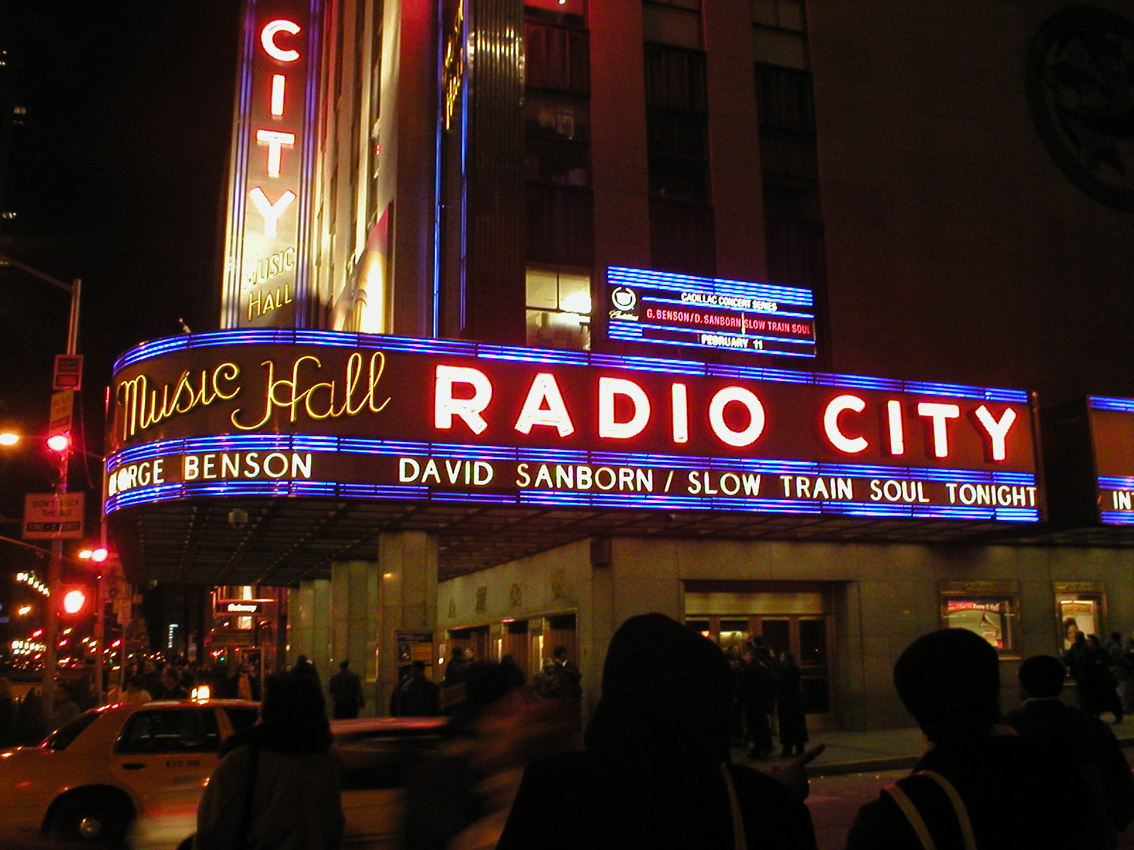
The Rockettes appear annually in the nationally televised Macy’s Thanksgiving Day Parade, as well as the NBC Rockefeller Center Tree Lighting Ceremony, inspiring scores of young dancers nationwide.
They have participated in many studio film premieres held at Radio City including “Miracle on 34th Street”, Disney’s “102 Dalmatians,” “The Lion King,” and “Ice Age”.

Slide 5
The dance troop has also opened the Tony Awards and Daytime Emmy Awards, broadcast live from Radio City Music Hall, and they have appeared numerous times on The Today Show, Good Morning America, The Late Show With David Letterman, Late Night with Conan O’Brien and The Tonight Show with Jay Leno.
They are even the inspiration for their own Rockette doll.

Slide 6
Their Starring Role…
Of course, the Radio City Rockettes are most famous for their annual starring role in America’s #1 live theatrical - The Radio City Christmas Spectacular. Performing since 1933, the Rockettes have danced their way into the hearts of millions by spreading the Christmas spirit to people of all ages.
For millions of families, the holiday season is just not complete without seeing this beloved classic production and experiencing the exciting and festive energy that the Rockettes bring to the show.

Slide 7
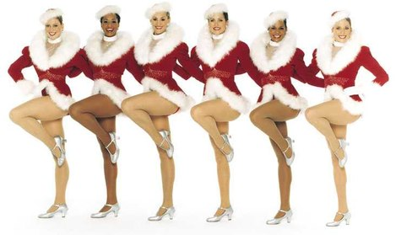
Last year, The Christmas Spectacular celebrated its biggest season ever with more than 2 million people attending productions at Radio City Music Hall, and in numerous other cities across the United States.
To date, Radio City Entertainment has brought this theatrical holiday tradition to 18 cities across North America.

Slide 8
In the Beginning…
The group first kicked to life in 1925 as the “Missouri Rockets” and made their show business debut in St. Louis, the realization of a long-time dream of their creator, Russell Markert.
They were discovered and brought to New York by consummate showman S.L. (Roxy) Rothafel who first dubbed them the “Roxyettes.”

Slide 9
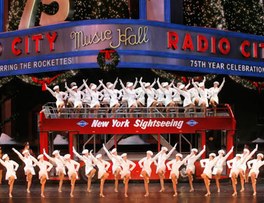
At Radio City’s opening night, on December 27, 1932, they shared the stage with 17 diverse acts, among them the Flying Wallendas, Ray Bolger and Martha Graham.

Slide 10
They were an instant sensation; the quintessential American chorus line- an exciting precision dance troupe with great style and glamour.

Slide 11
In 1933, Radio City featured a new movie and a lavish stage production every week starring the Rockettes.
Russell Markert’s requirements never varied, and he continued to stage and choreograph productions at the Music Hall until his retirement in 1971.

Slide 12
Concept of the Dance Line…
This concept of the dance line was to achieve absolute precision. The audience saw the Rockettes perform intricate routines, but always moving as “one dancer.”
Everything; the costumes, the steps and the skill, was kept completely identical.

Slide 13
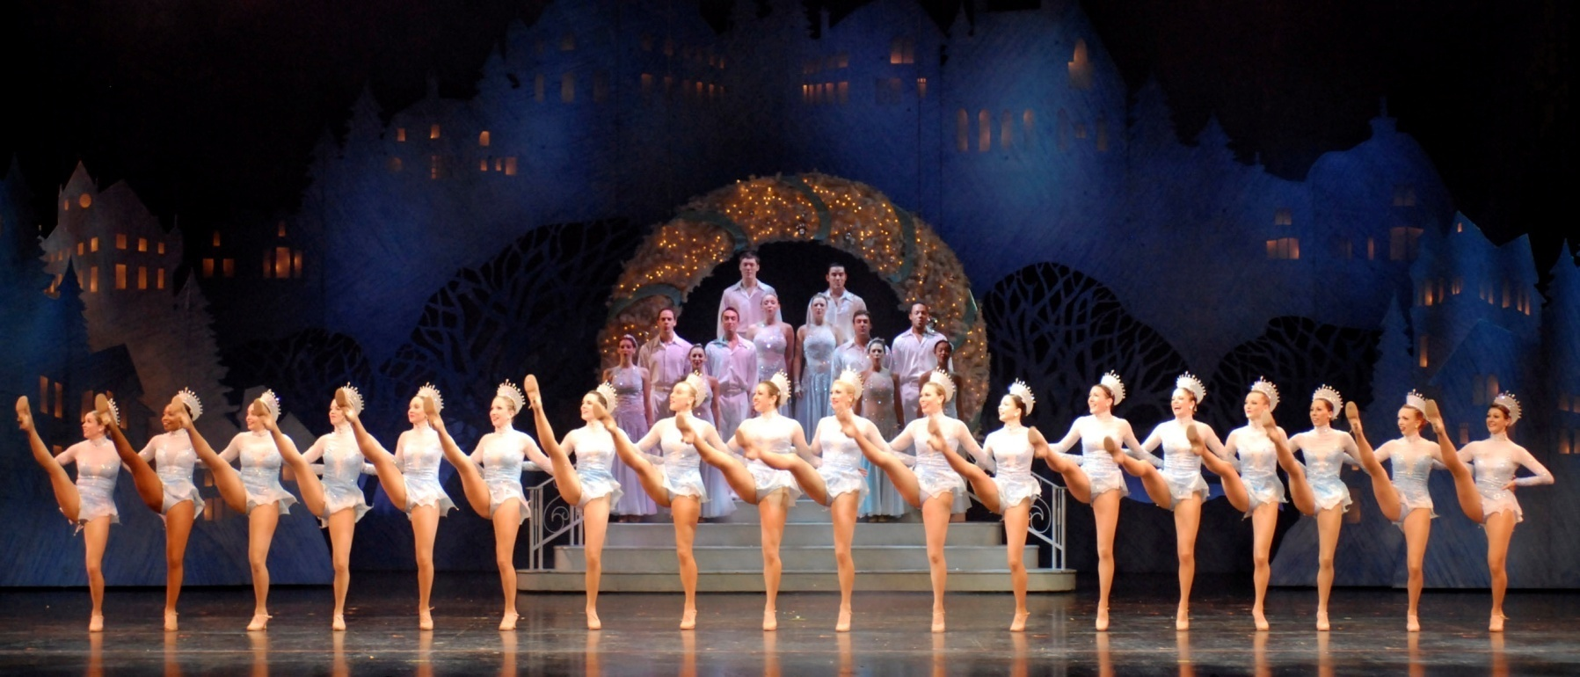
The illusion of uniform height is maintained to this day by putting the tallest dancers in the center, and gradually decreasing the height with the shortest women at either end.

Slide 14
Today’s Rockette…
The requirements today remain almost exactly as they were at the dance troupe’s inception.
Since 1932, more than 3,000 women have danced as Rockettes. Each year, in cities across America, hundreds of young women audition to be members of the internationally known troupe.

Slide 15
Radio City Rockettes must be between 5’6” and 5’10 and demonstrate proficiency in tap, jazz, ballet and modern dance.
But exceptional dance skill alone is not enough to secure a position on the dance line. They must also display a radiant energy that will shine across the footlights to their audience.
The Rockette line today embraces the diversity of women everywhere. The more than 200 women dance troupe embodies the modern-day woman – they are intelligent, strong, ambitious, multi-talented, beautiful, stylish, hip, fun, witty, fashionable, and not to mention they maintain the most physically fit bodies in the business.

Slide 16
The Rockette line is made up of obviously dancers, but also businesswomen, fashion designers, students, actresses, volunteer workers, and young mothers – all who have learned to perfect the art of balancing a dance career with their careers off the stage. Endurance, perseverance and dedication have all contributed to their success in life and they proudly serve as role models for young women everywhere.

Slide 17
Giving Back…
In addition to entertaining from the stage, the Rockettes are active members of the local community through their involvement in charitable and outreach programs while touring the country.
Their dedication to helping those less fortunate is tireless.

Slide 18
The Rockettes commitment to community involvement extends to every city they visit. In Chicago, the Rockettes hosted a benefit performance for the children of the COACH Care Center, which provides children with chronic, high-maintenance special health care needs a continuum of care beginning at the time of diagnosis.

Slide 19
While in Seattle, the Rockettes worked closely with the Juvenile Diabetes Research Foundation on several fundraising events including their annual “Gingerbread Village which helped to raise thousands of dollars for a wonderful cause

Slide 20
Most recently in Fort Lauderdale, the Rockettes proved that beauty is only skin deep with their work for “Facing it Together,” a not for profit organization dedicated to providing cosmetic surgery for children and adults with facial differences.

Slide 21
A National Treasure…
The Radio City Rockettes perform with a signature precision that perpetually delights every new audience. Indeed, these “dancing daughters” – as their founder, Russell Markert always referred to them – have not only persevered for more than 75 years, but are thriving now more than ever. They continue to represent the American dancer to the world…

Slide 22
Bibliography…
Loth, David. “The City Within the City” The Romance of Rockefeller Center. William Morrow and Co. Inc (1966)
http://www.radiocity.com/rockettes/index.html
http://en.wikipedia.org/wiki/The_Rockettes
http://manhattan.about.com/od/historyandlandmarks/a/rockefellercent_3.htm
http://www.nationaldanceweek.org/n_rock.htm
http://www.britannica.com/EBchecked/topic/506328/the-Rockettes
http://archives.heritage.com/pg/20031207/D09XROK.htm

Slide 23
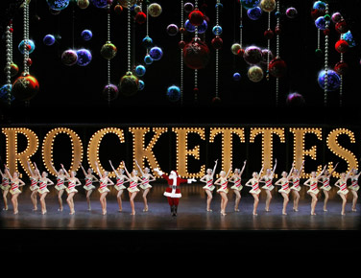
THE END…

