Slide 1
a quiz down memory lane….
Kerrie Deignan
Michelle Martinez
Stephanie Rivera
Ava Pappalardo
Jessica Scannell

Slide 2
About our group
Our group met a total of 9 times in order to complete this event.
Meetings happened both in the classroom setting and outside on our own time.
Each time the group met, something new was discussed in order to enhance our event

Slide 3
Our Ideas…
We as a group put numerous ideas out. By combining our ideas we came up with the what we called the perfect event to hold.
Our event would be called A Quiz Down Memory Lane.
It would involve interaction between us and an elderly population.
It would also involve the participants to challenge themselves to answer questions about the past.

Slide 4
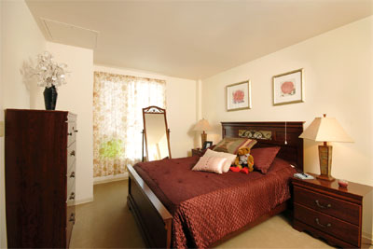
garito manor
The Garito Manor was the place of our event
The Garito Manor has an open house every Saturday from 1pm-4pm
It is made up of studios, one bedroom and two bedroom apartments for those 62 years old and over

Slide 6
QUOTE
You don’t stop laughing when you get old…
You get old when you stop laughing!

Slide 7
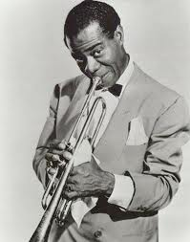
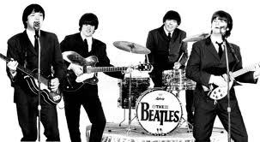
A Quiz down memory lane
As a group everyone was assigned a topic either sports, music, or TV shows.
We each had to make up five questions in order to quiz those participating.
Those who were talked about and mentioned were people like Louis Armstrong, The Beatles, Cy Young, Pete Sampras and much more!

Slide 8
How the game worked
To start off the game we put all of the people there to get in to five different teams- it didn’t matter how many people each team had. The team members were asked to sit either at a table or next to each other.
The rules of the game were simple. We would ask a question such as who played this song (the song would be played) and each group would discuss what they thought the answer was and write is down on a piece of paper.
At the end of all the rounds, the group with the most questions correct were given first place, and the placements went down to fifth. No matter the placement no participant went home empty handed.

Slide 9
EXAMPLES OF QUESTIONS
DO YOU KNOW WHO SANG A VERY GOOD YEAR ? ANSWER: FRANK SINATRA
WHICH SHOW CREATED IN 1969 STARRED ROBERT REED, FLORENCE HENDERSON, AND ANN B. DAVIS
ANSWER: The Brady Bunch

Slide 10
Materials needed to make this a successful event
Computer with the questions
Having the computer worked out better than we had planned. By having the questions typed out in large font, any participant who had a hearing loss was able to read the question off the screen and not feel left out
Paper
Pens
Picture Frames
IONA College Souvenirs

Slide 11
The Prizes
The method behind choosing the prizes we would hand out was simple.
During class we learned that one of the ways the elderly tend to remember things is by looking at pictures.
We purchased picture frames to give to the people involved in the event, in hope that they would put a photo they love in there in order to remember an event or time in their life they loved.

Slide 12
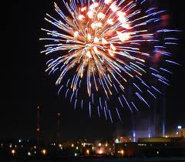
The prizes
Every person who was at the event was able to bring home at least one picture frame or ornament.
The better the team placed, the more prizes there was to choose from. The two men who participated each took home an Iona College Basketball Cap and many of the women chose to take home a t-shirt that said Iona on it.

Slide 13
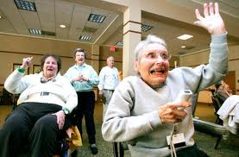
purpose
The purpose of our event was to get our seniors to do more daily activities
We wanted to enhance their social life so that they wouldn’t be closed out from the world.
We also wanted the elderly to dig deep and remember their past and laugh and share it with others.

Slide 15
This event took place on November 19, 2011 at 2:30 in the afternoon. In total there were 19 participants. Every single one were extremely happy we were there and didn’t want the event to end. They even asked us to come back another time!

Slide 16
Conclusion
In the end everyone seemed to enjoy themselves.
Some of our senior citizens who seemed unwilling to open up were smiling and interacting with at least two people by the time the event was over !

