Slide 1
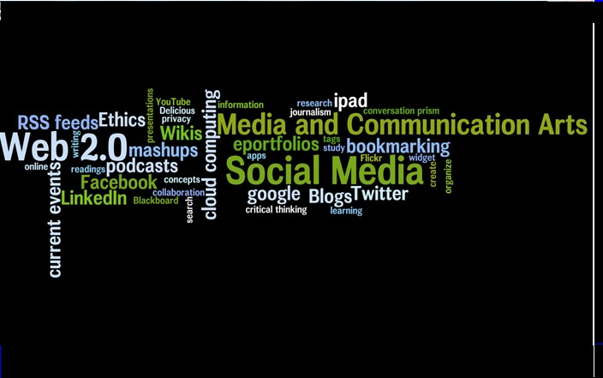
Survey of Social Networking Tools Michelle Pulaski Behling Pace University, Pleasantville

Slide 2
What is social networking?
the practice of expanding the number of one's business and/or social contacts by making connections through individuals (http://whatis.techtarget.com/definition/0,,sid9_gci942884,00.html)
web-based services that allow individuals to (1) construct a public or semi-public profile within a bounded system, (2) articulate a list of other users with whom they share a connection, and (3) view and navigate their list of connections and those made by others within the system. (Boyd &Ellison, 2008).

Slide 3
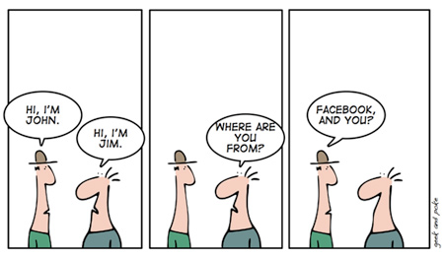
Social networking has revolutionized the way we socialize

Slide 4
Social Networking Sites
There are 1000s of social networking sites on the Internet ranging from the most popular (facebook + twitter) to dogster and 43things, there is literally something for everyone.
If you can’t find a SNS you like, you can create your own at Ning.

Slide 5
Sites to Cover

Slide 6
The most popular social networking site
Over 750million users (70% outside of the U.S.) boasting half a Billion unique visits in one day (Otober 2011)
The average user is on Facebook 55 minutes/day
New feature Timeline, which shows the story of your life, as you choose to tell it or as Facebook has recorded it.
Combination of visual blog and online scrapbook
Raises many privacy concerns

Slide 7
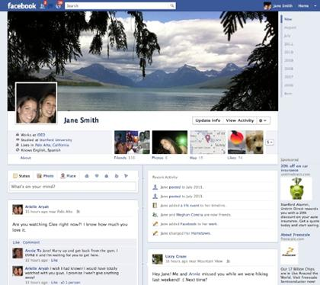
Facebook Timeline

Slide 8
Google’s answer to Facebook released this past summer
At first Google+ was only by invitation.
Now estimated 50 million+ users (reached 50 million faster than Facebook or Twitter)
Students seem to like Google+ because there are so few people on it + they feel it offers more privacy protection

Slide 9
Boasts several unique features including:
Circles – mirrors how we would organize friends in real life (similar to Facebook’s lists)
Sparks – online sharing engine that pulls in web content related to your chosen interests (share + discover)
Hangouts – allows up to 10 users to video chat
Instant upload – allows upload of photos + videos directly from phone
https://plus.google.com/#

Slide 10
+1s found all over the Web. Click on it and Google+ users give their stamp of approval
You can then add a comment and share it with your circles, starting conversation
Google+ boasts better privacy settings than other SNSs, however, users need to be aware of these privacy settings. It’s terms of service are less rigorous than Facebook’s.
More than 2/3 of Google+ activity is private
Visit http://www.google.com/intl/en-US/privacy/ for more information on privacy settings

Slide 11
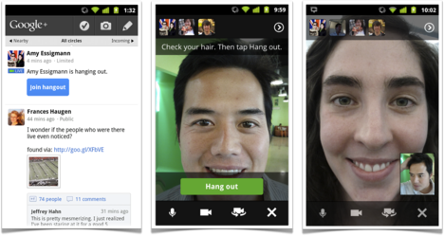
Hangouts video chat feature
Will you use it?

Slide 12
What is twitter?
“A very popular instant messaging system that lets a person send brief text messages up to 140 characters in length to a list of followers.” PC Magazine
Twitter is a microblog that contains brief entries about daily activities to keep followers up-to-date
Launched in 2006, the site boats over 200 million accounts with 140+ millions tweets a day

Slide 13
http://twitter.com/#mmbehling

Slide 14
eportfolios have emerged as a valuable online tool that students, faculty, and institutions can use to collect, store, update, and share information.
eportfolios allow students to reflect on their learning, communicate with instructors, document credentials, and provide potential employers with examples of their work. (Educause, 2005)
eportfolios encourage personal reflection and often involve the exchange of ideas and feedback.

Slide 15
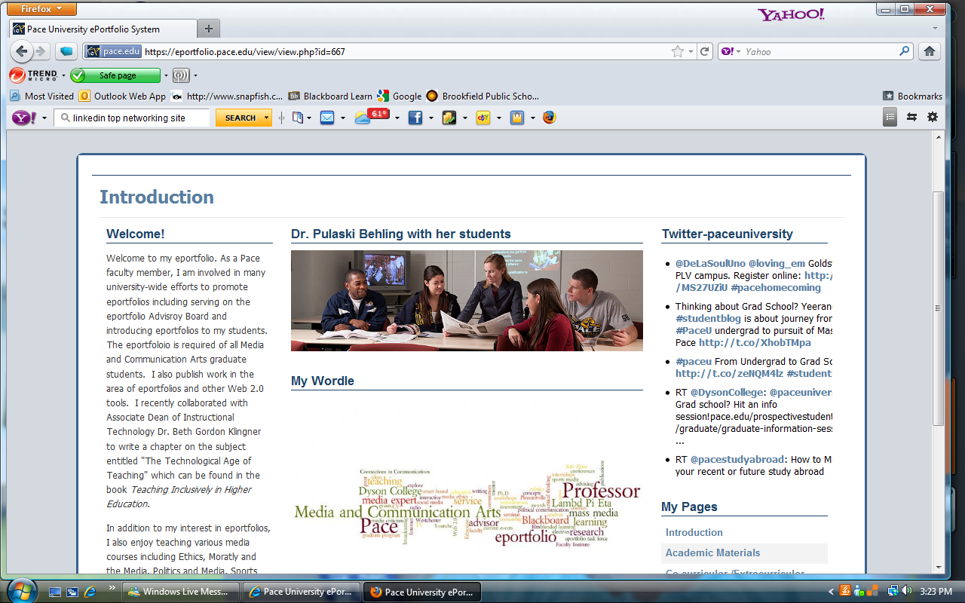
Eportfolio uses include: online resume, advising, repository for student work, storage space, tenure + promotion, alumni development, connecting with students
https://eportfolio.pace.edu/

Slide 16
AKA “MySpace for adults.” Designed to promote networking in user’s professional verses social life.
Launched in 2003, today 100 million+ members
Users create professional profiles and then link to others through the site
Also used for expert advice, job opportunities, endorsements, group communication, headlines
Users can import twitter feeds, slideshare presentations, documents, etc.
http://www.linkedin.com/pub/michelle-pulaski-behling/25/6b3/624

Slide 17
Resources
http://www.43things.com/
Bosker, B. (2011). Twitter finally shares key stats. http://www.huffingtonpost.com/2011/09/08/twitter-stats_n_954121.html
Boyd, D. M & Ellison, M. B. (2008). Social Network Sites: Definition, History, and Scholarship. Journal of Computer-Mediated Communication. Volume 13 Morgan Kaufmann Publishers
http://www.dogster.com/
http://eportfolio.pace.edu/
www.facebook.com
www.linkedin.com
http://www.ning.com/?n_e=1&n_v=0
http://plus.google.com
www.twitter.com
“Twitter” PC Magazine Encyclopedia. http://www.pcmag.com/encyclopedia_term/0,2542,t=Twitter&i=57880,00.asp
http://whatis.techtarget.com/definition/0,,sid9_gci942884,00.html

