Slide 1
Submitted by Group 2
Heather Castillo, Kristen Hamue, Julia Shvartsman, Jennifer Polanco, Camilla Gravia, Nellyn Caraballo

Slide 2
Situation Analysis
Key Industry Trends:
Retail, with more than 15 million employees in America alone, is one of the largest industries in the world by number of businesses and number of employees. Retail sales in the U.S. (total retail sales include the categories of gasoline, automobiles, and food service, as well as merchandise) totaled an estimated $4.300 trillion in 2009 according to Plunkett Research. Sales were $4.413 trillion in 2008 and $4.482 trillion in 2007.
Retails sales in 2008-2009 were driven partly by deep discounting. Meanwhile, automobile sales saw a disastrous drop off, with total sales of cars and light trucks in 2009 estimated at 10 million, and 2008 at about 13.2 million, down from 16.5 million in 2007 and 17.5 million at the peak in 2005. Retail sales in 2008-2009 were affected by several factors:
Sales of both new and existing homes were very slow. While homes themselves are not counted in retail sales figures, buyers of these homes are a significant force at retail stores where they purchase furniture, appliances, linens, consumer electronics and garden supplies to fill up their new residences. Likewise, builders and remodelers are a strong factor in retail sales, when they purchase supplies, materials, appliances, etc. at retail outlets. The slowdown in building and remodeling led to low levels of sales at home centers such as Home Depot.
Another factor was home mortgages: From 1998 through part of 2006, Americans were refinancing their existing home mortgages in record-setting numbers. In doing so, they took advantage of very low mortgage interest rates and very easy lending requirements. Many homeowners also increased the balance on their mortgages, taking advantage of rapidly rising home values that increased their borrowing power. Borrowing against home equity lines of credit was also high, and much of that money went to retail purchases. Homeowners were spending this cash windfall freely, driving up retail sales in many categories. However, by late 2006, the slowing real estate market, followed by tougher lending standards, meant that the party was over. This definitely had a negative effect on retail sales.
Another major negative impact was the growing number of homes going into foreclosure as their owners were unable or unwilling to meet monthly payments. Many of these foreclosed homes are part of the subprime mortgage fiasco that is rocking financial markets, where borrowers have poor credit or inadequate income. Also, a large portion of foreclosed homes are those subject to rising monthly payments due to adjustable rate mortgages.
Extremely high unemployment, topping 10% in late 2009, has limited the ability of consumers to spend.
Equally important, Americans have entered a new anti-consumption, pro-savings mindset that will dramatically change the retail industry for the long term.
Source: http://www.plunkettresearch.com/Industries/Retailing/RetailingSampleProfile/tabid/272/Default.aspx

Slide 3
Key Industry Trends Continued:
Negative factors that will impact the retail sector in 2010:
Consumer debt levels remain high
High health care costs continue to be a challenge
A continuation of depressed conditions in the housing market means low home equities and limits the ability of consumers to sell their houses
A high level of home mortgage foreclosures
High unemployment levels and a very difficult environment for job seekers
Tightened lending standards that make it more difficult for consumers to obtain credit, including a pull back in lines of credit available on credit cards and home equity loans
Low consumer confidence
Consumer tastes and expenditures influenced to a growing extent by LOHAS, a trend toward purchases that support “Lifestyles of Health and Sustainability.” Consumers will be more conservative going forward, saving more while spending less. When they do spend, they will be focusing to a growing extent on high-value items with long life, low impact on the environment and low energy consumption. Items that promote a healthy lifestyle will receive a growing focus.
Source: http://www.plunkettresearch.com/Industries/Retailing/RetailingSampleProfile/tabid/272/Default.aspx

Slide 4
Key Industry Trends Continued:
Competition among retailers has never been tougher. A retailer without a significant competitive advantage doesn’t stand a chance. Superstores are battling each other on every major corner while direct marketers (including catalogs and online sites) are stealing customers from stores. Online selling at deep discounts is even making immense inroads into major consumer purchases such as jewelry. Many retailers have been driven into bankruptcy recently, including Sharper Image, Linens ‘n Things, Bombay Co., and mail order firm Lillian Vernon, and more will follow.
Vacancy levels are higher at malls and shopping centers than they have been in years, and there are very few major chains that are currently expanding.
Direct marketing sales of all types fell to $1.74 trillion in 2009, down from $1.95 trillion in 2008. 2010 sales are expected to grow by 3.5% to $1.80 trillion
Growth in online shopping has been driven by two factors. First, the number of fast Internet connections in U.S. homes and businesses leapt to about 150 million by late 2009. These connections make buying online faster and more interactive. Next, there’s the savvy marketing of online giants like Amazon.com (with more than $19.1 billion in 2008 revenues, up dramatically from $14.8 billion in the previous year), as well as the e-commerce efforts of traditional retailers such as Home Depot and Wal-Mart. These fast Internet connections are extremely important, even at the office, since a large number of U.S. workers take time out to shop online from their desktops. Analysts at eMarketer project 2009 online sales to fall 0.4% to $133.1 billion. The fall follows growth of 4.6% in 2008 and 19.8% in 2007. For 2010, eMarketer projects a 9.8% increase in online sales to $146.1 billion.
All current trends point to a continued tough time for retailing. Revenues and profits at retailers for 2009-2010 are going to be relatively low. Sales of cars and luxury items were dismal in 2009 and are likely to remain slow in 2010. Among the rare bright spots are Wal-Mart and Costco, where consumers know they can find everyday low prices on high quality merchandise.
Source: http://www.plunkettresearch.com/Industries/Retailing/RetailingSampleProfile/tabid/272/Default.aspx

Slide 5
Key Industry Trends at a narrower view….
Each year the U.S population spends $510 billion on the categories that JCPenney sells, $82 billion of which is spent by consumers 25-34 years old. In 2009; of the $188.8 billion spent on apparel, $37.8 billion was spent by consumers 25-34 years old.
Department stores are extremely popular and the competition amongst them is fierce. Today the goes beyond the stores, it is also online. Costumers are becoming more and more demanding as they want to be able to find everything they need in one place. Women 25-34 especially, value, quality and practicality. With no time to waste, the shopping experience is an important part of buying and it can be a determining factor for them to choose where their “to-go” department store.
Source: http://www.research.philips.com/technologies/projects/shoplight/index.html

Slide 6
Company Overview
2010-
JCPenney launches MNG by Mango in 77 stores and jcp.com
JCPenney expands Sephora inside JCPenney to 215 stores
JCPenney launches mobile couponing.
JCPenney launches its first iAd
2006-
JCPenney launches the “JCPenney Experience”–- the largest branding campaign in the Company’s history
JCPenney announces its partnership with SEPHORA.
2008-
JCPenney launches JCP Rewards, a customer loyalty
JCPenney launches its CustomerFIRST initiative, empowering JCPenney Associates to make customers their No. 1 priority.
JCPenney opens 35 stores.
1902 - James Cash Penney opens The Golden Rule, a dry goods and clothing store, in Kemmerer, Wyoming
1972-
The Company advertises on national television for the first time
1994 -
The Company launches jcpenney.com, its online store on the Internet.
1951- Store sales exceed $1 billion for the first time.
1913 - J.C. Penney Company Inc. is incorporated
1963 - JCPenney issues its first catalog.
1979 -
Catalog sales pass $1 billion for the first time.
2005 -
jcp.com surpasses $1 billion in sales.
JCPenney establishes its WINNING TOGETHER company philosophy
2007 -
JCPenney launches its new “Every Day Matters” brand positioning.
JCPenney announces 2007-2011 Long Range Plan.
JCPenney opens 50 stores in one year.
JCPenney receives Energy Star Retail Partner of the Year award.
2009-
JCPenney opens 17 stores, including its first store in Manhattan.
JCPenney receives Energy Star Award for Sustained Excellence.
JCPenney launches iPhone app
Source: http://www.jcpenney.net/PDFs/EveryDayMatters-Eng.pdf

Slide 7
Products
Source: http://www.jcpenney.net/PDFs/EveryDayMatters-Eng.pdf
Men’s
- Apparel
- Accessories
-Shoes
Woman’s
- Apparel
- Accessories
-Shoes
Teen
- Apparel
- Accessories
-Shoes
Kids
- Apparel
- Accessories
-Shoes
Baby
- Apparel
- Accessories
-Shoes
Personal Care
Home
- Appliances
-Furniture
-Décor
Toys
Electronics

Slide 8
SWOT

Slide 9
Strengths
JCP offers amazing customer service. The employees of JCP undergo special training to help them improve their customer interaction and service. This extraordinary costumer service is what differentiates JCP from other department stores and also helps JCP retain their previous costumers while making new costumers loyal. The better the customer service, the happier the costumers are, which will in turn lead to more spending.
Another competitive advantage JCP has over other department stores is that they have many brands that are exclusive. Some of their recent exclusive brands include Liz Claiborne, MNG by Mango, One Kiss by Cindy Crawford, Olsenboye by Dualstar Entertainment Group, and Supergirl by Nastia Liukin. These exclusive brands attract many costumers because their popular associations (like famous people or previous success of a brand)
JC Penney has a lot of recognition in America. It has a strong reach; there are 1,107 JC Penney department stores in the U.S and Puerto Rico. In addition, JCP is the largest general merchandise catalog retailer in the U.S.
Source: http://www.jcpenney.net/PDFs/EveryDayMatters-Eng.pdf

Slide 10
Weaknesses
In 2009 JCPenney’s reputation was discredited when many of their products were recalled. These items included Ergorapido and Precision vacuum cleaners (because of faulty batteries) , Stork Crafts cribs, and Ms. Bubbles children’s hooded sweatshirts (due to hazard issues)
A survey conducted by Morgan Stanley AlphaWise revealed that JCP had low brand equity. The main purpose of the survey was to see weather costumers were happy with their shopping experience by measuring what the customers received as opposed to want they wanted. The results showed that JCP was inferior to Kohl’s when it came to price, fashion, selection, convenience and service.
JCPenney had an excess in their overall inventory due to low sales. JCP’s comparative sales have declined by 6.3% in FY2010. Compared to Target, Macy’s and Kohl’s, JC Penney has the highest percentage of declining comparable sales (within September 2009-January 2010).
Source: http://www.jcpenney.net/PDFs/EveryDayMatters-Eng.pdf

Slide 11
Opportunities
Many people are shopping online now, in fact 6% of online sales were in retail alone in 2009; and this tend is expected to grow. This is a great opportunity for JC Penney to do more promotions online or to facilitate or their online shopping process.
Wal-Mart has been surrounded by controversy in the past because of their questionable treatment of employees and faulty electronics. JC Penney can use this to their advantage by capitalizing on the excellent treatment of their employees.
People want to save money because of the recession and they aren’t looking to spend as much money on expensive name brands. Therefore, demand for generic and private label brands is high.
Source: http://www.jcpenney.net/PDFs/EveryDayMatters-Eng.pdf

Slide 12
Threats
Retail competition include, Macy’s, Sears, Kohl’s, Wal-Mart, and Target.As of 2010, 68% of JC Penney stores have a Target within a 5 mile radius; 53% have a Kohl’s with a 5 mile radius.One of JC Penney’s main competitors is Macy’s. Macy’s has 850 stores while JC Penney has 1,108. Even with having an inferior number of stores Macy’s was still able to gain $5,993 million more sales in the end of 2009.
People have less money to spend due to the recession.
Even if the economy improves, the customers JC Penney has lost might enjoy shopping at the competitor stores and they may not come back.
Source: http://www.jcpenney.net/PDFs/EveryDayMatters-Eng.pdf

Slide 13
JC Penney’s Market Composition
A little brief about the company: The Company has no independent assets or operations and no direct subsidiaries other than JCP. The company is traded on the New York stock exchange under “JCP”. They are the leading mall based department store operator in America (As of Aug 13, 2010) There are 1,107 stores in 49 states including Puerto Rico. Our business consists of selling merchandise and services to consumers through our department stores and Direct (Internet/catalog) channels. Department stores and Direct generally serve the same type of customers (Middle Americans) and provide virtually the same mix of merchandise, and department stores accept returns from sales made in stores, via the Internet and through catalogs.
Market segments: Women from the ages 25-34 (target). They sell family apparel and footwear, accessories, fine and fashion jewelry, beauty products through Sephora inside JCPenney and home furnishings. In addition, they provide their customers with services such as styling salon, optical, portrait photography and custom decorating. (This is their market segments)
Source: http://www.jcpenney.net/about/jcpmedia/corporatenews/articles/JCPenney_TransformsCatalog Strategy_to_Better_Serve_Customer_Pr,93.aspx and the JCPenney brief

Slide 14
Distribution: At January 30, 2010 our distribution network included 13 merchandise distribution centers, five regional warehouses and four direct fulfillment centers as indicated in the following table:

Slide 15
We also operated 19 Direct outlet stores totaling approximately 2.0 million square feet, of which we own four. Furthermore, we own our home office facility in Plano, Texas, and approximately 240 acres of property adjacent to the facility.
Key Players: Peer Group | Department Store Cos. - Larger
Also, Target and small stores like Express, NYCO, Banana Republic, Gap, Victoria Secret, and Old Navy.
Source: http://www.jcpenney.net/about/jcpmedia/corporatenews/articles/JCPenney_TransformsCatalog Strategy_to_Better_Serve_Customer_Pr,93.aspx and the JCPenney brief

Slide 16
Executive summary:
(from the standard & poors) CORPORATE STRATEGY. From FY 01 (Jan.) to FY 06, JCP executed a turnaround plan to improve the profitability of its JCPenney stores. The company focused on delivering competitive, fashionable merchandise assortments; developing a compelling and appealing marketing program; improving store environments; reducing its expense structure; and attracting and retaining an experienced and professional work force. In support of these objectives, JCP moved from decentralized to centralized merchandising, marketing and operating functions, and invested in a new store distribution network and in new merchandise planning, allocation and replenishment systems.
With what we view as the success of its turnaround, JCP has mapped out a new long-range plan for making JCPenney the preferred shopping choice for "Middle America," which it defines as customers aged 35 to 54 with annual household incomes of $35,000 to $85,000. Key strategies include offering styles that make an emotional connection with the customer; making it easier for the customer to shop seamlessly across store/catalog/Internet channels; creating and sustaining a customer-focused culture; and using the off-mall store format to expand the company's presence in high-potential markets. JCP sees the potential for up to 400 new stores, relocations or expansions on a long-term basis. (we will have to reword this part).
Source: http://www.jcpenney.net/about/jcpmedia/corporatenews/articles/JCPenney_TransformsCatalog Strategy_to_Better_Serve_Customer_Pr,93.aspx and the JCPenney brief

Slide 17
In July, in time for the Back-to-School shopping season, they launched three new surf and skate-inspired brands for young men: RS By Sheckler™, Rusty® surf apparel and Third Rail,™ a Zoo York Production, catering to the action sports lifestyle.
In September 2009, they launched Cindy Crawford Style™, a new brand of home furnishings and accessories exclusive to JCPenney. The collection includes bedding, window coverings, bath, decorative accessories, table top, area rugs, lighting and wall décor. Furniture is also available in select markets.
Also in September, they launched JOE Joseph Abboud®, a comprehensive collection of men’s sportswear, shirts, ties, tailored clothing, outerwear and footwear. JOE Joseph Abboud – owned by JA Apparel Corp., owners of global lifestyle brand Joseph Abboud – creates a “neo-traditional” lifestyle category in Men’s that caters to customers seeking designer casual, business casual and dressy attire at affordable prices. In addition, we launched she said™, a contemporary, private-label career sportswear brand focused on the professional career woman.
Source: http://www.jcpenney.net/about/jcpmedia/corporatenews/articles/JCPenney_TransformsCatalog Strategy_to_Better_Serve_Customer_Pr,93.aspx and the JCPenney brief

Slide 18
In October 2009, we entered into an agreement with Liz Claiborne, Inc. to make JCPenney the exclusive department store retailer for Liz Claiborne branded merchandise, other than footwear and beauty products, starting in fall 2010. Following the complete roll-out of the Liz Claiborne and Claiborne for Men brands, JCPenney will carry a full lifestyle collection in more than 30 merchandise categories. Our customer research shows that the Liz Claiborne brand is one of the most recognized and purchased brands in women’s apparel, with exceptional customer loyalty.
In November, we launched a preview collection of Olsenboye, an exclusive new juniors brand created by Dualstar Entertainment Group founders and designers Mary-Kate Olsen and Ashley Olsen. The preview collection was available for a limited time on jcp.com and in select JCPenney stores. The full launch is in spring 2010.
Also in November, we announced plans to become Mango’s exclusive department store retailer in the United States for the “MNG by Mango” brand. Mango, with more than 1,300 stores in 94 countries, is known for rapidly delivering European runway fashion at affordable prices. MNG by Mango is expected to become our largest contemporary brand and it will bring a representation of Mango fashion to JCPenney and will expand the brand’s presence in the United States. MNG by Mango will launch in fall 2010 on jcp.com and in approximately 80 stores, with plans to expand to a total of 600 stores by the end of 2011.
Source: http://www.jcpenney.net/about/jcpmedia/corporatenews/articles/JCPenney_TransformsCatalog Strategy_to_Better_Serve_Customer_Pr,93.aspx and the JCPenney brief

Slide 19
Marketing Initiatives
In February 2009, JCPenney launched their spring marketing campaign showcasing their compelling selection of affordable, exclusive designer brands. The campaign kicked off with commercials at the 2009 Academy Awards featuring several authentic designers from our portfolio, including nicole® by Nicole Miller, Bisou Bisou® by Michele Bohbot, ALLEN B. by Allen Schwartz, Fabulosity™ by Kimora Lee Simmons and I “Heart” Ronson by Charlotte Ronson. The spring campaign reflected our efforts to deliver brands that inspire and enable customers to have exceptional style and quality at affordable prices. They also launched an interactive, fully-integrated virtual runway shop on jcp.com featuring some of our exclusive designers.
Source: http://www.sec.gov/Archives/edgar/data/1166126/000119312510071527/d10k.htm#toc90600_1

Slide 20
They fully integrated two-year sponsorship of the “Rascal Flatts American Living Unstoppable Tour” presented by JCPenney kicked off in June 2009. The tour, which hits about 60 cities across the nation each year, promoted American Living during 2009, our affordable, all-American lifestyle brand developed exclusively for our customers by Polo Ralph Lauren’s Global Brand Concepts with offerings across nearly 40 merchandise categories.
In July 2009, they launched our Back-to-School marketing campaign, “Schooled in Style—Smart Looks for LessTM”, that included digital, social, mobile and traditional media with special events and promotions to support the merchandise in our portfolio of exclusive and private brands.
In keeping pace with consumers’ changing media habits and their continued migration to online versus catalog shopping, in November 2009, they announced their plans to discontinue publishing their twice-yearly “big book” catalogs. They will invest those resources in continued target growth initiatives on jcp.com, ongoing leading-edge social media services and a range of customized, more timely specialty catalogs. We expect a year-over-year reduction of 25% to 30% in paper use for catalogs in 2010, continuing their four-year trend of declining paper consumption.
.
Source: http://www.sec.gov/Archives/edgar/data/
1166126/000119312510071527/d10k.htm#toc90600_1

Slide 21
JCPenney and the Competitive Environment:
Aside from being one of the most traditional American companies, JCPenney is also the largest department-store retailer and catalog merchant in the United States, with over 1,200 stores in all 50 states as well as Puerto Rico, Mexico and Chile. The company is one of the industry leaders but needs to keep up with not only the competition, but also creating an approachable, fun and forward thinking environment for its target market.
The research conducted by Revolutionizing Together indicates that our target market will some times prefer other department stores like Macy’s or Kohl’s over JCPenney. JCPenney has the opportunity to revert that, we intend to focus more on popular and quality bra
Source: http://www.sec.gov/Archives/edgar/data/1166126/000119312510071527/d10k.htm#toc90600_1

Slide 22
Competition Overview
Industries Where J. C. Penney Corporation, Inc. Competes
Department Stores
Retail
Apparel & Accessories Retail
Footwear & Related Products Retail
Cosmetics, Beauty Supply & Perfume Retail
Home Furnishings & Housewares Retail
Purveyor of all that is cheap, yet chic, Target Corporation is the nation's #2 discount chain (behind Wal-Mart). The fashion-minded discounter operates about 1,745 Target and SuperTarget stores in 49 states, as well as an online business called Target.com. Target and its larger grocery-carrying incarnation, SuperTarget, have carved out a niche by offering more upscale, fashion-forward merchandise than rivals Wal-Mart and Kmart. Target also issues its proprietary Target credit card, good only at Target. After a reversal in fortune that coincided with the onset of the deep recession in the US, Target is growing its grocery business, remodeling stores, and -- in a few years -- entering the Canadian market.
Source: JCPenney Brief

Slide 23
Kohl's wants to be easy on shoppers and tough on competition. It operates 1,050-plus discount department stores in 49 states. More than a quarter of its stores are in the Midwest, where Kohl's continues to grow while rapidly expanding into other markets. Moderately priced name-brand and private-label apparel, shoes, accessories, and housewares are sold through centrally located cash registers, designed to expedite checkout and keep staff costs down. Kohl's competes with discount and mid-level department stores. Merchandising relationships allow Kohl's to carry top brands (NIKE, Levi's, OshKosh B'Gosh) not typically available to discounters; it sells them cheaper than department stores by controlling costs.
Source: JCPenney Brief

Slide 24
The nation's #1 department store chain has adopted the name of its most famous brand and cash cow: Macy's. Macy's, Inc., operates about 850 stores in 45 states, the District of Columbia, Guam, and Puerto Rico under the Macy's and Bloomingdale's banners that ring up some $25 billion in annual sales. The stores sell men's, women's, and children's apparel and accessories, cosmetics, and home furnishings, among other things. It also operates macys.com and bloomingdales.com. Macy's flagship store in Manhattan's Herald Square is the world's largest. The Macy's Thanksgiving Day Parade, started in 1924, is an annual rite. Macy's (formerly Federated Department Stores) began as a dry goods store more than 150 years ago.
Wal-Mart Stores is an irresistible (or at least unavoidable) retail force that has yet to meet any immovable objects. Bigger than Europe's Carrefour, Tesco, and Metro AG combined, it's the world's #1 retailer with 2.1 million employees in more than 8,400 stores, including about 800 discount stores, 3,100 combination discount and grocery stores (Wal-Mart Supercenters in the US and ASDA in the UK), and 595 Sam's Club warehouses. Wal-Mart's international division (25% of sales) is growing at a fast pace; it's the #1 retailer in Canada and Mexico and it has operations in Asia (where it owns a 95% stake in Japanese retailer SEIYU), Europe, and South America. Founder Sam Walton's heirs own about 45% of
Wal-Mart.
Source: JCPenney Brief

Slide 25
Sears Roebuck and Co. hasn't outgrown the mall scene, but it's spending more time in other places. Beyond its 850 US mall-based stores, Sears has more than 1,300 other locations nationwide. The company operates more than 900 independently owned Sears Hometown Stores (formerly known as dealer stores) in small towns and about 105 Sears hardware stores and some 85 Orchard Supply Hardware shops. Sears' stores sell apparel, tools, and appliances, and provide home services (remodeling, appliance repairs) under the Sears Parts & Repair Services and A&E Factory brands. It also sells appliances and tools online. Sears was acquired by Kmart Holding Corp. in 2005. The deal formed Sears Holdings, which owns both chains.
Source: JCPenney Brief

Slide 26
Brand Positioning
2007 → J.C. Penney launches “Every Day Matters” campaign
“will serve as the foundation for accelerating growth across the Company by enabling J.C. Penney to have a deeper, more emotional and enduring relationship with current and new customers.”
2010-2014 → JC Penney’s vision for growth is to be America’s shopping destination for discovering great styles at compelling prices. Currently, JCPenney does business with over half of the households in America each year. They are focused on getting those customers to spend more with them, while also finding ways to engage the other half to experience their great style and quality at smart prices. To do this, they are focusing on a Long-Range Plan consisting of four integrated business strategies intended to drive profitable sales growth, enhance their financial performance and achieve industry leadership.
Source: http://www.jcpenney.net/shared/content/PDFs/20102014%20LRP%20fact%20sheet.pdf

Slide 27
Four integrated business strategies:
Customers: Become America’s favorite retail destination for apparel, accessories and home fashion.
Merchandise: Consistently delight our customers with our merchandise and services
Associates: Become the preferred choice for a retail career
Performance/Shareholders: Establish JCPenney as the growth leader in our industry.
Value Proposition
For the second year in a row, J. C. Penney Company, Inc. (NYSE: JCP) was recognized for its leading customer service by ranking No. 1 among department store retailers according to a 2009 Customers’ Choice survey released by the NRF Foundation and American Express.
JC Penney’s value proposition of delivering great style, quality and affordable prices is only enhanced with the recognition for delivering the best in department store service.
JC Penney’s leading customer service standards reflect the Company’s CustomerFIRST culture of highly engaged associates.
Business Strategies
Source: http://www.jcpenney.net/shared/content/PDFs/20102014%20LRP%20fact%20sheet.pdf

Slide 28
Brand Problem
JCPenney has difficulty reaching a variety of women demographics, specifically those between ages 24-34.
JCPenney does not understand the lifestyle of this particular age group of women
JCPenney does not understand how this age group currently views the store
JCPenney does not know what needs this particular age group has

Slide 29
Target Overview ( According to the case)
There are 40.9 million individuals in the United States ages 25-34 years old; this constitutes 17.8% of all adults in the U.S. However, this age group is not a homogenous one; many individuals are at different stages of their lives forming families, pursuing jobs, and completing their education.
Individuals 25-34 years old constitute 18.4 million households; 16% of all households.
21.4% of people ages 25-34 moved in 2009; 32.5% of all moves.
There were 2.1 million births in this age group; 50% of all births.
1.8 million became married in 2006; 40% of all getting married that year.
People in this age group are more likely to live in urban areas or second cities than older counterparts.
While at different stages of their lives, studies have found that the attitudes and macro trends among people 25-34 years old to be similar;
Attitudes
Macro Trends
The New Savvy
Responsibility, Trust & Authenticity
A Simpler, Easier, More Convenient Life
Renewed Sense of Family & Community
A Sense of Discovery
Health & Wellness
Younger Oldsters
Authority as a provider
Instinct rule
Fun obsesses
“Whatever” (open to anything)
High self-esteem
Indulgent
Self-absorbed
Optimism
Source: JCPenney Brief

Slide 30
Each year the U.S. population spends $510 billion on the categories that JC Penney sells.
$188.8 billion was spent on apparel
$82 billion of which is spent by consumers 25-34 years old
$ 37.8 billion was spent by customer ages 25-34.
While this age group represents 16.2% of the total market, they account for only 10.6% of JC Penney’s sales
Source: JCPenney Brief

Slide 31
JCPenney’s Share of Wallet among ages 25-34 is significantly lower as compared to all other age groups. It is predicted that spending by consumers ages 25-34 will grow as they increase their family size and household income; however, it is not a guarantee that they will increase their spending at JCPenney, since they are establishing shopping patterns during this current phase of their lives.
Looking closer at the known JCPenney customer behavior, of the 31.3 million JCPenney store customers, 3.8 million customers were ages 25-34 years old. The average known JCPenney customer makes 3.9 trips to JCPenney stores per year, whereas those ages 25-34 makes 3.3 trips per year. Among the 6.4 million known jcp.com customers, there is an average of 2.0 orders a year, whereas of the 0.9 million customers that are 25-34 years old, there is an average of 1.7 orders a year. Of the 6.3 million JCPRewards members, .5 million are 25-34 years old. JCPRewares customers make an average of 1.9 additional trips per year.
Source: JCPenney Brief

Slide 32
Compared to the general population, the known JCPenney customer 25-34 years old is more likely to be Caucasian or Asian, have a higher education and work full time. Customer between the ages of 25-34 are more likely to research online before going to JCPenney store, to primarily research price and secondary to seek item availability, whereas for their older counterparts, item availably takes over price.
Top spend categories among females 25-34 years old are 1) women appeal 2)Children 3) Footwear, and 4) Furniture. Looking specifically at females between 25-34 year old without children, they purchase a wide variety of accessories and types of clothing for themselves, but non- to limited-department store shoppers. They are potentially moving into their first apartment, therefore they are more likely to be buying basic home necessities. Purchase triggers for these individuals are work wear, nightlife/social wear, weddings, and special occasions. In 2008, single females, 25-34 years old with out children constituted 6%of the total female population over 25 years of age, with a median household income of %59,474. In the same year, married females 25-34 years old without children constituted 2.6% of the total female population over 25 years of age, with a median household income of $79,434.
Source: JCPenney Brief

Slide 33
Females 25-34 years old with children constituted 10% of the total female population over 25 years of age in 2008, with a median household income of $53,975. These females are shifting their spending and shopping behavior now that they have children with fewer self-purchases. They are shopping at more price-conscious stores, and seek ease and convenience. Purchase triggers include physical changes (pregnancy), new baby, and work wear. Compared to the general population of females 25-34 years old, those who shop JCPenney are more likely to own a mobile phone and to access the internet from their phone. See the table below for mobile phone ownership and usage numbers for females between 25-34 years old, in the general population and of known JCPenney customers.
Source: JCPenney Brief

Slide 34
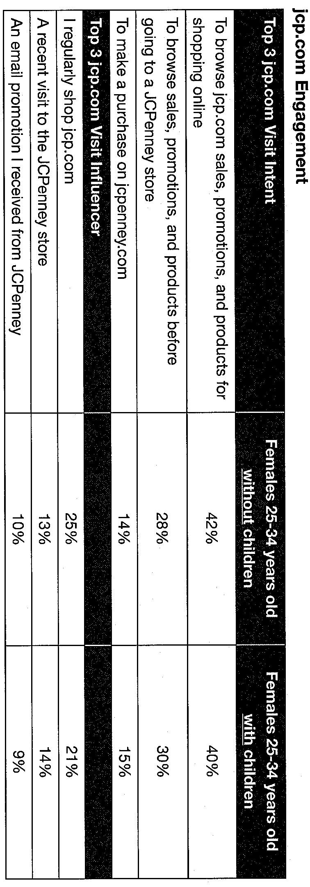
Source: JCPenney Brief

Slide 35
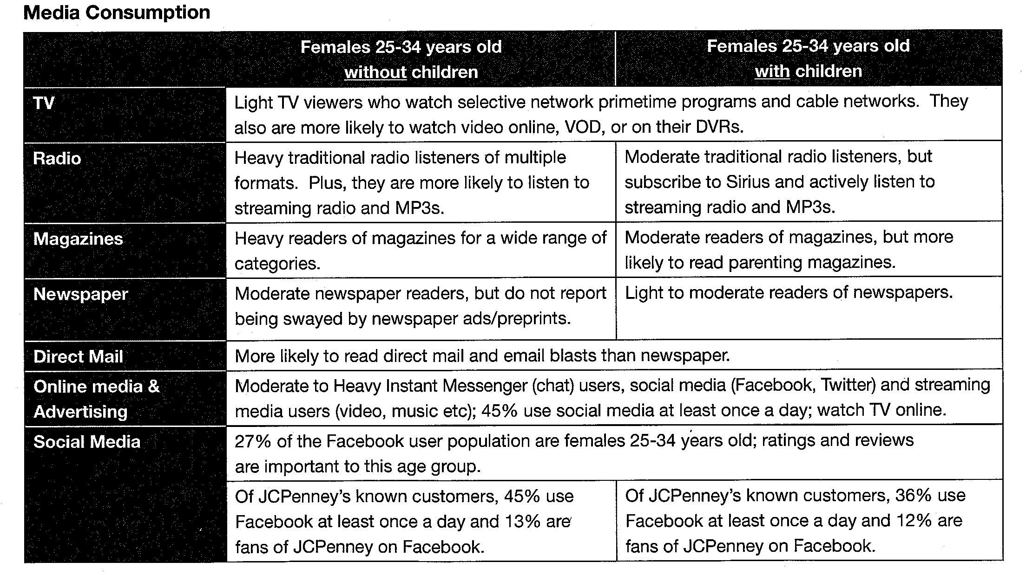
Source: JCPenney Brief

Slide 36
For a better understanding of the women within the age groups of 25-24 we divided this group into two sections: ages 25-29 and 30-24. Our primary research showed that result between these two age sections were significantly different and therefore, seperating them is necessary in order to better understand their needs.

Slide 37
Target Overview (Simmons Results)
Comparing shopping habits between the two age groups:
Age group 30-34 had a higher index regarding if they bought merchandise from a catalog in the last 12 months.
Age group 30-34 used more coupons when buying beauty and grooming products.
Age group 30-34 had a higher index regarding if they requested over night delivery in the last 6 months
Age group 25-29 shopped at Rooms to Go the most within a 3 month period.
Age group 30-34 shopped at Pottery Barn and Ikea the most within a 3 month period.

Slide 38
Purchase decisions within the last 4 months:
Type: Age 25-29 Index Age 30-34 Index
Clothing 109 114
Household Furnishing 135 125
Household Products 119 118
Major household Appliances 109 102
Result summary:
Age group 30-34 buys more clothing.
Age group 25-29 buys more household furnishings, household products, and major household appliances.

Slide 39
Purchase decisions in the last 12 months:
Type Age 25-29 Index
Towels 115
Vacuum Cleaner 120
Mattress/Box Spring 112
Other Bedroom Furniture 159
Couch/Sofa/Loveseat 151
Other Living Room Furn. 151
Dinning Room Furniture 162
Lawn/Porch/ Patio 126
Draper/Curtains 153
Small Countertop Appliances 112
Type Age 30-34 Index
Bed Pillows 119
Comforters/Quilts 148
Sheet Pillow Case 122
Other Blankets 117
Bed frame and head board 175
Children's Furniture 247
Table Lamps 125
WOK 147
Result Summary:
Age group 25-29 buys more towels, vacuum cleaners, mattress/box springs, other bedroom furniture, couch/sofa/loveseats, other living room furniture, dinning room furniture, lawn/porch/patio, draper/curtains, and small countertop appliances.
Age group 30-34 buys more bed pillows, comforter/quilts, sheet pillow cases, and other blankets, bed frames and head boards, children’s furniture, table lamps, and
WOKs.

Slide 40
Marital Status:
Age group 30-34 has a higher index for being married.
Age group 25-29 has a higher index for never married.
Top 4 Attitude Statements:
Age group 25-29
Like to make a unique fashion statement
I like to experiment with new styles
I really enjoy clothes shopping
I am first among my friends to try new styles
Age group 30-34
I really enjoy clothing shopping
Every season I buy the latest fashions
I like to experiment with new styles
I like to keep up with the latest fashion

Slide 41
Primary Research:
For Primary research we distributed surveys to 29 woman that fell within the age group 25-34.
Results:
The women who shop at JC Penny the least:
College graduate
Professionals
Make $50k or more a year
Reasons for not shopping at JC Penney
Dislike the quality of the products being sold in the store.
No store location’s in their area.
Never shopped at JC Penney

Slide 42
Where non-JC Penney shoppers prefer shopping:
Macy’s
Target
Kohl's
Wal-Mart
What the none JC Penny shoppers find important:
The store has to be visually appealing.
The stores layout must be convenient for the customer to move around.
The employees of the store must be knowledgeable, confident, and helpful.
Convenient store hours
Excepts all major credit cards

Slide 43
We used the survey to analyze the woman who do shop at JC Penney, as well. To better understand these woman , we broke down the 25-34 age group into three seperate ones.
Women in the Age group 25-27 years old who do shop at JC Penney mostly buy:
Lingerie
Women shoes
Women Apparel
Women Accessories
Home appliances
Home accessories
Kids Accessories
Kids Apparel
Toys
Demographics for age group 25-27:
Single
Caucasian or Hispanic
All high school grads
Some are College grads
House hold yearly Income $25,001-$49,999
Occupation either service worker or clerical work.
Most have at least one child or more living in their household.
Three or more people living in their household.

Slide 44
Amy McKabe
Age: 25
Brooklyn, NY
Amy shops at JCPenney and buys from the following categories the most:
Lingerie
Women shoes
Women Apparel
Women Accessories
Home appliances
Home accessories
Kids Accessories
Kids Apparel
Toys
.
Amy McKabe is a single Caucasian woman. She graduated high school and has a college degree. Her household income is between $25, 001 and $49,999. She is a clerical worker and has three of more people living in her household. She enjoys reading Business and Cook Books on her leisure time. Amy also enjoys playing board games, tailgating, and visiting a zoo.

Slide 45
Women in the Age group 28-30 years old who do shop at JC Penney mostly buy:
Home furniture
Home appliances
Home accessories
Kids apparel
Kids accessories
Demographics for age group 28-30:
Caucasian
Single
Two or more people living in their house hold.
At least one child living in the house hold.
All high school grads.
All have some college or college degree.
Occupations are service worker, clerical, and/ or sales.
Household income is between $25,001- $49,999.

Slide 46
Julie Marks
Age:29
Austin, Tx
Julie shops at JCPenney
and buys from the following categories the most:
Home furniture
Home appliances
Home accessories
Kids apparel
Kids accessories
Julie is a single Caucasian woman. She is a high school graduate and has a college degree. She works in sales and her household income is between $25,001 and $49,999. There is a least two or more people living in her household. Julie enjoys reading Business and Science Fiction books on her leisure time. Julie also enjoys playing board games and card games. She really enjoys eating out when she has the time.

Slide 47
Women in the Age group 31-34 years old who do shop at JC Penney mostly buy:
Women apparel
Women accessories
Men's apparel
Men's accessories
Kids apparel
Kids accessories
Home appliances
Demographics for age group 31-34:
Hispanic or Caucasian
Divorced or Separated
Three or more people living in their household.
Two or more children living in their household.
All are high school grads.
Most are college grads.
Household income between $50,000- $74,999.
Occupation Clerical or service worker.

Slide 48
Jessica Frith
Age: 32
Los Angeles, CA
Jessica shops at JCPenney
and buys from the following categories the most:
Women apparel
Women accessories
Men's apparel
Men's accessories
Kids apparel
Kids accessories
Home appliances
Jessica is a divorced Caucasian woman. She is a high school graduate and has received a college diploma. She is a service worker and her household income is between $50,000 and $74,999. She has two children, Mia and Jake. She reads Children’s and Travel books the most. She often visits the Zoo, the State Fair, and the Aquarium.

Slide 49
Top 4 Attitude Statements for age group 25-29:
I am first among my friends to try new styles
I like to experiment with new styles
I really enjoy clothing shopping
I am first among my friends to try new styles
Top 4 Attitude Statements for age group 30-34:
I really enjoy clothing shopping
Every season I buy the latest fashions
I like to experiment with new styles
I like to keep up with the latest fashion trends

Slide 50
When asked when they shop at JC Penney, the entire age group (25-34) responded:
Winter and Summer is when they shop the most.
Shop at least once or more a month.
When asked why they shop at JC Penney, the entire age group (25-34) responded:
The store is very clean.
Store layout makes things easily accessible.
Many like that the store has their own credit cards and accepts all major credit cards.
Employees in the stores are very helpful.

Slide 51
When the entire age group (24-34) was asked what other department stores they like to shop at, their answers were as follows:
Macy’s (most popular)
Wal-Mart (2nd )
Target (3rd)
Kohl's (4th)
Sears (last least favorite)
Two most popular celebrities collections these women would like to see are:
Victoria Beckham
Gwen Stefani

Slide 52
Creative
Introducing Express…YOU

Slide 53
Slogan: Express……YOU!
Unique Selling Point: JC Penney helps women express themselves.
Target problem: Women ages 25- 34 are not specifically targeted and therefore, they feel they have no way of expressing themselves.
Target Insight:

Slide 54
Brand Personality
Through our campaign we hope to try the JCPenny brand as being:
Helpful
Trustworthy
Women to women
Reliable
Expert

Slide 55
The Tone of our Campaign is:
Fun
Sincere
Confident

Slide 56
What do we want the target to do?
Through our Express… YOU campaign we want our target to see JC Penney as their top of mind department store where they can buy furniture and clothing that expresses who they are.

Slide 57
Positioning Statement
JC Penney is the only store that has everything a women needs, from home, beauty, and apparel to express who they are.

Slide 58
Internet
www.jcp/expressyou.com
We have developed a website for the Express…YOU! Campaign. This space is dedicated for women who want to share their ideas and experiences and also share how JCPenney can better help them to Express...YOU!
In this user friendly website users can interact with several tools such as a forum, weekly polls, share links to our Facebook and Twitter accounts, learn news about JCPenney, and participate in the Express…YOU! Challenge.
Aside from connecting users directly with the Express…YOU! Campaign, the website will also display our ads.

Slide 59
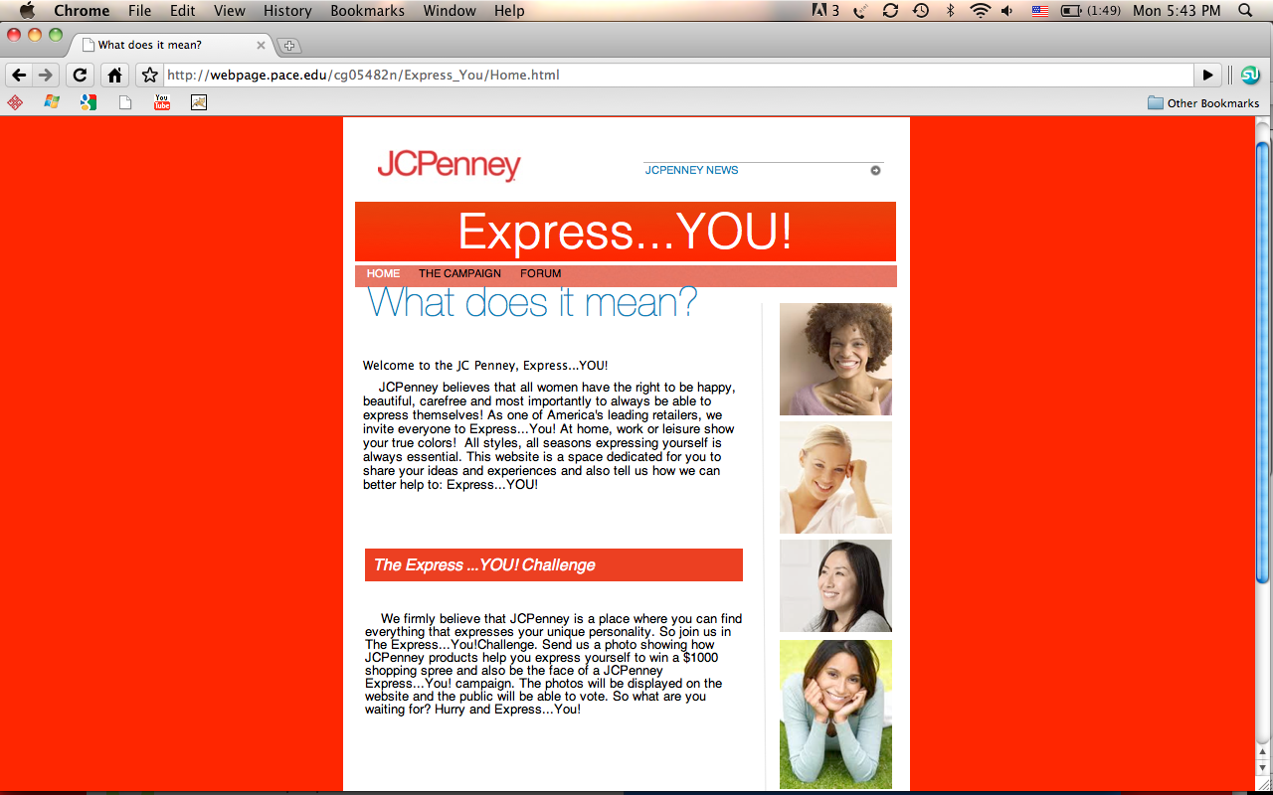

Slide 60
The Express…YOU! Challenge.
The Express…YOU! Challenge will be launched on our website.
The challenge will require women to ‪submit a photo showing how JCPenney products help them to better express themselves.The photos will be displayed on the website and the public will be able to vote for the best.‬
The winner will receive a $1000 shopping spree and also be the face of a‬ new ‪JCPenney Express…YOU! campaign.‬

Slide 61
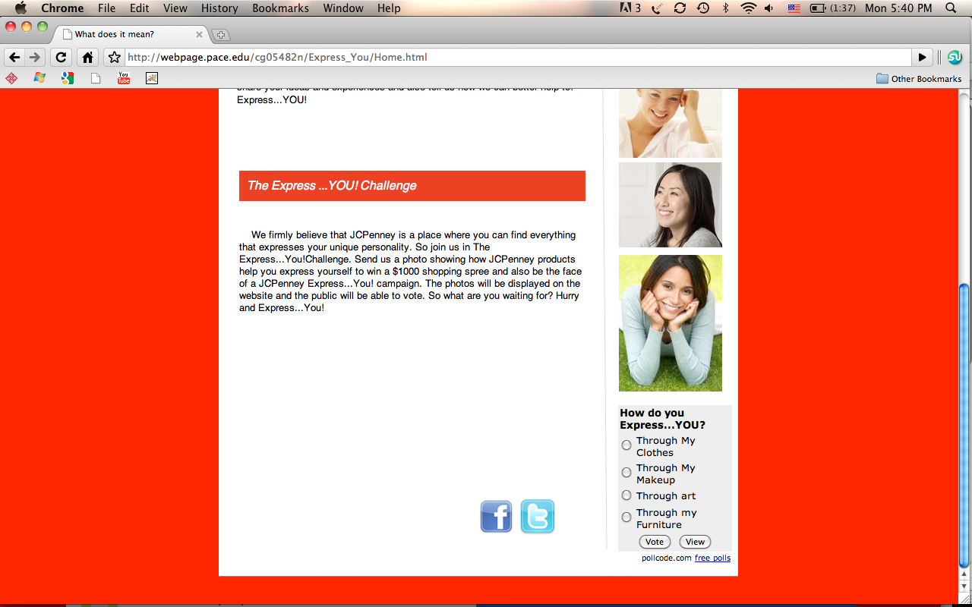

Slide 62
Facebook and Twitter Fan Page:
Our agency RT Revolutionizing Together has made a fan page for our JCP campaign titled “Express … YOU!!!”
Our Facebook and Twitter fan page provides photos of all our latest advertisements, upcoming events, and posts.
This page allows fans of JCPenney to express themselves on the wall.

Slide 63
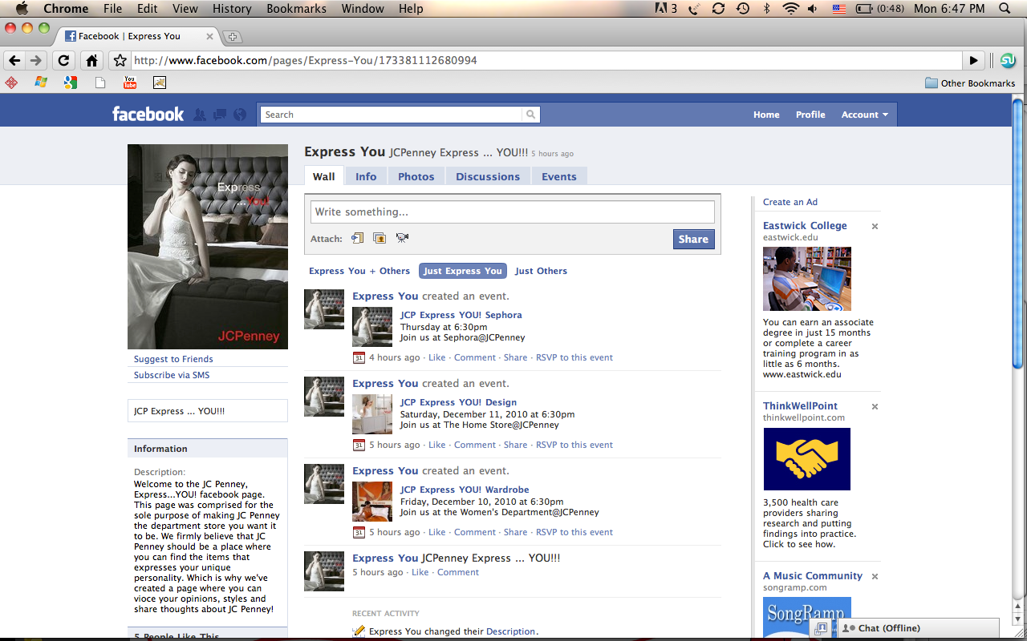

Slide 64
Facebook “Express … YOU!!!”
On our fan page we have our fan wall in which our fan can express themselves.
How they feel today?
What they feel about JCP?
Do you like the “Express … YOU!!!” campaign?
They also can post photos and videos of themselves in their nearby JCP store.
Fans also can upload a video or photos expressing their true personality.
In addition, fans can see the events JCPenney provides for their frequent and loyal customers.

Slide 65
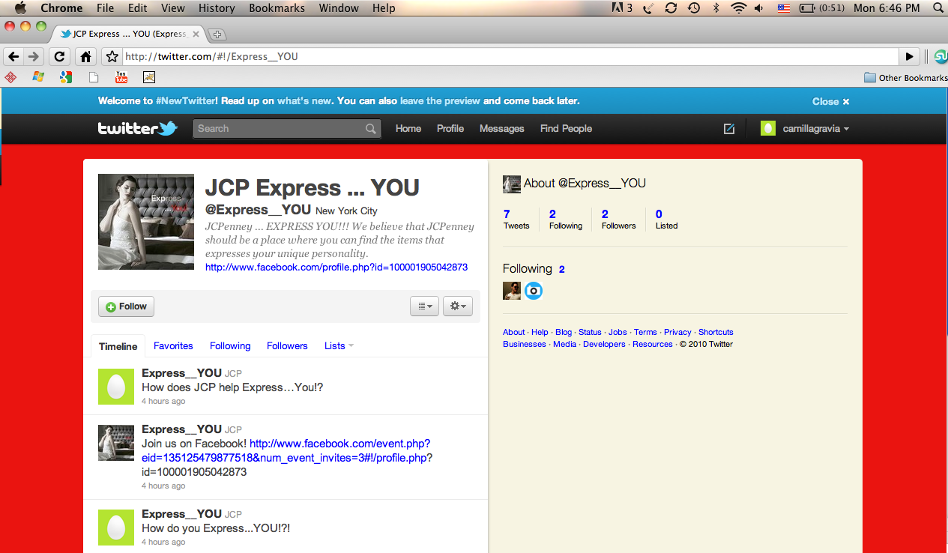

Slide 66
Twitter “JCP Express … YOU”
On the twitter page fans can see our latest posting.
They can reply to them and express themselves on how they are feeling corresponding the post. They can also “retweet” posts that we post if they really like it.
Fans as well can upload photos and videos to express themselves and the true identity.

Slide 67
Improve JC Penney shopping experience…..
Store music
Lighting
Seasonal decorations
Big promotions signs for brands we want to stress
Improving management
Events

Slide 68
Store Music
An experiment was conducted to learn how individuals engaged in a shopping activity might be affected by environmental music varying in its perceived familiarity to the shoppers. Fontaine and Schwalm (1979) reported that, relative to no music or unfamiliar music, playing familiar music increased subjects' arousal level, vigilance in detecting visual signals, and mitigated an expected decline in vigilance as the length of the session increased. Thus, it is expected that individuals listening to familiar music will be more aroused and spend more time shopping than individuals listening to unfamiliar music. This was tested in the current study by observing the length of time individuals shopped when given a choice as to how much time to spend shopping. This study was done again by Columbia students in 2009 and received the same results.
Source: http://faculty.bschool.washington.edu/ryalch/Research/atmosphe.htm

Slide 69
Store Music Continued….
To increase our shoppers experience we plan to play music that our target demographic is familiar with.
Simmons results show that the age group 24-34 like alternative, Urban, and Urban Contemporary music the most.
Age group 24-34 Index:
Alternative 313
Urban Contemporary 235
Urban 153

Slide 70
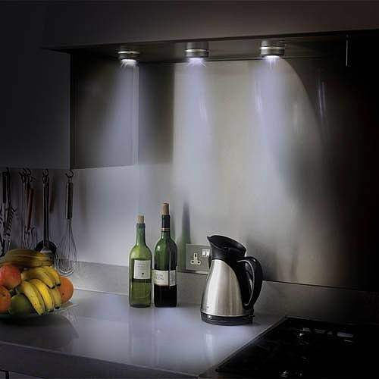
Lighting
Shopping has become one of the most popular leisure activities in economically advanced countries. People no longer only go shopping when they need something: the experience of shopping is becoming more important. This also means that these people navigate through stores in a less structured way, and will be attracted by environments, which are appealing and pleasant to be in. As a result, we will continuously try to optimize the shopping experience in such a way that increases people’s willingness to buy. Research shows that one of the most effective ways of influencing buyers is through lighting. solutions.
Source: http://www.research.philips.com/technologies/projects/shoplight/index.html

Slide 71
Improving Lighting in JC Penney
Focus lighting main brand signs displays in each section.
Include spot lights on manikins displaying clothing
Lighting in bathrooms should be well lit
Warm lighting in fitting rooms to improve appearances while trying on clothing
Increase lighting in home furnishing area so environment is well lit and cheerful.

Slide 72
Seasonal Decorations
We are adding seasonal decorations for all the holidays. We want our customers to like the environment they are shopping in. Decorations make the customers’ shopping experience fun and esthetically pleasing.
This picture shows one example of how we will decorate our home furniture section. Furthermore, by doing this, we will also give our customers ideas for their own home.
Source: http://www.unitymarketingonline.com/cms_christmas/

Slide 73
Improve Brand Signs
We will provide more appealing signs by making them stand out with the proper lighting, size, and making
them more colorful. Our goal is to
give each brand sign a glamorous touch.
For our most popular brands:
St Johns Bay
East 5th
Liz Claiborne
Jones Wear
A.N.A
MNG by Mango

Slide 74
Improving Management
To improve employee performance we plan to first start with their managers. We will implement a knew form of management in which ALL managers will follow the One Minute Manager process. This process includes one minute goal setting, one minute reprimands, and one minute praises. Each manager will be encouraged to purchase the One Minute Manager book in order to familiarize themselves with the process. By implanting the One Minute Manager process, the work environment for very employee will improve and associates will know exactly what their managers expect from them. If the work environment at JC Penney is working well then it should positively effect customer’s shopping experience.

Slide 75
Events
JCPenney wants to help women express themselves in every possible way. We invite everyone to come Express...You! at our in-store events. These events will take place in our largest market areas throughout the country. We will have assistance from some of the best make-up artists, style and interior designer professionals. These events not only have the intent of creating a positive attitude towards the JCP brand but should also improve our clients shopping experience.

Slide 76
Express…You! Wardrobe Where? Join us at the Women's Department@JCPenney What? Casual, Chique or Sporty, stylists together with the JCPenney staff will help women Express...You! Clothes say a lot about women. It’s one of the main ways in which our target consumer express themselves. Research shows that this demographic feels a strong need to be up to date with the newest trends. In this event, we will present our clients our latest designer collections and provide them with expert styling tips on how to dress, accessorize and express themselves.

Slide 77
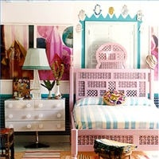
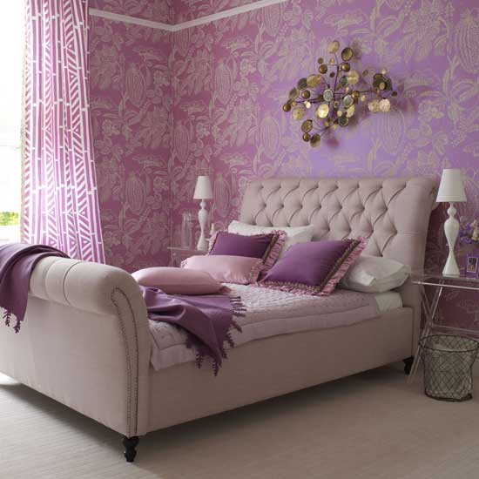
Express…You! Design Where? Join us at The Home Store@JCPenney What? Minimalist, Classic or Modern, decorators together with the JCPenney staff will help women Express...You! The home is extremely important for our target audience, it is one of the main ways in which they express themselves. The women feel like the home should have their own personal touch. In this event, we will present our clients to our latest home and furniture collections and our design experts will give them tips and about home decoration and how to make a better use of their home spaces while expressing themselves.

Slide 78
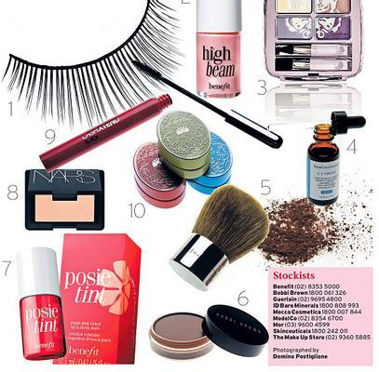
Express…You! Sephora Where? Join us at Sephora@JCPenney What? Natural, Glam or Classic, make-up artists together with the JCPenney staff will help women Express...You! With make-up and beauty products being indispensable in women's daily routines, and also a great form of expression for our target audience, there is a need for them to be up to date with all of the new trends. In this charming event, we will present to our clients all of the Sephora's latest products, the opportunity to learn tips and tricks directly from our experts and also to get their make up done.

Slide 79
New Idea for JC Penney
A new lower cost line from a celebrity (Victoria Beckham)
Victoria Beckham is recognized as an international style reference. Aside from having her own clothing lines, Victoria Beckham and Victoria Beckham Denin she has had a lot of experience in the fashion world, from collaborations with important brands and designers and to modeling for countless campaigns. Victoria Beckham has many facets, therefore she is an icon that inspires the target audience and the celebrity who will be the designer for a new collection, Victoria B by JCPenney.
We will launch a full lower cost Victoria Beckham line in all JCPenney stores. Based on primary research, Victoria was the celebrity that our target market most wanted a lower cost line from.

Slide 80
Advertisements (below the line)
Ads in locations where the target audience would notice (Magazines, Gym, AMTRAK)
Magazines:
Our target demographic reads Cosmopolitan, Parents, Star, and US Weekly. We will pick the Ad from our campaign that best fits the magazine’s style. All of our ads will be a full page in magazine.
Age group 25-34 Index:
Parents 544
Cosmopolitan 327
US Weekly 185
Star 141

Slide 81
Gym:
Research from Simmons showed that more people in the age group 24-34 answered “yes” to visiting a gym in the last 12 months than “no.” Therefore, a gym is a key locations for putting up a JCPenney Express…YOU ad. Our ads will be placed near the exits of the gym, and in the kids zone (if the gym has one).
Visited a gym in the last 12 months?
Age group 25-34 Index
Yes 125
No 77

Slide 82
We will put our ads on AMTRAK. Simmons results show that age group 30-34 used public transportation in the last 6 months. Results for age group 25-29 were low. However, we fell that reaching the 30-34 age section is profitable regardless of have lower numbers for the other age section.
Used public transportation in last 6 months?
Age group 25-29 Index Age group 30-34
Yes 93 118
No 25 19

Slide 83
This ad displays a women expressing her elegant style using JC Penney products:
This Ad will appear in Cosmopolitan because it fits the magazines stylish tone.
She is wearing a very elegant dress that is bright orange expresses her exuberant personality.
There is a portrait on the wall that is orange as well, it emphasizes a consistent theme. This portrait also shows a lot of diversity and culture.
There are white flowers, white bed sheets as a well as a classic lamp displayed in the ad. This contributes to the ethnic feel of the advertisement and most importantly these are items that are sold at JC Penney.
In General:
The model is reading a book, a common hobby of our target market.
The race of the model in this ad is ambiguous. So women of many races can relate to this women
The “express you” slogan is two shades of orange so it relates to this specifics advertisement.

Slide 84
This lady uses furniture and clothing from JC Penney to express her casual style in several ways:
This causal laid back look will be used as Ads in Parent and US weekly
The walls, dresser, bedpost, sheets, flowers and lamps are white. This color gives off a very relaxed ambience.
The brown rug and the portrait of flowers in the background adds a stylish twist to the room.
The model is wearing white lingerie. This contributes to the white color scheme in the ad.
In General:
The model appears to be Anglo Saxon which appeals to the target audience
. The slogan “express you” is in ordinance with the style of the room and model.

Slide 85
The model in the advisement has an classic style which is expressed through JC Penney merchandise:
This Ad will be displayed in US weekly. This magazine is know for celebrity gossip and a fashion goes hand and hand with celebrities.
The couch, bed sheets and bed post are black. Black furniture gives the room a stylish edge.
The model is wearing a long white dress which is very chic.
The model’s red lips, pale skin and hair pulled back, as well as her pose, emphasizes the model’s confident style
In General:
This ad displays a very fashionable yet sophisticated women.
Fashionistas can relate to the model and find interest in the furniture and clothes.
The slogan “express you” matches the color scheme of the room and Ad.

Slide 86
Reason to believe….
Our insight that Women ages 25-34 are unaware of the many opportunities JCPenney provides to assist them in expressing themselves is backed by strong primary and secondary research. Our ads clearly reveal how JCPenney can help woman express themselves through what they wear and through their furniture. The reason to believe are the woman in the ads and the environment that they are in, which assists in expressing who these woman are.

Slide 87
Our mission statement
We will create a loyalty of customers ages 25-34 by allowing them to easily express themselves in multiple ways.

