Slide 1
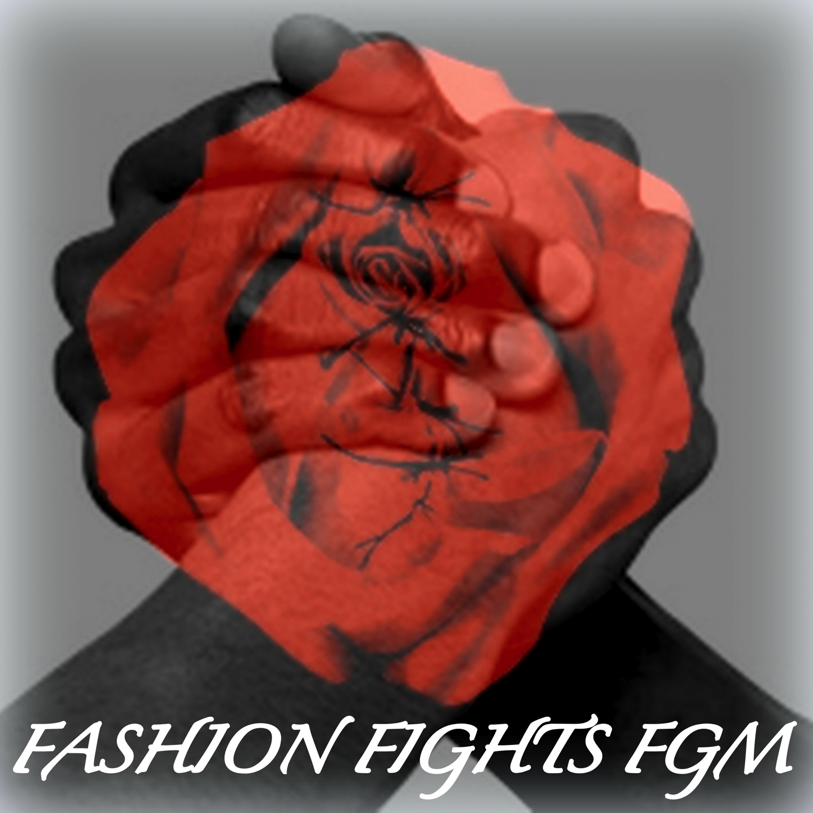
Media Relations Individual Project
Jessica Scannell

Slide 2
The Organization
The Desert Flower Foundation
Waris Dirie

Slide 3
The Campaign

Slide 4
SWOT
Strengths: Only US based FGM foundation. The celebrity of Waris Dirie. The link with the fashion Industry. | Weaknesses: Limited public awareness. Limited online presence. FGM is a taboo, rarely discussed topic.
Opportunities: Increase awareness Use fashion industry to lessen taboo and create mainstream conversation. Increase online presence. | Threats: Opposition from certain individual. Lack of prosecutions Victims and public unwilling to speak out.

Slide 5
Goals: End FGM Create mainstream conversation/public awareness. Improve Desert Flower visibility. | Objectives: 10% more public awareness in NYC by 02.20.13 10% more social media fans/followers by 02.20.13 10% more donations by 02.20.13
Strategies: Use celebrity founder for publicity. Use fashion industry to gain public attention. Use social media to connect with public. | Tactics: Fashion Fights FGM event New social media platforms Press Kit, Press Release, Media Alert TV talk shows, TedTalks Helpline Surveys before and after

Slide 6
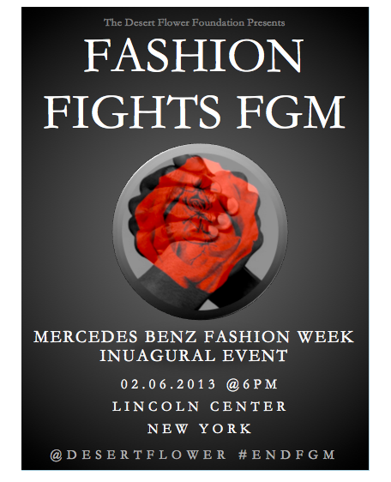
The Event

Slide 7
Messaging Matrix

Slide 8
The PR Plan: Media Targets
New York Times and Vogue press release exclusive.
Pitch to Broadcast Media, share stories before event.
Social Media Campaign
Media alert to all media and bloggers to attend event.
Ted Talks

Slide 9
Why Fashion Industry? 5th Step: Mainstream Public Awareness
1. Outreach and education to immigrant communities about the legal, physical and psychological consequences of FGM.
2. Encouraging community and religious leaders to educate their communities about the harm and illegality of FGM
3. Guidelines and training to assist front-line professions, such as law enforcement agents, teachers and health care workers to identify and protect girls at risk.
4. Robust enforcement of laws prohibiting FGM, not only on U.S. soil but in the case of girls sent abroad for the procedure.

