Slide 1
Ethics of DIGITAL MANIPULATION IN ADVERTISING & Fashion Magazines
Amber Jones
May 1, 2015
MCA 696 – Ethics, Morality, and the Communications Industry

Slide 2
DIGITAL MANIPULATION IN ADVERTISING
The photos of models and celebrities in advertisements and fashion magazines are often ‘retouched’ before being published
Retouching can be slight (colors brightened, stray hairs fixed) or extreme (adding height, erasing wrinkles, changing body shape) (Lohr, 2011)

Slide 3
DIGITAL MANIPULATION IN ADVERTISING
More and more it seems that companies are taing the extreme route and getting a little heavy handed with their Photoshop tools.
Final images may have little or no resemblance to the original (Jones, 2012)
For example…

Slide 4
CANDIES / BRITNEY SPEARS
Britney Spears allowed original photos of a Candies ad to be released with the Photoshopped ones so people could see the differences.
Minor changes: removal of blemishes and skin toned evened out
Major changes: Cellulite was removed, her waist and legs were slimmed, her butt was slimmed and lifted
(Woodward, May 2014)

Slide 5
CANDIES / BRITNEY SPEARS
(Woodward, May 2014)

Slide 6
COMPLEX / KIM KARDASHIAN
Complex Magazine accidentally posted the original photos of a photo shoot with Kim Kardashian on its website
Minor Changes: skin tone evened out
Major Changes: cellulite removed, waist slimmed, tummy slimmed, legs slimmed, arms slimmed, face slimmed, breasts lifted/sculpted
In response to all the negative comments about the photos, Kim said “So what: I have a little cellulite. What girl doesn’t? How many people do you think are Photoshopped, it happens all the time”
(Woodward, May 2014)

Slide 7
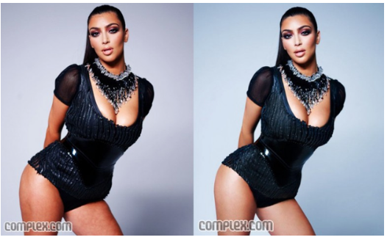
COMPLEX / KIM KARDASHIAN
(Woodward, 2014)

Slide 8
OK! MAGAZINE / KOURTNEY KARDASHIAN
Kourtney posed for a picture for Life and Style magazine 7 days after giving birth. The imaged was published on the cover of OK! Magazine …but looked a little different.
The colors of Kourtney and Baby Mason’s clothing were changed, giving the impression of a new photo shoot.
Baby weight/belly removed
Kourtney spoke out to let everyone know that the image was Photoshopped and that she had not, in fact, lost the baby weight that quickly.
(Woodward, 2014)

Slide 9
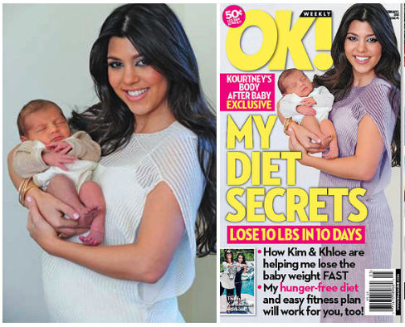
OK! MAGAZINE / KOURTNEY KARDASHIAN
(Woodward, 2014)

Slide 10
PHOTOSHOPPED MODELS
Here are more examples of celebrity Photoshopping
Excessive Photoshopping is not just for celebrities.
Many companies and magazines heavily Photoshop their models as well…

Slide 11
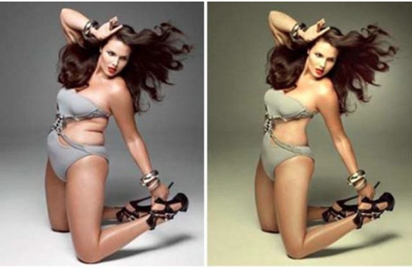
PHOTOSHOPPED MODELS
To look thinner…
(Zara, 2014)

Slide 12
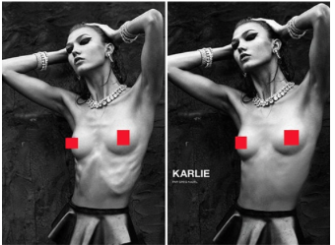
PHOTOSHOPPED MODELS
And heavier…
(Wade, 2014)

Slide 13
DIGITAL MANIPULATION IN ADVERTISING
Every part of a model can be altered in Photoshop, creating an image that looks nothing like the original

Slide 14
CELEBRITIES SPEAK OUT
Keira Knightly posed topless and un-retouched for Interview Magazine to take a stand against publications always making her bust larger and her body curvier
Jamie Lee Curtis posed un-retouched in a sports bar and shorts for More’s September 2012 issue
Singer, Lorde, posted an un-retouched photo on her Twitter account next to the Photoshopped version to show her skin imperfections stating: Remember flaws are ok :-)
(Dockterman, 2014)

Slide 15
PHOTOSHOP ON SOCIAL MEDIA
However, not all celebrities feel this way and make Photoshop a part of their everyday life, not just in ads and magazines
Celebrities like Beyoncé and Kim Kardashian have been accused of using Photoshop in their Instagram photos
I think this is, potentially, more harmful than when done in ads, because the images posted are portrayed as ‘candid’ and ‘real’ photos
This gives their followers the impression that this is really what they look like
This can be VERY harmful and is extremely misleading

Slide 16
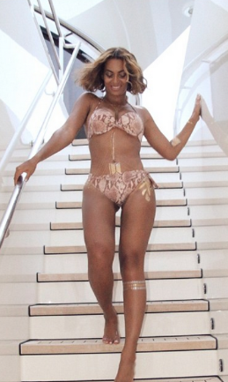
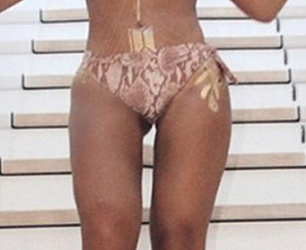
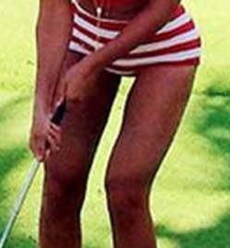
BEYONCE INSTAGRAM - #nofilter ?
Visible distortions have caused accusations that Beyoncé is Photoshopping a “thigh gap” in her images
(Woodward, May 2014)

Slide 17
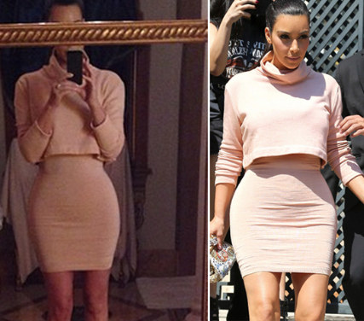
KIM K. INSTAGRAM - #nofilter ?
The same has been said of Kim Kardashian’s Instagram photos, who reportedly pays a Photoshop Assistant a yearly salary (Nessif, 2015)
(Left) Image of Kim from Instagram account
(Right) Paparazzi photo of Kim that same day
(Woodward, March 2014)

Slide 18
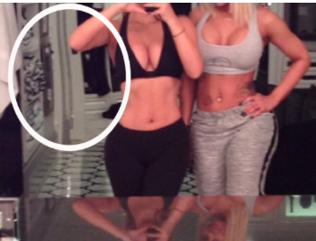
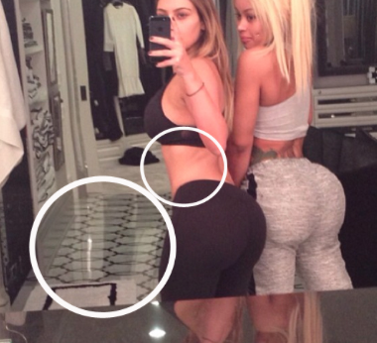
KIM K. INSTAGRAM - #nofilter ?
Images from Kim K’s Instagram account showing alterations in the background to prove Photoshopping
(Woodward, March 2014)

Slide 19
THE ‘IDEAL’ DOESN’T EXIST
When ‘real’ women see Photoshopped versions of themselves…

Slide 20
Current Laws

Slide 21
CURRENT LAWS
Many countries are taking note of the excessive use of Photoshop and the harm it can cause
Countries with digital manipulation laws:
Israel
France
Countries trying to set up laws:
Australia
UK
USA

Slide 22
ISRAEL
March 20, 2012 Israel announced legislation that includes BMI regulations for models as well as limitations on the digital alterations of advertisements (Sieczkowski, 2012)
Dubbed the “Photoshop Law” (Sieczkowski, 2012)
Law took effect on January 1, 2013 (Nota, 2013)

Slide 23
ISRAEL - “PHOTOSHOP LAW”
Fashion/commercial models should have a MBI of at least 18.5
5’8” / 120lbs = BMI of 18.2
Digitally altered Images making models appear thinner must be labeled (Nota, 2013)
Labels must cover at least 7% of the surface area of the image (Carrick, 2014)

Slide 24
FRANCE
Similar to Israel
Condoning anorexia is illegal.
Any re-touched images that “alter the bodily appearance of a model for commercial purposes” must carry a label stating it has been manipulated
Models must provide a medical certificate showing that they have a BMI of at least 18, both before being hired and for a few weeks after the job
5’7” / 121 lb = BMI of 18
(Picey, 2015)

Slide 25
AUSTRALIA
Australian Federal Government set up National Advisory Group on Body Image in 2009, which set up initiatives to improve body image issues in Australia
One of those initiatives was a Voluntary Industry Code of Conduct for media, fashion and advertising industries
Code includes:
More diversity in the representation of women
Realistic and natural images of people
Healthy-weight models
Positive content and messaging
So far the code has not worked
(Carrick, 2014)

Slide 26
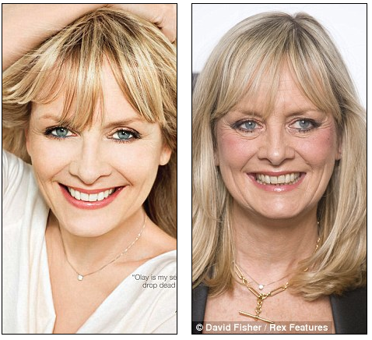
UK
Twiggy’s OLAY ad campaign in 2009 sparks members of British Parliament to call for a ban on Photoshopping ads aimed at children and labels for photoshopped ads aimed at adults
(North, 2009)
FYI – this ad was for an anti-aging cream…so should OLAY be allowed to digitally ‘anti-age’ its model??

Slide 27
UK
Proposal called for rating system for warning labels
All ad images would be rated on a scale, based on the degree of retouching.
Highest rating = cosmetic changes from Photoshop
Lowest rating = less severe changes (altered lighting)
No law in place, but ads are heavily monitored by Advertising Standards Authority
(Donovan, 2012)

Slide 28
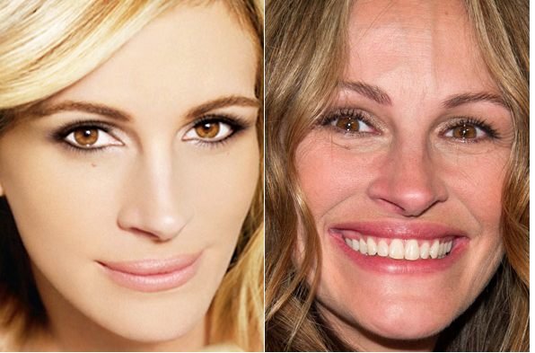
UK
ASA has banned many ads due to overuse of Photoshop, including Lancôme and L’Oreal ads featuring Julia Roberts and Christy Turlington (Warr, 2011)
BANNED

Slide 29
U.S.
No laws in place, however anti-Photoshop sentiments are growing among the general public, companies, and celebrities.
Bills have been proposed to put an end to excessive Photoshop use including:
Truth in Advertising Act of 2014
Media and Public Health Act (formerly called the Self Esteem Act)

Slide 30
TRUTH IN ADVERTISING ACT OF 2014
Bipartisan bill introduced on March 27,, 2014
Also known as the “Anti-Photoshop Act”
Bill asks Federal Trade Commission to:
Come up with a strategy to reduce Photoshop use in advertisements
Submit a report to Congress on the amount of images that have been “altered to change the physical characteristics of bodies and faces” in commercial* media and advertisements
*Editorial images are covered more strongly under the First Amendment and would not be affected by this bill
(Zara, 2014)

Slide 31
MEDIA AND PUBLIC HEALTH ACT
First announced in August of 2011 under the name of the Self Esteem Act
Created by former Creative Artists Agency executive, Seth Matlins, and his wife Eva Matlins.
Would force ads and editorials to place disclaimers on an image of the “human form” that was significantly digitally altered
Joined with National Eating Disorder Association in 2012 and renamed the Media and Public Health Act
Why the name change?
“to make crystal clear the cause and effect relationship between the media (and media industries) and public health”
(Barry, 2011)
(Off Our Chests, 2012)

Slide 32
ETHICAL ISSUES

Slide 33
ETHICAL ISSUES
Truthfulness and Accuracy
Responsibility
Disclosure / Transparency
First Amendment

Slide 34
TRUTHFULNESS / ACCURACY
According to Patterson and Wilkins (2013), accuracy is “using the correct facts and the right words and putting things in context” (p. 35).
FTC and Federal Law state: “When consumers see or hear an advertisement…that ad must be truthful, not misleading…” (FTC, n.d.)
Advertisements promoting the benefits of an anti-aging cream that digitally remove the wrinkles of the model are very misleading and inaccurate
NYT Ethicist, Randy Cohen considers Photoshopping False Advertisment
“…we already accept labels that list a product’s ingredients or assess its nutritional value or warn of dangers in its use. Similar transparency should apply to phony-baloney advertising photographs”
(Cohen, 2009)

Slide 35
RESPONSIBILITY
According to the American Marketing Association (AMA), organizations have the responsibility to accept the consequences of their marketing strategies and acknowledge the social obligations that come with “increased marketing and economic power” (About AMA, 2014).
Media professionals should take responsibility for inaccurate information (Pulaski-Behling, 2015)

Slide 36
DISCLOSURE / TRANSPARANCY
According to the American Marketing Association (AMA), marketers must “create a spirit of openness in marketing operations,” and should explain significant product or service risks that could affect consumers and their perceptions
AMA also states that marketers should strive to communicate clearly with their consumers and avoid omissions that can be harmful to the consumer
(About AMA, 2014)

Slide 37
FIRST AMENDMENT
Commercial Speech = speech that advertises a product or service, was not always protected under First Amendment
(Advertising is protected, 2015)
Commercial Speech Doctrine – truthful advertisements are protected under the First Amendment
(Pulaski-Behling, 2015)
Commercial speech carries less protection than other types of speech (ie editorial)
FTC can regulate “deceptive” speech
(Advertising is protected, 2015)

Slide 38
DIGITAL MANIPULATION IN ADVERTISING…
ETHICAL OR UNETHICAL?

Slide 39
UNETHICAL!!!
Many Advertisers and magazine editors believe a warning label only tells people what they already know
Chief Editor at Marie Claire, Christin Leiritze, says “fashion provides a dream that is important for women” and that her “readers aren’t idiots”
(Donovan, 2012)
However, just because readers know they are Photoshopped, doesn’t mean it doesn’t negatively affect them
“Seeing is believing”
(Patterson & Wilkins, 2014, p.196)

Slide 40
NEGATIVE AFFECTS OF DIGITAL MANIPULATION
Photoshopped images portray an unrealistic idea of beauty that is impossible to attain
Photoshopped images in magazines and advertisements have contributed to depression, anorexia, bulimia, and other health issues among young women
10 million women in US women suffer from eating disorders
More than 80% of women report being dissatisfied with their appearance
(Donovan, 2012)

Slide 41
NEGATIVE AFFECTS OF DIGITAL MANIPULATION
While I don’t believe that digital manipulation in the media causes eating disorders – which are very complex and are developed based on a number of factors – I do believe they create unrealistic ideas of beauty and cause body image issues and unhealthy eating habits and behaviors
Higher exposure to beauty and fashion magazines increases the likelihood that young girls will develop negative body image and eating disorders
Girls in Fiji begun to develop eating disorders and body image issues only 3 years after western TV was introduced!!!
(Rhodan, 2014)

Slide 42
NEGATIVE AFFECTS OF DIGITAL MANIPULATION
Being constantly bombarded with images of perfection can subliminally affect a persons views – especially young impressionable minds
(Piper, 2007)

Slide 43
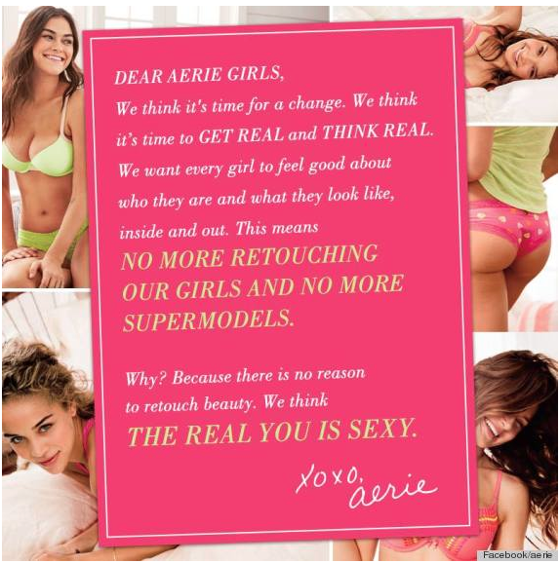
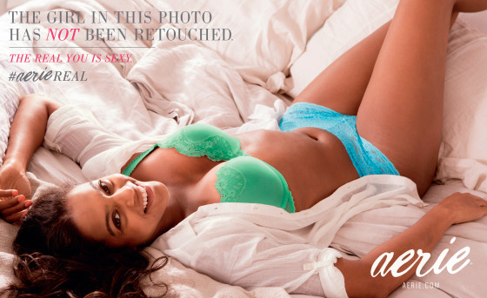
COMPANIES SPEAK OUT - AERIE
American Eagle’s lingerie store aerie launched Spring 2014 campaign called aerie Real, featuring un-retouched models in their latest collection of lingerie

Slide 44
COMPANIES SPEAK OUT – MODCLOTH
Online clothing retailer ModCloth is the first to sign Anti-Photoshop pledge, promising not to “change the shape, size, proportion, color and/or remove/enhance the physical features of models in advertisements post-production”
Signed pledge in August of 2014
(Adamczyk, 2014)

Slide 45
COMPANIES SPEAK OUT – MODCLOTH
ModCloth also uses models of all shapes and sizes in its advertising – and trangender model Rye Sliverman! Bravo ModCloth!

Slide 46
FINAL THOUGHTS

Slide 47
PHOTOSHOP NEEDS TO STOP
The public has become very obsessed with exposing Photoshopped images of celebrities and models
It can seem like a bit of an attack on these women (and men), but I do think that it’s important to expose
Digitally altering images is really damaging to children and adults
Even if you know an image is Photoshopped, its still discouraging and damaging to see an image of beauty and perfection that is IMPOSSIBLE to attain

Slide 48
PHOTOSHOP HAS TO STOP
“I don’t think women and girls know the extent to which photos are retouched…and even if they do know I’m not sure it penetrates”
- Alexis Beck, Clinical Nutritionist
This video discusses the extent to which Photoshop is a part of our media, and the affect it has on society
(Diethealth, 2008)

Slide 49
PHOTOSHOP HAS TO STOP
Media companies need to be more responsible with the images they release, and take note of the damage it is causing to society.
Celebrities should be more responsible to their fans as well. Whether or not they like it, they are role models and their actions do leave an impression on their fans.
Whether or not someone believes that heavily Photoshopped images cause eating disorders, the fact that so many people in our country have issues with their body, should be enough
The more we see ‘normal’ looking people in the media, the more people will start to let go of these unrealistic ideals

Slide 50
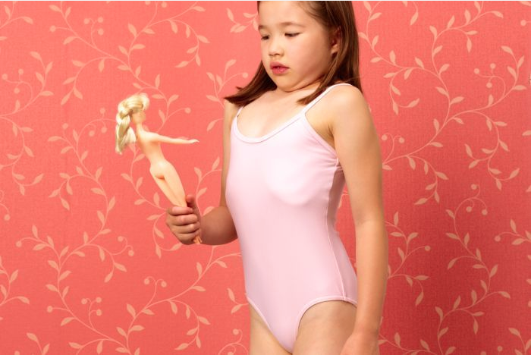
PHOTOSHOP HAS TO STOP
“When generations of women compare themselves to images and standards that are unattainable, when generations of men are taught to believe that’s what people should look like, the evidence for action and change is morally incontrovertible.”
- Seth Matlin
(Barry, 2011)
(Carrick, 2014)

Slide 51
REFERENCES
Adamczyk, A. (2014, August 14). ModCloth is first retailer to sign anti-
Photoshop pledge. Forbes. Retrieved from
http://www.forbes.com/sites/aliciaadamczyk/2014/08/14/modcloth-is-first-retailer-to-sign-anti-photoshop-pledge/
About AMA (2014) Statement of Ethics. Retrieved February 27, 2015 from
https://www.ama.org/AboutAMA/Pages/Statement-of-Ethics.aspx
ArtFido.com. (2013, October 31). Video shows how quickly a model can be
manipulated using Photoshop [Video File]. Retrieved from
https://www.youtube.com/watch?v=u8kty1SEqZQ
Barry, D. (2011, October 10). Concerned parents look to pass the ‘Self-Esteem
Act.’ Jezebel. Retrieved from
http://jezebel.com/5848194/concerned-parents-look-to-pass-the-self-esteem-act
BuzzFeedVideo. (2014, February 13). Photoshopping real women into cover
models [Video File]. Retrieved from
https://www.youtube.com/watch?v=zRlpIkH3b5I

Slide 52
Carrick, D. (2014, February 1). Body Image and the law. ABC RN: Law Report.
Retrieved from
http://www.abc.net.au/radionational/programs/lawreport/5225592
Cohen, R. (2009, October 20). Should photos come with warning labels? New York
Times. Retrieved from
http://ethicist.blogs.nytimes.com/2009/10/20/should-photos-come-with- warning-labels/
Diethealth. (2008, June 16). The Photoshop effect [Video File]. Retrieved from
https://www.youtube.com/watch?v=YP31r70_QNM
Dockterman, E. (2014, Novebmer 7). Keira Knightley and 7 other celebs protest
Photoshop and won. TIME. Retrieved from
http://time.com/3572400/keira-knightley-topless-celebrities-protest-photoshop/
Donovan, K. C. (2012). Vanity fare: The cost, controversy, and art of fashion
advertising retouching. Notre Dame Journal of Law, Ethics, & Public Policy 26(2), 580-620. http://scholarship.law.nd.edu/ndjlepp/vol26/iss2/9
Federal Trade Commission. (n.d.). Truth in advertising. Retrieved from
https://www.ftc.gov/news-events/media-resources/truth-advertising

Slide 53
Jones, M. (2012). Media-bodies and Photoshop. In Attwood, F., Campbell, V.,
Hunter, I.Q., & Lockyer, S. (Eds.), Controversial images: Media representation on the edge (pp. 19-35). New York, NY:Palgrave Macmillan
Krupnick, E. (2014, January 17). Aerie’s unretouched ads ‘challenge supermodel
standards’ for young women [Blog Post]. Huffington Post. Retrieved from
http://www.huffingtonpost.com/2014/01/17/aerie-unretouched-ads-photos_n_4618139.html
Lohr, S. (2011, November 28). Photoshopped or not? A tool to tell. New York
Times. Retrieved from http://www.nytimes.com/2011/11/29/technology/software-to-rate-how-drastically-photos-are-retouched.html?_r=0
n.a. (2015). Advertising is protected by the first amendment. Advertising Compliance
Service. Retrieved from http://www.lawpublish.com/amend1.html
Nessif, B. (2015, February 24). Kim Kardashian pays an assistant $100,000 a year to
Photoshop her pictures? E!Online. Retrieved from http://www.eonline.com/news/629279/kim-kardashian-pays-an-assistant-100-000-a-year-to-photoshop-her-pictures

Slide 54
North, A. (2009, August 3). British lawmakers take stand against Photoshop [Blog
Post]. Jezebel. Retrieved from http://jezebel.com/5328736/british-lawmakers-take-stand-against-photoshop
Nota, B. (2013, January 3). Israeli law bans Skinny, BMI-challenged models.
ABC News. Retrieved from http://abcnews.go.com/International/israeli-law-bans-skinny-bmi-challenged-models/story?id=18116291
Off Our Chests. (2012, February 1). Renaming the Self-Esteem Act. Feel More
Better. Retrieved from http://www.feelmorebetter.com/renaming-the-self-esteem-act/
Patterson, P. & Wilkins, L. (2014). Media ethics: Issues & cases (8th ed.). New York,
NY: McGraw-Hill.
Picy, E. (2015, April 3). France bans super-skinny models in anorexia clampdown.
Reuters. Retrieved from http://www.reuters.com/article/2015/04/03/us-france-anorexia-idUSKBN0MU0JK20150403
Piper, T. (2007, October 2). Beauty Pressure [Video File]. Retrieved from
https://www.youtube.com/watch?v=Ei6JvK0W60I

Slide 55
Pulaski-Behling, M. (2015). Ethics, morality and the communications industry.
[PowerPoint Slides]. Retrieved from https://blackboard.pace.edu/bbcswebdav/pid-2554933-dt-content-rid-5506378_1/courses/MCA-696X-23418.201520/EthicsOverview.ppt
Pulaski-Behling, M. (2015). Advertising and Ethics [PowerPoint Slides]. Retreived from
http://blackboard.pace.edu/bbcswebdav/pid-2582880-dt-content-rid-5628172_1/courses/MCA-696X-23418.201520/AdvertisingEthicsGrad.pptx
Rhodan, M. (2014, April 3). Lobbyists push congress to curb misleading Photoshopped
ads. TIME. Retrieved from http://time.com/48853/lobbyists-push-congress-to-curb-misleading-photoshopped-ads/
Sieczkowski, C. (2012, April 11). Supermodels without Photoshop: Israel’s
‘Photoshop law’ puts focus on digitally altered images. International Business Times. Retrieved from http://www.ibtimes.com/supermodels-without-photoshop-israels-photoshop-law-puts-focus-digitally-altered-images-photos

Slide 56
Wade, L. (2014, January 6). You’d be shocked at what these fashion editors are
editing out of their photos [blog post]. Huffington Post. Retrieved from http://www.huffingtonpost.com/lisa-wade/youd-be-shocked-at-what-these-fashion-editors-are-editing-out-of-their-photos_b_4542067.html
Warr, P. (2011, July 27). L’Oreal and Lancome rapped over airbrushed ads. My
Daily UK. Retrieved from http://www.mydaily.co.uk
Woodward, E. (2014, September 17). Here is more evidence that Beyonce is
Photoshopping her Instagram photos [Blog Post]. Huffington Post. Retrieved from http://www.buzzfeed.com/elliewoodward/there-is-yet-more-evidence-that-beyonce-is-photoshopping-her#.afyDNzQ12
Woodward, E. (2014, May 21). The most wtf celebrity Photoshop fails of all time
[Blog Post]. Buzzfeed. Retrieved from http://www.buzzfeed.com/elliewoodward/the-most-wtf-celebrity-photoshop-fails-of-all-time#.acmBVoaP8
Woodward, E. (2014, March 21). Are these celebrities Photoshopping their Instagram
Photos? [Blog Post]. Huffinton Post. Retrieved from http://www.buzzfeed.com/elliewoodward/are-these-celebrities-photoshopping-their-instagram-photos#.yqoedEbgm

Slide 57
Zara, C. (2014, June 16). Truth in advertising gains support, but Photoshop
regulation is a tall order. International Business Times. Retrieved from http://www.ibtimes.com/truth-advertising-gains-support-photoshop-regulation-tall-order-1602702

