Slide 1
Rethinking the Writing Process: Using a Procedural Method to Writing Steven Bookman

Slide 2
Purpose of Grant
The purpose of this grant is to study whether English Language Learners write better essays and pass the exit examinations easier if they followed a procedural or carefully-scaffolded method to writing.

Slide 3
Linear vs. Recursive Writing Methods
Linear
Recursive
A product-oriented approach treats writing as a procedure (Ferris & Hedgcock, 2009; Reid, 1984).
Writing can be viewed as a mathematical formula (Reid, 1982).
A process-oriented approach treats writing with no plan of action (Ferris & Hedgcock, 2009; Masuda, 2003; Zamel, 1983, 1984).
There are hierarchical processes that are not fixed in a rigid order (Flower & Hayes, 1981).

Slide 4
Rationale for a Carefully-Scaffolded Method to Writing
Students can envision the whole essay before they write it in paragraph form.
The brainstorming process is more complete and focused.
The focus is on the outline.

Slide 5
Theoretical Framework for a Procedural Method to Writing
Four-component instructional design model (Van Merriënboer, 1997; Van Merriënboer & Kirschner, 2013)
Model where each component of a real-world task is worked on individually until it becomes proficient while the tasks are completed in its entirety
Metacognition (Flavell, 1976, 1979)
The awareness and control of one’s own knowledge

Slide 6
Procedure for Grant
Students were introduced to each step of the writing process individually while writing whole essays from the beginning of the semester.
Each step was thoroughly explained then practiced until it was performed proficiently and effectively before moving to the next step.

Slide 7
How Does a Linear Method to Writing Look?
There are three phases to a linear method to writing.
Brainstorming Phase
Outlining Phase
Proofreading Phase

Slide 8
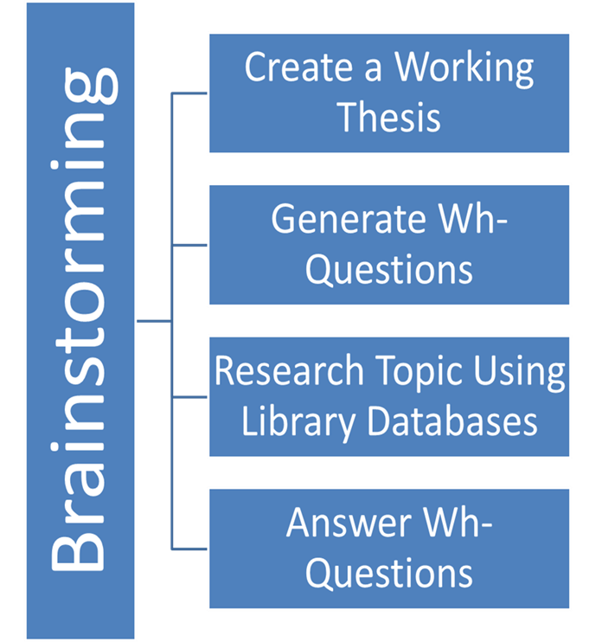
Brainstorming Phase

Slide 9
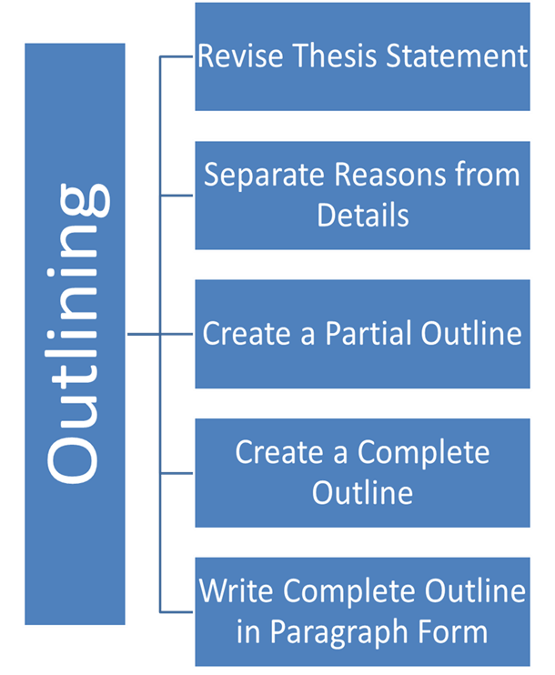
Outlining Phase

Slide 10
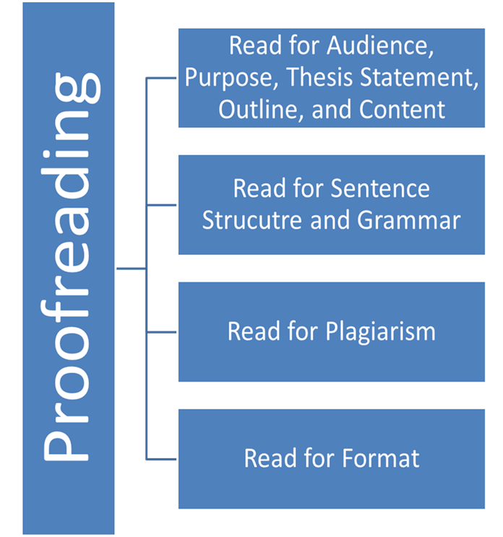
Proofreading Phase

Slide 11
Assessment
In-class work
Homework
Midterm exam
Final exam
One-to-one individual conferences
Group project

Slide 12
Quantitative Results of Grant (1)
Likert scale result
The students felt more confident about their writing.
Although the students felt that they were too many steps in the beginning, they would not change anything about it after they completed my method.

Slide 13
Quantitative Results of Grant (2)
Midterm and final exams
Eight out of 13, or 62%, passed midterm and/or final exams. Out of the five students who did not pass the midterm and/or final, two of them did not take the final exam.

Slide 14
Qualitative Results of Grant
The students felt they were more focused and organized in the writing, especially in their brainstorming.
The students were able to come up with more ideas in their brainstorming process.
The students were able to monitor where they were in the writing process at all times.

Slide 15
Advantages to Using a Procedural Method to Writing
Students are more focused.
Students know exactly where they are in the writing process at all times.
Students can envision the essay before it is written in paragraph form.
Students are able to brainstorm more ideas and develop an outline much quicker.

Slide 16
Disadvantages to Using a Procedural Method to Writing
Teaching students to create complete outlines takes a long time.
Some students will resist wanting to generate a complete outline the first time it is introduced to them.
Some students do not work well with outlines.

Slide 17
How Does My Research Fulfill the Grant
Since outlining is a skill that reading (RDL) classes test on their final exams, students get extra practice and instruction.
The Socratic method is one way of teaching analytical reading skills.

Slide 18
References (1)
Ferris, D. R., & Hedgcock, J. S. (2009). Teaching ESL Composition: Purpose, process, and practice (2nd ed.). New York: Routledge.
Flavell, J. H. (1976). Metacognitive aspects of problem solving. In L. Resnick, The nature of intelligence (pp. 231-235). Hillsdale, NJ: Lawrence Erlbaum Associates Publishers.

Slide 19
References (2)
Flavell, J. H. (1979, October). Metacognition and monitoring: A new area of cognitive-developmental inquiry. American Psychologist, 34(10), 906-911. doi: 10.1037/0003-066X.34.10.906
Flower, L., & Hayes, J. R. (1981, December). A cognitive process theory of writing. College Composition and Communication, 32(4), 365-387. doi: 10.2307/356600

Slide 20
References (3)
Masuda, P. K. (2003). Process and post-process: A discursive history. Journal of Second Language Writing, 12, 65-83. doi: 10.1016/s1060-3743(02)00127-3
Reid, J. (1984, September). The radical outliner and the radical brainstormer: A perspective on composing processes. TESOL Quarterly, 18(3), 529-534. doi: 10.2307/3586722

Slide 21
References (4)
Reid, J. (1985, June). Comments on Joy Reid's "The Radical Outliner and the Radical Brainstormer: A Perspective on Composing Processes." The Author Responds. TESOL Quarterly, 19(2), 398-400. doi: 10.2307/3586842

Slide 22
References (5)
Van Merriënboer, Jeroen J. G. (1997). Training complete cognitive skills: A four-component instructional design model for technical training. Englewood Cliffs, NJ: Educational Technology Publications.
Van Merriënboer, Jeroen J. G., & Kirschner, P. A. (2013). Ten steps to complex learning: A systemic approach to four-component instructional design (2nd ed.). New York: Routledge.

Slide 23
References (6)
Zamel, V. (1983, June). The composing processes of advanced ESL students: Six case studies. TESOL Quarterly, 17(2), 165-187. doi: 10.2307/3586647
Zamel, V. (1984, March). Comments on Vivian Zamel’s “the composing processes of advanced ESL students: Six case studies.” The author responds. TESOL Quarterly, 18(1), 154-158. doi: 10.2307/3586345

Slide 24
Contact Information
Email: steven.bookman@bcc.cuny.edu or steven.bookman@yahoo.com
Eportfolio: https://bcc-cuny.digication.com/the_theory_and_practice_for_improving_writing_skills_an_alternative_perspective/home

