Slide 1
Marlboro
Danielle Carroll
Tameka Bazile

Slide 2
About
The brand began in England in 1847 and was initially targeted at female smokers.
Advertising to this segment was unsuccessful, so in the 1920’s, Marlboro was retargeted to female smokers in the United States.
By the 1950’s, Marlboro repositioned their brand as a man’s cigarette.
Within a year after the ‘Marlboro Man’ campaign, Marlboro went from having less than 1% market share to the fourth selling cigarette brand nationwide.
Currently, Marlboro appeals to a broad range of consumers, and is targeted to both males and females 21 years of age and older.
For the past 30 years, Marlboro has held the ranking of being the largest selling cigarette brand in the U.S, and the number one cigarette brand of choice among males and females.

Slide 3
Philip Morris USA
Marlboro is owned by Philip Morris, a subsidiary of Altria Group Inc., operating under their cigarette segment.
PM USA has been the largest tobacco company in the US since the 1980’s.
Currently the nations leading cigarette manufacturer based on revenue and market share.
Marlboro leads their cigarette product portfolio with a 43.6% retail market share.

Slide 4
SWOT Analysis
Strengths Largest selling cigarette brand in the US High brand awareness and brand equity High retail market share and accounts for most of company’s sales volume Leading brand in Philip Morris’s cigarette product portfolio | Opportunities Expansion of product line to smokeless tobacco products (Marlboro Snus)
Weaknesses Marlboro is the most counterfeited cigarette brand world-wide Causes a variety of health related issues Faces litigations because of health related issues | Threats Rising in Federal, State, and Local cigarette excise taxes. Steady decline in volume sales and consumption of cigarettes in the US

Slide 5
Marketing Strategy
Product
To convince consumers that Marlboro is a quality, trusted brand cigarette with a differentiating, unique flavor.
Price
To convince their target market that Marlboro cigarettes are premium priced and worthy of purchase because of its strong value-added brand equity and quality.
Place
Marlboro has an intensive distribution strategy; their cigarettes can be found at a variety of convenient locations and participating retailers, as well as the Internet.
Promotion
Because of government restrictions and mandates on cigarette advertising, Marlboro relies heavily on their loyal consumers for consistent purchase, and promotes their cigarettes through sponsorships and consumer marketing activities to markets of ages 21 and over.
Marlboro refuses to use any form of media to promote their cigarettes, of which include magazines, movies, television, radio, billboards, etc.

Slide 6
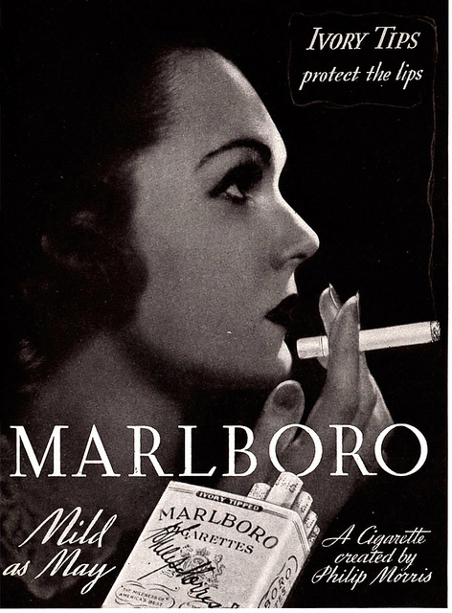
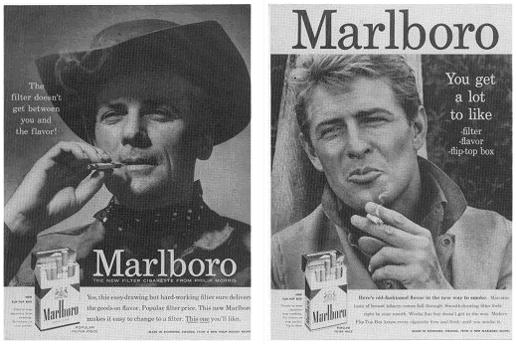
Marlboro Ads
http://www.youtube.com/watch?v=GDdBDWK2m54&feature=share&list=PL4F8FD8ED622B34BB (Marlboro Country)
http://www.youtube.com/watch?v=wibHcZ4FNbU (Manly 1950’s)

