Slide 1
Stealth Marketing
By: Iqra Mir, Jessica Nelson and Jessica Szczechowicz

Slide 2
What is Stealth Marketing?
Undercover or hidden marketing
Target market is unaware
Deliberate act of entering, operating, and exiting an industry

Slide 3
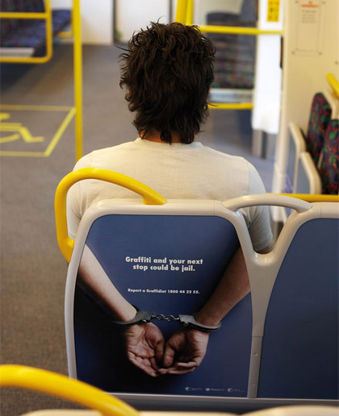
Types of Stealth Marketing
Behavioral targeting
Pushing ads based on past website visits
Celebrities
Marketing in entertainment
Music/ movies
Video games
Flogs- fake blogs
Guerrilla
Lasting impression

Slide 4
How it was Clever
They were getting the product out there
Actually placed it in the hands of the consumer
Protected the brand name by keeping it a secret
Gave the company feedback from an outsider

Slide 5
How it was Deceptive
Making up a ruse to get the product directly into the hands of a consumer
“Actresses” are being paid to fake interest in these random non-acting men
Not really allowing the consumer to have a say in participating in the marketing ploy

Slide 6
Our Opinions
We do NOT approve!
Poor Customer Relationship Management
No empathy for the Consumer
Misleading Behavior
Consumer feels used (he thought he was getting a girl!)

Slide 7
Additional Examples
Celebrity Marketing
- Armstrong Williams being paid by the Bush administration to talk up No Child Left Behind
Marketing in Music
- Rapper Jay-Z was paid to mention Motorola in his music
Viral Marketing
- Dr. Pepper's Raging Cow campaign pays bloggers

Slide 8
Additional Examples
Brand pushers
- Sony Ericsson T68i camera phone campaign that hired actors to pose as tourists
Marketing in video games
- Toyota and other car manufacturers pay for their cars to appear in Sony's Grand Turismo video game
Other:
-Morphing celebrity faces into people on advertisements to subconsciously make them seem more trustworthy to the audience

Slide 9
Solutions
Phone Testing booth at a Mall (customers can participate voluntarily)
Take the Febreeze approach
Offer special deals and promotions to those who help out

Slide 10
Do you think that this is a clever way of marketing or is it deceptive? How would you feel if this was done to you?

Slide 11
Sources:
Article from Blackboard:
http://articles.nydailynews.com/2010-04-19/entertainment/27062069_1_stealth-marketing-buzz-marketing-blackberry-pearl
PDF File: Implications of Company-sponsored messages disguised as word-of-mouth
PDF File: Stealth Marketing as Strategy
Stealth Marketing Examples:
http://customerevangelists.typepad.com/blog/2005/01/exposing_stealt.html
Face Morphing in Ads:
http://blogs.wsj.com/ideas-market/2012/04/13/the-stealth-celebrity-endorsement/

