Slide 1
ePortfolio and Online Presence: A Graduate Student Perspective

Slide 2
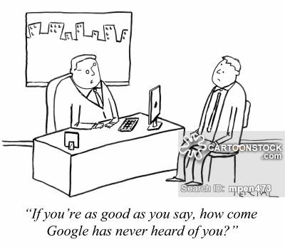
What is online reputation?
Online activity and content that shapes public perception
Google yourself – what pops up?

Slide 3
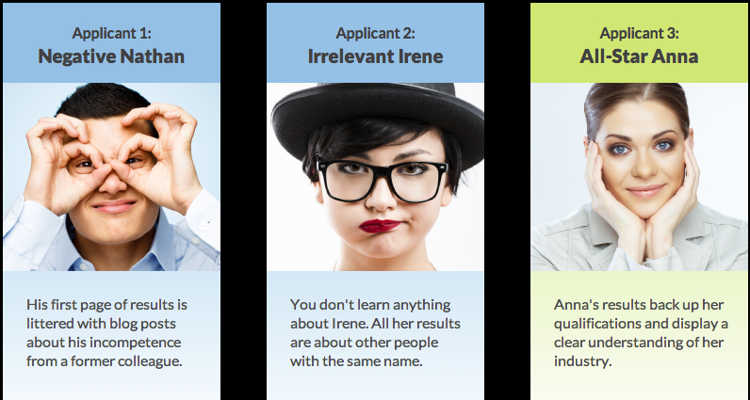
Online Reputation
Online reputation can make or break your job search
Personal branding is necessary today
According to The Creative Group, 86% of executives surveyed say they’re likely to search online for information about potential hires.

Slide 4
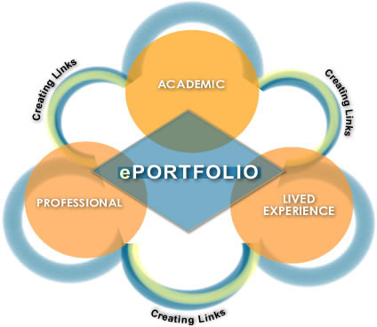
Online Reputation
According to CareerBuilder’s annual social media recruitment survey (2016), 59% of hiring managers use search engines to research candidates.
Hiring managers are “looking for information that supports their qualifications for the job.”
53% percent of hiring managers want to see if the candidate has a professional online persona.
ePortfolios provide these answers.

Slide 5
Online Reputation
Online presence is more than just what you post online. Content, timing and location are important.
“Candidates who look good on paper but who lack an active online presence can fall to the wayside during the recruiting process.” Diane Domeyer Executive Director of The Creative Group

Slide 6
Online Reputation Tips
Get online and establish your presence (a combination of social media and an eportfolio).
Google yourself often to monitor your online-presence.
Look for aliases.
Maintain your professional presence with frequent updates.

Slide 7
ePortfolio and online presence
ePortfolio can positively impact your online presence if you follow these tips:
Be sure to make several pages of your eportfolio “Public” so they show up in Google searches.
Connect your eportfolio with your social media pages so people can find you more easily.
Include a link to eportfolio in your email signature
Place epotfolio link on your resume

Slide 8
ePortfolios and employers
Most research on employer use of eportfolios in the hiring process shows that many are still unfamiliar with the concept.
Those hiring managers familiar with eportfolio would like to see the following content:
evidence and background relevant to the job application; applicants critiquing something;
evidence of learning, progress, thinking, judgement;
and offering information more visually (Watty & McKay).

Slide 9
ePortfolio Project
Graduate students in Industry Theory and Practice create an eportfolio showcasing their academic, professional and personal interests. This semester-long project is a requirement for all students in the Master's in Communication Arts program at Pace.
Students are also required to present their ePortfolios to the class and provide feedback on their peers' work through ePortfolio.

Slide 10
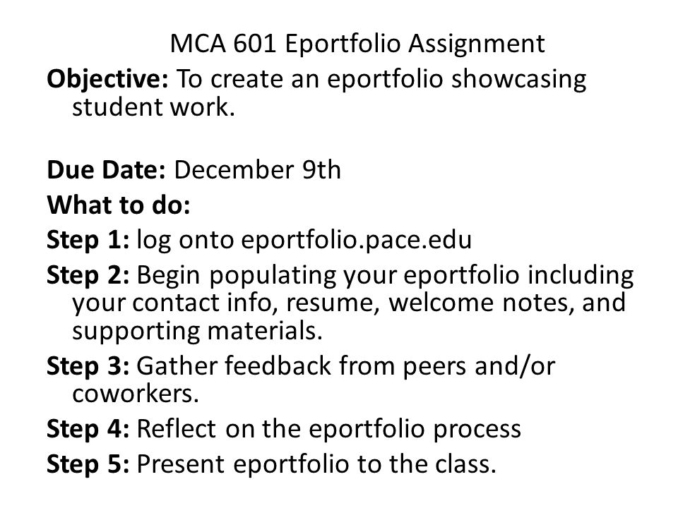

Slide 11
Grad Student Testimonials - ePortfolio Reflections
"The general assignment of developing, creating and implementing an ePortfolio is and will continue to be extremely useful in my career. It gave me the opportunity to rediscover my successes throughout my academic and professional career. Unlike many social networking sites, I can monitor and control all aspects of the material and opinions expressed through privacy settings." Lisa Lazzari
"Being able to add your own personal touches to the pages makes the e-Portfolio website a great tool for job seekers. I personally like the fact that I can upload multiple writing samples, as well as pictures, to show future employers my accomplishments, and my life outside of work. I think that being able to show potential employers a little bit of your personal life shows that you have more depth." Carly Steet "I don't believe my professional experience is summarized by my resume. I am unique and viewing my ePortfolio will provide an overall view of who I am as a person and what I have to offer any potential employer, group, professional organization or committee. This is a wonderful tool, which in a sense is an evolving "live" resume. I will keep updating this as my studies progress and keep it current as a professional and academic tool." Joanne DeMarco

Slide 12
Grad Student Testimonials
“[My] interview process was very intense and lengthy and according to my new boss they received over 100 applications. I wanted to let you know that it was the e-portfolio that I developed and maintained in your Industry Theory & Practice Class that my boss told me set me apart from the steep competition and made HR want me. I can now say that I just turned 23 and I am employed in my major's field full time with a competitive salary and benefits.” - Harrison C. Davies

Slide 13
Graduate Student ePortfolios
Grace Telesco
Camilla Klaevold

Slide 14
Contact Info
Dr. Michelle Pulaski Behling Associate Professor Media and Communication Arts Pace University
mpulaskibehling@pace.edu
https://eportfolio.pace.edu/user/view.php?id=202

