Slide 1
Organizational Behavior 15th Ed
Chapter 7
Robbins and Judge
Motivational Concepts
Notes:
Chapter 7 introduces us to the concepts of motivation. These are topics that pervade the workplace providing opportunity for managers and leaders to be more effective and efficient in accomplishing work. So, this is an important set of concepts to focus on.

Slide 2
Chapter 7 Learning Objectives
After studying this chapter you should be able to:
Describe the three key elements of motivation.
Identify early theories of motivation and evaluate their applicability today.
Apply the predictions of self-determination theory to intrinsic and extrinsic rewards.
Understand the implications of employee engagement for management.
Compare and contrast goal setting theory and management by objectives.
Contrast reinforcement theory and goal-setting theory.
Demonstrate how organizational justice is a refinement of equity theory.
Apply the key tenets of expectancy theory to motivating employees.
Compare contemporary theories of motivation.
Notes:
We begin this chapter with a definition of the nine learning objectives defined for chapter’s contents. We will discuss each of these in some detail.

Slide 3
Describe the three key elements of motivation
LO 1
Many people incorrectly view motivation as a personal trait.
Motivation is “the processes that account for an individual’s intensity, direction, and persistence of effort toward attaining a goal.”
We will narrow the focus to organizational goals in order to reflect our singular interest in work-related behavior.
Notes:
Many people incorrectly view motivation as a personal trait—that is, some have it and others do not. Motivation is the result of the interaction of the individual and the situation. Our Definition of Motivation is that it is “the processes that account for an individual’s intensity, direction, and persistence of effort toward attaining a goal.” We will narrow the focus to organizational goals in order to reflect our singular interest in work-related behavior.

Slide 4
Describe the three key elements of motivation
LO 1
The three key elements of our definition are intensity, direction, and persistence:
Intensity is concerned with how hard a person tries.
Direction is the orientation that benefits the organization.
Persistence is a measure of how long a person can maintain his/her effort.
Notes:
The three key elements of our definition of motivation are intensity, direction, and persistence. Intensity is concerned with how hard a person tries to do anything. This is the element most of us focus on when we talk about motivation. Direction is the orientation that benefits the organization. It can be positive or negative. Persistence is a measure of how long a person can maintain his or her effort. Motivated individuals stay with a task long enough to achieve their goal.

Slide 5
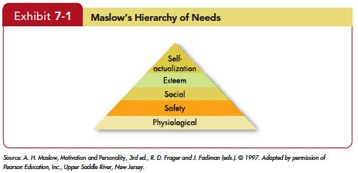
Identify early theories of motivation and evaluate their applicability today
LO 2
Notes:
Abraham Maslow’s hierarchy of needs is the most well known theory of motivation. He hypothesized that within every human being there exists a hierarchy of five needs. These begin with Physiological needs that include hunger, thirst, shelter, sex, and other bodily needs. The second level is Safety needs that include security and protection from physical and emotional harm. The next level is Social needs and it includes affection, belongingness, acceptance, and friendship. Reaching a higher level we find Esteem needs that includes internal esteem factors such as self-respect, autonomy, and achievement; and external esteem factors such as status, recognition, and attention. At the top of the hierarchy is Self-actualization needs. This is the drive to become what one is capable of becoming; includes growth, achieving one’s potential, and self-fulfillment.
As a need becomes substantially satisfied, the next need becomes dominant. No need is ever fully gratified; a substantially satisfied need no longer motivates.
.

Slide 6
Identify early theories of motivation and evaluate their applicability today
LO 2
Maslow’s need theory has received wide recognition, particularly among practicing managers.
Research does not generally validate the theory.
Some researchers have attempted to revive components of the need hierarchy concept, using principles from evolutionary psychology.
Notes:
Maslow’s need theory has received wide recognition, particularly among practicing managers. Research does not generally validate the theory. Maslow provided no empirical substantiation, and several studies that sought to validate the theory found no support for it. Some researchers have attempted to revive components of the need hierarchy concept, using principles from evolutionary psychology. Time will tell whether these revisions to Maslow’s hierarchy will be useful to practicing managers.

Slide 7
Identify early theories of motivation and evaluate their applicability today
LO 2
Theory X assumptions are basically negative.
Employees inherently dislike work and, whenever possible, will attempt to avoid it.
They must be coerced, controlled, or threatened with punishment.
Theory Y assumptions are basically positive.
Employees can view work as being as natural as rest or play.
Notes:
Douglas McGregor’s Theory X and Theory Y concluded that a manager’s view of the nature of human beings is based on a certain grouping of assumptions and he or she tends to mold his or her behavior toward employees according to these assumptions.
Theory X assumptions are basically negative. Employees inherently dislike work and, whenever possible, will attempt to avoid it. Since employees dislike work, they must be coerced, controlled, or threatened with punishment. Employees will avoid responsibilities and seek formal direction whenever possible. Most workers place security above all other factors and will display little ambition.
Theory Y assumptions are basically positive. Employees can view work as being as natural as rest or play. People will exercise self-direction and self-control if they are committed to the objectives.

Slide 8
Identify early theories of motivation and evaluate their applicability today
LO 2
The implications for managers are best explained by using Maslow’s framework:
Theory X: lower-order needs dominate individuals.
Theory Y: higher-order needs dominate individuals.
McGregor himself believed that Theory Y assumptions were more valid than Theory X.
No evidence to confirm that either of is valid.
Notes:
What are the implications for managers? This is best explained by using Maslow’s framework Theory X assumes that lower-order needs dominate individuals. Theory Y assumes that higher-order needs dominate individuals. McGregor himself held to the belief that Theory Y assumptions were more valid than Theory X. There is no evidence to confirm that either set of assumptions is valid.

Slide 9
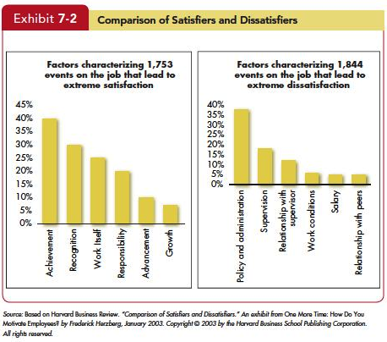
Identify early theories of motivation and evaluate their applicability today
LO 2
Notes:
The Two-Factor Theory is sometimes also called motivation-hygiene theory. Proposed by psychologist Frederick Herzberg when he investigated the question, “What do people want from their jobs?” He asked people to describe, in detail, situations in which they felt exceptionally good or bad about their jobs. These responses were then tabulated and categorized. From the categorized responses, Herzberg concluded that Intrinsic factors, such as advancement, recognition, responsibility, and achievement seem to be related to job satisfaction. Dissatisfied respondents tended to cite extrinsic factors, such as supervision, pay, company policies, and working conditions. The opposite of satisfaction is not dissatisfaction. Removing dissatisfying characteristics from a job does not necessarily make the job satisfying. Job satisfaction factors are separate and distinct from job dissatisfaction factors.

Slide 10
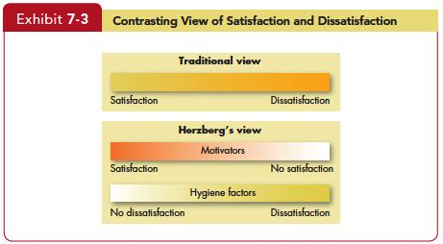
Identify early theories of motivation and evaluate their applicability today
LO 2
Notes:
Managers who eliminate job dissatisfaction factors may not necessarily bring about motivation. Please look at Exhibit 7-3. It reveals that when hygiene factors are adequate, people will not be dissatisfied. Neither will they be satisfied. To motivate people, managers must emphasize factors intrinsically rewarding that are associated with the work itself or to outcomes directly derived from it.

Slide 11
Identify early theories of motivation and evaluate their applicability today
LO 2
Criticisms of Herzberg’s theory:
The procedure is limited by its methodology.
The reliability of methodology is questioned.
No overall measure of satisfaction was utilized.
Herzberg assumed a relationship between satisfaction and productivity, but the research methodology he used looked only at satisfaction, not at productivity.
Notes:
Recent review of Herzberg’s research has resulted in many criticisms of the theory. For example, The procedure that Herzberg used is limited by its methodology. The reliability of Herzberg’s methodology is questioned. No overall measure of satisfaction was utilized. Herzberg assumed a relationship between satisfaction and productivity, but the research methodology he used looked only at satisfaction, not at productivity.
Regardless of criticisms, Herzberg’s theory has been widely read, and few managers are unfamiliar with his recommendations. The popularity of vertically expanding jobs to allow workers greater responsibility can probably be attributed to Herzberg’s findings.

Slide 12
Identify early theories of motivation and evaluate their applicability today
LO 2
McClelland’s Theory of Needs
The theory focuses on three needs: achievement, power, and affiliation.
Need for achievement need (nAch)
The drive to excel, to achieve in relation to a set of standards, to strive to succeed.
Notes:
The next traditional theory is McClelland’s Theory of Needs. This theory focuses on three needs: achievement, power, and affiliation. Let’s look at each one for a minute.
The first of this theory’s variables is achievement need, which is abbreviated nAch, and is the drive to excel, to achieve in relation to a set of standards, to strive to succeed. High achievers perform best when they perceive their probability of success as 50-50. They like to set goals that require stretching themselves a little.

Slide 13
Identify early theories of motivation and evaluate their applicability today
LO 2
Need for achievement predicted Relationships
With a high degree of personal responsibility and feedback and an intermediate degree of risk, high achievers are strongly motivated.
A high need to achieve does not necessarily make someone a good manager, especially in large organizations.
Needs for affiliation and power tend to be closely related to managerial success.
Notes:
Predicted relationships from this variable can be seen when jobs have a high degree of personal responsibility and feedback and an intermediate degree of risk, high achievers are strongly motivated. A high need to achieve does not necessarily make someone a good manager, especially in large organizations. Needs for affiliation and power tend to be closely related to managerial success. The view that a high achievement need acts as an internal motivator presupposes two U.S. cultural characteristics—Willingness to accept a moderate degree of risk (which excludes countries with strong uncertainty-avoidance characteristics) and Concern with performance (which applies to countries with strong achievement characteristics).

Slide 14
Identify early theories of motivation and evaluate their applicability today
LO 2
Need for power: The need to make others behave in a way that they would not have behaved otherwise.
Individuals high in nPow enjoy being “in charge.”
Strive for influence over others.
Prefer to be placed into competitive and status-oriented situations.
Notes:
Need for power, the second variable, is the need to make others behave in a way that they would not have behaved otherwise. The need for power is abbreviated nPow and is the desire to have impact, to be influential, and to control others. Individuals high in nPow enjoy being “in charge.” They strive for influence over others. They prefer to be placed into competitive and status-oriented situations. And they tend to be more concerned with prestige and gaining influence over others than with effective performance.

Slide 15
Identify early theories of motivation and evaluate their applicability today
LO 2
McClelland’s theory has had the best support.
It has less practical effect than the others.
Because McClelland argued that the three needs are subconscious—we may rank high on them but not know it—measuring them is not easy.
However, the process is time consuming and expensive, and few organizations have been willing to invest in measuring McClelland’s concept.
Notes:
Among the early theories of motivation McClelland’s has had the best research support. Unfortunately, it has less practical effect than the others. McClelland argued that the three needs are subconscious. We may rank high on them but not know it. Because of this measuring them is not easy. In the most common approach, a trained expert presents pictures to individuals, asks them to tell a story about each, and then scores their responses in terms of the three needs. However, the process is time consuming and expensive, and few organizations have been willing to invest in measuring McClelland’s concept.

Slide 16
Apply the predictions of self-determination theory to intrinsic and extrinsic rewards
LO 3
Proposes that people prefer to feel they have control over their actions.
Research on self-determination theory has focused on cognitive evaluation theory.
People paid for work feel less like they want to do it and more like they have to it.
Proposes that in addition to being driven by a need for autonomy, people seek ways to achieve competence and positive connections to others.
Notes:
Self Determination Theory, one of the first contemporary theories, proposes that people prefer to feel they have control over their actions, so anything that makes a previously enjoyed task feel more like an obligation than a freely chosen activity will undermine motivation. Much research on self-determination theory in OB has focused on cognitive evaluation theory, which hypothesizes that extrinsic rewards will reduce intrinsic interest in a task. When people are paid for work, it feels less like something they want to do and more like something they have to do. Self-determination theory also proposes that in addition to being driven by a need for autonomy, people seek ways to achieve competence and positive connections to others. A large number of studies support self-determination theory. Its major implications relate to work rewards.

Slide 17
Apply the predictions of self-determination theory to intrinsic and extrinsic rewards
LO 3
Extrinsic rewards used as payoffs for performance, employees feel they are doing a good job.
Eliminating extrinsic rewards can also shift an individual’s perception of why she works on a task from an external to an internal explanation.
Self-determination theory acknowledges that extrinsic rewards can improve even intrinsic motivation under specific circumstances.
Notes:
When organizations use extrinsic rewards as payoffs for superior performance, employees feel they are doing a good job less because of their own intrinsic desire to excel than because that’s what the organization wants. Eliminating extrinsic rewards can also shift an individual’s perception of why she works on a task from an external to an internal explanation. If you’re reading a novel a week because your English literature instructor requires you to, you can attribute your reading behavior to an external source. However, if you find yourself continuing to read a novel a week after the course is over, your natural inclination is to say, “I must enjoy reading novels because I’m still reading one a week.” Studies examining how extrinsic rewards increased motivation for some creative tasks suggest we might need to place cognitive evaluation theory’s predictions in a broader context. Goal setting is more effective in improving motivation, for instance, when we provide rewards for achieving the goals. The original authors of self-determination theory acknowledge that extrinsic rewards such as verbal praise and feedback about competence can improve even intrinsic motivation under specific circumstances. Deadlines and specific work standards do, too, if people believe they are in control of their behavior. This is consistent with the central theme of self-determination theory: rewards and deadlines diminish motivation if people see them as coercive.

Slide 18
Apply the predictions of self-determination theory to intrinsic and extrinsic rewards
LO 3
Self-determination theory suggestions for providing rewards.
A senior sales representative may be motivated by a commission.
A computer programmer who values writing code because she likes to solve problems might react negatively to having to write a certain number of lines of code every day.
Notes:
Self-determination theory creates suggestions for providing rewards If a senior sales representative really enjoys selling and making the deal, a commission indicates she’s been doing a good job and increases her sense of competence by providing feedback that could improve intrinsic motivation. If a computer programmer values writing code because she likes to solve problems, a reward for working to an externally imposed standard she does not accept, such as writing a certain number of lines of code every day, could feel coercive, and her intrinsic motivation would suffer. She would be less interested in the task and might reduce her effort.

Slide 19
Apply the predictions of self-determination theory to intrinsic and extrinsic rewards
LO 3
A recent outgrowth of self-determination theory is self-concordance, which considers how strongly peoples’ reasons for pursuing goals are consistent with their interests and core values.
Notes:
A recent outgrowth of self-determination theory is self-concordance, which considers how strongly peoples’ reasons for pursuing goals are consistent with their interests and core values. If individuals pursue goals because of an intrinsic interest, they are more likely to attain their goals and are happy even if they do not. The process of striving toward them is fun. In contrast, people who pursue goals for extrinsic reasons (money, status, or other benefits) are less likely to attain their goals and less happy even when they do. Because the goals are less meaningful to them. OB research suggests that people who pursue work goals for intrinsic reasons are more satisfied with their jobs, feel they fit into their organizations better, and may perform better.

Slide 20
Apply the predictions of self-determination theory to intrinsic and extrinsic rewards
LO 3
Implications
For individuals, it means choose your job for reasons other than extrinsic rewards.
For organizations, it means managers should provide intrinsic as well as extrinsic incentives.
Notes:
The Implications for extrinsic and intrinsic rewards can be summed up. First, for individuals, it means to choose your job for reasons other than extrinsic rewards. For organizations, it means managers should provide intrinsic as well as extrinsic incentives. They need to make the work interesting, provide recognition, and support employee growth and development. Employees who feel what they do is within their control and a result of free choice are likely to be more motivated by their work and committed to their employers.

Slide 21
Understand the implications of employee engagement for management
LO 4
Job engagement, the investment of an employee’s physical, cognitive, and emotional energies into job performance.
Many studies attempt to measure this deeper level of commitment.
Academic studies have also found positive outcomes.
Notes:
Job engagement is the investment of an employee’s physical, cognitive, and emotional energies into job performance. Practicing managers and scholars alike have lately become interested in facilitating job engagement, believing something deeper than liking a job or finding it interesting drives performance. Many studies attempt to measure this deeper level of commitment. The Gallup organization has been using 12 questions to assess the extent to which employee engagement is linked to positive work outcomes for millions of employees over the past 30 years. There are far more engaged employees in highly successful than in average organizations, and groups with more engaged employees have higher levels of productivity, fewer safety incidents, and lower turnover. Academic studies have also found positive outcomes. One examined multiple business units for their level of engagement and found a positive relationship with a variety of practical outcomes. Another reviewed 91 distinct investigations and found higher levels of engagement associated with task performance and citizenship behavior.

Slide 22
Understand the implications of employee engagement for management
LO 4
One key to increasing job engagement is the degree to which an employee believes it is meaningful to engage in work.
Another factor is a match between the individual’s values and the organization’s.
Leadership behaviors that inspire workers to a greater sense of mission.
Notes:
What makes people more likely to be engaged in their jobs? One key is the degree to which an employee believes it is meaningful to engage in work. This is partially determined by job characteristics and access to sufficient resources to work effectively. Another factor is a match between the individual’s values and those of the organization. And, leadership behaviors that inspire workers to a greater sense of mission also increase employee engagement.

Slide 23
Understand the implications of employee engagement for management
LO 4
Construct is partially redundant with job attitudes.
May also predict work outcomes better than job attitudes.
May be a “dark side”, as evidenced by positive relationships between engagement and work-family conflict.
Notes:
One of the critiques of engagement is that the construct is partially redundant with job attitudes like satisfaction or stress. However, engagement questionnaires usually assess motivation and absorption in a task, quite unlike job satisfaction questionnaires. Engagement may also predict important work outcomes better than traditional job attitudes. Others critics note there may be a “dark side” to engagement, as evidenced by positive relationships between engagement and work-family conflict. Individuals might grow so engaged in their work roles that family responsibilities become an unwelcome intrusion. Further research exploring how engagement relates to these negative outcomes may help clarify whether some highly engaged employees might be getting “too much of a good thing.”

Slide 24
Compare and contrast goal setting theory and management by objectives
LO 5
Goal-Setting Theory proposed by Edwin Locke.
Goals tell an employee what needs to be done and how much effort is needed.
Evidence strongly suggests
that specific goals increase performance,
that difficult goals, when accepted, result in higher performance than do easy goals; and
that feedback leads to higher performance than does nonfeedback.
Notes:
In the late 1960s, Edwin Locke proposed that intentions to work toward a goal are a major source of work motivation. Goals tell an employee what needs to be done and how much effort is needed. Evidence strongly suggests that specific goals increase performance, that difficult goals, when accepted, result in higher performance than do easy goals; and that feedback leads to higher performance than does nonfeedback. Specific hard goals produce a higher level of output than do the generalized goals. If factors like ability and acceptance of the goals are held constant, we can also state that the more difficult the goal, the higher the level of performance.
Why are people motivated by difficult goals? Challenging goals get our attention and thus tend to help us focus. Difficult goals energize us because we have to work harder to attain them. When goals are difficult, people persist in trying to attain them. Difficult goals lead us to discover strategies that help us perform the job or task more effectively. People will do better when they get feedback on how well they are progressing toward their goals. Self-generated feedback is more powerful a motivator than externally generated feedback. The evidence is mixed regarding the superiority of participative over assigned goals. If employees have the opportunity to participate in the setting of their own goals, will they try harder? A major advantage of participation may be in increasing acceptance. If people participate in goal setting, they are more likely to accept even a difficult goal than if they are arbitrarily assigned it by their boss. Evidence strongly suggests that specific goals increase performance, that difficult goals, when accepted, result in higher performance than do easy goals; and that feedback leads to higher performance than does nonfeedback. If participation isn’t used, then the individual assigning the goal needs to clearly explain its purpose and importance.

Slide 25
Compare and contrast goal setting theory and management by objectives
LO 5
There are contingencies in goal-setting theory.
Feedback,
Performance relationship,
Goal commitment, task characteristics, and
National culture.
Notes:
There are contingencies in goal-setting theory. In addition to feedback, three other factors influence the goals-performance relationship, goal commitment, task characteristics, and national culture.
Goal-setting theory presupposes that an individual is committed to the goal. He or she believes they can achieve the goal and They want to achieve it. Goal commitment is most likely to occur when goals are made public, when the individual has an internal locus of control, and when the goals are self-set rather than assigned.
Goals themselves seem to affect performance more strongly when tasks are simple rather than complex, well learned rather than novel, and independent rather than interdependent. On interdependent tasks, group goals are preferable.
National culture. Goal-setting theory is culture bound and it is well adapted to North American cultures, where individual achievement and performance are most highly valued. To date, research has not shown that group-based goals are more effective in collectivists than in individualist cultures. In collectivistic and high-power-distance cultures, achievable moderate goals can be more highly motivating than difficult ones. Finally, assigned goals appear to generate greater goal commitment in high than in low power-distance cultures. More research is needed to assess how goal constructs might differ across cultures.

Slide 26
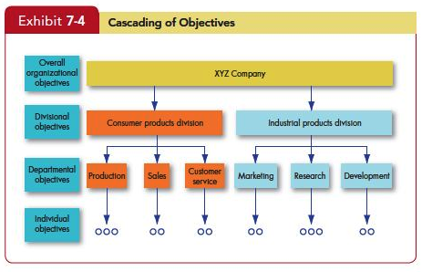
Compare and contrast goal setting theory and management by objectives
LO 5
Notes:
How do you make goal-setting operation in practice? Management by Objectives (MBO) allows employees to participatively set goals that are tangible, verifiable, and measurable. Organization’s overall objectives are translated into specific objectives for each succeeding level. Four Ingredients common to MBO programs: Goal specificity, Participation in decision making, Explicit time period, Performance feedback. MBO programs are common in many business, health care, educational, government, and nonprofit organizations.

Slide 27
Self-Efficacy Theory
Self-Efficacy Theory
Enactive mastery
Vicarious modeling
Verbal persuasion
Arousal
Known also as social cognitive theory and social learning theory
Notes:
Self-Efficacy Theory is a new theory gaining much attention. Albert Bandura, developer of self-efficacy theory defined four characteristics. First is Enactive mastery that is gaining relevant experience with the task or job. Second is Vicarious modeling, or becoming more confident because you see someone else doing the task. Third is Verbal persuasion when a person is more confident because someone convinces you that you have the skills. And lastly is Arousal that leads to an energized state driving a person to complete the task. This theory is also known also as social cognitive theory and social learning theory

Slide 28
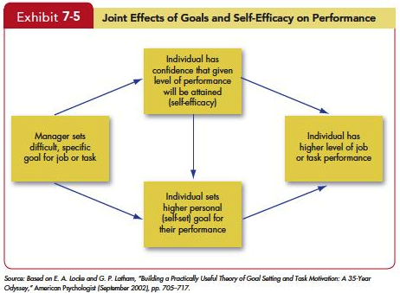
Self-Efficacy Theory
Notes:
Goal setting theory and self-efficacy theory don’t compete with one another; they complement each other as shown in Exhibit 7–5.

Slide 29
Self-Efficacy Theory
Implications of Efficacy Theory
Training programs often make use of enactive mastery by having people practice and build their skills.
The best way for a manager to use verbal persuasion is through the Pygmalion effect or the Galatea effect.
Intelligence and personality are absent from Bandura’s list, but they can increase self-efficacy.
Notes:
The implications of Efficacy Theory are many. First, training programs often make use of enactive mastery by having people practice and build their skills. In fact, one reason training works is that it increases self-efficacy. Individuals with higher levels of self-efficacy also appear to reap more benefits from training programs and are more likely to use their training on the job. The best way for a manager to use verbal persuasion is through the Pygmalion effect or the Galatea effect.
As discussed in Chapter 5, the Pygmalion effect is a form of self-fulfilling prophecy in which believing something can make it true. In some studies, teachers were told their students had very high IQ scores when in fact they spanned a range from high to low. Consistent with the Pygmalion effect, the teachers spent more time with the students they thought were smart, gave them more challenging assignments, and expected more of them—all of which led to higher student self-efficacy and better grades. This strategy also has been used in the workplace. Sailors who were told convincingly that they would not get seasick were in fact much less likely to do so. Intelligence and personality are absent from Bandura’s list, but they can increase self-efficacy. People who are intelligent, conscientiousness, and emotionally stable are so much more likely to have high self-efficacy that some researchers argue self-efficacy is less important than prior research would suggest. They believe it is partially a by-product in a smart person with a confident personality. Although Bandura strongly disagrees with this conclusion, more research is needed.

Slide 30
Contrast reinforcement theory and goal-setting theory
LO 6
Goal-Setting vs. Reinforcement Theory
Goal-setting is a cognitive approach, proposing that an individual’s purposes direct his action.
Reinforcement theory, in contrast, takes a behavioristic view, arguing that reinforcement conditions behavior.
The two theories are clearly at odds philosophically. Reinforcement theorists see behavior as environmentally caused.
Notes:
Let’s look at a contrast between Goal-Setting and Reinforcement Theory. Goal-setting is a cognitive approach, proposing that an individual’s purposes direct his action. Reinforcement theory, in contrast, takes a behavioristic view, arguing that reinforcement conditions behavior. The two theories are clearly at odds philosophically. Reinforcement theorists see behavior as environmentally caused. You need not be concerned, they would argue, with internal cognitive events, that is, what controls behavior are reinforcers. Any consequences that, when immediately following responses, increase the probability that the behavior will be repeated.

Slide 31
Contrast reinforcement theory and goal-setting theory
LO 6
Reinforcement theory ignores the inner state of the individual and concentrates solely on what happens when he or she takes some action.
Operant conditioning theory argues that people learn to behave to get something they want or to avoid something they don’t want.
Notes:
Reinforcement theory ignores the inner state of the individual and concentrates solely on what happens when he or she takes some action. Because it does not concern itself with what initiates behavior, it is not, strictly speaking, a theory of motivation. But it does provide a powerful means of analyzing what controls behavior, and this is why we typically consider it in discussions of motivation.
Operant conditioning theory argues that people learn to behave to get something they want or to avoid something they don’t want. Unlike reflexive or unlearned behavior, operant behavior is influenced by the reinforcement or lack of reinforcement brought about by its consequences. Reinforcement strengthens a behavior and increases the likelihood it will be repeated. B. F. Skinner, one of the most prominent advocates of operant conditioning, argued that creating pleasing consequences to follow specific forms of behavior would increase the frequency of that behavior. He demonstrated that people will most likely engage in desired behaviors if they are positively reinforced for doing so; that rewards are most effective if they immediately follow the desired response; and that behavior that is not rewarded, or is punished, is less likely to be repeated.

Slide 32
Contrast reinforcement theory and goal-setting theory
LO 6
In its pure form, reinforcement theory ignores feelings, attitudes, expectations, and other cognitive variables known to affect behavior.
Some researchers look at the same experiments reinforcement theorists use to support their position and interpret the findings in a framework.
Reinforcement is undoubtedly an important influence on behavior, but few scholars are prepared to argue it is the only one.
Notes:
In its pure form, reinforcement theory ignores feelings, attitudes, expectations, and other cognitive variables known to affect behavior. In fact, some researchers look at the same experiments reinforcement theorists use to support their position and interpret the findings in a framework. Reinforcement is undoubtedly an important influence on behavior, but few scholars are prepared to argue it is the only one. The behaviors you engage in at work and the amount of effort you allocate to each task are affected by the consequences that follow. If you’re consistently reprimanded for out producing your colleagues, you’ll likely reduce your productivity. But we might also explain your lower productivity in terms of goals, inequity, or expectancies.

Slide 33
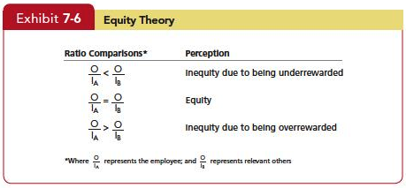
Demonstrate how organizational justice is a refinement of equity theory
LO 7
Notes:
What role does equity play in motivation? An employee with several years experience can be frustrated to find out that a recent college grad hired at a salary level higher than he or she is currently earning, causing motivation levels to drop. Why? Employees make comparisons of their job inputs and outcomes relative to those of others. See Exhibit 7-6. If we perceive our ratio to be equal to that of the relevant others with whom we compare ourselves, a state of equity is said to exist. We perceive our situation as fair. When we see the ratio as unequal, we experience equity tension. Additionally, the referent that an employee selects adds to the complexity of equity theory. There are four referent comparisons that an employee can use. First is Self-inside, which is based on an employee’s experiences in a different position inside his or her current organization. Second is Self-outside, which is based on an employee’s experiences in a situation or position outside his or her current organization. Third is Other-inside where another individual or group of individuals inside the employee’s organization Is the basis of comparison. Other-outside: Another individual or group of individuals outside the employee’s organization work and the amount of effort you allocate to each task are affected by the consequences that follow. If you’re consistently reprimanded for out producing your colleagues, you’ll likely reduce your productivity. But we might also explain your lower productivity in terms of goals, inequity, or expectancies.

Slide 34
Demonstrate how organizational justice is a refinement of equity theory
LO 7
Which referent an employee chooses will be influenced by the information the employee holds about referents, as well as by the attractiveness of the referent.
Gender
Length of tenure
Level in the organization
Professional ranks and higher education
Notes:
Which referent an employee chooses will be influenced by the information the employee holds about referents, as well as by the attractiveness of the referent. There are four moderating variables. They are gender, length of tenure, level in the organization, and amount of education or professionalism. Let’s consider each.
First is gender. Men and women prefer same-sex comparisons. This also suggests that if women are tolerant of lower pay, it may be due to the comparative standard they use. Employees in jobs that are not sex-segregated will make more cross-sex comparisons than those in jobs that are either male- or female-dominated. Second is length of tenure. Employees with short tenure in their current organizations tend to have little information about others. Employees with long tenure rely more heavily on coworkers for comparison. Third is level in the organization Upper-level employees tend to be more cosmopolitan and have better information about people in other organizations. Therefore, these types of employees will make more other-outside comparisons. The amount of education or professionalism can contribute here. Employees with higher education are more likely to include others outside the organization as referent points Last is Professional ranks and higher Education. Upper-level employees, those in the professional ranks, and those with higher amounts of education tend to have better information about people in other organizations and will make more other–outside comparisons.

Slide 35
Demonstrate how organizational justice is a refinement of equity theory
LO 7
When employees perceive an inequity, they can be predicted to make one of six choices:
Change their inputs.
Change their outcomes.
Distort perceptions of self.
Distort perceptions of others.
Choose a different referent.
Leave the field.
Notes:
When employees perceive an inequity, they can be predicted to make one of six choices. They can change their inputs. They can change their outcomes. They can distort perceptions of self. They can distort perceptions of others. They can choose a different referent. Or, they can leave the field.

Slide 36
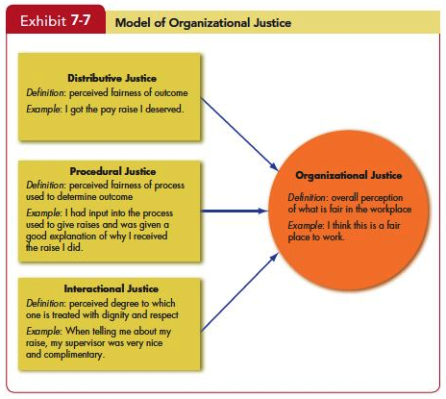
Demonstrate how organizational justice is a refinement of equity theory
LO 7
Notes:
But organizational justice draws a bigger picture. Exhibit 7-7 shows a model of organizational justice. Employees perceive their organizations as just when they believe rewards and the way they are distributed are fair. In general, people see allocations or procedure favoring themselves as fair. Few people really make mathematical calculations of their inputs relative to the outcomes of others. They base distributive judgments on a feeling or an emotional reaction to how they think they are treated relative to others, and their reactions are often emotional as well. Our discussion has also focused on reactions to personal mistreatment. People react emotionally to injustices committed against others, prompting them to take retributive actions. The other key element of organizational justice is the view that justice is multidimensional. How much we get paid relative to what we think we should be paid (distributive justice) is obviously important. But, according to researchers, how we get paid is just as important. Thus the model of organizational justice includes procedural justice—the perceived fairness used to determine the distribution of rewards. Two key elements of procedural justice are process control and explanations. Process control is the opportunity to present your point of view about desired outcomes to decision makers. Explanations are clear reasons management gives for the outcome. Thus, for employees to see a process as fair, they need to feel they have some control over the outcome and that they were given an adequate explanation about why the outcome occurred. It’s also important that a manager is consistent (across people and over time), is unbiased, makes decisions based on information, and is open to appeals. The effects of procedural justice become more important when distributive justice is lacking. If we don’t get what we want, we tend to focus on why. If your supervisor gives a cushy office to a co-worker instead of to you, you’re much more focused on your supervisor’s treatment of you than if you had gotten the office. Explanations are beneficial when they take the form of post hoc excuses (“I know this is bad, and I wanted to give you the office, but it wasn’t my decision”) rather than justifications (“I decided to give the office to Sam, but having it isn’t a big deal.”). Interactional justice describes an individual’s perception of the degree to which she is treated with dignity, concern, and respect. When people are treated in an unjust manner (at least in their own eyes), they retaliate (for example, badmouthing a supervisor). Because people intimately connect interactional justice or injustice to the conveyer of the information, we would expect perceptions of injustice to be more closely related to the supervisor. Of these three forms of justice, Distributive justice is most strongly related to organizational commitment and satisfaction with outcomes such as pay. Procedural justice relates most strongly to job satisfaction, employee trust, withdrawal from the organization, job performance, and citizenship behaviors. There is less evidence about interactional justice.

Slide 37
Apply the key tenets of expectancy theory to motivating employees
LO 8
Expectancy Theory argues that a tendency to act in a certain way depends on an expectation that the act will be followed by a given outcome and the attractiveness of that outcome to the individual.
An employee will be motivated to exert a high level of effort when he/she believes that:
Effort will lead to a good performance appraisal.
A good appraisal will lead to rewards.
The rewards will satisfy his/her personal goals.
Notes:
Expectancy theory is one of the most widely accepted explanations of motivation. Victor Vroom’s expectancy theory has its critics but most of the research is supportive. Expectancy theory argues that the strength of a tendency to act in a certain way depends on the strength of an expectation that the act will be followed by a given outcome and on the attractiveness of that outcome to the individual. It says that an employee will be motivated to exert a high level of effort when he/she believes that effort will lead to a good performance appraisal. That a good appraisal will lead to organizational rewards, and that the rewards will satisfy his/her personal goals.

Slide 38
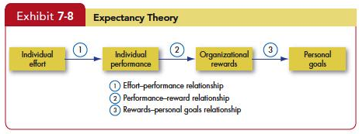
Apply the key tenets of expectancy theory to motivating employees
LO 8
Notes:
Three key relationships in Expectancy Theory include the Effort-performance relationship, which is the the probability perceived by the individual that exerting a given amount of effort will lead to performance. Second, Performance-reward relationship is the degree to which the individual believes that performing at a particular level will lead to the attainment of a desired outcome. And third, Rewards-personal goals relationship is the degree to which organizational rewards satisfy an individual’s personal goals or needs and the attractiveness of those potential rewards for the individual.

Slide 39
Apply the key tenets of expectancy theory to motivating employees
LO 8
The key to expectancy theory is the understanding of an individual’s goals and the linkage between effort and performance, between performance and rewards, and finally, between the rewards and individual goal satisfaction.
Some critics suggest that the theory has only limited use, arguing that it tends to be more valid for predicting in situations where effort-performance and performance-reward linkages are clearly perceived by the individual.
Notes:
The key to expectancy theory is the understanding of an individual’s goals and the linkage between effort and performance, between performance and rewards, and finally, between the rewards and individual goal satisfaction. Some critics suggest that the theory has only limited use, arguing that it tends to be more valid for predicting in situations where effort-performance and performance-reward linkages are clearly perceived by the individual.

Slide 40
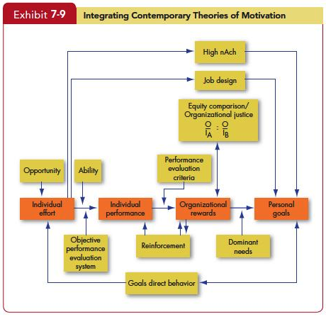
Compare contemporary theories of motivation
LO 9
Notes:
The Model in Exhibit 7–9 integrates much of what we know about motivation. Its basic foundation is the expectancy model. Expectancy theory predicts that an employee will exert a high level of effort if he/she perceives that there is a strong relationship between effort and performance, performance and rewards, and rewards and satisfaction of personal goals. Each of these relationships, in turn, is influenced by certain factors. For effort to lead to good performance, the individual must have the requisite ability to perform, and the performance appraisal system must be perceived as being fair and objective. The final link in expectancy theory is the rewards-goals relationship. The model considers the achievement, need, reinforcement, and equity/organizational justice theories. High achievers are internally driven as long as the jobs they are doing provide them with personal responsibility, feedback, and moderate risks. Reinforcement theory recognizes that the organization’s rewards reinforce the individual’s performance. Individuals will compare the rewards (outcomes) they receive from the inputs they make with the outcome-input ratio of relevant others and inequities may influence the effort expended.

Slide 41
Summary and Implications for Managers
The motivation theories in this chapter differ in their predictive strength.
Need Theories
Self-Determination Theory and Cognitive Evaluation Theory
Goal-Setting Theory
Reinforcement Theory
Equity Theory/Organizational Justice
Expectancy Theory
Notes:
The motivation theories in this chapter differ in their predictive strength. Here, we review the most established to determine their relevance in explaining turnover, productivity, and other outcomes, and assess the predictive power of each. We looked at Need Theories such as Maslow’s hierarchy, McClelland’s needs, and the two-factor theory focus on needs. None has found widespread support, although McClelland’s is the strongest, particularly regarding the relationship between achievement and productivity. In general, need theories are not very valid explanations of motivation. We focused on Self-Determination Theory and Cognitive Evaluation Theory. As research on the motivational effects of rewards has accumulated, it increasingly appears extrinsic rewards can undermine motivation if they are seen as coercive. They can increase motivation if they provide information about competence and relatedness. We looked at Goal-Setting Theory. Clear and difficult goals lead to higher levels of employee productivity, supporting goal-setting theory’s explanation of this dependent variable. The theory does not address absenteeism, turnover, or satisfaction, however. Reinforcement Theory was next one the list. This theory has an impressive record for predicting quality and quantity of work, persistence of effort, absenteeism, tardiness, and accident rates. It does not offer much insight into employee satisfaction or the decision to quit. We went over Equity Theory/Organizational Justice. Equity theory deals with productivity, satisfaction, absence, and turnover variables. However, its strongest legacy is that it provided the spark for research on organizational justice, which has more support in the literature. And we closed with Expectancy Theory. Expectancy theory offers a powerful explanation of performance variables such as employee productivity, absenteeism, and turnover. But it assumes employees have few constraints on decision-making, such as bias or incomplete information, and this limits its applicability. Expectancy theory has some validity because for many behaviors people consider expected outcomes.

Slide 42
All rights reserved. No part of this publication may be reproduced, stored in a retrieval system, or transmitted, in any form or by any means, electronic, mechanical, photocopying, recording, or otherwise, without the prior written permission of the publisher. Printed in the United States of America.
Copyright © 2013 Pearson Education, Inc. publishing as Prentice Hall
Notes:
All rights reserved. No part of this publication may be reproduced, stored in a retrieval system, or transmitted, in any form or by any means, electronic, mechanical, photocopying, recording, or otherwise, without the prior written permission of the publisher. Printed in the United States of America.

