Slide 1
NIGERIA
By Jess, John, & Zach

Slide 2
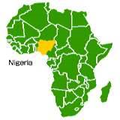
Welcome to Nigeria
Location: Western Africa
Population: 135,031,164
Diversity: Over 250 ethnic groups
Language: Over 500 languages, English is the official language for education, business, and government.
Notes:
Very diverse country
People prefer to speak in their native tribal languages.
Christians mainly live in the south, Muslims in the north. Both religions are often intertwined with indigenous tribal religions that worship spirits and ancestors.

Slide 3
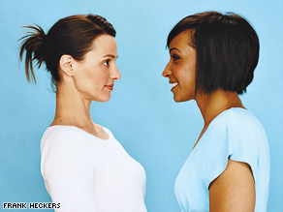
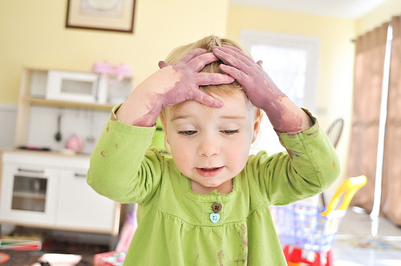
High contact v. Low contact culture

Slide 4
Individualist v. collectivist culture
Nigeria is a super-power in Africa, with educated and industrious people
Extended family support each other, most senior member responsible for decisions that benefits the group
In business meetings Nigerians prefer to see a united front, a reflection of their own belief in collective strength

Slide 5
Conversational Style
Speak in short simple sentences and avoid using jargon and slang when communicating in English.
Conversations may get loud and passionate.
Interrupting others may be considered rude.
It is in your best interest to mask any negative feelings with a smile.
It may jeopardize your relationship if you openly criticize someone, even in a one-on-one setting.

Slide 6
Use of Time
Nigerians tend to distrust people who appear unwilling to spend the time or whose motives for relationship building are unclear.
Health and safety in the workplace still seems to be a new topic in Nigeria.
Government initiatives and programs are focused on providing meaningful work and eradicating poverty in Nigeria.
Workers in the manufacturing sector are either uneducated or minimally educated.

Slide 7
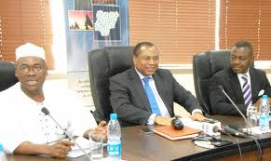
Social Customs
- Age is traditionally very much respected. The oldest person in a group is greeted and served first.
- Greetings consist of a firm handshake with a warm smile.
-In Meetings; it is important to develop personal relationships before conducting business.
Notes:
- Age is traditionally very much respected. The oldest person in a group is greeted and served first. It is widely believed that older people are wiser and are always asked for their opinions first. However, there has been an increase in abuse toward the elderly in recent years. It is expected that their families look after elderly people. Retirement homes are very rare. When people who do not have children reach old age they are often left in poverty with no one to protect them.
_ The most common greeting is a firm handshake with a warm smile. Greetings should never be rushed. As you can see in the picture men may place their left hand, on the right shoulder when shaking hands. Men wait for women to extend their hand first. When greeting elderly people it is respectful to bow your head.
- At the beginning of business meetings, people really take the time to ask about each others personal lives. For instance, they ask how each others families are doing. It is important not to rush these conversations. If people sense that you are rushing it will be very difficult to close a business deal later on. If people are meeting for the first time these conversations can be up to two hours long!

Slide 8
Gender Roles
Generally speaking Nigeria is a patriarchal, male dominated society.
Only 50% of women are literate, compared to 70% of men.
The degree to which gender roles are enforced varies greatly across the county, this is due to:
Various Traditional Tribes
Different Religions
Rural Vs. Urban Areas.
Legal Issues
Notes:
A large number of traditional tribes that exist in the country, each with their own gender roles eg: In the Urhobo tribe in southern Nigeria, a woman is not seen as having an identity of her own. Her identity is established by her husband when she gets married. If a woman is of the age to marry and she does not, she loses her social recognition. In time, she could be perceived to be a prostitute.
- The different religions practiced in the country, each with different gender-oriented practices. Muslim vs Christian.
- Gender roles vary depending on the environment, in rural areas they tend to be more prevalent than in urban areas where woman do work in the corporate sector. Yet they usually occupy positions of lower power and pay. Influential women, who are high in social status are usually in this position because of who they marry.
- Under Nigerian law, women are not afforded the same rights as men. It is not illegal to for husbands to beat their wives as long as no permanent harm is caused.
- However in some farming communities eg the Igbo tribe women do just as much as the labor as men. The crops that are grown in this tribe are divided by gender; yams are seen as men's crops, while beans and cassava are seen as women's crops.
-

Slide 9
References
http://www.globalnegotiationresources.com/cou/Nigeria.pdf
http://www.kwintessential.co.uk/resources/global-etiquette/nigeria.html
http://www.krepublishers.com/02-Journals/JSS/JSS-27-0-000-11-Web/JSS-27-1-000-11-Abst-PDF/JSS-27-1-067-11-1045-Omadjohwoefe-O-S/JSS-27-1-067-11-1045-Omadjohwoefe-O-S-Tt.pdf
https://www.cia.gov/library/publications/the-world-factbook/geos/ni.html

