Slide 1
Holly Madison
Griffin Timoney

Slide 2
Who Is Holly Madison
Holly Madison is best known for being a TV personality
She stared on the E! network’s show The Girls Next Door as Hugh Heffner's Girlfriend and then eventually got her own show
She had a live show in Vegas while living in Planet Hollywood.

Slide 3
Animal Activist
Holly loves animals and is active in the Animal rescue Foundation (ARF). The foundation is based for companion animals that are in shelters and need a home. They want every animal to have a home where someone will care for them as much as the animal cares for the person
Holly also as worked with PETA

Slide 4
Madison’s Work With PETA
Holly has done a lot of work with PETA. She was one of the various celebrities to take part in the “ Id rather go naked than wear fur” campaign.
She also was apart of their “save the seals” campaign
http://bit.ly/LFrHJf

Slide 5
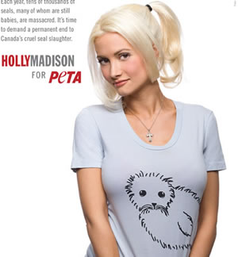

Slide 6
Celebrity Endorsement
I believe that Holly Madison was able tor each another audience about the issues she cared about. I think that because a lot of her charity work has been to do with animals, and it is a subject that most people do feel bad for that her work has helped the campaigns and hopefully taught people about issues that animals face, whether it be negligence or cruelty both are wrong.

Slide 7
Sources
http://www.peta.org/tv/videos/skins-fur/292373920001.aspx
http://www.looktothestars.org/celebrity/holly-madison
http://www.peta2.com/heroes/save-the-seals-celebrity-ad-series/holly-madisons-save-the-seals-ad/

