Slide 1
An examination of semantic variations across different dialects of English.
By: Jessica Scannell,
Jaclyn Morra,
Krystal Ricciardi-Weber,
and Joseph Russo.

Slide 2
Semantic Differences
Studying how different words in different dialects refer to the same thing.
Lexical Semantics- investigates word meaning.
Notes:
We looked at three different English dialects- American, Irish and British- and compared how they called certain nouns. During the process of obtaining information, we noticed that they also used different words for ideas. For example, when “poking fun” at each other, the American referred to that process as “kidding” while the Irish person said “messing” and the British person said “joking”.

Slide 3
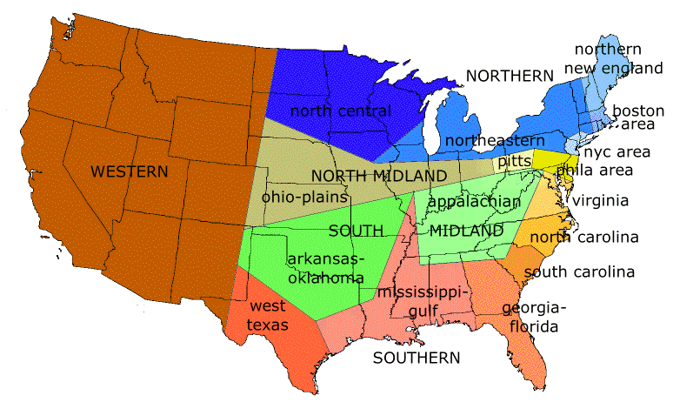
American Northeastern Dialect
American English (AmE) is the form of English used in the United States.
It includes all English dialects used within the United States
We looked specifically at the northeastern dialect.
Influenced by “London” English
Also influenced by the “melting pot” of cultures that settled in the area.
Notes:
The northeast American dialect has really been influenced by many different cultures with many different words. The person we observed spoke the dialect found outside of Philadelphia which is similar to that of New York with differences in the phonemic and morphemic aspects. Their vocabulary is more or less the same as what we find in New York, although a sandwich that we refer to as a “sub” might be referred to as a “hoagie”.

Slide 4
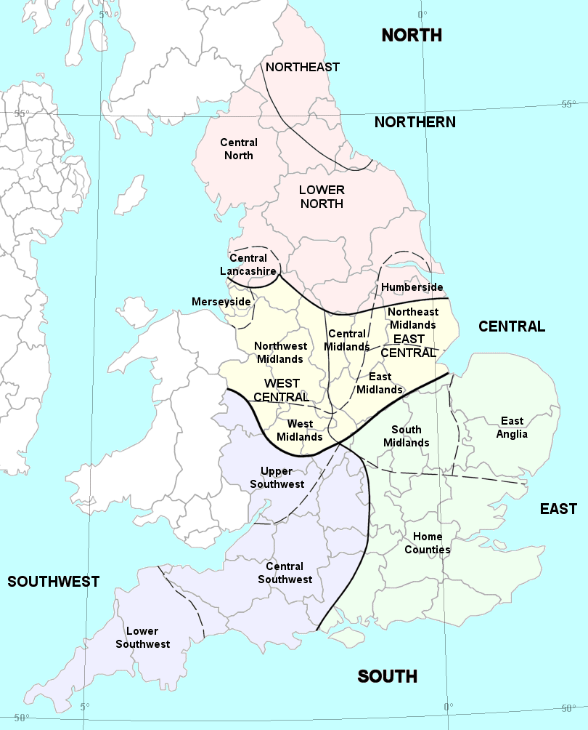
“Mancunian” English Dialect
The dialect spoken by people from Manchester in England.
Distinct intonation patterns
People tend to end their sentences on a high note.
“Get to the point” speech
Notes:
A person from Manchester, or a “Manc” as they are colloquially known, tends to end their sentences on high notes. For example,

Slide 5
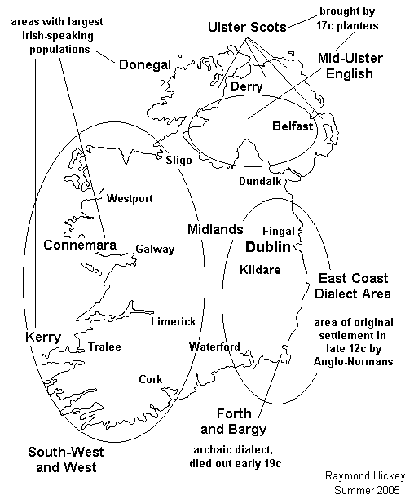
Cork, Ireland Dialect
Irish English, also called Hiberno-English,
is the dialect of English spoken in Ireland.
Strongly influenced by Gaelic
Voiceless “th” is almost
never used.
Voiced “th” is rarely used.
English spoken in Cork has a large number of dialect words that are particular to the city.
Notes:
The Irish dialect is influenced by an entire other language known as Gaelic. Many words that the Irish people use are not simply a lexical difference but a word from the other language. For example, while Americans might address someone in a police uniform as “Officer”, an Irish person would call him “Garda” ( the gaelic form or the word) or risk sounding disrespectful. Also when referring to a social event an Irish person might say “Last night was great craic” meaning last night was a lot of fun and not a reference to drug use!

Slide 6
Dialects
The oldest sense of the word dialect was simply “a manner of speaking” or “phraseology,” in accordance with its derivation from the Greek dialectos, a discourse or way of speaking.
The modern meaning is somewhat more precise. In relation to a language such as English, it is used in a special sense to signify “a local variety of speech differing from the standard or literary language.”

Slide 7
American English and British English
Although there are many different categories of English, American English (AmE) and British English (BrE) are most commonly used.
American English and British English are similar in some ways
There are many differences between American English and British English in aspects of:
word spelling, pronunciation and grammar.
The differences are mainly shown in the usage of:
prepositions, auxiliary verbs, articles, pronouns, adjectives and adverbs, and tense and subjunctive mood.

Slide 8
British English And Irish English
British English is the “mother language”.
Irish is influenced by British English but has its own dialects that are strongly influenced by Gaelic.
Southern areas of Ireland have a stronger gealic influence this results in a “thicker” accent.
This is because southern areas began speaking English later than areas around Dublin, the first place to be conquered by the British.

Slide 9
Our Study
We interviewed three English as a first language speakers in order to compare their semantic differences.
Three Little Pigs
21 different pictures of things
Notes:
We found three people who all speak English as their first language but who learned how to speak in three different areas of the world. We recorded them speaking regularly, introducing themselves and talking about their perception of language (having never studied anything about language).
Next we showed them the story of the Three Little Pigs in pictures, splitting the story three ways, and recorded how each person told a bit of the story.
Finally, we showed them 21 different pictures of things and asked what they would call them. There were significant differences between American English and Irish/ British English, but many of the words were the same between Irish and British English.

Slide 10
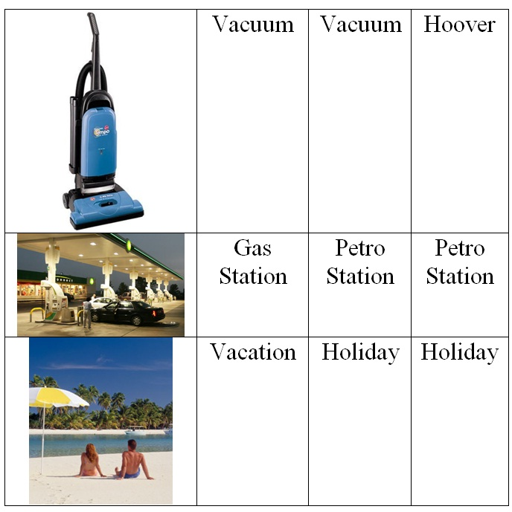
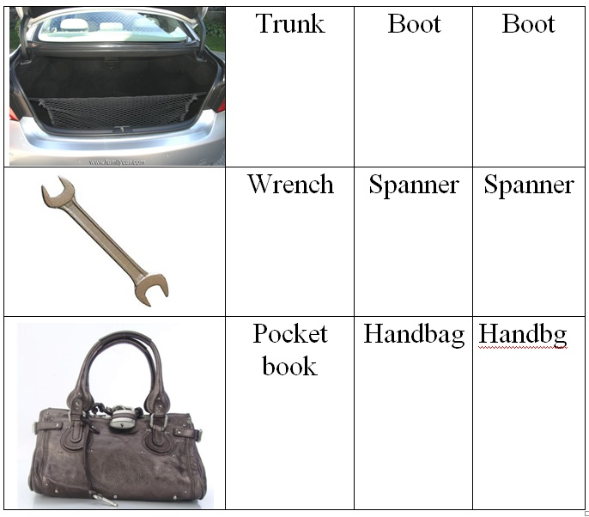
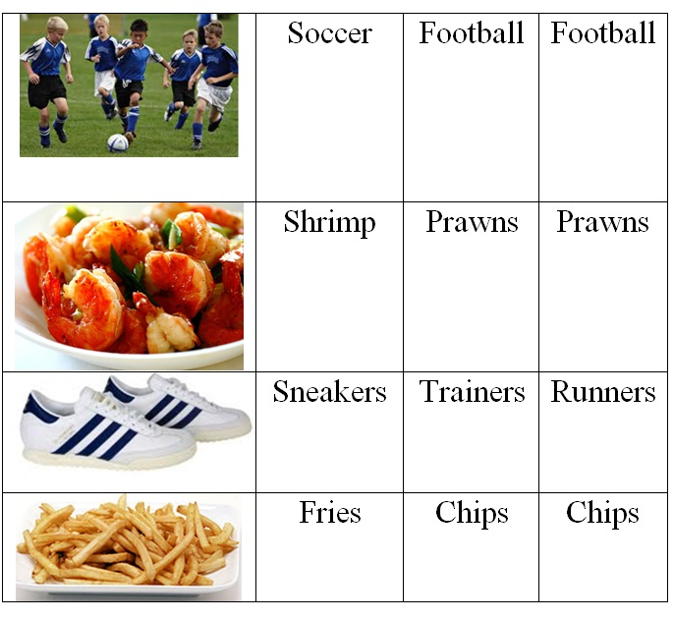
Results

Slide 11
Results

Slide 12
Our Observations
British English and Irish English are more semantically similar to each other than they are to American English, but there are some noticeable differences in both semantics and phonetics between the two.

Slide 13
Our Observations
The American speaker did not view his semantic differences as part of his culture, the others did.
Speakers from these dialects are just as likely to use slang as people from our dialect.

Slide 14
Our observations
There are plenty of different dialects within the countries of Ireland and Britain.
Example: Southern British dialects are semantically different from Northern British dialects because Southern Brits have a more “posh” way of speaking.
Speakers of these dialects wouldn’t change their semantic speech patterns if they were talking to a non-native English speaker.

Slide 15
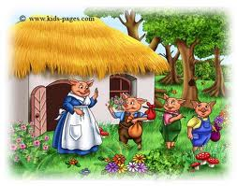
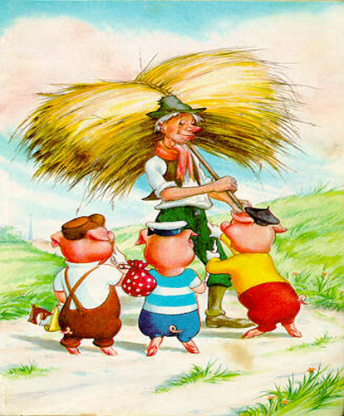
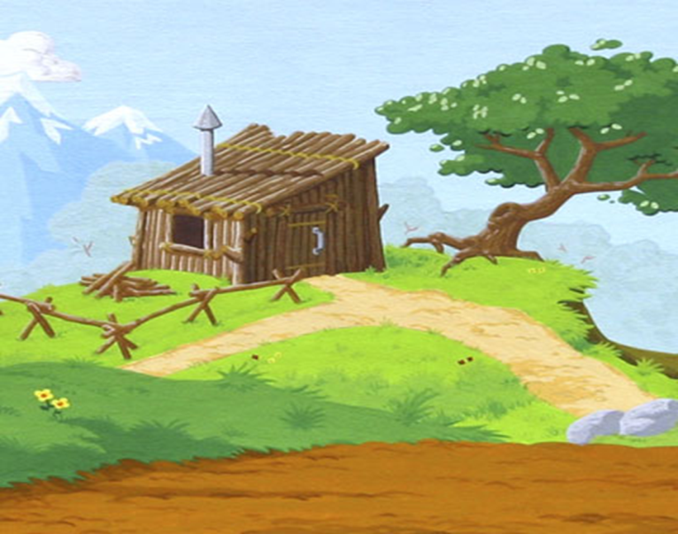
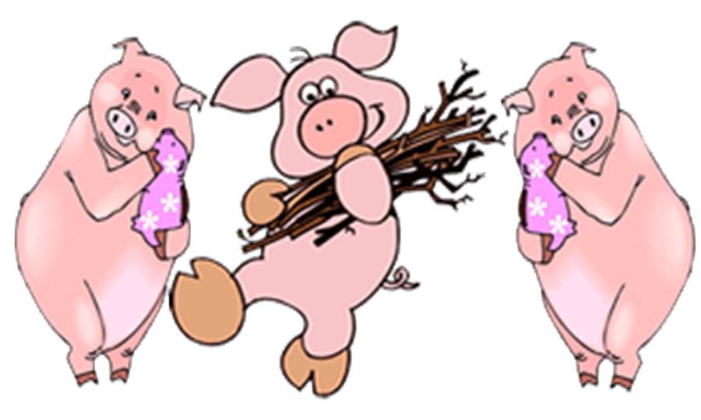
2)
1)
3)
5)
4)

Slide 16
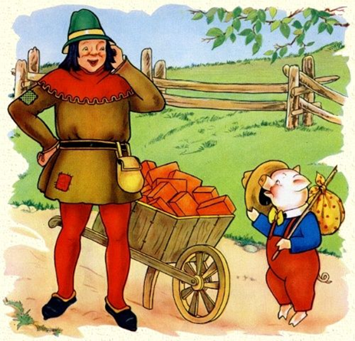
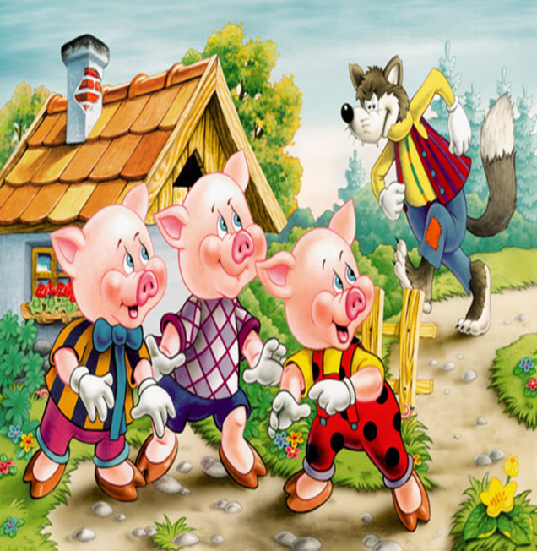
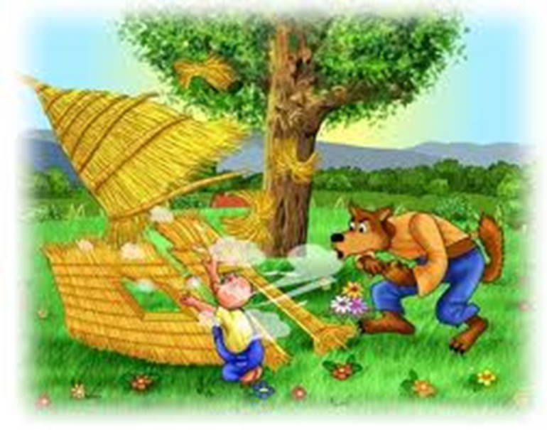
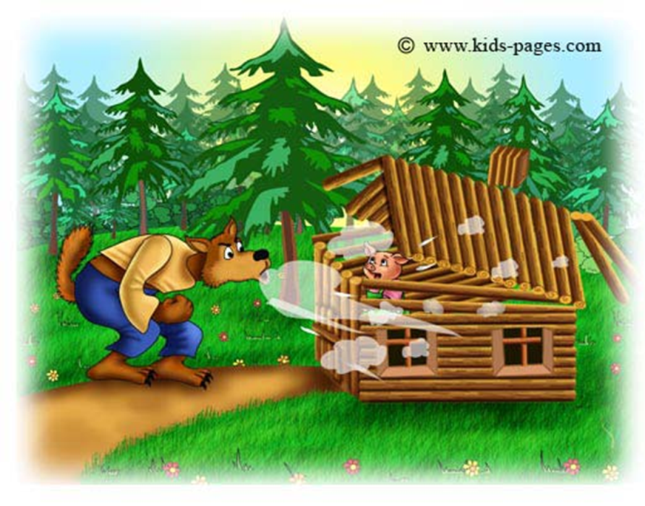
6)
7)
8)
9)
10)

Slide 17
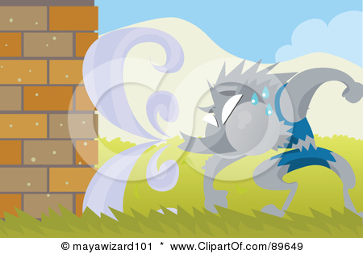
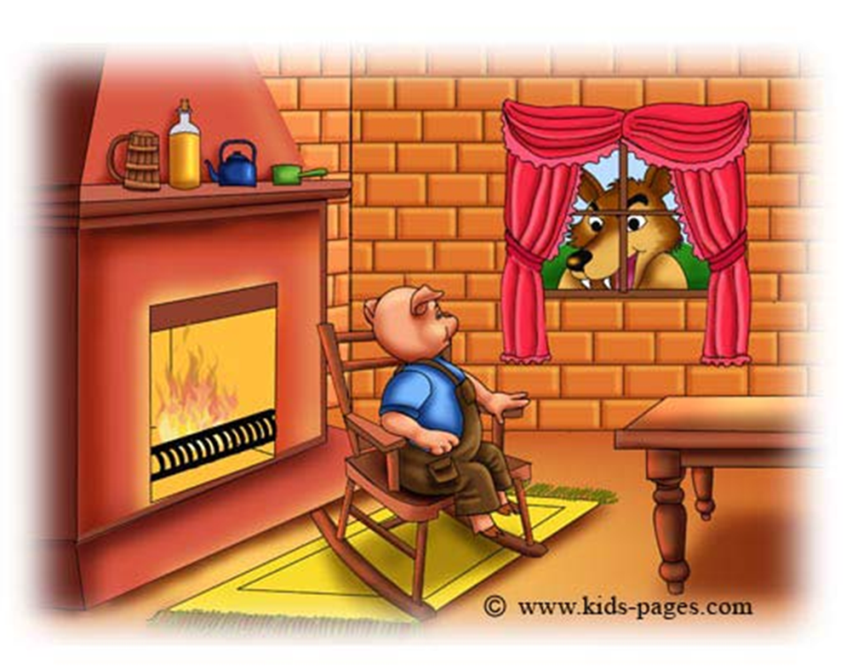
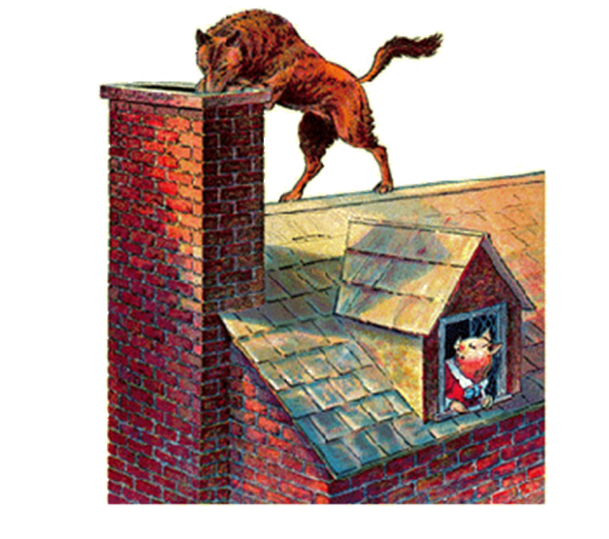
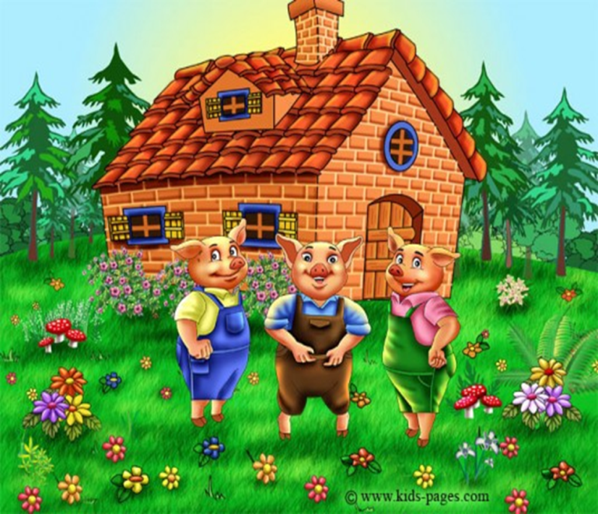
11)
12)
14)
15)
13)

Slide 19
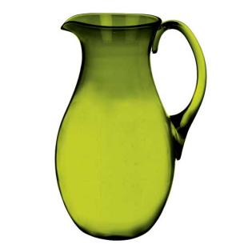

Slide 22
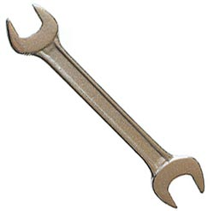

Slide 23
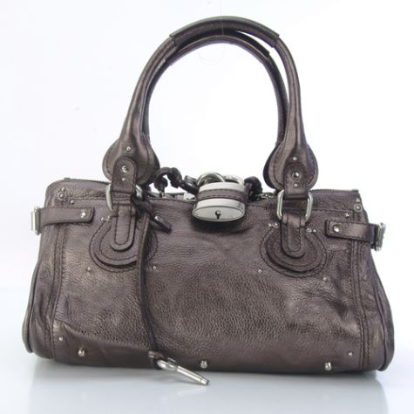

Slide 24
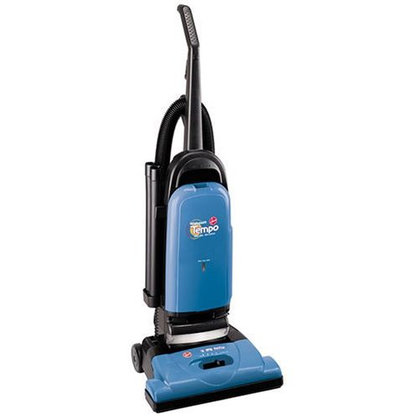

Slide 25
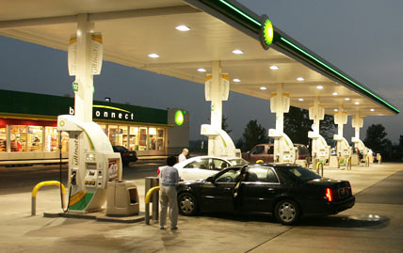

Slide 27
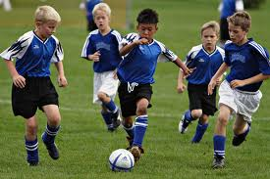

Slide 28
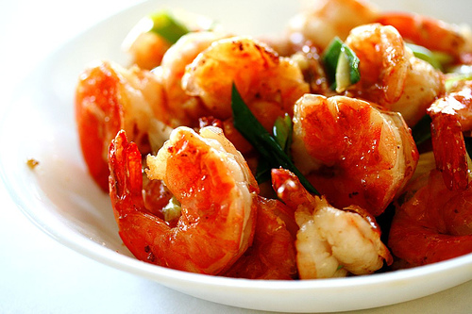

Slide 29
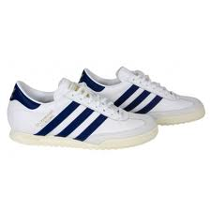

Slide 30
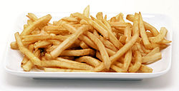

Slide 31
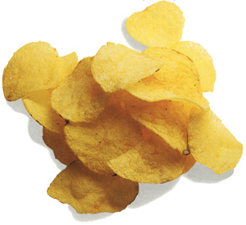

Slide 32
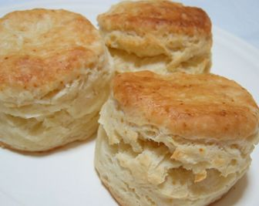

Slide 33
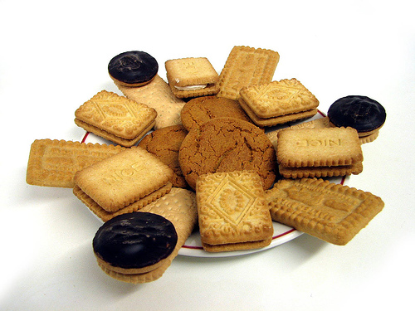

Slide 34
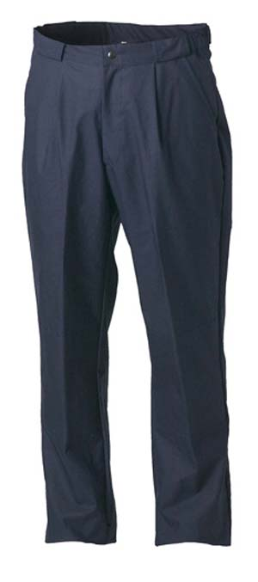

Slide 35
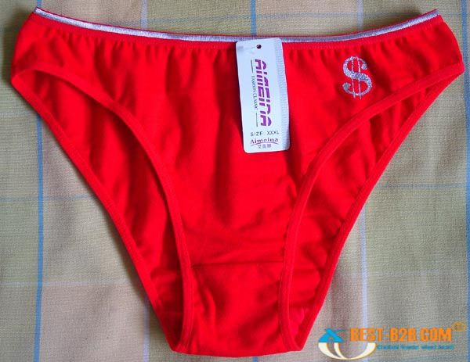

Slide 37
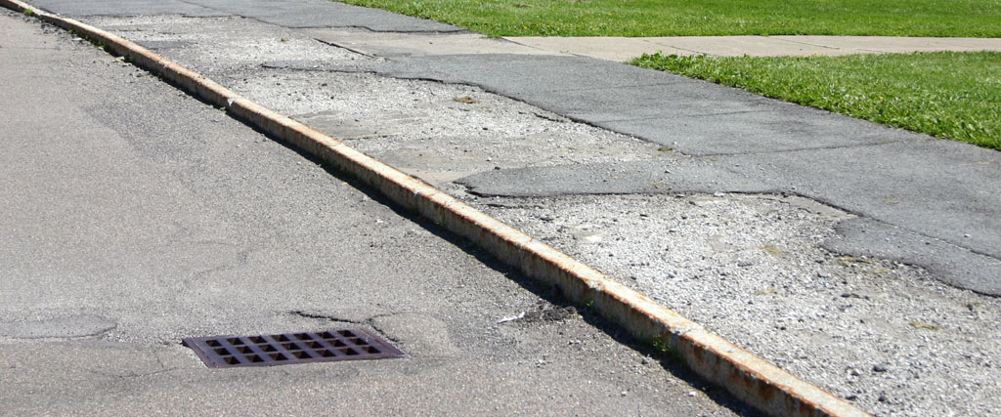

Slide 38
