Slide 1
The Mammosphere- Use of 3D tumor models to study Breast Cancer
Maria Lane
Nancy A Krucher, PhD
Department of Biology
Pace University- PLV

Slide 2
Breast Cancer
American Cancer Society estimates 300,000 cases per year in the US.
40,000 deaths/year
1 in 8 American women affected during her lifetime
Treatment:
Surgery, Radiation, Chemotherapy, Hormonal (Estrogen blocking treatments)

Slide 3
Cancer Development
Complicated process
All cancers have mutations in genes that control proliferation (cell growth)
Research in the field:
-identification of mutations
-development of therapies that target specific mutations in the cancer (Targeted Therapy)

Slide 4
Retinoblastoma (Rb) gene/protein
Rb protein acts as a brake on cell proliferation
Rb is known as a “Tumor Suppressor”
Rb braking function is controlled by a chemical modification: phosphorylation (addition of phosphate)
P
P
P
P
Rb Rb
P
P
P
CANCER CELLS NORMAL CELLS
INACTIVE ACTIVE
TUMOR GROWTH HEALTHY CELLS

Slide 5
Target: Breast cancer cells have highly phosphorylated, inactive Rb
Palpociclib- April 2015- newly approved by the FDA
-BC drug to improve treatment by blocking Rb phosphorylation (by inhibiting cdks)
P
P
cdks
P
P
Rb Rb
P
Phosphatase
P
P

Slide 6
Dr Krucher’s research on Phosphatase
PNUTS
Phosphatase Nuclear Targeting Subunit
PNUTS inhibits Phosphatase
If you remove the inhibitor,
will Phosphatase activity go up, dephosphorylate Rb, and result in a reduction of
cancer cell growth?
Phosphatase
P
P
P
P
Rb Rb
P
P
P

Slide 7
Yes, these experiments are called PNUTS Knockdown
Breast cancer cells
Also pancreatic, colon and ovarian cancer
Phosphatase is activated, Rb is dephosphorylated and cell proliferation is blocked
Previous studies were done in cells growing on a flat cell culture dish (2D)

Slide 8
My project: Can PNUTS be knocked down in breast cancer cells grown in 3D and what is the effect on tumor cell growth/proliferation?

Slide 9
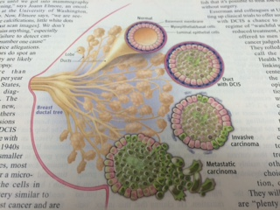
Development of breast cancer tumors:
Normal breast cells form ducts in breast tissue
Early cancer cells proliferate and fill in the duct
Later in the process the cells become invasive- start to spread outward from duct
Finally in the late stage the cells become metastatic and spread out of the tissue and eventually to other parts of the body
Science 343:1455 (2014)

Slide 10
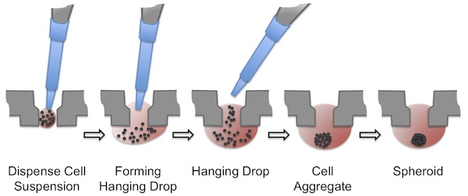
Using breast cancer cells called MCF7 we wanted to grow these structures in culture called Mammospheres
Using Specialized Hanging drop plates (3D Biomatrix):

Slide 11
PNUTS knockdown in 3D
Cells infected with a virus that carries a RNA molecule called shRNA that will bind to the PNUTS mRNA and cause it to be destroyed by the cell
“Inducible” (can turn on when desired) by adding a drug called Dox
Cells grow into mammosphere (about 10 days) then add Dox- get PNUTS knockdown
Notes:
***Remember RNA does not like to be double stranded. Engineered sequence that should induce apoptosis in a culture

Slide 12
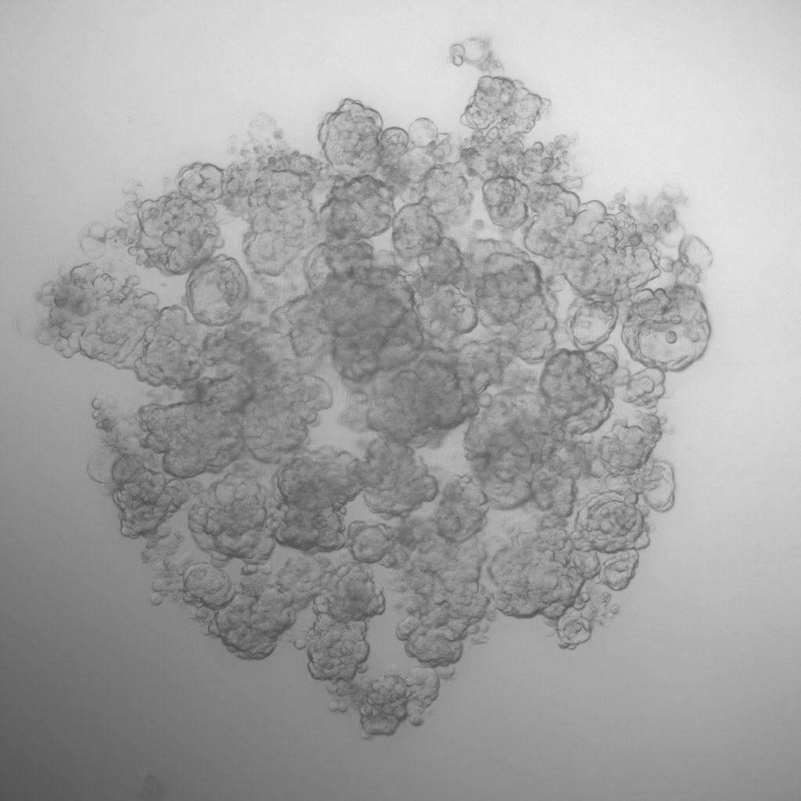
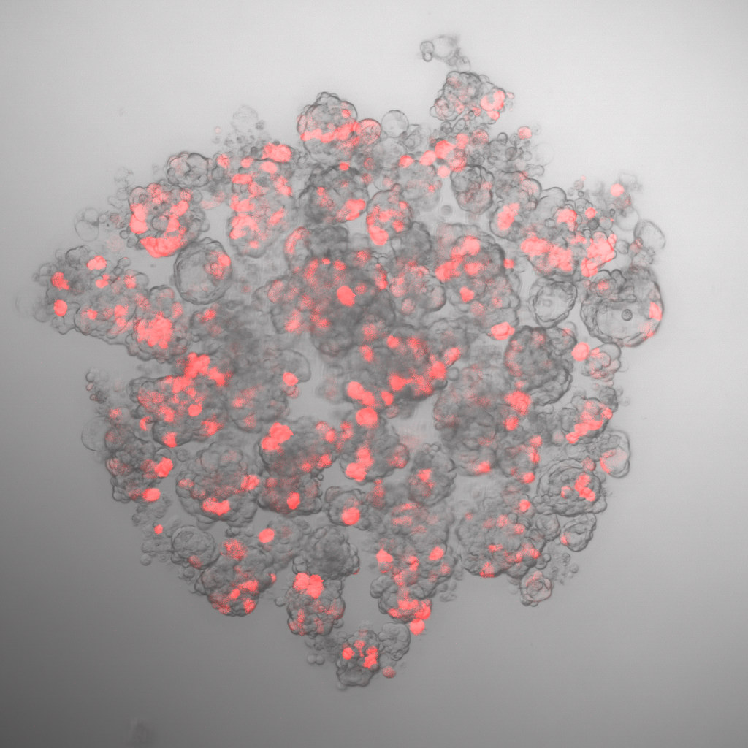
Confocal Microscopy of the Mammospheres
3D tumor red: PNUTS knockdown

Slide 13
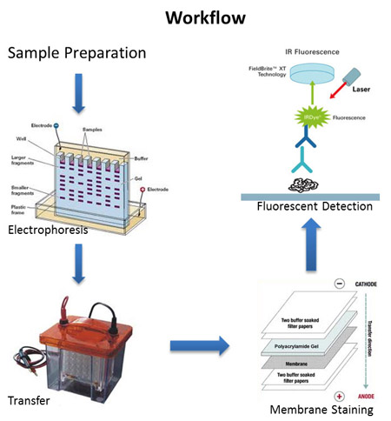
Molecular Analysis of Protein
After knockdown, obtain spheres from hanging drop
Protein quantification assay
Immunoblotting

Slide 14
Molecular Analysis: Is PNUTS Protein knocked down?
PNUTS
Actin
knockdown: CT PNUTS

Slide 15
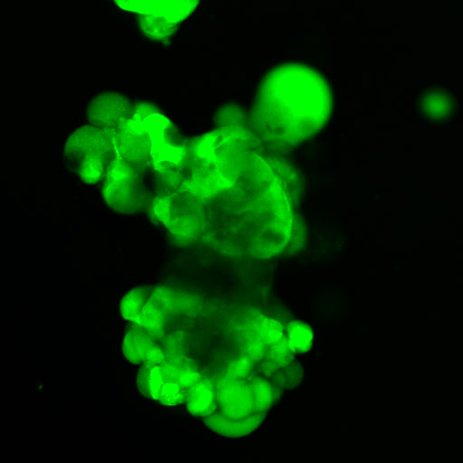
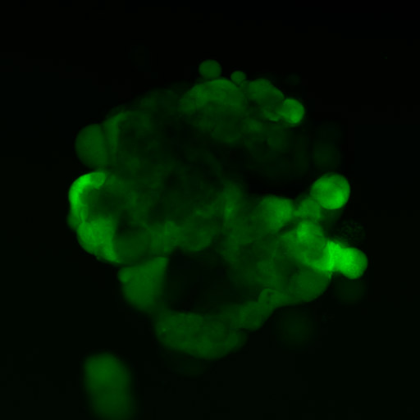
What is the effect of PNUTS knockdown on cell proliferation in BC cells grown in 3D?
green: live cells
knockdown: CT PNUTS

Slide 16
Conclusion and Further Directions:
Targeting Rb phosphorylation in 3D BC tumor model “Mammosphere” leads to a reduction in cell number
Is this due to decreased proliferation or increased cell death?
Does this strategy have the same effect on other cancer types?

Slide 17
Thank you!

