Slide 2
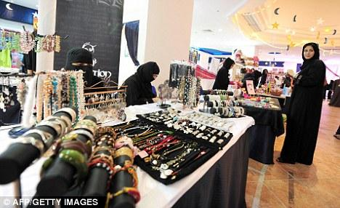
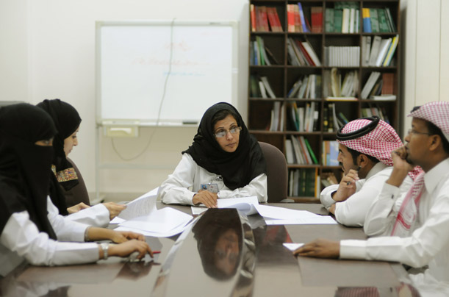
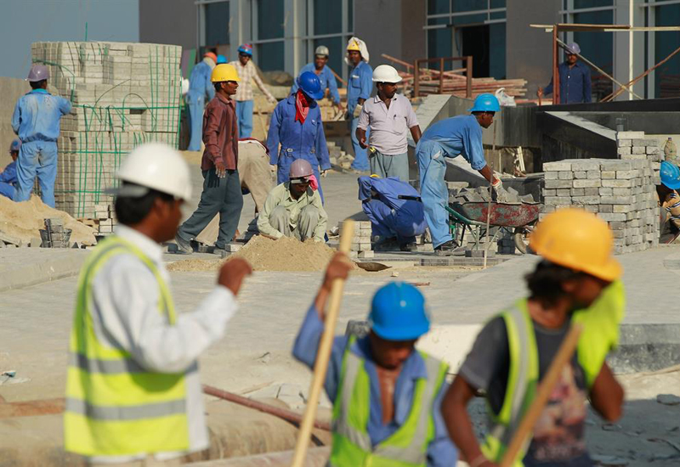
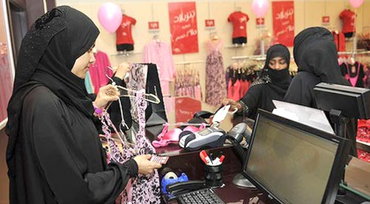
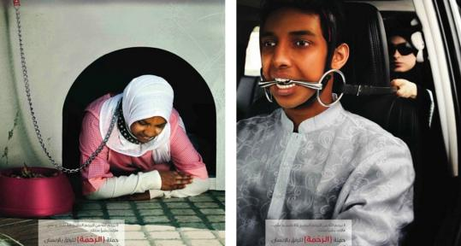
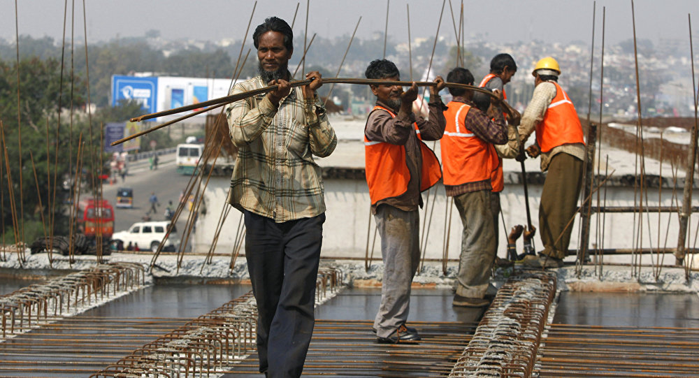
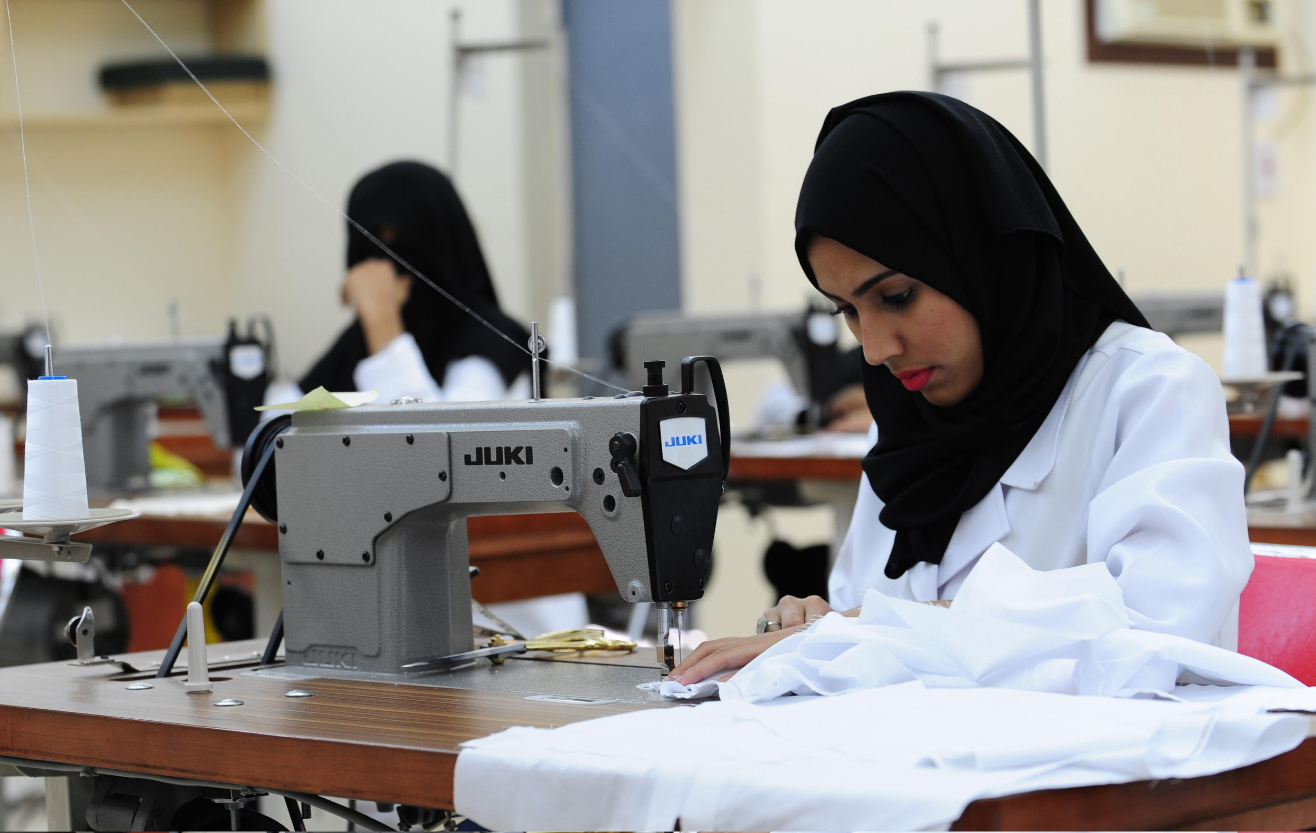
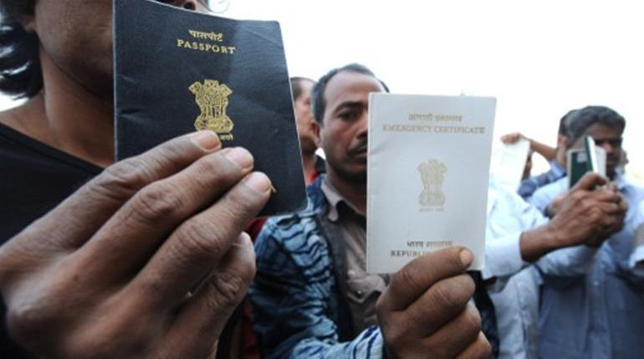
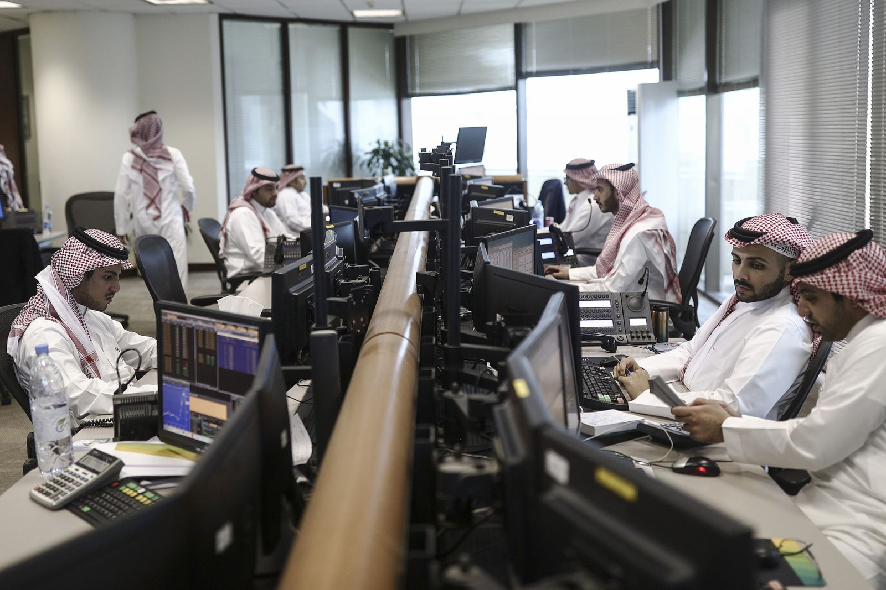
Notes:
INTRODUCTION
Just to give you a quick background info on Saudi Arabia:
- Country in the Middle East
- As of 2016, their population is 32.2 million
- All Saudi citizens follow the Muslim religion
- Saudi Arabia possesses approximately 22% of the world's oil reserves. It is the world's largest exporter of petroleum liquids and relies within the oil industry.
As you can see here we have the many different type of Saudi Arabian workers… interestingly enough, although Saudi Arabia is on the other side of the world, at a first glance they have a lot of similarities to the United States.
- Sales Associates (Usually Saudi Arabian native women work these types of jobs)
- Manual labor such as sewing, making crafts and jewelry to sell
- Professional business men and women, specializing in banking/finances and business
- Construction workers (typically Indian men, some immigrants, work this type of job)
- Housewives/maids
The middle picture in particular, depicts what immigrant people go through in Saudi Arabia. Immigrant working women are known to be mistreated and abused as maids, in some instances killed, and immigrant working men are known to be beat and abused as well. The people who migrate into Saudi Arabia are Indian, Ethiopian, Bangladesh, Sri Lanka, and Indonesia amongst others.

Slide 3
Notes:
We’d like to show you this video to provide you with a visual on the conditions of immigrant workers in Saudi Arabia.

Slide 4
High Context Culture
A lot of association and friendships are developed
Nonverbal communication
Use of space
Time isn’t everything
Notes:
Saudi Arabia is a high context culture.
Association: Saudis believe in building strong personal relationships is critical. Having a positive relationship with coworkers is the most important factor in doing business. Before starting a meeting, they would openly discuss about each other's health and personal activities. Co-workers would be treated like family. Business and personal friendships bounce off each other. They generally prefer to do business with people they know and like. 90% of businesses are run by family.
Communication: nonverbal communication plays a huge role in Saudi Arabia. Their opinions are not verbally expressed. They rely on their body and physical features to do all the talking. Emphasis is placed on the tone of voice, facial cues and body language. A lot of silence is used because it communicates ideas and feelings. Silence is often used for contemplation and in serious decision making. Yes, they do speak and talk. They tend to talk out loud and may appear aggressive but it should be taken as an indication of interest and engagement.
Space: Saudis will typically stand very close to you when in a conversation. If you try to keep a greater distance, they may think you find their physical presence distasteful. When standing in conversation with someone, leaning against the wall or keeping hands in pockets is taken as a lack of respect. It is considered rude in interactions to sit or stand far away from the other person.
Time: Time is not an important factor. Deadlines and meetings do not follow a set schedule. Frequent interruptions and cancellations are common. A lot the times, things are scheduled around the prayer times. They pray five times a day and all shops and many offices will close to observe prayer. Arabs are polychromic in relation to time, meaning that they may focus on several things at once and may be highly distractible.

Slide 5
Hand Gestures
Notes:
Here are some examples of nonverbal communication. Each hand gesture has a significant meaning.

Slide 6
Saudi Arabia Collectivist Culture
Maintain a healthy relationship
Everyone is active
Loyalty
Avoiding shame
Notes:
Saudi Arabia is considered a Collectivist country.
Clearly, they enjoy having long-term commitment with families, extended family, and coworkers.
Everyone in the group is involved and active when making decisions.
Saudis believe that collectivism increases loyalty and commitment in each other.
When any members of the organization or family, perceive threats of another group towards their group, they may derogate or attack the other group.
They like to prevent any embarrassment and any shame at all times. They are very conscious of their personal honor and families honors. The practice of preventing shame from happening to you or anyone in your group/family . is an inescapable duty for any member, especially males.
As a tradition-based culture, the harm of shaming one’s family not only affects the present group members, but also family members in the past and future.

Slide 7
Use of Time
Work Days
Working Hours
Notes:
Time
WORK DAYS
The Saudi work week runs on a five day working week starting from Saturday through Wednesday. Most people do not work on Thursday, and there is no business conducted on Friday - the Muslim holy day.
WORKING HOURS
Normal working hours are 8 a.m. to 12 noon and 3 p.m. to 6 p.m. When scheduling appointments, it is important to take into account the five daily prayer times, as well as the Islamic religious holidays.
The working week tends to vary between 40 and 48 hours, depending on the particular company’s policy. In the month of Ramadan, the working day is reduced to six hours and legally this should apply to all staff, but many companies only apply it to Muslims, who fast during daylight hours.

Slide 8
Conversational Style
Greeting
Topic of Conversation
Tone
Business
Notes:
Conversation Style
GREETING
It’s best to wait for your Saudi counterpart to initiate the greeting. Westernized Saudi men usually shake hands with other men, and some Saudi men will shake hands with Western women.
“Saving face” and avoiding shame are very important, it’s always best to offer praise rather than criticism. Therefore, they may be reluctant to give you bad news about business. Avoid talking about Politics, Israel, illness, accidents, death, or bad luck of any kind. Saudi people prefer positivity, and even if the negativity is necessary they avoid it at all cost.
TOPIC OF CONVERSATION
Family is a good topic of conversation, however don’t inquire about female members unless they bring it up first. Periodically ask about the health and happiness of family brothers, uncles, cousins, and sons. Also, mostly Saudi men, converse about Sports, especially soccer (known as "football"), horse and camel racing, hunting and falconry – although keep in mind that all betting is illegal.
TONE
In the Saudi culture conversations are enthusiastic. Speaking loudly, rising the pitch and tone, or even shouting can be perceived as signs of sincerity. If you appear distant, reserved, quiet, or shy, it could make the Saudis think something is wrong.
BUSINESS
Business is conducted in a personal manner, and it's important to pay close attention to all family members that you are introduced to.
When negotiating, Saudis frequently use personalized arguments, appeals, and insistent persuasion, so they will expect a similar approach from you.
The pace of business is slower in Saudi Arabia than in the West, so patience is essential. Business meetings start slowly, and there will be initial questions and small talk to create rapport. Saudi Arabians feel that they can trust you while discussing business face to face with constant eye contact.

Slide 9
Notes:
(Play this video after you are done talking about Gender Roles) This video shares the story of Jamila, whom is a female Lawyer in Saudi Arabia. The video also goes over the difference between male and females in the workplace.

Slide 10
Gender Roles
Men
Men are protected by the law
Main ones to go to college
Role in the family is to be the breadwinner and support the family
Conservative dress outside of the home
Women
Women’s rights are defined by Islam & tribal customs
Are not allowed to vote
New policy for women to be allowed to drive takes effect on June 24, 2018
Still follow a Guardian System for certain issues
Dress code
Majority of women wear an abaya- long cloak & headscarf
Interaction with other people outside of family is limited
Many public buildings (offices, banks, universities) have separate entrances for women
Women are not allowed to use public swimming pools
Not allowed to enter a cemetery
Cannot read “uncensored” fashion magazines

Slide 11
Social Customs
Religious obligations
Hand Gestures
Which hand is the proper one to use
Proper way to sit
High importance of family
“Women only” areas
Alcohol consumption
Older brothers are to have their hand kissed by younger brothers, sit above them on formal occasions, and enter a room before them
Marriage
Notes:
I found these in my source… thought this may help:
· The left hand is considered unclean in the Arabic culture, so always use the right hand when touching, eating, or gesturing
· While sitting keep both feet on the ground, don’t cross your legs, and avoid showing the bottom of your foot which is considered very offensive
· Although Saudis gesture with their hands while speaking, pointing or using the thumbs-up gesture is considered rude

Slide 12
Thank You!
شكرا
shukraan
Sources:
Cultural Tops for Doing Business in Saudi Arabia
Saudi Arabia - Business Culture
Working Conditions: Salary & Working Hours
Saudi Arabia- Etiquette, Customs, Culture & Business
What Women Can't Do In Saudi Arabia
Saudi Arabia Communication
Cross-Cultural and Language Training
Cultural Worldview and Business Pratices
Notes:
https://www.tripsavvy.com/doing-business-saudi-arabia-4022381
http://www.expatfocus.com/expatriate-saudi-arabia-business-culture
https://www.justlanded.com/english/Saudi-Arabia/Saudi-Arabia-Guide/Jobs/Working-conditions
http://www.kwintessential.co.uk/resources/guides/guide-saudi-arabia-etiquette-customs-culture-business/
http://www.theweek.co.uk/60339/nine-things-women-cant-do-in-saudi-arabia
http://dpuadweb.depauw.edu/$1~mkfinney/teaching/Com227/culturalPortfolios/Saudi_Arabia/Communication.htm
https://www.communicaid.com/country/saudi-arabia/
http://www.iorworld.com/saudi-arabia-pages-498.php

