Slide 1
ePortfolio Assessment
Rubrics, Peer Feedback, Contests
ePortfolio Teaching Circle 2013

Slide 2
Joy Tatusko + Sarah Burns Feyl

Slide 3
Folio Thinking
"We believe that Folio Thinking enables students to become aware of, document, and track their learning and develop an integrated, coherent picture of their personal learning experiences from both inside and outside of the classroom." - Helen Chen of the Stanford Center for Innovations in Learning
This approach reaches beyond the technology to support reflective and transformational uses of e-portfolios.
The e-portfolio becomes a space to reflect on learning and demonstrate growth.
Folio thinking focuses on the process as much as product.
This tendency reflects folio thinking's emphasis on metacognition and documentation of learning growth over time, processes rarely captured in conventional approaches. (microsoft.com/education/highered)

Slide 4
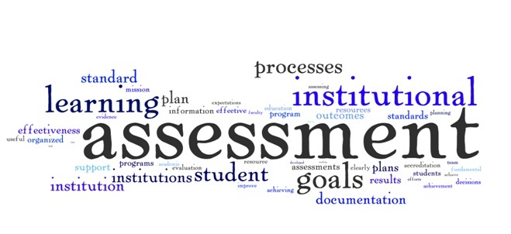
What is a rubric?
How do you use rubrics?

Slide 5
Guideline for student performance
Checklist for assignments
Articulates expectations for an assignment by listing the criteria, and describing levels of quality (Heidi Andrade)
Explicit set of criteria used for assessing a particular type of work
Fosters greater transparency + accountability

Slide 6
ePortfolio rubric
Located on ePortfolio

Slide 7
My feedback
Comments: __Very impressive eportfolio. I would love for you to make the whole thing public for Pace to see as an example of excellent work! And of course you should enter the contest! Very strong reflections – keep those up. Watch typos in 3rd line of reflections use vulnerability instead of venerability and I instead of 1. I suggest adding Tom Lynch’s website to your description below his letter. Your pages are balanced and you thoroughly describe each artifact. Include where your work was published on your activities page. I liked your “blast from the past” graphics! This shows your evolution as a designer which is what eportfolio is all about. Good caption under your wordle (I am going to borrow the idea from you!). Just make the link active. Your pages were well balanced. Great work overall._______________

Slide 8
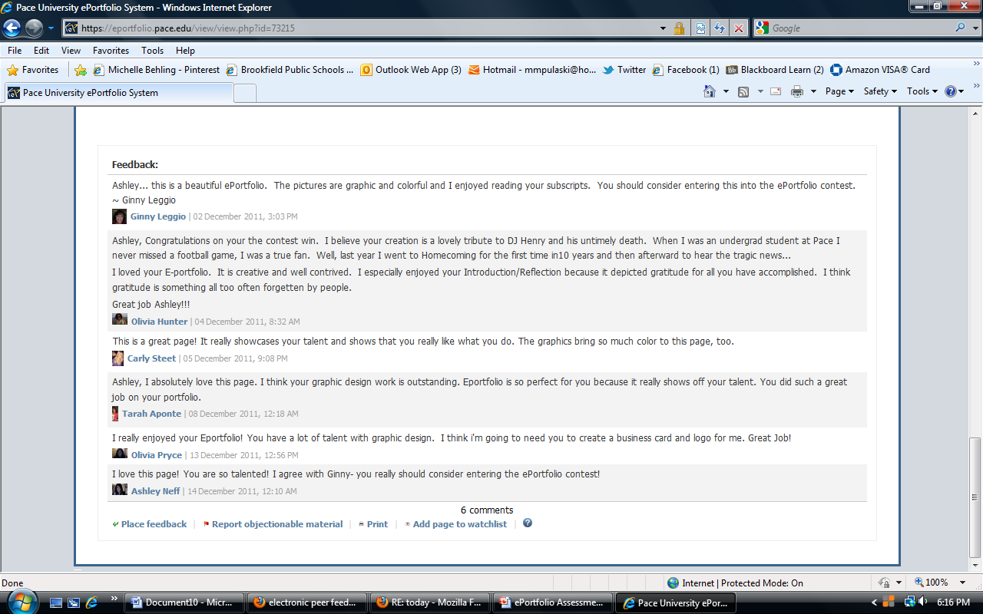
Peer Feedback

Slide 9
Individual Assignment Rubric
Located on ePortfolio

Slide 10
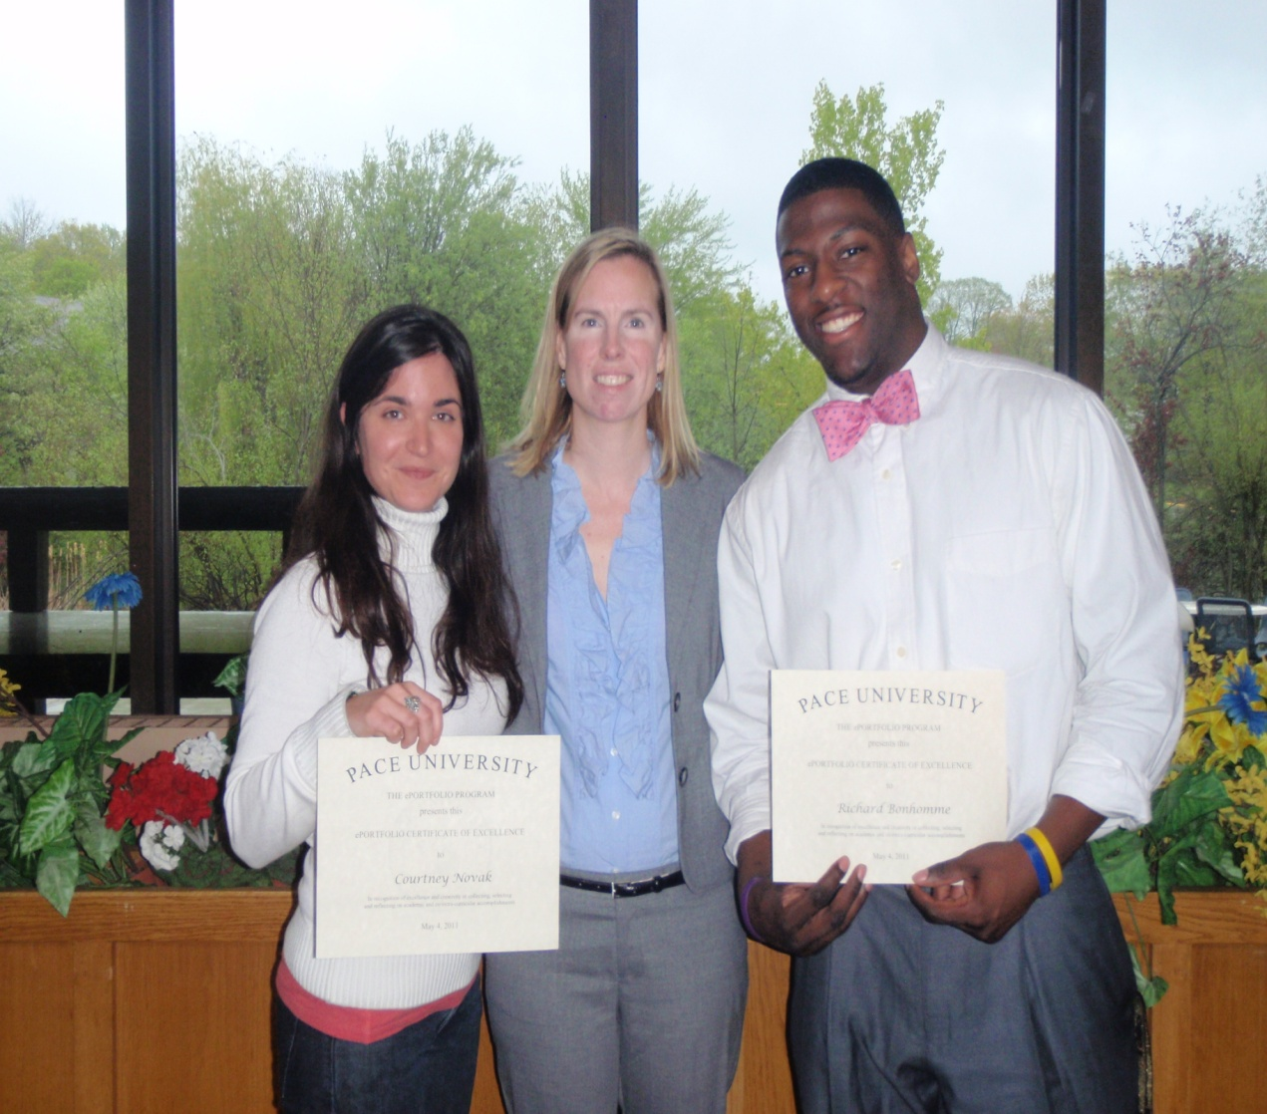
Contests
Held in the spring to encourage students to create and share their eportfolios
winners highlighted here: https://www.pace.edu/ctlt/eportfolios/contest-winners
MCA winners recognized at the ePortfolio Student Showcase with their Excellence in ePortfolio Awards

Slide 11
Contest Badge Can be Featured on Student ePortfolio

Slide 12
Contest Rubric
Located on eportfolio

Slide 13
Homework
Create an Introduction page on eportfolio/populate another page
Read the following articles on reflection found under files in the Teaching Circle group:
Reading Assignment Chapter 2 Studying Student Reflection
Should Graduate Students Create ePortfolios?
TAP Into Learning

