Slide 1
Marketing 250
Professor Ray

Slide 2
Executive Summary
This presentation gives an in-depth and analytical look at MetroPCS, and how they can revamp their marketing.
Here we’ll take a look at:
Market Trends
a) The history of MetroPCS
b) What their current strategy is
c) How they have grown as a company
d) Why this isn’t working for them
e) How they market
f) a dive into MetroPCS’ product, price, promotion, and placement
MetroPCS →SWOT analysis
a) an analytical look at the strengths, weaknesses, opportunities, and threats of MetroPCS
Competition
a) Verizon Wireless, AT&T, and T-Mobile hold most of the market share and are MetroPCS’ true competition; this segment takes a look at their:
b) History
c) Market share
d) Performance
Target Market
a) Just who exactly is MetroPCS’ service directed too
b) Here we have statistical data all broken down into specifics to give the most detailed explanation on who MetroPCS should gere towards and why, including what trends state so

Slide 3
Executive Summery Cont…
Through this study, we aim to:
a) Give MetroPCS a new market strategy
b) Boost market share
c) Give MetroPCS a reputable name that consumers can associate the company with
d) Give people a better understanding of who exactly MetroPCS is

Slide 4
Challenges
MetroPCS is a mobile services company who serves its cliental through offering various affordable monthly plans. These plans include unlimited texting, calling, and something that is not offered elsewhere, unlimited international.
Through this marketing strategy we hope to advance the sales and market share of MetroPCS.
Since MetroPCS’ release of its 4G network in Dallas, its customers increased by 600,000+
Its 4G network will launch all across America by the end of 2010
Based on Dallas’ statistics, we are projecting a sales increase of approx. 2.5 million
With this new market strategy and approach, we are estimating to increase that growth to 5 million.
(S.V.)

Slide 5
What is Metro PCS?
CEO and Chairmen of the Board Roger D. Linquist
Founded 2002
Fifth largest wireless company
Formerly known as General Wireless Inc.
Headquarters are in Richardson, Texas.
They only use CDMA
Sept 20, 2010 first to offer 4G service through LTE
(K.M.)

Slide 6
A wireless phone company that targets youth and minority demographics, offering service without requiring a contract or a credit check
This is the difference between them and Verizon Wireless, AT&T, etc.
Unlimited voice plans start at $30 a month, and youth and young professionals form 55% of MetroPCS's customers
The company spends $124 on average per new customer added, compared to the industry average of $358
(G.D.)

Slide 7
Metro PCS (Cont)
In November 2008, MetroPCS expanded their coverage to cover more than 300 cities in the contiguous United States. As of 2010, all MetroPCS subscribers have unlimited voice and text in more than 11,000 cities and towns.
In January 2010, MetroPCS announced "What you see is what you pay," a series of new calling plans. The new plans included all taxes and fees so the advertised price was the final price at the beginning of each monthly cycle.
In August 2010, MetroPCS extended the International Calling list to include more areas in Mexico. In addition, it added more mobile carriers to the TextTalk Global list.
In September 2010, MetroPCS began offering Free Wifi at all MetroPCS locations. This came with the release of the Samsung Craft in Las Vegas,
(G.D.)

Slide 8
Strategy for Metro PCS
Making a significant change to their business model
Will no longer offer a free month of service with the purchase of a new handset
Prices for handsets will fall $40-50 which matches the approximate value of the free month of service that was previously included.
Also, they are adjusting rate plans upward slightly and all plans will now include consumer taxes and government fees
These changes are an effort to be better positioned in the marketplace for handset prices, simplify the rate plan offerings and reduce consumers dropping current service in order to purchase a handset that included a month of service
http://www.youtube.com/watch?v=yzEJbHcDS3w
(G.D.)

Slide 9
How they’ve grown
After being bankrupt for four years, they have made a comeback
As of 2010 they have 7.6 million subscribers
Is the fifth largest wireless broadband PCS provider in the US as measured by growth in subscribers and revenues
There 4G coverage is limited to Las Vegas and Dallas but is expanding to; Detroit , California, Florida, Atlanta and New York City by the end of 2010
In Dallas they gained 684,000 new subscribers because of the 4G coverage
(K.M.)

Slide 10
Why they aren’t working
New Company
Minimal phone selection
Weak brand
Not enough service towers
Very low market share
Dependence on Single Vendor
Reliance on Supplies
Poor operational efficiency for the company
(K.M.)

Slide 11
Why aren’t they working (Cont.)
The company utilizes CDMS technology for rendering its services. They depend only on and have an individual agreement with Alcatel Lucent for supply of CDMA network infrastructure equipment. But because they are picking up LTE from another vender, this may push Alcatel Lucent to terminate agreement or cease to develop new products or services for them.
The company relies on third-party suppliers for products, software and services that are vital for the company.
The company reported poor operational efficiency with increased cost structure and decreased margins. Metro PCS reported declined operating margin of 15.31% in the year of 2009 as compare to 15.88% in 2008.
(K.M.)

Slide 12
Service Map
Maximum Service
High Service
Medium Service
Minimal Service
(K.M.)

Slide 13
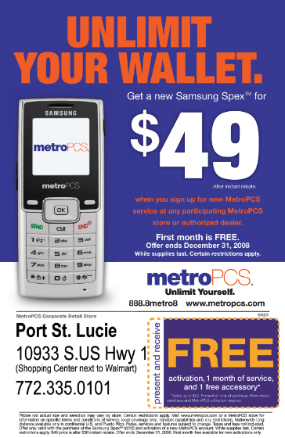
How they market
Very promotional
through the radio
including ‘Hot .97’
Subway advertisements
Word of mouth
http://www.youtube.com/watch?v=64_2DkIv3DM (Commercial In Spanish)
(K.M.)

Slide 14
(K.M.)

Slide 15
What they promote
The best plans (See Chart)
Pricing (See Chart)
Unlimited plans (See Chart)
$5 Bundles
‘Add Ons’ for extremely low prices
‘What you see is what you pay’
No contracts
No activation fee
No limits
Blackberry
(K.M.)

Slide 16
$5 Bundles
Social networking
Loopt (GPS Friend Finder) – find friends using maps
Mobile Instant Messaging – AIM, Yahoo, Windows
Music Bundles
Ringback Tones Bundles 2 for $5
Ringtones Bundle 5 for $5
Full-Track/mp3 Downloads
Bundle 5 for $5
Navigation & Info
Unlimited Metro Navigator - GPS
Unlimited Directory Assistance – Unlimited business and residential listings for anywhere in the U.S., Canada or P.R.
Roaming
$5 TravelTalk Bundle (Includes 30 minutes) – Minutes & text used outside of your covered areas.
(K.M.)

Slide 17
Add ons – Per month. Taxes and regulatory fees included.
Protection and More
$1 MetroBACKUP – keep contacts even if your phone is stolen or lost
$2 Unlimited Directory Assistance – business and residential listings anywhere in the US, Canada and P.R.
$5 Call Forwarding -
$5 GroupLINE ⁻ Lets your family or friends share one phone number, just like at home.
$4 MetroGUARD Handset Insurance – lost, stolen or damaged
$1 E-Statement – electronic bill
$3 Voice Mail to Text – voicemail as text and email
(K.M.)

Slide 18
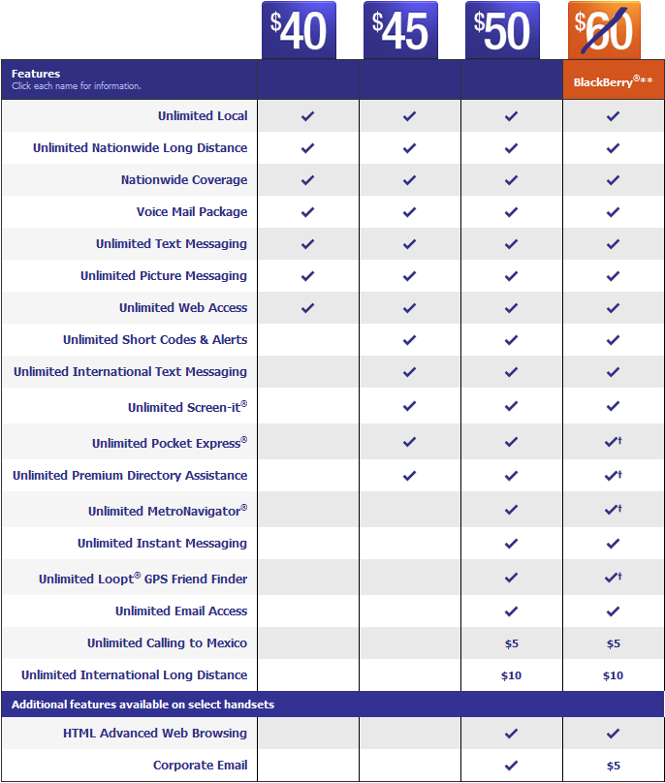
Metro PCS Plans
vs
At&t Plans
(K.M.)

Slide 19
Who they target
One-third of Metro PCS’s growth was in New York, Boston, and Philadelphia
Low income consumers
“my target audience is really, really simple: It is any person who pays their own bill.” Mr. Keys, MetroPCS’s operating chief.
Teens and young adults (ages 13-25 who are overpaying their bills)
Low income
Customers with high Text messaging usage, high minute usage, high internet usage
(K.M.)

Slide 20
(S.V.)

Slide 21
Strengths…
From a customer’s standpoint, MetroPCS deliver’s the most service for the least and most affordable price.
Blackberry is the IPhone's/Droid’s biggest competition. It is one of the most popular smart-phones out.
The release of the 4G network shows technological growth and advancement in the mobile industry.
Throughout 2009, the company was able to widen its market share by a double-digit growth in its customer base. Its total customers reached 6.64 million as of December 31, 2009, a 23.71% increase in the net customers acquired over 2008.
(S.V.)

Slide 22
Strengths Cont…
The company was also able to decrease its Cost Per User (CPU) from $18.17 in 2008 to $17.23 in 2009.
The cost benefit was achieved through the increased scale of its business. The solid customer base resulted in strong Average Revenue Per User (ARPU) of approximately $40.68. A strong customer base also ensures constant revenues for the company. Due to a steady customer base and a solid operational growth, the company’s revenue grew by 26.49% over 2008 to $3,480.52 million.
The company as increased their ARPU!
(S.V.)

Slide 23
Weaknesses
MetroPCS has not reached to enough clients yet. They still need to reach out to new people in new places.
People do not associate the name MetroPCS with something they can relate to or trust.
They suffer from “New Kid on the Block Syndrome.” Their new to the industry and can easily get pushed around by the older and higher market shared companies, at the same time they end up getting isolated and detached from the market.
Their 4G coverage is limited to Vegas and Dallas
and does not reach enough people.
(S.V.)

Slide 24
Weaknesses Cont…
The company utilizes CDMS technology for its services. The company depends upon Alcatel Lucent for supply of CDMA network infrastructure equipment. Alcatel Lucent is the only vendor with whom the company has an agreement to provide PCS and AWS CDMA system products and services, including without limitation, wireless base stations, switches, power, cable and transmission equipment and services. Unfortunately for MetroPCS this technology and equipment is not compatible with other manufacturers. In conflict with this, MetroPCS has decided to purchase its LTE technology from another vendor; in consequence to this, Alcatel Lucent may end its agreement with MetroPCS.
The company depends on one main supplier for infrastructure equipment. These supplies are not compatible with other companies services They recently jeopardized their alignment with this company!
(S.V.)

Slide 25
Weaknesses Cont…
The company relies on third-party suppliers for products, software and services that are essential for the company. The company depends upon third-party vendors for meeting its requirement of financial, management, information, network management and billing systems. The company has entered into agreement with third-party suppliers to provide solutions for customer care, product distribution, content development, financial reporting, network management, network infrastructure equipment, services, billing and payment processing. Aside from this, the company depends upon one or two vendors for its products, software and services in all these areas. As the company does not have long-term contracts with any of them, it has a huge risk of interrupted supply of products and services. In times of high demand, if the suppliers and vendors deny or delay deliveries, or charge higher prices, MetroPCS’s business could be adversely affected.
The company is very dependant on other suppliers for critical internal systems: financial, management, information, network management, and billing systems.
(S.V.)

Slide 26
Weaknesses Cont…
The company reported poor operational efficiency with increased cost structure and decreased marginal returns. So although they have decreased the cost per user, they have taken a step back and increased their operating cost. MetroPCS reported declined operating margin of 15.31% in the year 2009 as compared to 15.88% in 2008.
The company has become very inefficient internally and have increased costs!
(S.V.)

Slide 27
Opportunities
An increase in wider variety of smart-phones will attract wider audience.
Right now our economy is in a recession and people have been more frugal with their spending. MetroPCS’s plans fit these people’s budgets perfectly.
- 4G coverage is looking to expand in the following regions: Detroit, Los Angeles, Sacramento, Central North and Central Florida, Boston, Philadelphia, San Francisco, Atlanta, and New York City by the end of 2010
- Dallas increased its customers by 684,000 since the 4G expansion
(S.V.)

Slide 28
Opportunities Cont…
MetroPCS reported increase in its returns on equity, capital and assets in 2009. The company's return on equity (ROE) increased to 7.73% at the end of 2009, from 7.35% in 2008.
(S.V.)

Slide 29
Opportunities Cont…
The company could benefit from the rising demand for Mobile Broadband services. Analysts predict that fixed broadband would grow at a compounded annual growth rate (CAGR) of 9% from 2008 through 2014, while mobile broadband computing would see 3x as much growth, totaling to $69 billion by the end of 2014. It is expected that mobile broadband market will reach to about $1.1 trillion by the year 2012, growing at a CAGR of approx. 6.4%
There is a very large demand for mobile broadband services, and MetroPCS being the fastest growing network can make up a lot of lost ground from this high demand.
(S.V.)

Slide 30
Opportunities Cont…
The global telecommunications industry is growing rapidly. Analysts project a steady growth in the US and global telecom market in the coming years; which is perfect for MetroPCS, since they are the only mobile service provider with UNLIMITED INTERNATIONAL. Reports suggest that this growth could generate an estimated $ 4.9 trillion in revenues by the end of 2011. With an estimated 12.5% CAGR increase globally, it is expected that the US telecom market would witness a growth of 7.2% CAGR till 2011. Also, the European telecommunications market is expected to grow at a CAGR of about 7.5% through 2011 while the Asian telecommunications market is seen to display a growth of about 36% CAGR during 2007-2011.
More people are seeing the importance of international telecommunications services, and MetroPCS can greatly benefit from this due to their unlimited international service.
(S.V.)

Slide 31
Threats
MetroPCS must be always be head of their competition if they want to move up in market share.
A price war would only distract MetroPCS from growth and improvement; also if the competitor wins, MetroPCS would lose a large volume of their market share.
If the consumer is not willing to pay less for MetroPCS’ service than MetroPCS finds themselves in big trouble.
A revolutionary new phone for a different service could prevent MetroPCS from expanding.
Although MetroPCS can use the recession to their advantage, if it gets too bad they could lose a large portion of their target market, and ultimately stunt their growth as a business
(S.V.)

Slide 32
Executive Summary
This presentation gives an in-depth and analytical look at MetroPCS, and how they can revamp their marketing.
Here we’ll take a look at:
MetroPCS →SWOT analysis
Market Trends
Competition
MetroPCS’ Target Market
A new marketing strategy for MetroPCS.
(S.V.)

Slide 33
Competitors for Metro PCS
DIRECT
INDIRECT
Direct
(G.D.)

Slide 34
AT&T
The largest provider of fixed telephones in the United States, and also provides broadband and television services.
The second largest provider of mobile telephones service in the United States, with over 92.8 million wireless customers, just behind Verizon Wireless 93.2 million, and more than 210 million total customers
The 7th largest company in the U.S.by total revenue, as well as the 3rd largest non-oil company behind Wal-Mart and Bank of America
(G.D.)

Slide 35
Strategy for AT&T
Realizing that there is a good chance that Verizon Wireless could take a sizable lead in terms of US subs over the next several years
Wishes to have more of an emphasis on profit margin
More focused approach could lead to bigger earnings
Emphasize connections per person and connections per household
State that it has more wholesale subscribers of any U.S. carrier
Spend more time thinking outside the box
http://www.youtube.com/watch?v=WUSvfAskoJs&NR=1
(G.D.)

Slide 36
Verizon
A wireless phone provider that owns and operates the largest mobile telecommunications network in the U.S., based on a total of 93.2 million U.S. subscribers
A joint venture of Verizon Communications and Vodafone group
In 2009, Verizon acquired Alltel Wireless for over $28 Billion
The acquisition expanded Verizon's wireless network to establish Verizon as the largest United States wireless carrier, based on number of subscribers
(G.D.)

Slide 37
Strategy for Verizon
Provide the highest network quality through CDMA (code division multiple access) technology
Improve data transmission rates through evolution data optimized technology
Continue to expand the wireless data, messaging, and multi-media offerings for both customer and business segments
Focus on efficiency and satisfaction rates in customer service, distribution and product development divisions
Stay atop of AT&T Wireless
http://www.youtube.com/watch?v=cCHKGUUxpbE
(G.D.)

Slide 38
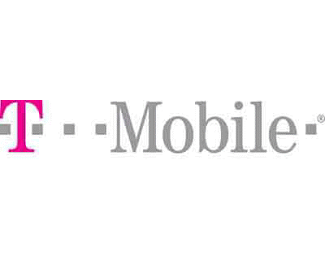
T-Mobile
A German mobile telephone provider, owned by Deutsche Telekom
Operates several Global System for Mobile Communications in Europe and the U.S.
7th largest mobile phone service provider
3rd largest multinational
Has financial stakes in mobile operators in Central and Eastern Europe
In 2008, the company announced its plan to acquire Siemens (Cinterion) Wireless Modules
(G.D.)

Slide 39
Strategy for T-Mobile
Offering some devices for less than $100 and with qualifying rate plan and a two-year agreement
Also will be offering low-cost data service plans for individuals and families
Web 200MB Plan
Web Unlimited
Tethering and Wi-Fi Sharing Plan
All data plans require a new or existing voice and text messaging plan
http://www.youtube.com/watch?v=JLU2_w91QEU
(G.D.)

Slide 40
Wireless Market Share 2009
As you can see, the two biggest companies for wireless market share as of 2009 has been AT&T and Verizon. Our goal is to make Metro PCS up there with these two companies.
(G.D.)

Slide 41
Income Statement of Competitors
Company (Numbers in Thousands) | Verizon (2009) | AT&T (2009) | T-Mobile (2009)
TOTAL REVENUE | 107,808,000 | 123,018,000 | 64,602,000
COST OF REVENUE | 44,299,000 | 50,405,000 | 36,259,000
GROSS PROFIT | 63,509,000 | 72,613,000 | 28,343,000
OPERATING EXPENSES | 49,482,000 | 51,121,000 | 22,331,000
OPERATING INCOME | 14,027,000 | 21,492,000 | 6,012,000
INCOME FROM CONTINUING OPERATIONS | 10,376,000 | 8,957,000 | 5,139,000
NET INCOME | 3,651,000 | 12,535,000 | 873,000
(G.D.)

Slide 42
Why are AT&T and Verizon so successful?
They are so successful due to the fact that they are both the top 5 largest companies of service provides around the world
However, they also do a great job of using the marketing mix-price, product, place, and promotion- in their creation of new products
AT&T- IPhone
Verizon-Blackberry
Here is an example of how AT&T uses the marketing mix in introducing the iPhone
(G.D.)

Slide 43
The Marketing Mix of the Iphone
Product
Full year warranty along with an optional three-year Apple Care warranty
Same taste as all other Apple products
Special edition version to be launched (including the iPhone Beatles edition celebrating their 40th anniversary)
Launching a cheaper version in 2008 with less advanced features along with a more advanced version for professional use
Adding the following features to the iPhone(large disk storage capacity, lower weight, thinner device, long battery life, 4G wireless, GPS and improved camera)
(G.D.)

Slide 44
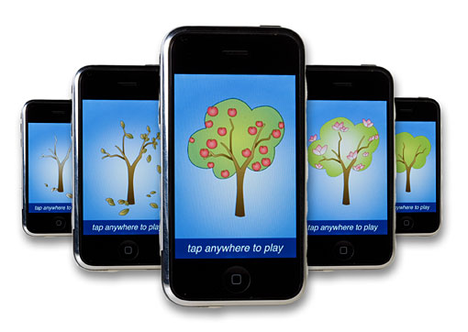
IPhone (Cont)
Price
Set the base model at a cheap price of $349
A more advanced model for $399
Special limited edition Beatles iPhone for special prices
Generally lower our prices to ensure we establish market dominance in as short of time as possible
(G.D.)

Slide 45
IPhone (Cont)
Place
Massive rollout worldwide at all reputable major retailers
Massive rollout Online, Showrooms and in all cell phone providers
All Apple Stores the Apple website will dedicate themselves to the iPhone
Eye catching displays will be found at all physical stores featuring the iPhone to make the product stand out from the pack
Apple Stores will have the iPhone on display a full month before its worldwide release
(G.D.)

Slide 46
IPhone (Cont)
Promotion
Integrate Apple message of revolutionary communications and audio/visual experience together in all media advertisements
Differentiate the iPhone against others is the touch screen functionality
Emphasize Apple brand prominently and associate the iPhone with the iPod’s groundbreaking lineage
Original but tasteful advertisements at the same time
A massive TV campaign is planned before launching the iPhone featuring a soon to be legendary ad to be the talk of the country
Advertising will be appearing on a regular basis to maintain general public awareness
(G.D.)

Slide 47
Who are the current targets?
Teens and young adults (ages 13-35 who are overpaying their bills)
Low income
Customers with high Text messaging usage
Customers with high minute usage
Customers with high internet usage
(N.G.)

Slide 48
General interests of our target market
(N.G.)

Slide 49
General interests of our target market (cont.)
Computers are being used on daily bases by 65% of teens, 96.5% of young adults, 59% adults
Books are being read on daily bases by 30% of teens, 47% of young adults, 30% of adults
Video games are being played on daily bases by 25% of teens, 75% of young adults, 53% of adults
Full part time employment is being held by 25.6% of teens, 55% of young adults, 64.9^ of adults
TV programs are being watched on daily bases by 67% of teens, 76% of young adults, 88.3% of adults
Music is being listened on daily bases by 99% of teens, 96% of young adults, 48% of adults
(N.G.)

Slide 50
Employment/Education status (vertical percentage)
(N.G.)

Slide 51
Employment/Education status (vertical percentage) cont.
53.1% of females are employed and their index is 91, and only 3.60% of female are college students and their index is 111
66.30% of males are employed and their index is 113, and only 2.75% of males are college students and their index is 84
70.6% of people age 13-17 are employed and their index is 121, and only 3.56% of teens age 13-17 are college students and their index is 110
62.5% of people age 18-24 are employed and their index is 107, and only 21.3% of people age 18-24 are college students and their index is 656
75.4% of people age 25-34 are employed and their index is 129 and only 5.42% of people age 25-34 are college students and their index is 167
(N.G.)

Slide 52
Attitudes Toward Media Horizontal %
(N.G.)

Slide 53
Attitudes Toward Media Horizontal %
From 100% of females living in United States 59.9% with index 101 likes websites that protect their privacy, 56.2% with index 95 gets their news from internet, and 64.7% with index 109 finds TV advertisings interesting and useful
From 100% of males living in United States 40.1% with index 98 likes websites that protect their privacy, 43.8% with index 107 gets their news from internet, and 35.3% with index 86 finds TV advertisings interesting and useful
From 100% of people age 13-17 living in United States 12.2% with index 120 likes websites that protect their privacy, 8.89% with index 97 gets their news from internet, and 9.76% with index 96 finds TV advertisings interesting and useful
From 100% of people age 18-24 living in United States 8.65% with index 111 likes websites that protect their privacy, 12.9% with index 166 gets their news from internet, and 10.3% with index 132finds TV advertisings interesting and useful
From 100% of people age 25-34 living in United States 19.9% with index 120 likes websites that protect their privacy, 26.6% with index 160 gets their news from internet, and 20.4% with index 123 finds TV advertisings interesting and useful
(S.V.)

Slide 54
Interpretation based on age
6.65% of people ages 10-17 are AT&T users | 6.64% of people age 18 are AT&T users | 40.7% of people age 19 are AT&T users | 19.4% of people age 20 are AT&T users | 16.2% of people age 21 are AT&T users | 19% of people age 21-49 are AT&T users, who make the 57.6% of the company’s users.
23.1% of Verizon users are age 10-17 | .64% of Verizon users Are age 18 | .20% of Verizon users are age 19 | 1.37% of Verizon users are age 20 | .93% of Verizon users are age 21 | 56.4% of Verizon users are age 21-49 who make 20.7% of people age 21-49.
(N.G.)

Slide 55
Interpretation based on brands
19.4% of all women who took the survey use Blackberry | 80.6% of all mate who took the survey are users of Blackberry | .49% of all Blackberry users are white | 1.76% of all Blackberry users are black
53.5% of all women who took the survey use Nokia | 46.5% of al mate who took the survey are users of Nokia | 15.72%of all Nokia users are white | 12.0% of all Nokia users are Black
(K.M.)

Slide 56
Interpretation by index
(N.G.)

Slide 57
Interpretation by index
Demographics | Sprint/Nextel (index) | T-Mobile (index) | US Cingular (index) | US Cellular (index)
$75,000-$99,000 | 162 | 109 | 124 | 65
$99,000-$150,000 | 191 | 84 | 147 | 14
Age 40-44 | 150 | 101 | 112 | 69
Age 45-49 | 107 | 92 | 111 | 180
Full-time workers | 127 | 118 | 118 | 97
Part-time workers | 91 | 141 | 95 | 104
(N.G.)

Slide 58
Interpretation by index
For the income between $75,000-$99,000 Sprint/Nextel has an index of 162 and U.S. Cellular has an index of 65, both of significant importance. For the income between $99,000-$150,000 again Sprint, Nextel has an index of 191 and U.S, Cellular has it of 14 which is both high and low for their respective companies.
For the age of household between 45-49 U.S. Cellular stands out with an index of 180. Surprisingly for the age of 40-44, that company has relatively low index of 69
For 3 or more children between the age of 10-17, U.S. Cingular is the lowest with an index of 75 and T-Mobile skyrockets with an index of 166
For a full-time workers, Sprint/Nextel has an index of 127, compared to the 141 index that T-Mobile has for a par-time workers.
If you are a single person never married, T-Mobile seems right for you with an index of 136
if you were looking for the best deals on phones, turn no other than to T-Mobile with an index of 123
(G.D.)

Slide 59
What are the target cities of Metro PCS and why??
New York
Long Island
White Plants
Bridge Port
Boston Metropolitan areas
Worcester
(N.G.)

Slide 60
How has the number of customers changed over time?
More then one million subscribers for the forth consecutive year
Over 6.6 million subscribers in 2009 alone(23.71% more then in 2008)
215 million nationwide customers today
(N.G.)

Slide 61
What are the needs and wants do to the needs of customers?
Needs | Wants
Wireless Phones | Affordable (cheap)
Local/ Long distance Talk | Unlimited
SMS Package | Unlimited
MMS Package | Unlimited
Data Package | Unlimited
(N.G.)

Slide 62
How does the services provided by Metro PCS satisfy customers needs and wants?
Giving them flat low rate plans
Providing them services that they need and want
Including more unlimited services in their plans then customers actually need or use
(N.G.)

Slide 63
How and when do the customers pay their bills?
All plans are prepaid
Payments are done at
Authorized Metro PCS Stores
Western Union
(N.G.)

Slide 64
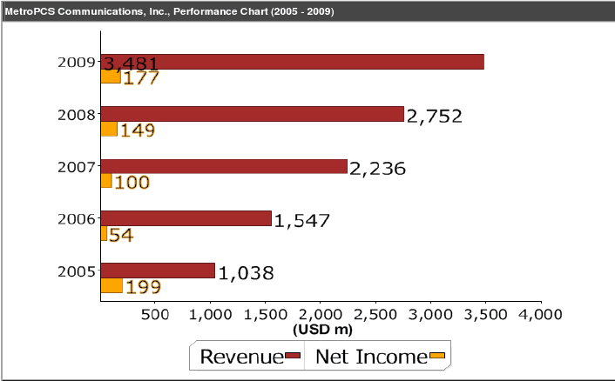
The company reported revenues of $3,480.52 million during the fiscal year ended December 2009, an increase of 26.49% over 2008.
The operating profit of the company was $532.90 million during the fiscal year 2009, an increase of 21.97% over 2008.
The net profit of the company was $176.84 million during the fiscal year 2009, an increase of 18.34% over 2008.
(K.M.)

Slide 65
How has the net income of Metro PCS changed over time?
$1154.31 million increase in 2009 which was 65.39% more then the growth of 2008
Increase of $3.5 billion in total revenue today which was 26.49% more then there revenue of 2008.
(N.G.)

Slide 66
Who can become the potential target market?
People who are afraid of commitment and contracts
Customers with friends and families living overseas
Parents with more then one kids
(N.G.)

Slide 67
How can they create new needs and wants for the target market
Creating new ads and catchphrases
Creating new tools and applications that will make people’s need of phone use more frequent.
Developing new phones
Placing more towers for better reception.
Creating parental control on phones
(N.G.)

Slide 68
Demographics/lifestyles/geographies based on age (Simmons)
 | ELEMENTS | AGE: 10-17 | AGE:18 | AGE: 19 | AGE:20 | AGE:21 | AGE:21-49
AT&T | SAMPLE (000) VERT% HORZ% INDEX BASE | 158 2,343 6.65% 20.6% 124 1.10% | *37 86.5 6.54% .40% 40 .08% | **24 280 40.7% 1.56% 249 .25% | **24 166 19.4% .93% 119 .15% | **16 173 16.2% .96% 99 .16% | 1,032 10,350 19.0% 57.6% 116 9.42%
T-MOBILE | SAMPLE (000) VERT% HORZ% INDEX BASE | 73 1,011 6.97% 8.90% 130 48% | **24 165 12.5% 2.39% 199 .15% | **14 23.4 3.40% .34% 54 0.2% | **17 66.4 7.75% .96% 124 .06% | **20 231 21.7% 3.36% 346 .21% | 561 4,333 7.95% 62.9% 127 3.94%
VERISON | SAMPLE (000) VERT% HORZ% INDEX BASE | 184 2,626 6.52% 23.1% 122 1.24% | *37 128 9.71% .64% 53 .12% | **15 39.0 5.67% .20% 30 .04% | **29 274 32.0% 1.37% 176 .25% | **24 187 17.5% .93% 96 .17% | 1,138 11,260 20,7% 56.4% 114 10.2%
NEXTEL | SAMPLE (000) VERT% HORZ% INDEX BASE | 106 1,067 5.19% 9.39% 97 .50% | **14 189 14.3% 2.65% 220 .17% | **6 18.0 2.61% .25% 40 .02% | **10 138 16.1% 1.93% 248 .13% | **7 67.3 6.32% .94% 97 .06% | 297 3,080 5.65% 43.2% 87 2.80%
(N.G.)

Slide 69
Demographics/lifestyles/geographies based on gender and race (Simmons)
 | ELEMENTS | FEMALE | MALE | RACE: WHITE | RACE: BLACK
PHONES BRANDS OWED: BLACKBERRY | SAMPLE (000) VERT% HORZ% INDEX BASE | **24 261 19.4% .24% 37 .12% | 62 1,087 80.6% 1.06% 167 .51% | 68 811 60.1% .49% 76 .38% | **9 405 30.0% 1.76% 278 .19%
PHONES BRANDS OWED: NOKIA | SAMPLE (000) VERT% HORZ% INDEX BASE | 904 16,353 53.5% 14.9% 103 7.70% | 645 14,187 46.5% 13.8% 96 6.68 | 1,313 25,439 83.3% 15.72% 106 12.0% | 75 2,755 9.02% 12.0% 83 1.30%
(K.M.)

Slide 70
Demographics/lifestyles/geographies BASED ON INCOME (Simmons)
 | ELEMENTS | LESS THAN $10,000 | $10,000- $14,999 | $15,000- $19,999 | $20,000- $24,999
AT&T | SAMPLE (000) VERT% HORZ% INDEX BASE | *37 720 8.08% 4.01% 45 .66% | **30 362 4.53% 2.01% 28 .33% | *45 961 16.1% 5.35% 98 .88% | 68 1,017 13.8% 5.66% 84 .93%
T-MOBILE | SAMPLE (000) VERT% HORZ% INDEX BASE | *34 420 4.71% 6.10% 75 .38% | **12 211 2.65% 3.07% 42 .19% | **17 86.2 1.43% 1.24% 23 .08% | *47 414 5.62% 6.01% 90 .38%
VERIZON | SAMPLE (000) VERT% HORZ% INDEX BASE | **26 800 8.97% 4.00% 49 .73% | *35 450 5.63% 2.25% 31 .41% | **29 192 6.57% 1.96% 36 .36% | *39 734 9.98% 3.68% 55 .67%
NEXTEL | SAMPLE (000) VERT% HORZ% INDEX BASE | *31 816 9.15% 11.4% 141 .74% | **19 616 7.72% 8.64% 119 .56% | **25 765 12.8% 10.7% 197 .70% | *35 461 6.26% 6.45% 96 .42%
(G.D.)

Slide 71
Fall 2009 Media: Demographics – Household
1 Man 24-35
 |  | Total '000 | Proj '000 | Pct Across | Pct Down | Index
Cable: Galavision |  | 7584 | 2488 | 32.8 | 6.6 | 196
American Baby |  | 6891 | 2196 | 31.9 | 5.8 | 190
Fit Pregnancy |  | 2473 | 1054 | 42.6 | 2.8 | 255
Game Informer |  | 9104 | 2952 | 32.4 | 7.8 | 194
Maxim |  | 12542 | 4308 | 34.4 | 11.4 | 205
Official Xbox Magazine |  | 6689 | 2181 | 32.6 | 5.8 | 195
Parenting |  | 9673 | 3063 | 31.7 | 8.1 | 189
WWE Magazine |  | 3869 | 1255 | 32.4 | 3.3 | 194
Mag Types: Babies |  | 10092 | 3246 | 32.2 | 8.6 | 192
Mag Types: Video Games/PC & Console |  | 14946 | 4896 | 32.8 | 13 | 196
(K.M.)

Slide 72
Fall 2009 Media: Demographics – Household
2 Men 24-35
 |  | Total '000 | Proj '000 | Pct Across | Pct Down | Index
Maxim | * | 12542 | 665 | 5.3 | 20.2 | 363
Penthouse | * | 2603 | 130 | 5 | 3.9 | 343
Cable: Galavision | * | 7584 | 361 | 4.8 | 11 | 326
Flickr.com | * | 4656 | 208 | 4.5 | 6.3 | 306
Men's Fitness | * | 7574 | 316 | 4.2 | 9.6 | 286
Cable: Fuse | * | 4663 | 187 | 4 | 5.7 | 275
Entrepreneur | * | 2736 | 108 | 3.9 | 3.3 | 270
American Way | * | 1635 | 62 | 3.8 | 1.9 | 258
(K.M.)

Slide 73
MRI Report
Fall 2009 Media: Demographics - Household
Telephone
Cell phone only (no landline) in household
Total Adults
 |  | Total '000 | Proj '000 | Pct Across | Pct Down | Index
Cable: Adult Swim |  | 16785 | 5763 | 34.3 | 11.9 | 160
Bridal Guide |  | 4216 | 1447 | 34.3 | 3 | 160
Cosmopolitan |  | 18208 | 6145 | 33.7 | 12.7 | 157
In Touch Weekly |  | 7670 | 2559 | 33.4 | 5.3 | 155
Lucky |  | 2265 | 783 | 34.6 | 1.6 | 161
Maxim |  | 12542 | 4633 | 36.9 | 9.5 | 172
Playboy |  | 8954 | 3084 | 34.4 | 6.4 | 160
Rolling Stone |  | 11942 | 4130 | 34.6 | 8.5 | 161
Runner's World |  | 2853 | 1028 | 36 | 2.1 | 168
Spin |  | 1594 | 624 | 39.1 | 1.3 | 182
WWE Magazine |  | 3869 | 1323 | 34.2 | 2.7 | 159
IMDb.com |  | 9275 | 3292 | 35.5 | 6.8 | 165
MTV.com |  | 3502 | 1203 | 34.3 | 2.5 | 160
MySpace.com |  | 35372 | 11846 | 33.5 | 24.4 | 156
Based on this information, we chose to use the Magazines Lucky and Maxim in advertising Metro PCS
(G.D.)

Slide 74
Advertising Budget
Magazines | Length | Pages | Total
Lucky | 12 months | 1 | $1,280,664.00
Maxim | 9 months | 2/3 | $1,025,703.00
Men's Fitness | 10 months | 10 | $1,076,520.00
 |  |  | $3,382,887.00
Newspaper | length | Columns | width | depth | total
New York Times | 3x21 | 3 | 5.7 | 10.5 | $192,348.00
Radio | Frequency (FM) | Time (Sec) | Total
Hot 97 | 97.1 | 0.30 | $219,180
Magazine | $3,382,887.00
Newspaper | $192,348
Radio | $219,180
Total | $3,794,415.00
Total Budget | $ 5,000,000.00
 | -3,794,415
Total that’s left | $ 1,205,585.00
(K.M.)

Slide 77
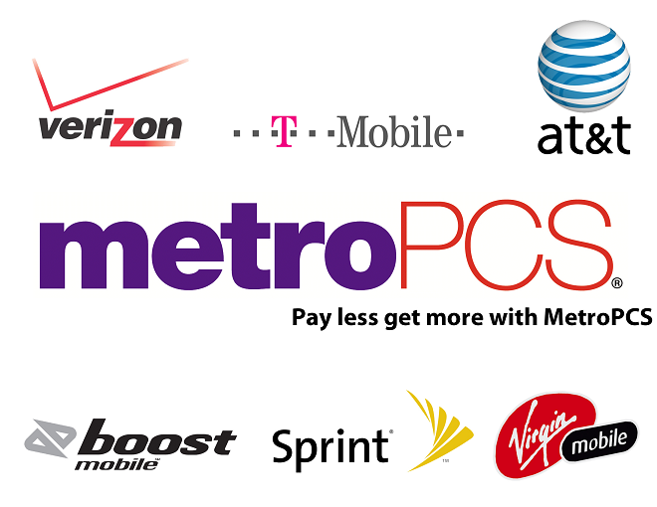

Slide 80
Sources
http://www.consumerelectronicsnet.com/articles/viewarticle.jsp?id=1175081 http://www.mcclatchydc.com/2010/03/24/90996/tight-job-market-is-squeezing.html http://www.highbeam.com/doc/1G1-241522762.html?key=01-42160D517E1A106816080018006C4B2E224E324D3417295C30420B61651B617F137019731B7B1D6B39 http://nces.ed.gov/programs/coe/2010/section2/indicator17.asp
http://www.spherion.com/downloads/Workplace_Snapshot/Workplace_Snapshot_IPod_at_Work.pdf
(N.G.)

