Slide 1
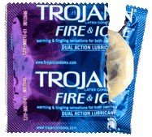
TROJAN FIRE & ICE
Racey Agency
2
Adelina Sisiti
Andrew Greenwald
Christine Leone
Erika Macalinao
Nikole Casimir
Rebecca Thornton

Slide 2
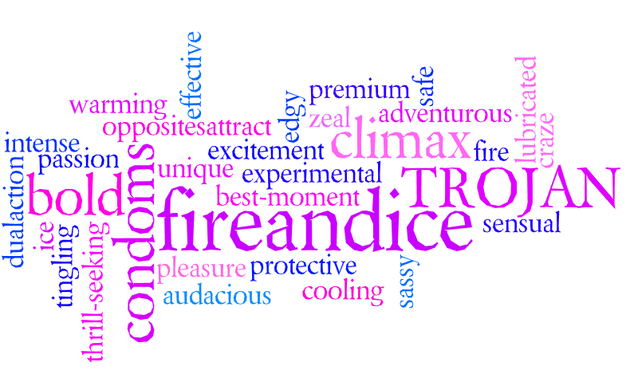
TROJAN FIRE & ICE
Notes:
What describes Trojan Fire and Ice? Edgy, experimental, bold, audacious, premium, sensual, sassy, cooling, thrill-seeking, protective, opposites attract, climax.

Slide 3
It all began in 1927…
Background
Manufactured by the Church & Dwight Company
Trojan was previously owned by two other companies
Young’s Drug Products
Carter-Wallace Inc.
Trojan Fire & Ice is Trojan’s newest brand of condom’s
Regular Trojan Fire & Ice
Trojan MAGNUM Fire & Ice
Notes:
Trojan began selling condoms in 1927 through an ad placed in a trade magazine for pharmacists. The Trojan brand name of condoms is manufactured by the Church & Dwight Company. It’s previous owners were “Young’s Drug Products” in 1920 and “Carter-Wallace Inc.” in 1985. Trojan Fire & Ice condoms just recently came out this 2010. They make the regular Fire & Ice condom and also the Magnum Fire & Ice, which is larger than the standard condoms marketed.

Slide 4
Marketing Strategy
The following Marketing Strategy will ensure the success of Trojan Fire & Ice condoms through a comprehensive promotional effort.
Notes:
As a company, Trojan uses $14 Million of their sales for their advertising budget. Out of the $14 Million, Trojan Fire & Ice is given $2 Million for advertising. The reason they receive 15% of the budget is because Trojan is kicking off the brand and they want it to be a success. Trojan Fire & Ice was just released in March of 2010.

Slide 5
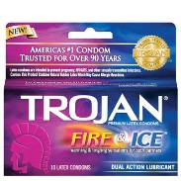
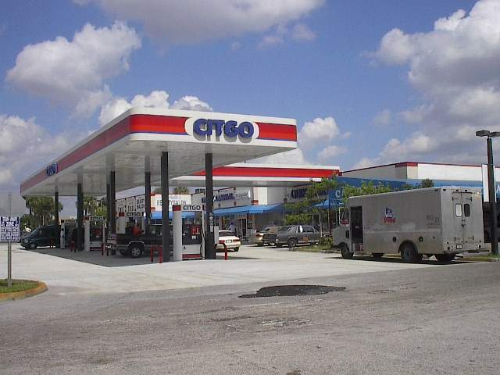
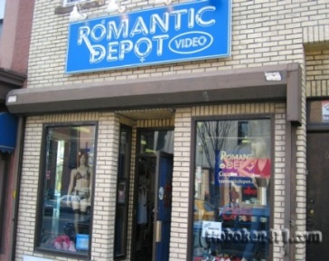
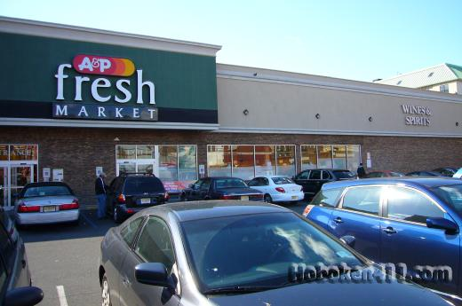
Marketing Mix: 4 P’s
Product
Price: 3 pack = $4.00
10 pack= $11.00
Place
Promotion
Notes:
Product: Trojan Fire and Ice Condoms are uniquely designed as a dual action lubricant inside and out to deliver warming and tingling sensations to both partners. Experience thrilling sensations of pleasure with TROJAN FIRE & ICE Lubricated Condoms specially designed for more passion and excitement.
Price: Our target market consists of pleasure seekers who will want to bay a premium for pleasure. Three packs will be $4.00 and a ten pack will be $11.00.
Place: Trojan Fire & Ice Condoms will be sold at all major drug stores, grocery stores, gas stations and all major sex stores.
Promotion:
Mass Selling
Advertising –The total advertising budget for Trojan Fire and Ice will be 2.5 million.
Publicity – Sponsored Events and street teams that will be giving out our promotional giveways and free condoms. Getting people from the Jersey Shore to take pictures with our condom in their hands.
Sales Promotion
Make the condoms visible next to our other competitors on the shelves of the multiple locations that will be selling the condoms. We will also use contests, coupons, free samples.

Slide 6
Marketing Objective
Trojan as a company is worth $277 Million
$41.45 Million is Fire & Ice.
$2.5 Million is the Advertising Budget for Fire and Ice.
The Marketing Plan for next year is to increase sales by 18% so that the dollar sales for next year are $49.05 Million.
Increase Brand Awareness
Notes:
People buy Trojan Fire and Ice condoms because they are the most trusted condoms in the condom market. As far as brand awareness is involved, we are already a step ahead in the game.
By next year, we would like be at 74% brand awareness.

Slide 7
SWOT Analysis
Strengths
Weaknesses
Opportunities
Threats
Notes:
Strengths:
We are the only condom in the market that offers lubrication for both partners
Weakness:
The condom carters to one specific consumer, those who are thriller seekers and are willing to take risks and try something new,
Opportunities:
The size of the condom market allows for a wide variety of consumers in which our condom
Threat:
Our direct threat is condoms with similar sensations
People who aren’t thrill seekers and therefore don’t want to engage in dual sensation condom
People who don’t wear condoms

Slide 8
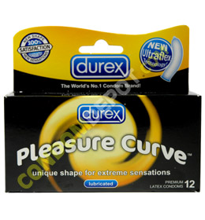
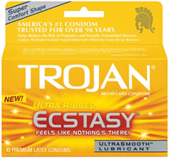
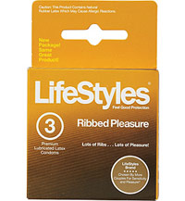
Competition
Inside
Outside
Trojan Shared Pleasure has a similar dual pleasure as Fire & Ice has, except we have warming & tingling effects.
Trojan Ecstasy is another condom that delivers dual sensation. Not as exciting as Fire & Ice.
Durex Pleasure Max is shaped and textured to intensify sensation.
Lifestyles Ribbed Pleasure delivers a textured sensation to both parties.
Notes:
Trojan Fire & Ice competition is mostly within the mother company. With Trojan owning 60% of the condom market, we are competing most with our brother and sister brands. From the outside, there are a few brands that we are aware of. Both Durex and Lifestyle has pleasure providing condoms that could be competitors to Fire & Ice.

Slide 9
Creative Strategy
Desired Action
Barriers
Personality
Best Forms of Communication
Key Insight
Reward
Executional Guidelines
Notes:
Creative Strategy:
Desired Action: to make the consumer aware of the advantages over other condoms and to buy our condoms, then more of them.
Barriers: Limited knowledge of product on the consumers end, consumers uninterested in product, and consumers who are afraid of how the sensation may feel.
Personality: We said some words earlier, but the main personality of our brand is going to be Thrilling, Pleasure-Seeking, Edgy, Passionate, and Aggressive
Best Forms of Communication: Commercials during appropriate times as well as our street teams and promotional events
Key Insight: our customer is the pleasure seeker. they care about pleasure for themselves and their partner above anything else. they are always looking for new ways to spice up their sex life and make new pleasure. We're going to give that to them with our condom
Reward: Because we have dual lubrication-meaning lubrication on both sides, each partner will experience erotic warming and tingling sensations. No other condom offers this...some offer warming, some offer tingling, but none of them have the lubrication on both sides so only one person benefits.
Executional Guidelines: Our legal disclaimer is the basic required message for all condoms. When used correctly, they are 99% effective in protecting against STI's and Pregnancy, etc. Our limits for the creatives are: nothing extremely sexual or over the top for example, Beyonce just did a new campain for her perfume "Heat" and the commercials aren't allowed to run on tv because they are too suggestive. Because our budget is so small, we can't afford to waste money on production costs and then not be able to use the finished product. We want our ads to be energetic, exciting and erotic.

Slide 10
Does size really matter…?
Surveyed target market:
pleasure seekers 18-34
Survey Logistics
AGE
60% 18-21
35% 22-25
5% 25+
GENDER
51% male
49% female
USAGE
85% first time users
Survey Experiences
LOYALTY
90% would use again
4% never again
SENSATIONS
70% of men
90% of women
RATINGS
80% gave 9/10
20% gave 8 or below
Notes:
100 people within our Target Market (pleasure seekers from 18-34 with a sweet spot from 18-24) were given a survey along with a Trojan Fire & Ice condom.

Slide 11
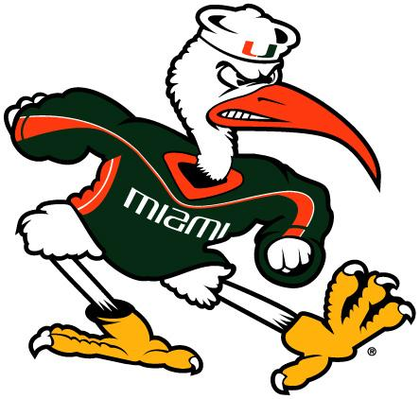
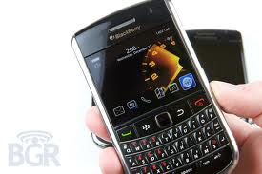
Campaign Overview
What can it do for you?
Use effective, innovative advertising
Online
Applications
Promotions
Street teams/Guerilla Marketing
Events
Commercials
Print Ads
The right amount of ice in the heat of the moment
Notes:
Online: having easy access to our resources (facebook page, easily navigated website)
Applications: New tools for smart phone users
Promotions: free give aways, college tours and events with popular celebrities
Commercials: aired during times that will reach the most of our target market, like during Desperate Housewives and the Jersey Shore
Print ads: Sexy ads in magazines like Cosmo that will spark curiosity
Our campaign is based off of the idea “what can Fire and Ice do for you”
we focused on the ideas of “Freeze your hesitations and melt with our sensations: the new experience from Trojan.”
and “The right amount of ice in the heat of the moment”

Slide 12
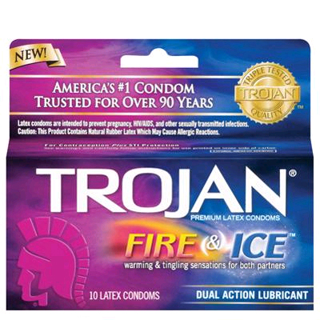
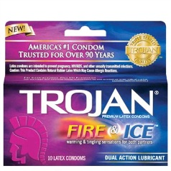
Creative Online/Free Media
Notes:
These are our creative online mediums that we will use to promote Trojan Fire & Ice. We plan to create a Trojan Fire & Ice Facebook page where members can share their personal testimonies on the brand. Also allowing them to interact with others who share the same love for Fire and Ice as they do. On the Twitter account, we will be holding a contest. Whoever tweets the most about fire and ice within a certain time period can get a free trip to a tropical or ski resort of their choice. Lastly our Youtube account will be used for viewers to upload their own commercial to represent our brand. It can either be a sequence of the original commercial we plan on launching, or their own ideas. The videos that get the most hits will be added into our campaign.

Slide 13
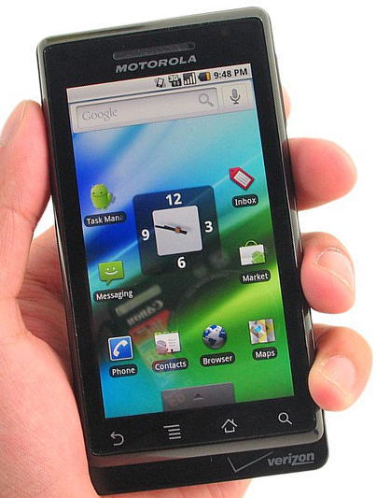
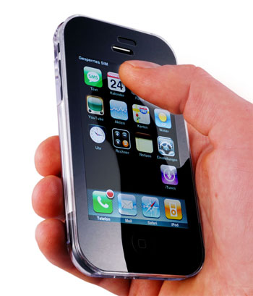
We’ve got an app for that!
Notes:
We will be creating mobile applications for the Andriod, Blackberry, and iPhone. The mobile applications will provide users with sextrology, a daily sex position, and tips on how to enhance your sex life, all of which will be sponsored by Trojan Fire and Ice.

Slide 14
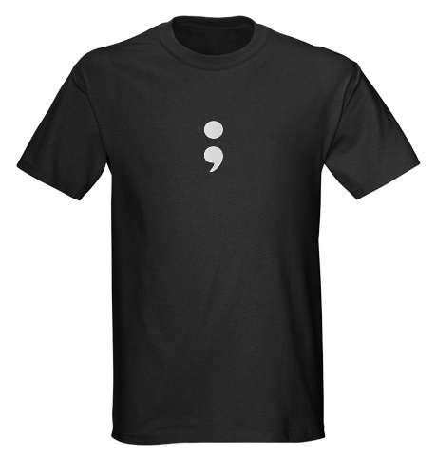
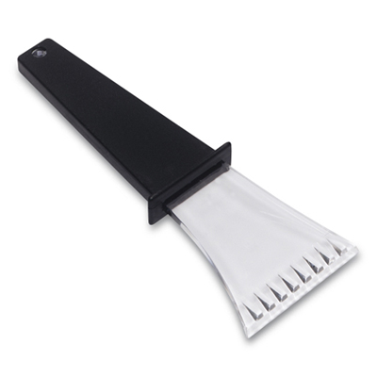
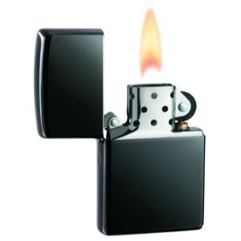
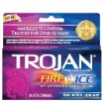
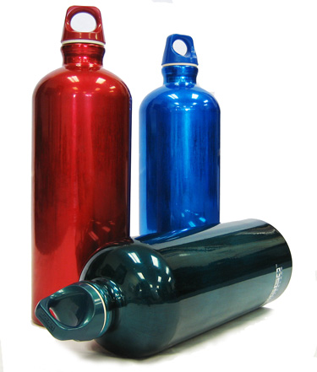
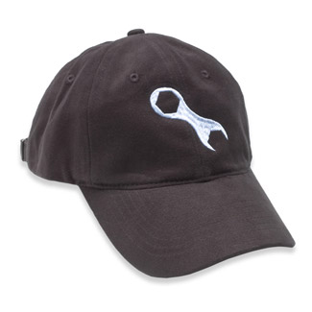
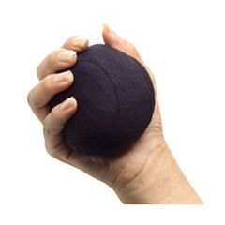
let’s raise awareness…
Notes:
These are some of the free giveaways and promotional items that will be passed out to our target market at their popular venues. Example: The items will be distributed at sporting events, gym, beach, bars/clubs, colleges during our college tour, and other sponsored events. With the wide variety of promotional products, we are hoping to expand our target market and psychographics by appealing to those who are not already in the market. With the confidence that our product provides, we will increase our sales even more.

Slide 15
Let’s talk sex…
College tour!
Notes:
The Trojan Fire & Ice street team will be touring around college campuses to promote sex education through workshops and seminars for the students. By going to college campuses, our target market is seeing our name and recognizing our brand and will be more likely to try and buy the product, therefore increasing our sales. There will be free condoms given away at the seminars along with all of our promotional materials. Traveling from west to east, we plan on stopping at all major university’s. This tour not only gets our brand out there more, but it also promotes sex education and safe sex.

Slide 16
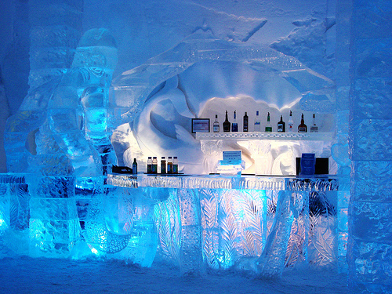
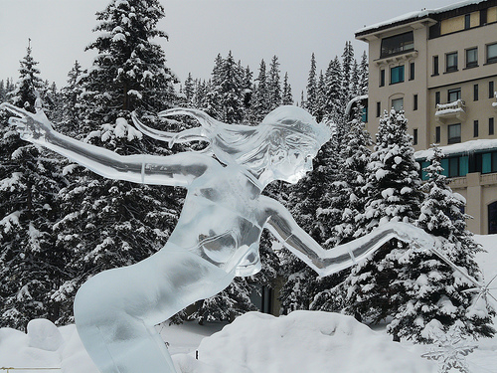
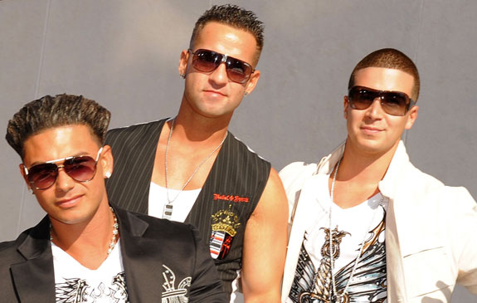
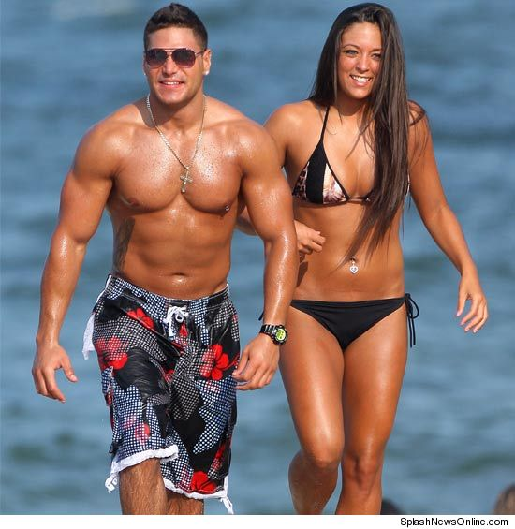
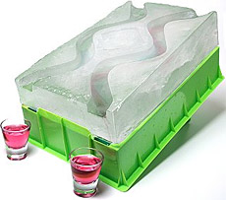
Heat up your senses…
Party With Fire, Play With Ice
Notes:
Trojan Fire & Ice wants to heat up your senses this Spring Break. Trojan Fire & Ice is one of the sponsors for MTV’s 2011 Spring Break, and will be hosting a “Party with fire, Play with Ice” party. The party will be hosted by the cast of Jersey Shore. The theme of the party is party with fire (the jersey shore cast) and play with ice (the décor of the party). The party will be decorated with ice sculptures, ice luges, ice bar, and free Trojan Fire & Ice condoms everywhere, along with all of the other promotional items to be given away. Music will be supplied by DJ Pauly D himself. The whole purpose of the party is to gain exposure for Trojan Fire & Ice condoms and to appeal to the pleasure seeking crowd that is our target market. With the Jersey Shore cast present and hosting the party, our sweet spot within our target market, which is ages 18-24, will be more likely to come, to gain maximum attendance. It will increase brand awareness and ultimately a ploy to increase sales by 7% once the free samples are tested, and the consumers realize the uniqueness of the sensations and the brand.

Slide 17
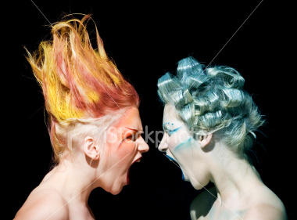
COMMERCIAL
Trojan Fire & Ice:
See what it can do for you!
Notes:
Trojan Fire & Ice: See what it can do for you! Commercial concepts on poster board.

Slide 18
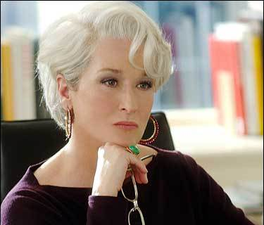
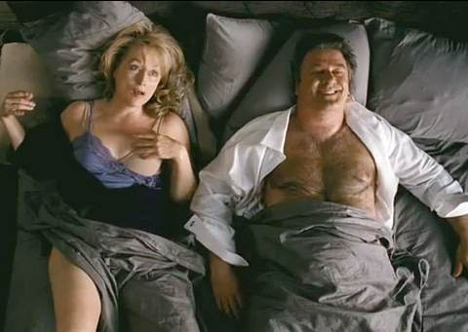
Even the coldest will melt…
Ice…
Meet Fire…
Trojan Fire& Ice, Heat up your senses
Notes:
This print ad will be printed throughout magazines such as: Cosmopolitan, Redbook, Glamour, Maxim, and Essence. This ad features Miranda Priestly, the ice queen from The Devil Wears Prada who always has a smug attitude and never has a smile on her face. It shows her before using Trojan Fire & Ice condoms as her usual insensitive self and then after using Trojan Fire & Ice condoms loosened up lets go. She is stunned by the pleasure that she received. This print ad will cost approximately $190,000.

Slide 19
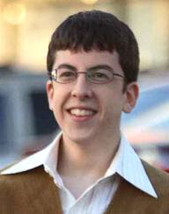
Set your dreams on fire…
Notes:
This print ad features McLovin from the movie “Superbad.” It will be run in magazines such as: GQ, Details, Playboy, and Sports Illustrated. The concept of the ad is that McLovin is “setting his dreams on fire.” With Trojan Fire & Ice condoms, you can make your dreams a reality. McLovin is dreaming about a girl in school who is out of his league, and with the help of Trojan Fire & Ice, and the confidence it gives him, he ends up sleeping with her. This print add will cost approximately $190,000.

Slide 20
Press Release
FOR IMMEDIATE RELASE
Re: Freeze your hesitations and melt with our sensations: the new
experience from Trojan
Trojan Fire & Ice, being a relatively new product, is going to be targeted
towards the younger generation. No other condom offers what we offer. No
only is there dual lubrication, there is also a dual sensation that releases
warming and tingling feelings to both partners.
As we progress in our campaign and advertisements, a formal press release
will be announced to the public. Upcoming events, promotions, print ads,
and commercials will be used to officially launch our product and its brand
new campaign.
Sincerely,
Racey Agency

Slide 21
Lets wrap it up…
Conclusion
Our Agency would be the best fit for this brand because:
We will make sure to utilize all forms of media possible, thus enhancing brand recognition
We will give Trojan Fire and Ice personality, making it attractive to our target audience
Experience the sensations for yourselves, because once you’ve had the best of both worlds, anything else seems mediocre.
Notes:
Pass out Trojan Fire & Ice condoms for trials.

