Slide 1
Reduced expression of pnuts leads to dephosphorylation of the tumor suppressor protein retinoblastoma (rb) through phosphatase activation and caspase-mediated apoptosis in Mcf7 breast cancer cells in a three-dimensional culture
Maria Lane
Bio 490
Fall 2014

Slide 2
Important things to know
What is involved? PP1, PNUTS/PNUTS siRNA, Rb, E2F, CDK, Caspases, Cyclins, and much more!
Cell Cycle/Division
Living conditions of breast cells and cancerous cells (2-D vs 3-D models)
Importance of Rb protein in cancer research
Apoptosis
Antibodies

Slide 3
Retinoblastoma protein
Tumor suppressor protein found in all cells
1st identified as mutated in a rare childhood cancer of the eye
Contains 16 phosphorylation sites
Acts as “brake” for cell division (inactive versus active)
Found to be considerably important in all cancer types
Notes:
In 100% of cancers, Rb pathway is found to be dysfunctional. Rb is considered “a switch” for cell division-active versus inactive-controlled by kinases:enzymes that help regulate cellular movement through the cell cycle. Impossible to know exactly the activity of all 16 phosphorylation sites but it is known that some of them play a role in cell division cycle. Also has a 928 amino acid sequence.

Slide 4
Rb Phosphorylation states
P x15
P x16
Rb
Rb
phosphorylation
(dephosphorylated)
active
(p16 inhibitor)
(phosphorylated)
inactive
Mitogens → Cyclin D synthesis → cdk4/6+cyclin D complex → phosphorylated Rb

Slide 5
Rb Phosphorylation states
P x15
P x16
E2F
Rb
Rb
(dephosphorylated)
active
(phosphorylated)
inactive
E2F
When Rb active: E2F bound=“brake” for cell division
When Rb inactive: E2F not bound=cell proliferation

Slide 6
What is apoptosis?!
“Programmed Cell Death”/Activation of genes to cause the cell to commit suicide
Cancer cells avoid apoptosis
Therefore, how do you kill cells that refuse to die? =caspase mediated apoptosis
Caspases-enzymes that chop up important proteins and cellular structures during apoptosis will cause it, but how is Rb involved?
There are many more complicated steps and specifics involved…..
Notes:
Cancer cells avoid apoptosis and do not need outside signals to allow the cells to even begin the cell cycle. Can grow and divide without growth factors present. Then will invade neighboring cells and negatively affect them→metastisis!

Slide 7
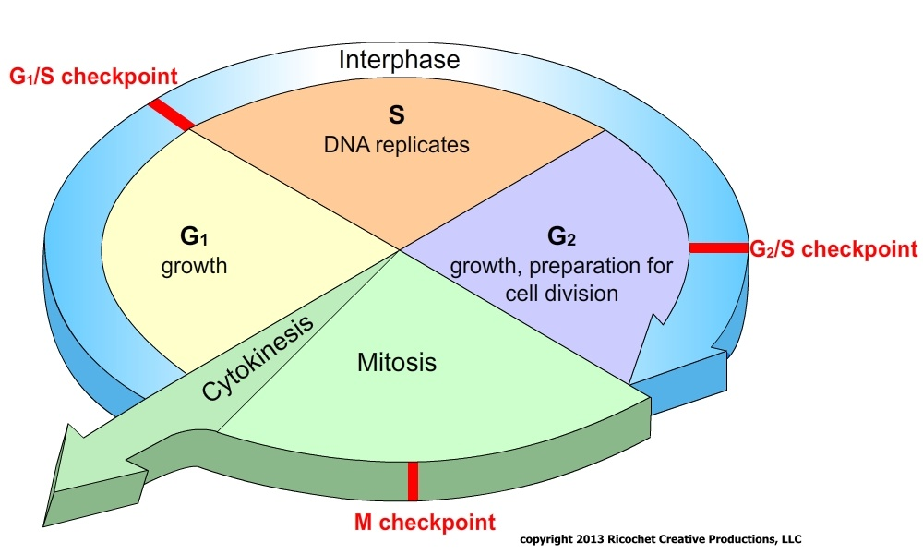
Who remembers…
Cell Cycle

Slide 8
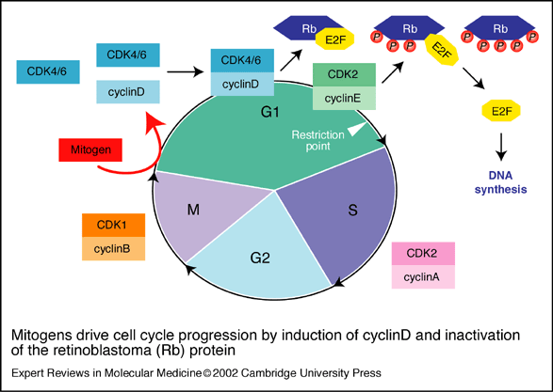
Rb during cell cycle
Notes:
Restriction point: where cancer cells make decision to proliferate when they really should not—leads to excess proliferation of cancerous cells!

Slide 9
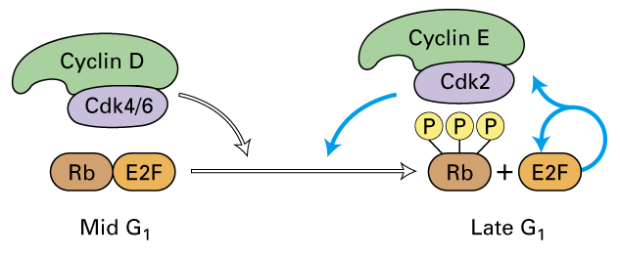
At the restriction point in g1 phase

Slide 10
Notes:
As Rb moves through the cell cycle, it becomes highly phosphorylated. Rb/cell must pass the restriction point first in G1 which is what happens in cancerous cells as they continue to divide and coagulate. THIS IS NOT WHAT WE WANT!

Slide 11
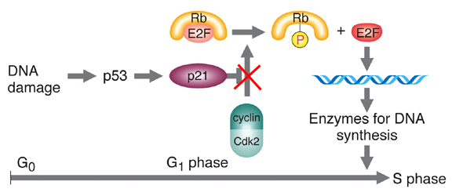
p53: tumor protein that helps regulate cell division acting as a tumor suppressor and attempts to repair damaged DNA; almost always mutated in all cancers
p21: cyclin-dependent kinase inhibitor that suppresses cell cycle
Notes:
When DNA damage occurs, p53 will be activated to bind to p21 which then binds to cyclins and kinases to inhibit their activity in order to allow the cell to go into cell cycle arrest. However cancer cells will continue through cell cycle process instead.

Slide 12
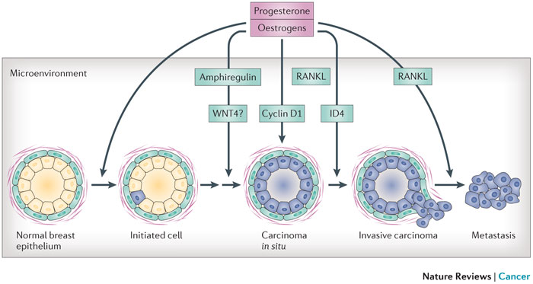
Stages of breast cancer in ducts
Notes:
3-D structure: At the ends of breasts are ducts containing a hollow lumen called mammary acini. Stages: 1. healthy ducts 2. DCS-Ductal carcinoma in-situ 3. Invasive carcinoma (cancer starts to break through duct lining/epithelium 4. Metastatic carcinoma (cancer is now spread and will move to other parts of the body)

Slide 13
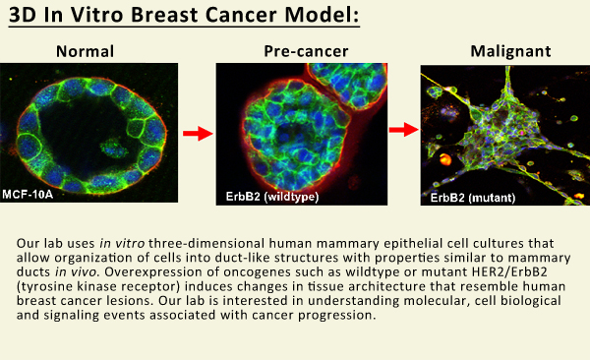
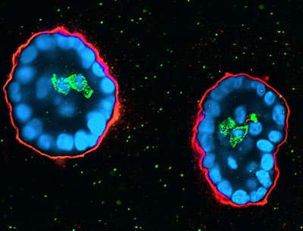
Notes:
Cells shown under a confocal microscope, we can dye the cells in order to track the growth of the cells in the wanted acinar structures as well as track metastasis of the tumors. These photos prove that the cells are growing as in-vitro 3-D cultures while exemplifying properties similar to the cells in-vivo.

Slide 14
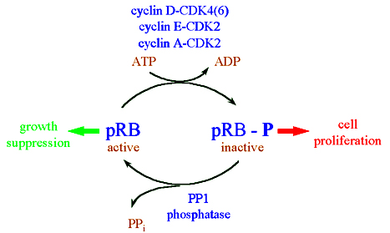
What are we aiming for?
Apoptosis!
Notes:
Protein Phosphatase 1: phosphatase found all over in the body that helps in mediating signaling pathways. It’s targeting subunit, PNUTS, attaches to it to inactive PP1. We want to active PP1 by knocking down PNUTS in order to allow PP1 to target Rb in order to dephosphorylate it.

Slide 15
Usually in cancer cells:
PP1
PNUTS
When PNUTS bound to PP1, PP1=inactive→ cell division continues

Slide 16
What we want for cancer cells:
PP1
PNUTS
When PNUTS not bound to PP1, PP1=active→ cell division stops
Notes:
Based on previous research with PNUTS KD, PNUTS KD only affects cell # in cells that contain Rb deeming this process important and significant. Following this would be dephosphorylation of Rb by PP1, loss of E2F1, inhibition of cyclin-kinases complexes, morphological changes by caspases thus resulting in mediated apoptosis

Slide 17
Begin with:
Introduce:
Initiate activity:
P x16
P x16
PP1
Rb
Rb
PP1
PNUTS
(phosphorylated)
(phosphorylated)
(knockdown)
PNUTS
(activity turned off)
P x15
Cyclin-D
Apoptosis of breast cells
CDK4
Rb
(dephosphorylated)
P x15
Rb
P x15
Caspase-8
Rb
E2F
E2F

Slide 18
Retinoblastoma Activity overview
When Rb is active, it regulates proliferation by inhibiting the TF E2F (“brake”). When inactive or mutant, brake is lost.
Under stress, Rb is dephosphorylated (losing of a phosphate) due to the initiation of Protein Phosphatase 1 (PP1) which then knocks down its binding protein, Phosphatase Nuclear Targeting Subunit (PNUTS).
E2F1 dissociates from Rb once PNUTS is knocked down. (This is against the norm for E2F1-Rb complexes)
Cyclin/Cdk complexes inhibited
Caspase 8 inhibitors (a family of cytosolic cysteine proteases) are activated thus allowing apoptosis to occur within the cancer cells.

Slide 19
How Does one do this?
Quick Overview of Procedures:
1. Cell Culturing in 3-D
2. Protein Extraction
3. Cell Lysis/Protein Concentration Assays
4. Gel Electrophoresis/Western Blotting

Slide 20
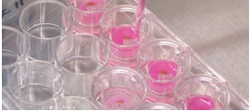
Cell culturing: 3-D Versus 2-D
Why 3-D cultures over 2-D?
More control in densities, compositions of tumor, reduced time efforts, more relatable to real-life tumors
More observable genetic manipulations and changes over time
Matrigel
PNUTS siRNA
Notes:
Tumors grown in the human body are globular,3-D structures (we aren’t 2-dimensional creatures either). Matrigel- extracellular matrix material with specific fibers that allow cells to form in more normal acinar-like structures. Also keep cells in their place. Cells must be fed every four days to stay alive/growing in clumps.

Slide 21
PNUTS sirna
Sequence that was created by an RNA molecule that base paired with mRNA of PNUTS and was cleaved into separate portions. (RNA does not like to be double stranded!)
Engineered sequence that should induce apoptosis in a culture.

Slide 22
Protein, Protein, Protein!
Can’t forget about the most important part, the protein!
Must first be removed out of cell and compared to standard curve to find out how much protein we actually have.
Notes:
Protein extraction/cell lysis: dissolves Matrigel, removes cells from slides, and extracts protein from cells—forms lysate to be used for Cell Lysis. Protein conc=standard curve comparison to elaborate on how much protein we actually have in our samples. This helps us determine how much protein will be loaded into a well of a gel.

Slide 23
Next…
Gel electrophoresis & Western Blot
This is where the amount of protein really matters!
Nitrocellulose paper-four layers (“sandwich”)
Monoclonal (primary) and secondary antibodies
Notes:
Electrophoresis separates proteins by size with the largest sequences at the top and the smallest towards the bottom of the gel. Western Blot:will help us be able to detect how much phosphorylated Rb was left (protein concentrations) (darker bands=more protein picked by by blot at that specific molecular weight)

Slide 24
Results? – figure 1
Notes:
CT-control (just media and cells) NT-sequence of PNUTS siRNA that will not induce apoptosis-does not want to be targeted Seq5 (reg and high)-PNUTS siRNA sequence that was engineering to induce apoptosis in the MCF7 cancer cells Staursporine-positive control-drug introduced that is known to kill off cells.

Slide 25
P-values
CT vs NT | CT vs Seq 5 | CT vsHighSeq 5 | CT vs 48St | CT vs 24St | NT vsHigh Seq5
7.03593e-09 | 6.493e-03 | 8.55882e-16 | 2.33957e-16 | 9.77635e-17 | 1.38456e-05
p-values from two-tailed, unpaired t-tests show all significance-not due to chance
Proves transfection technique does not have an effect on cell viability
NT vs High Seq 5: significant therefore proves PNUTS important in apoptosis!

Slide 26
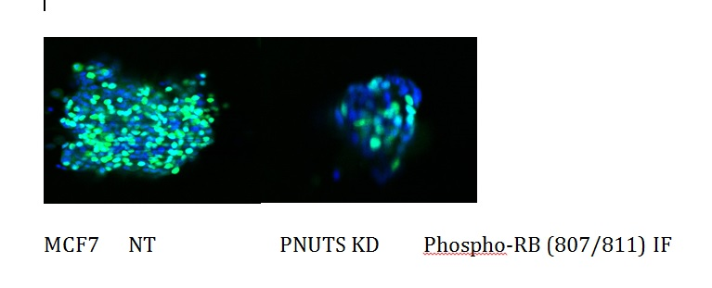
Figure 2
Notes:
MCF7 breast cancer cells were cultured in a Matrigel (3-D) environment and given time to clump thus resembling real life acinar-like structures. MCF7 cells were dyed with a green immunofluorescence [Phospho-Rb antibodies] in order to monitor the amount of phosphorylated Rb in a Non-targeting sample compared to a sample that had PNUTS KD initiated in order to induce apoptosis. The presence of less fluorescence proves that Rb was indeed dephosphorylated in order to knock out PNUTS from the protein thus permitting apoptosis in the 3-D culture. About 70-80% of the MCF7 breast cancer cells undergone apoptosis as shown through this figure. As shown above, breast cancer cells grown in 3-D have highly phosphorylated Rb compared to normal cells(not shown but proven). Also proves that PNUTS KD only affects cell # in cells that contain Rb (not shown).

Slide 27
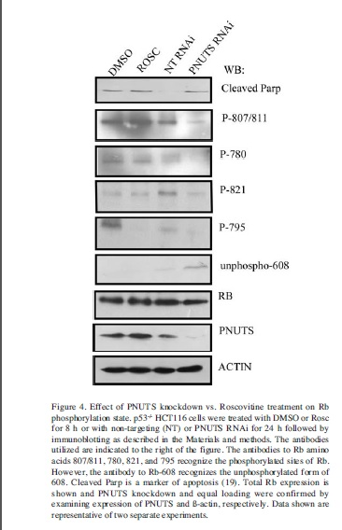
More proof
Notes:
Just to prove that PNUTS KD only affects cell # in cells that contain Rb, here is a western blot of HCT116 colon cancer cells performed by another scientist. Right hand side shows the antibodies to specific Rb amino acids that were used to recognize phosphorylated sites of Rb. Again cleaved parp is a marker of apoptosis. PNUTS band not expressed under PNUTS RNAi lane because presence of Rb allowed disconnection of PNUTS from PP1 to occur thus Rb was invaded by PP1 to KD PNUTS and cause apoptosis.
DMSO was what control cells were treated with as well as Roscovitine.

Slide 28
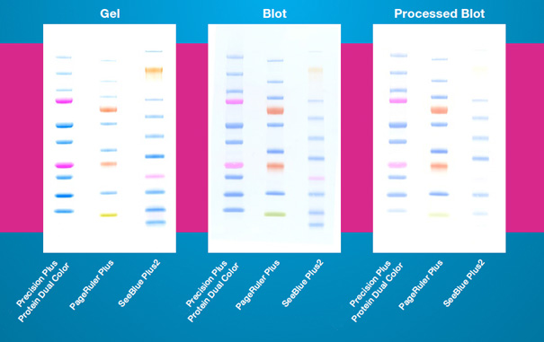
Molecular weight Standard
Notes:
Precision Plus Protein Standard. Ladder exhibits a column of bands all consisting of different weights measured in kilodaltons (kD). Used as a comparable reference for the weight of Rb which bands should be expressed around 110 kD. Standard runs from 10-250 kD (pink-reference stains). Monoclonal pirmary and secondary antibodies are placed on the blot (primary 45 miuntes, secondary overnight). Block (primary) placed to reduce non-specific antibody interactions on the band sequences. The secondary antibody is used in order to bind to the portions of the specific protein we are looking for in order to guide its expression on the blot and limit any background interference. After washed with TBST buffer to remove any leftover antibodies, a labeled probe or dye is introduced on the nitrocellulose to introduce chemiluminesence in order to detect the phosphorylation activity of Rb in a specific sample.

Slide 29
Figure 3
Notes:
Results of Western Blot as performed in Materials and Methods. MCF7 cells undergone UV stress and treated with Roscovitine or DMSO for 24 hours before immunoblotting. Dephosphorylation of Rb is displayed by the migrating, smaller or loss of bands in the second lane of the Rb row. Cleaved Parp and β-actin expression was essential to confirm induction of apoptosis and equal loading of protein in the cultures.
The darker the bands, the more protein that was picked up by the blot at that weight. Bands should not be as present in second columns for Rb-less bands=dephosphorylated Rb.
Figure 3 shows that about 60% of the Rb protein was lost due to Uv stress and about 45% was lost due to treatment with Roscovitine (selective inhibitor of cyclin dependent kinases)

Slide 30
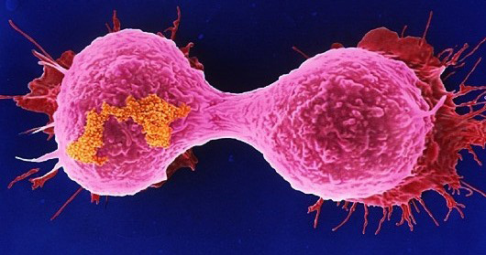
Conclusion
Rb is definitely an important factor in all cancers, apoptosis and the cell division cycle
PNUTS KD does indeed initiate PP1 to bind to Rb thus causing dephosphorylation and a cascade of events leading to mediated apoptosis
Seq 5 (PNUTS siRNA sequence) does cause apoptotic activity within breast cancer cells
PNUTS KD can successfully be carried out in 2-D as well as 3-D cultures
Notes:
Rb found to be highly phosphorylated in most cancers. Other research concluded that PNUTS KD induced apoptosis was found to be Rb dependent in that PP1 activation is only towards Rb and no other substrate thus making Rb an important factor in apoptosis.

Slide 31
Thank you for listening (:
Any questions? Comments?

