Slide 1
Intel
By: Team Baldwin
Sarah Hsiao, Jaehee Lee, Al Li, Amanda Sorrentino and Meg Burke

Slide 2
Agenda
Describe the strategy that Intel followed for its microprocessor business from 1990 to 1996.
Discuss policies about resources developed between 1980 and 1990 that continued to support microprocessors.

Slide 3
Intel’s Purpose
Remain positioned “to be at the heart of this long-term technology build-out, with innovative architectures targeted at key Internet areas”
“Become the main supplier of the building blocks for the Internet economy”
Become and remain the “market lead in microprocessors”
“the preeminent supplier to the new computing industry worldwide”
Produce fast, reliable, improved products in mass quantities
Notes:
-While competition cut back on research and development, Intel’s CEO, Craig Barrett continued investing in R&D in order to
-be the main supplier in the industry
-Intel’s goal was to deliver standards to the new computing world, and it did just that by creating the microprocessor that went in IBM’s first PC
-In this time period, the PC was at the center of computing and Intel was the dominant supplier in the industry.
-Intel’s focus was on performance. Reliability of products was extremely important to the success of the company!

Slide 4
Strategy (1990-1996)
“the preeminent supplier to the new computing industry worldwide”
Protection of microcodes
Negotiations with competitors
Produce fast improved products
Provide exceptional customer service
Court “independent software vendors to write software applications for their leading-edge processors”
Invest in small companies to ensure outsourced bits and pieces of technology were completed in a timely manner
“the creation of a market ecosystem and the development of complementors to drive the system.”
Notes:
-in this time period, the PC was at the center of computing and Intel was the dominant supplier in the industry.
-
-
-Intel’s focus was on performance
-When the Pentium processor proved to be unreliable, Intel’s strategy was to “honor every request” or replacement demand
-”According to Les Vadasz, president of IC, ‘we realized that we alone don’t create the market. We need complementors to help develop and create an ecosystem.’

Slide 5
Marketing Strategy
Red X campaign (1990)
Intel Inside campaign (July, 1991)
Notes:
-why buy a 286 when customers could buy a 386X for the same price? Demand almost immediately exploded
-”fresh new user-friendly look and feel to Intel” “OEMs were required to use the Intel Inside logo in their advertisements, as well as the Intel Inside sticker on their products indicating that the Intel processor was indeed inside”
-Intel Inside had become one of the world’s most recognized brands

Slide 6
Resources Developed – PC/One Size Fits All
Early 1980s- Context of Changing Resource Focus
Intel Market Share <1% DRAMs
Dominated by Japanese – Industry overcapacity
Relates to rapid diffusion of best practices
Importance of differentiation from competitors
Worth investing $600 million for 10% market share?
Generation market share leadership changing
Leave DRAMs – trade off
Preserve “Intel’s legacy” – Moore
Re-established Intel as “innovator”
Importance of supplier relations

Slide 7
Resources Developed-1980s
1981- IBM-PC 1 & “Project Crush”
focus on microprocessors & flash memory
First PC with microprocessor 8086 & 8088
Global and domestic factors influenced market
1983 –1985 -2nd generation 80286, 80386
Licensing of Microprocessors lost revenues
Second sources like AMD
Limited to four licenses “Checkmate”
Controlled Pricing
80386
Intellectual Resources despite second sources
Notes:
Project crush marketing and sales campaign – helped them win contract to put first microprocessor in PC
Still innovative even though latecomer to PCs
Second sources – Manufacturing partners like AMD rights to intel

Slide 8
Resources Developed -1990s
RISC Architecture – Early to mid 1990s
RISC versus CISC processors not compatible
“Intel found its resources divided between two architectures”
Intel focused on 486 processor
Consumer preference
Ideal for capacity emphasis
1994 – Pentium Multiprocessor
Mid 1990s to late 1990s –Intel Capital
“Creation of a market ecosystem” for business strategy

Slide 9
Competences
Early in Memory Chip Industry
DRAM:
100+ Patents: Cross-licensing share
Japanese Manufacturer: Suppliers Integration, Abundant Capital and quality
EPROM: Sole Player
Microprocessor Company (1970s – 1990s)
Early Period: Motorola
Second-Source Strategy: AMD became threat
Lawsuits against AMD, NEC and etc.

Slide 10
Competences cont’d
Microprocessor Company (1990s – 2000s)
Antitrust: competitors’ complaints
AMD Challenges:
Push Intel focus on R&D
Explore all markets (Celeron/Pentium/Xeon)
Mobile segment: new architectural level design
Server Platform: Sun Microsystem, IBM and AMD
64-bit Itanium Processor collaborated with HP
Cellular and Wireless: Texas Instruments
Xscale Architecture

Slide 11
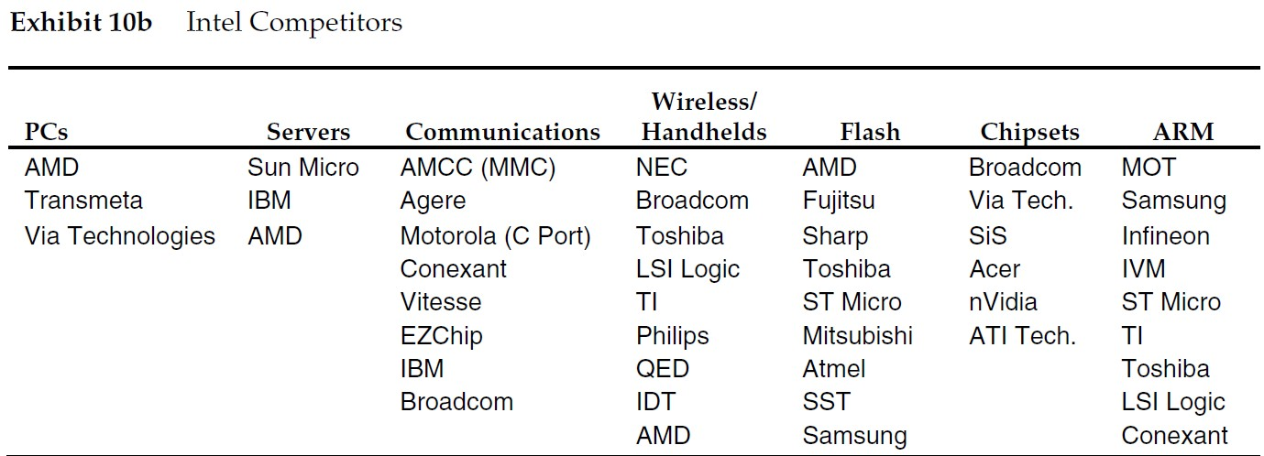
Competences cont’d
Broad Industry Age (2000s – Now)
Rapidly growing AMD and Samsung’s R&D
Large number of incumbent competitors

Slide 12
Horizontal Scope & Emphasis from 1990-1996: Customers
Description: Offer OEM clients and the ultimate end users who are seeking high performing microprocessors or computers with "Intel Inside” in general.
Original Equipment Manufacturers
End Users
PC Makers: IBM, Compaq, Dell *
300 other OEMs (e.g. NCR)
High performance seekers*
Price sensitive consumers around end of 1 year launching
Notes:
The company seeks these customers.
The Intel is seeking customers who need high performing chips in their PC.

Slide 13
Horizontal Scope & Emphasis from 1990-1996: Product
Need
OEM in need of fulfilling demand of the end users
Function
A semiconductor that acts as a computer’s central processing unit that does logics
Technology
RISC Techniques, Algorithm, technologies from second sources, own patents
Pentium MMX (133 MHz) P5 Fifth Generation.
Notes:
Need they satisfy, functions they perform, technologies that they employ
The company satisfied the customers by making strategic trade-off between concentrating on one component with vertical integration all computer peripherals
Software development is always slower than hardware development.
Skim Pricing: New generation chips were generally priced at a premium to limit demand then the price drops 30-50% in less than 1 year to stimulate consumption. Demand always exceeded supply and the company was able to place preferential to its best customers.

Slide 14
Vertical Integration from 1990-1996: Processes
Work with Suppliers
Outsource Algorithm
Collaborate with Software Developers
Notes:
Work with suppliers to gain privileged early access to the most advanced capabilities by investing in the suppliers and pushing for efficiency
Outsource needed algorithm development to the capable companies and manage the completion deadline utilizing Intel Capital.
Collaborate with both major partnership with software developer Microsoft and independent software inventors that can drive demand of high performing processor.

Slide 15
Geographic Dimension of Scope from 1990-1996
The United States where PC makers (e.g. Dell, IBM, Compaq), other OEMs (e.g. NCR) were headquartered
All around the world where the end users were
Customer
Product
Region
Activities
Goal

Slide 16
Organization and Traditions
Corporate spirit- Innovation
Leadership- Visionary, Insightful, Optimistic
Robert Noyce (Co founder): Open and Trustful
Craig Barrett (CEO): Ambitious, Aggressive
Dennis Cater (CMO): Bold, Creative- “Red X,” “Intel Inside”
Paul Otellini (CEO): Change
Notes:
Anticipate the need for new markets outside of PCs, Barrett pursued an aggressive strategy to build new business. Pushing Intel into new markets such as networks, wireless, communications, and online service. He also changed the corporate mission statement. (P.11)
- “The PC was at the center of computing during the 1990s, but… Networking is becoming more important.”
- “Even if we raise performance while lowering average selling prices, the important piece is that we are still driving technology ahead and forcing competition to innovate. (p.13)
(p.12)
Intl management believed that the recession would stimulate a change in industry structure that would work to Intel’s advantage. (p.15)
The meltdown of the communication industry is a great opportunity for us. Intel is making big bets on capital investment in an economic downturn. From a strategic standpoint we can build a gap in performance with advanced technology, but our own challenge is to keep ourselves ready to be the technical supplier of the Internet. (p.15)

Slide 17
Organization and Traditions (cont’d)
Component source
Outside Suppliers -> Manufacture on their own
Structure
Industry categories (Old)- Client platforms; Server platforms; Cellular and wireless; Communication and networking
Customer categories (New)- Digital Enterprise; Digital home; Mobility; Digital health; Channel platforms

