Slide 1
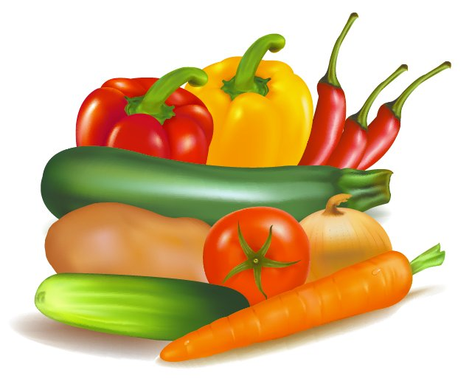
Vegetarianism/ Veganism
Heather Choi

Slide 2
What is Vegetarianism?
- The practice of abstaining from consumption of meat

Slide 3
What is Veganism?
- The practice of abstaining from the use of animal products

Slide 4
Health Benefits of a Vegetarian Diet
Increased healthy heart
Increased skin health
Increased natural consumption of antioxidants

Slide 5
Benefits of Being Vegan
- Decrease in blood sugar levels
Lose weight faster
Lower fat content
More carbohydrates

Slide 6
Top 5 Nutrients Vegetarian Lack
Protein
Iron
Zinc
Calcium
Vitamin B-12

Slide 7
8 Meat Alternatives
Tofu
Quinoa
Veggie Burger
Almonds
Yogurt
Tempeh
Legumes
Cheese

Slide 8
Reasons Why People Choose to have a Vegan or Vegetarian Diet
To lose weight
Good way to help animals
Healthy Lifestyle
Religion
Meat Contamination
“Save the Planet”

