Slide 1
Rockin’ Rococo
Megan Morse

Slide 2
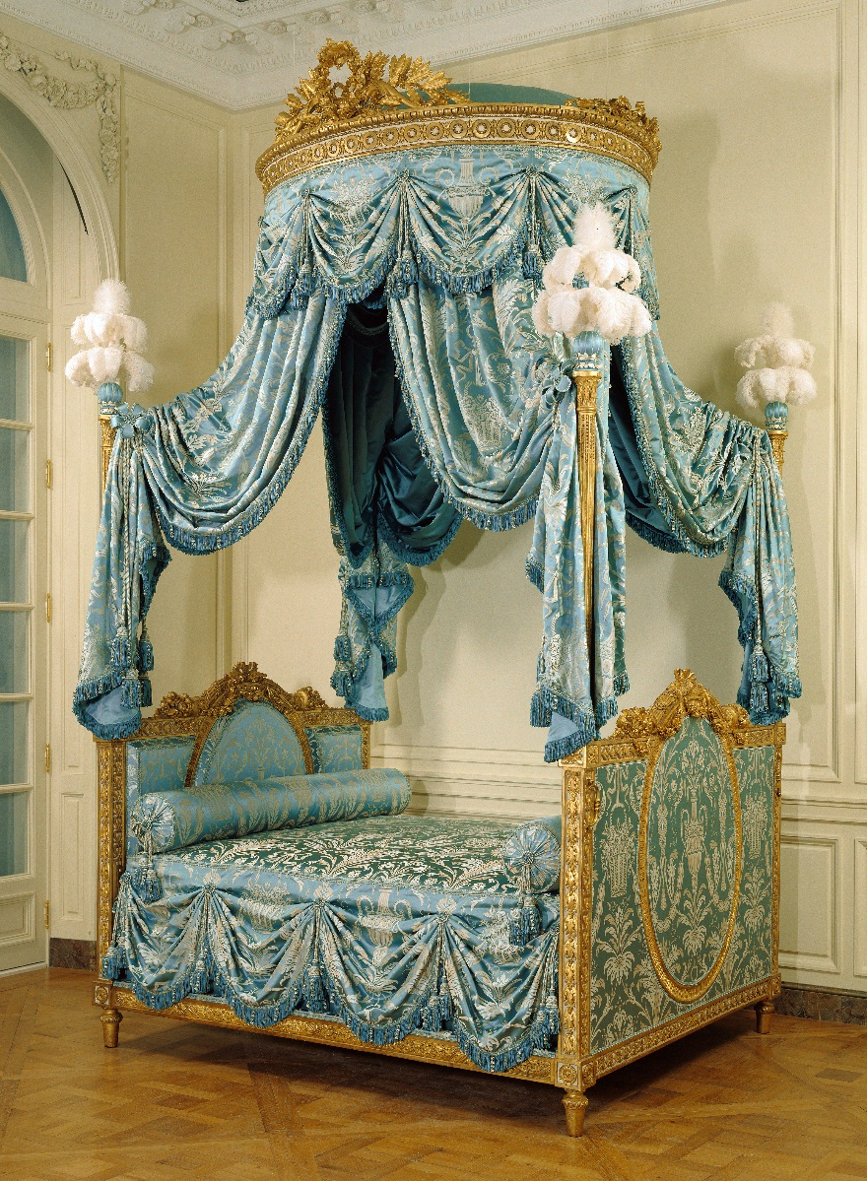
Bed (Lit à la Polonaise)
Unknown French, Paris, about 1775 - 1780 Painted and gilded walnut, gilded iron, modern silk upholstery and passementerie, and ostrich feathers 9 ft. 11 in. x 5 ft. 10 1/2 in. x 7 ft. 5 in. 94.DA.72

Slide 3
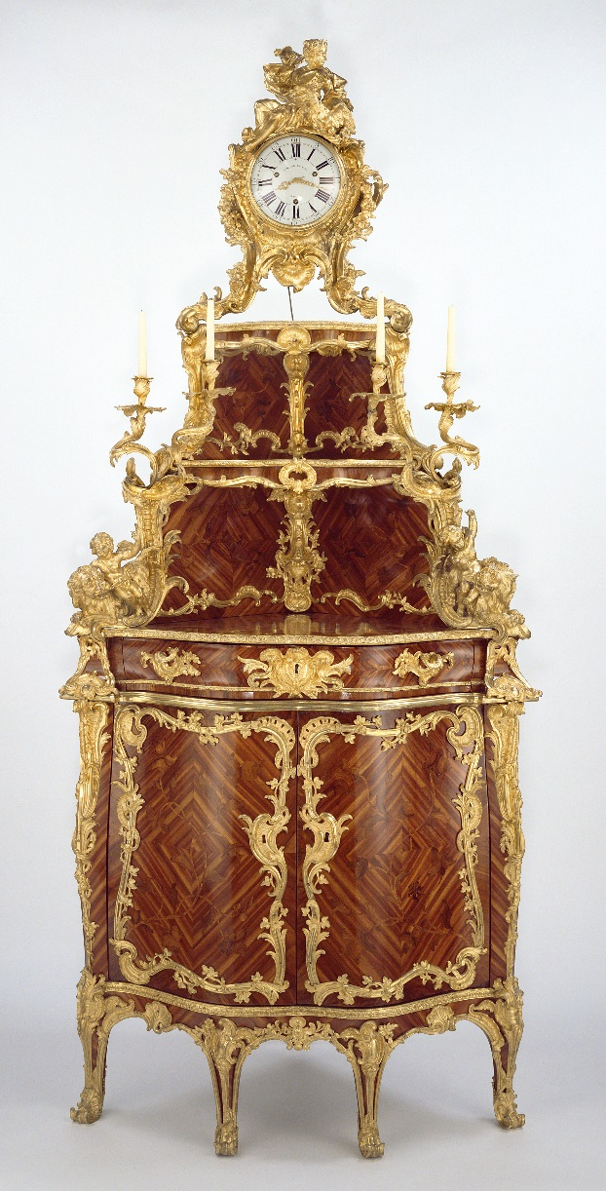
Corner Cupboard
Cabinet by Jacques Dubois; clock movement by Étienne Le Noir; enamel by Antoine-Nicolas Martinière French, Paris, about 1744 - 1752 Oak veneered with bois satiné and rosewood; gilt bronze mounts 9 ft. 6 in. x 4 ft. 3 in. x 2 ft. 4 1/2 in. 79.DA.66

Slide 4
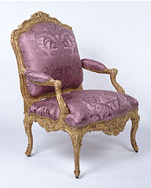
Pair of Armchairs
Unknown French, Paris, about 1730 - 1735 Gilded beechwood; brass casters; modern silk upholstery 94.DA.10

Slide 5
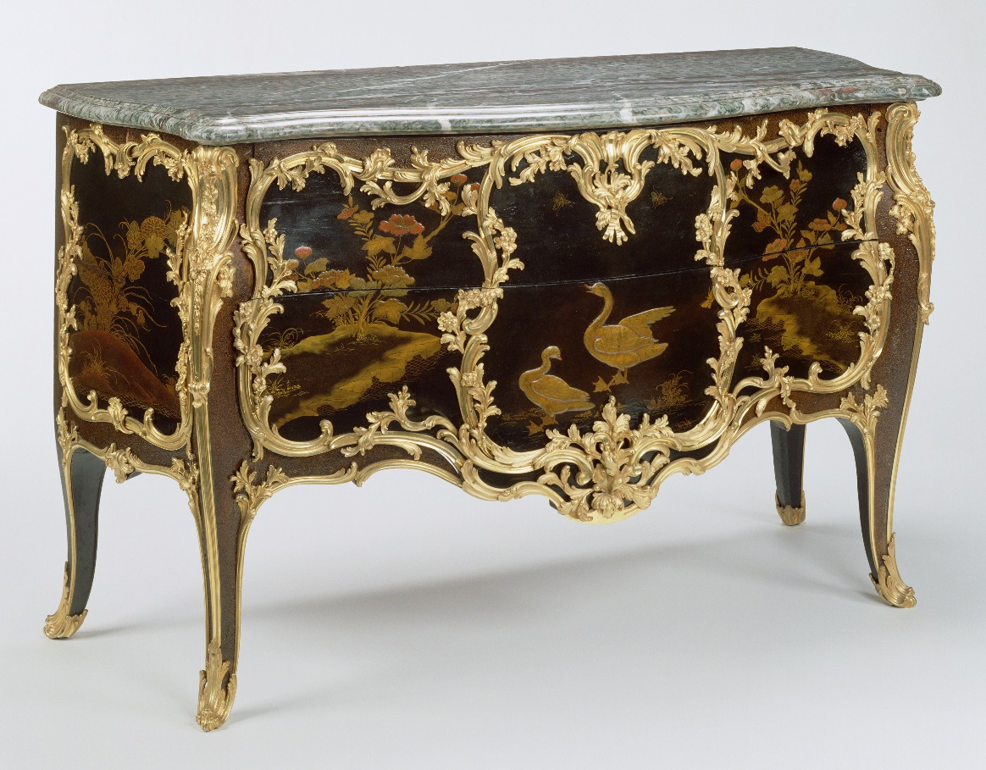
Commode
Attributed to Joseph Baumhauer French, Paris, about 1750 Oak veneered with panels of Japanese lacquer and painted with French vernis Martin; gilt-bronze mounts; campan mélangé vert marble top 2 ft. 10 3/4 in. x 4 ft. 9 1/2 in. x 2 ft. 5/8 in. 55.DA.2

Slide 6
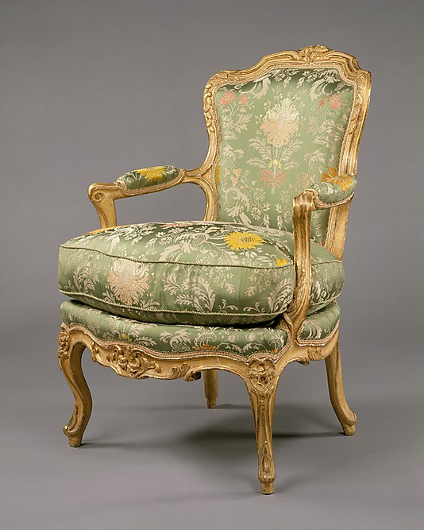
Set of four armchairs (fauteuils en cabriolet)
Date: ca. 1750–60 Culture: French Medium: Carved and gilded beechwood, upholstered in modern green broché Dimensions: Each, 34 1/4 x 25 1/2 x 26 in. (87 x 64.8 x 66cm) Classification: Woodwork-Furniture Credit Line: The Jack and Belle Linsky Collection, 1982 Accession Number: 1982.60.73-.76

Slide 7
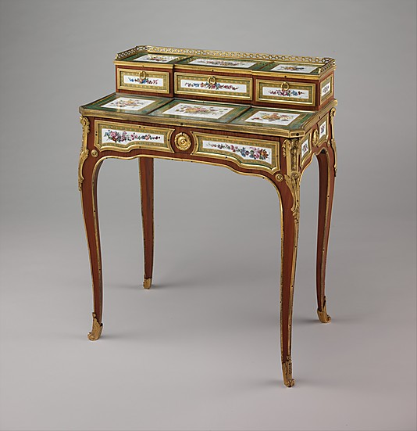
Small writing desk (bonheur-du-jour)
Martin Carlin (French, near Freiburg im Breisgau ca. 1730–1785 Paris)
Factory: Porcelain plaques by Sèvres Manufactory (French, 1740–present) Decorator: Decorated by Denis Levé (active 1754–93, 1795–1805) Date: ca. 1768 Culture: French, Paris and Sèvres Medium: Oak veneered with tulipwood, amaranth, and stained sycamore; mahogany; seventeen soft-paste porcelain plaques; gilt bronze mounts; velvet (not original) Dimensions: 32 1/2 x 25 7/8 x 16 in. (82.5 x 65.7 x 40.6 cm) Classification: Woodwork-Furniture Credit Line: Gift of Samuel H. Kress Foundation, 1958 Accession Number: 58.75.48

Slide 8
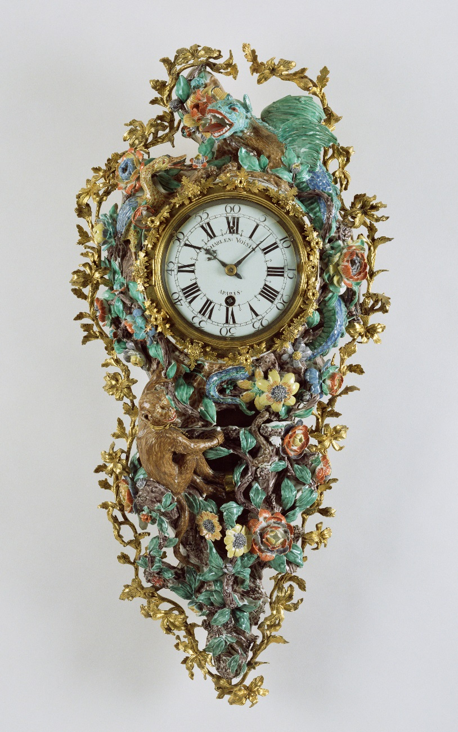
Wall Clock (Pendule d'alcove)
Movement by Charles Voisin, clockmaker; clock case made at the Chantilly Porcelain Manufactory French, Paris and Chantilly, about 1740 Soft-paste porcelain; gilt bronze; enameled metal; glass 2 ft. 5 1/2 in. x 1 ft. 2 in. x 4 3/8 in. 81.DB.81

Slide 9
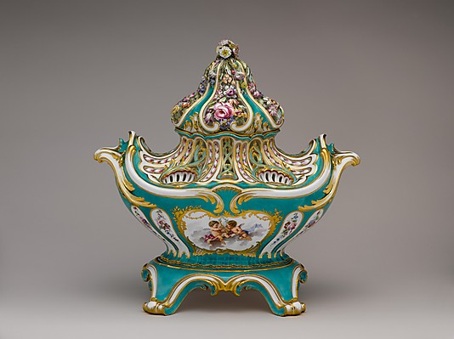
Potpourri vase (pot-pourri gondole)
Sèvres Manufactory (French, 1740–present)
Modeler: Jean-Claude Duplessis (ca. 1695–1774, active 1748–74) Decorator: Attributed to Charles-Nicolas Dodin (1734–1803) Date: 1756–57 Culture: French, Sèvres Medium: Soft-paste porcelain Dimensions: Overall, body with lid (confirmed): 12 3/16 x 14 1/4 x 7 3/4 in. (31 x 36.2 x 19.7 cm); Overall, base (confirmed): 2 5/16 x 9 x 5 1/4 in. (5.9 x 22.9 x 13.3 cm); Height assembled (confirmed): 14 1/8 in. (35.9 cm) Classification: Ceramics-Porcelain Credit Line: Gift of Samuel H. Kress Foundation, 1958 Accession Number: 58.75.88a–c

Slide 10
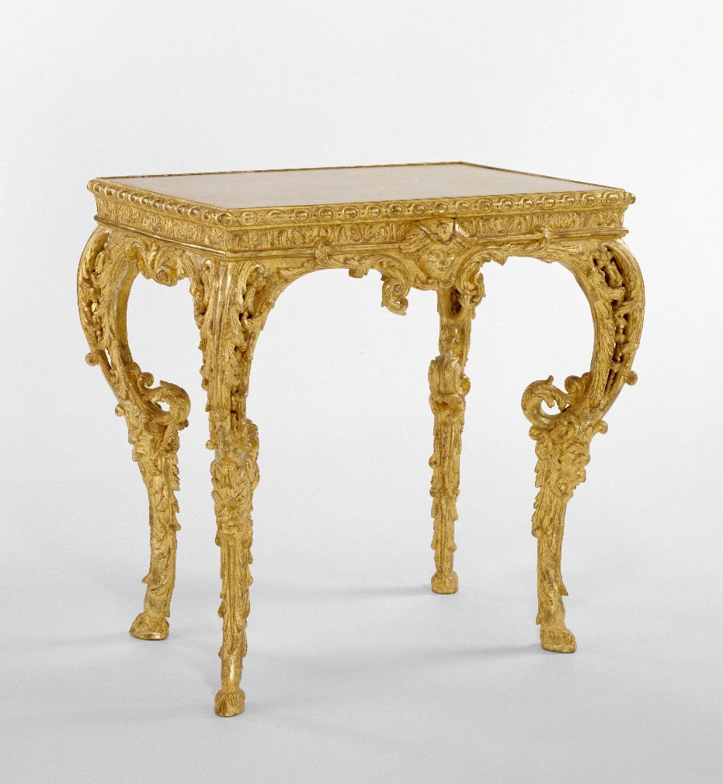
Table or Stand
Unknown French, Paris, about 1700 - 1715 Gilded oak; pine H: 2 ft. 1/2 in. x W: 2 ft. 6 1/2 in. x D: 1 ft. 8 1/2 in. 90.DA.23

Slide 11
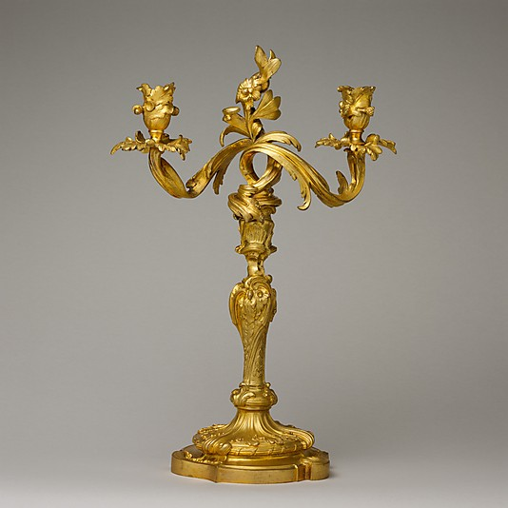
Pair of two-light candelabra
Date: ca. 1745–55 Culture: French Medium: Gilt bronze Dimensions: Each: H. 15 7/8 x W. 11 in. (40.3 x 27.9 cm) Classification: Metalwork-Gilt Bronze Credit Line: Gift of Mr. and Mrs. Charles Wrightsman, 1979 Accession Number: 1979.172.7, .8

Slide 12
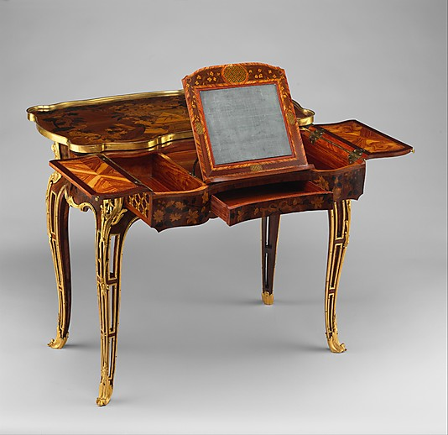
Mechanical table
Jean-François Oeben (1721–1763)
Maker: and Roger Vandercruse, called Lacroix (French, 1727–1799) Date: ca. 1761–63 Culture: French Medium: Oak veneered with mahogany, kingwood, and tulipwood, with marquetry of mahogany, rosewood, holly, and various other woods; gilt-bronze mounts; imitation Japanese lacquer; replaced silk Dimensions: H. 27 1/2 in. (69.8 cm), W. 32 1/4 in. (81.9 cm), D. 18 3/8 in. (46.7 cm) Classification: Woodwork-Furniture Credit Line: The Jack and Belle Linsky Collection, 1982 Accession Number: 1982.60.61

Slide 13
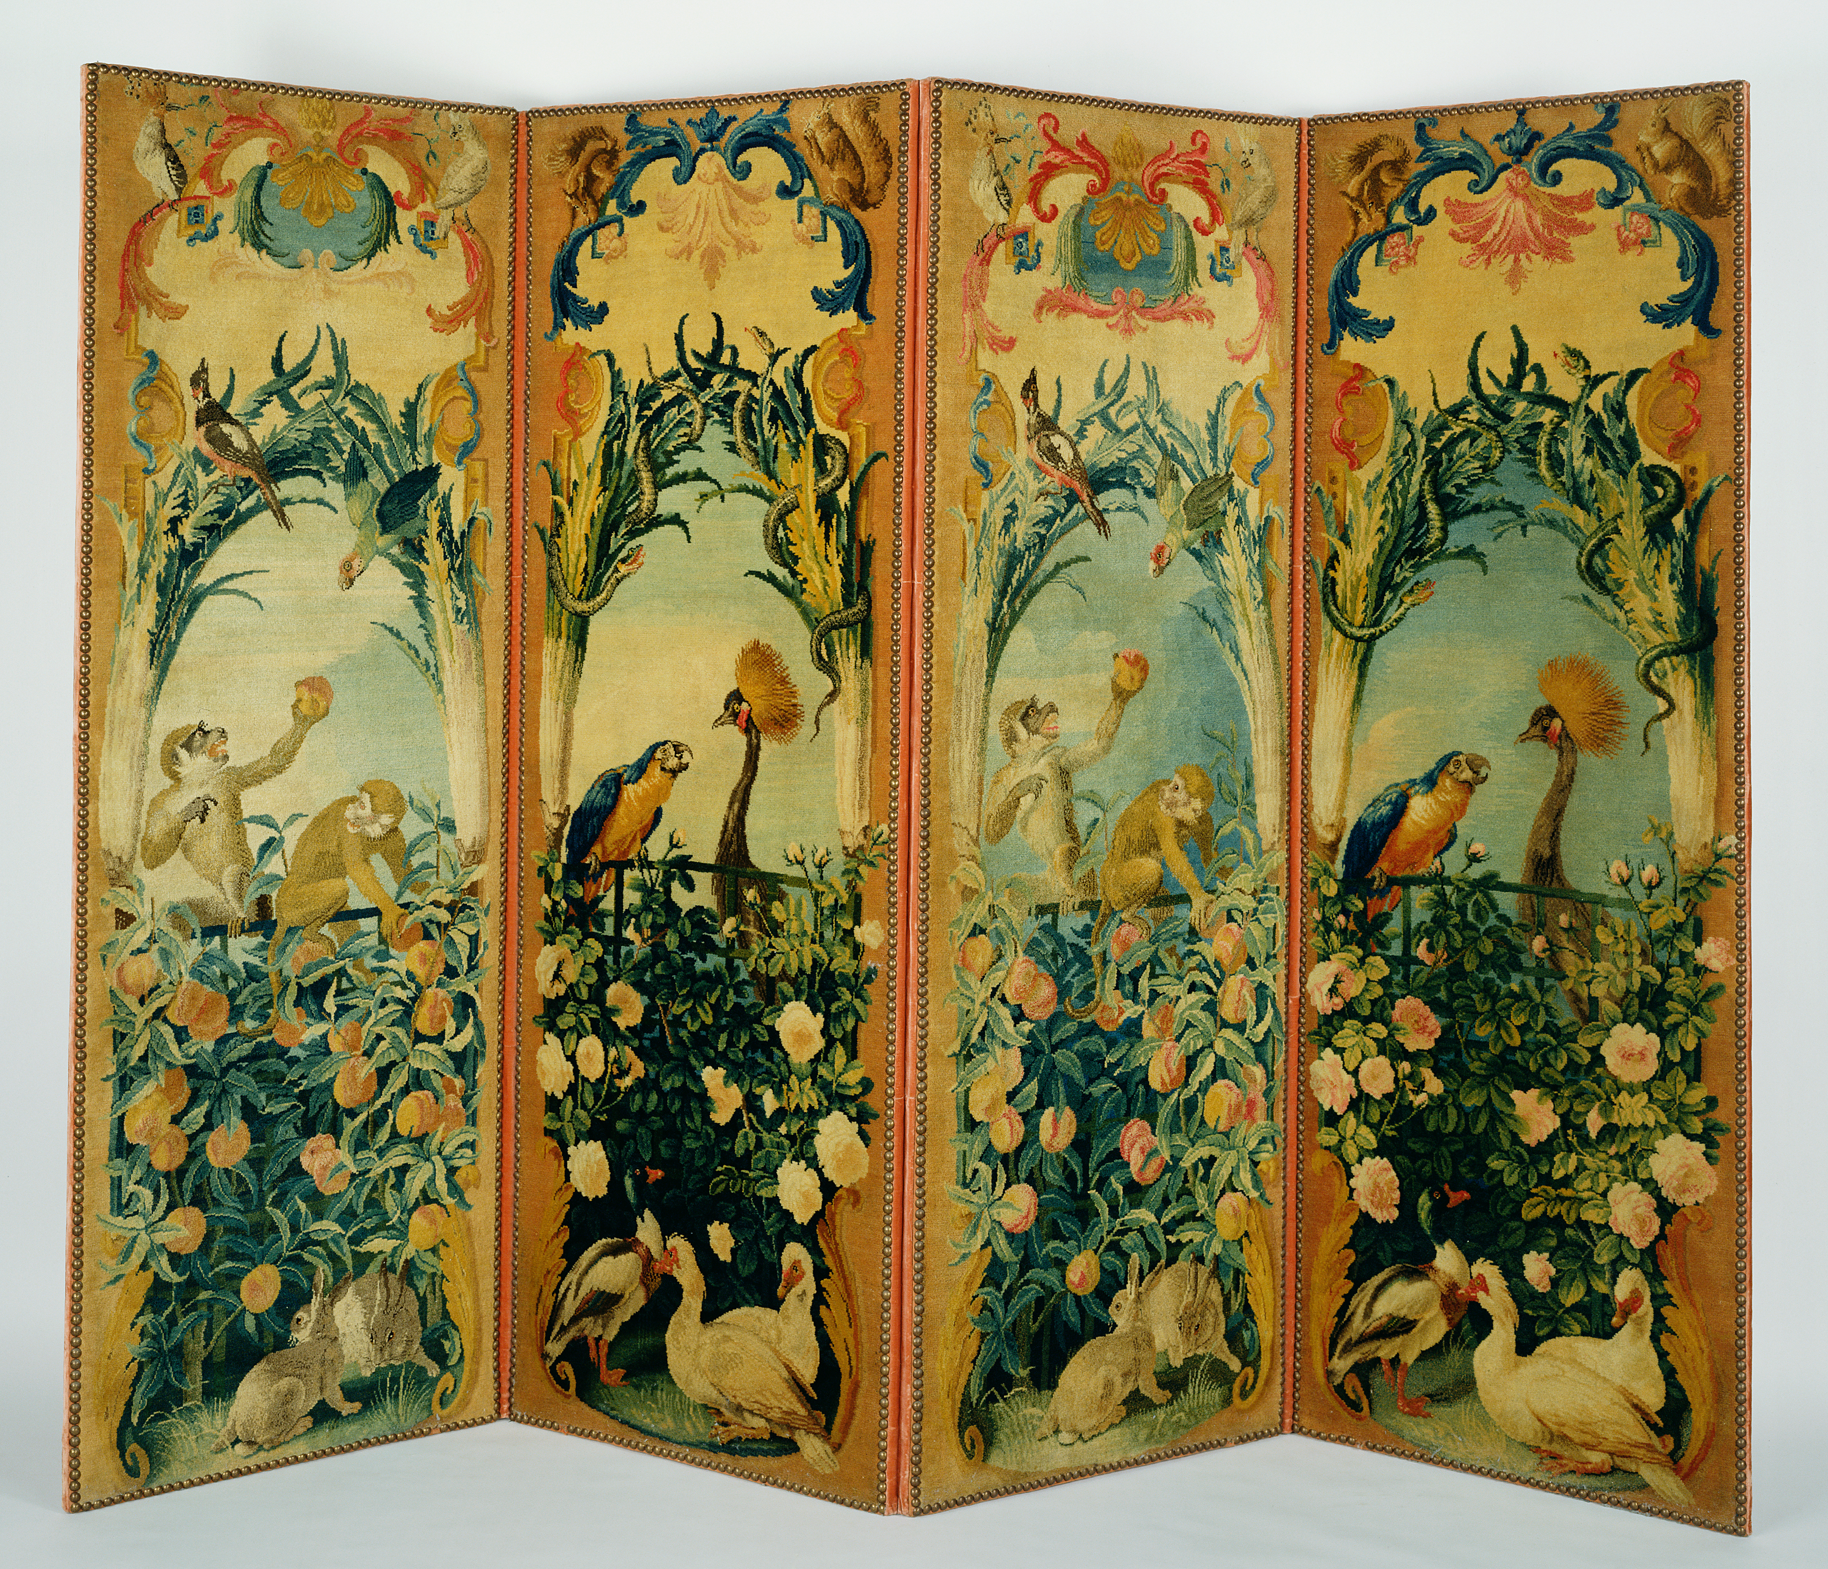
Four-Panel Screen
1719 - 1784,
Wool and linen; wood frame; modern cotton-twill gimp; modern silk velvet; modern brass nails
Object: H: 185.4 x W: 254 cm (6 ft. 1 in. x 8 ft. 4 in.)
The J. Paul Getty Museum, Los Angeles

Slide 14
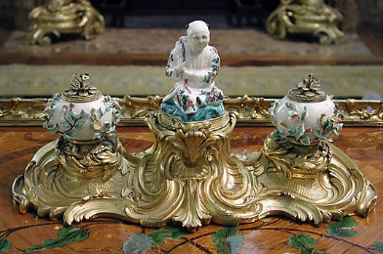
Inkstand (écritoire)
Villeroy
Maker: Gilt-bronze mounts attributed to Jean-Joseph de Saint Germain (1719–1791) Date: ca. 1740–48 Culture: French, Villeroy Medium: Soft-paste porcelain, gilt-bronze mounts Dimensions: H. 6 11/16 x W. 13 11/16 x D. 6 3/4 in. (17.0 x 34.8 x 17.1 cm) Classification: Metalwork-Gilt Bronze Credit Line: Gift of Mr. and Mrs. Charles Wrightsman, 1976 Accession Number: 1976.155.155

Slide 15
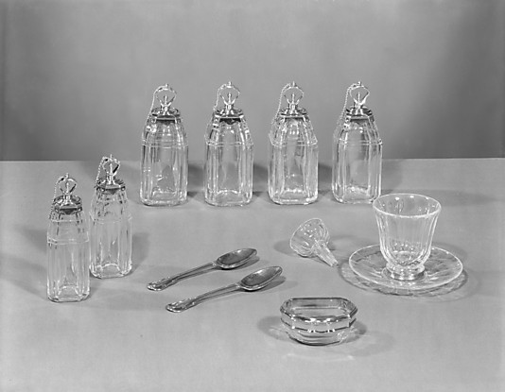
Toilet set
Louis Mailly (master 1723, died 1739)
Maker: Jean Écosse (master 1705, died 1741/3) Maker: Noël Hardivillers (master 1729, died 1779) Date: 1728–30 Culture: French, Paris Medium: Rock crystal, gold Classification: Metalwork-Gold and Platinum Credit Line: Gift of Mr. and Mrs. Charles Wrightsman, 1976 Accession Number: 1976.155.47a, b–.58

Slide 16
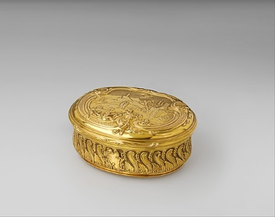
Snuffbox
Jean Ducrollay (born 1709, master 1734, recorded 1760)
Date: 1736–37 Culture: French, Paris Medium: Gold Dimensions: Overall: 1 9/16 x 3 5/16 x 2 11/16 in. (4 x 8.4 x 6.8 cm) Classification: Metalwork-Gold and Platinum Credit Line: Gift of Mr. and Mrs. Charles Wrightsman, 1976 Accession Number: 1976.155.7

Slide 17
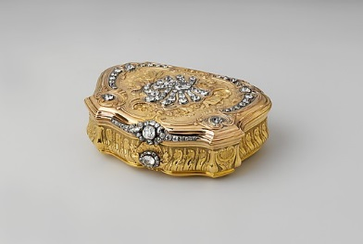
Snuffbox
Daniel Govaers (or Gouers) (French, master 1717, active 1736)
Date: 1734–35 Culture: French, Paris Medium: Gold, diamonds Dimensions: 1 x 3 1/4 x 2 3/8 in. (2.5 x 8.3 x 6cm) Classification: Metalwork-Gold and Platinum Credit Line: Bequest of Catherine D. Wentworth, 1948 Accession Number: 48.187.419

Slide 18
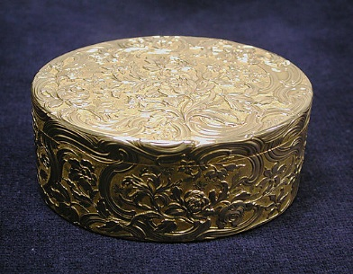
Snuffbox
Jean Moynat (master 1745, died 1761)
Date: 1750–51 Culture: French, Paris Medium: Gold Dimensions: 1 1/2 x 3 1/2 x 2 3/4 in. (3.8 x 8.9 x 7cm) Classification: Metalwork-Gold and Platinum Credit Line: Bequest of Catherine D. Wentworth, 1948 Accession Number: 48.187.448

Slide 19
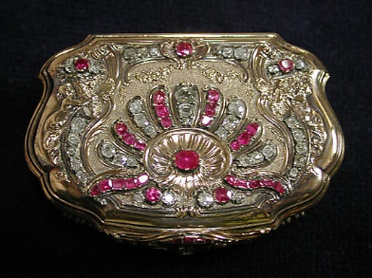
Snuffbox
Daniel Govaers (or Gouers) (French, master 1717, active 1736)
Date: 1733–34 Culture: French, Paris Medium: Gold, rubies, diamonds Dimensions: 7/8 x 2 3/4 x 2 in. (2.2 x 7 x 5.1cm) Classification: Metalwork-Gold and Platinum Credit Line: Bequest of Catherine D. Wentworth, 1948 Accession Number: 48.187.420

Slide 20
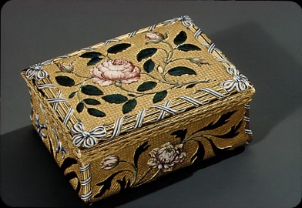
Snuffbox
Jean Moynat (master 1745, died 1761)
Date: 1747–49 Culture: French (Paris) Medium: Gold, enamel Dimensions: 1-3/8 x 3-1/8 x 2-3/8 in. (3.5 x 7.9 x 6.0 cm) Classification: Metalwork-Gold and Platinum Credit Line: Bequest of Catherine D. Wentworth, 1948 Accession Number: 48.187.426

Slide 21
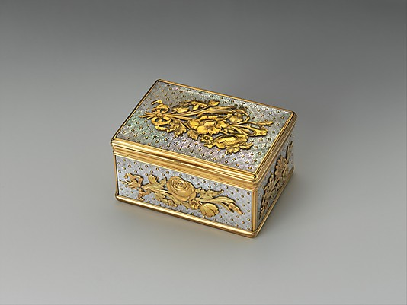
Snuffbox
Date: 1738–44 Culture: French (Paris) Medium: Gold, mother-of-pearl Dimensions: 2-1/2 x 1-13/16 x 1-1/4 in. (6.4 x 4.6 x 3.2 cm) Classification: Metalwork-Gold and Platinum Credit Line: The Lesley and Emma Sheafer Collection, Bequest of Emma A. Sheafer, 1973 Accession Number: 1974.356.657

Slide 22
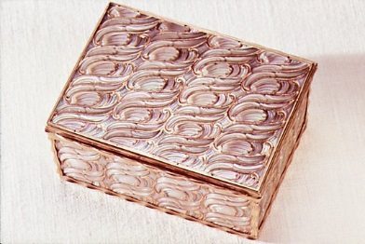
Snuffbox
Date: 1744–45 Culture: French, Paris Medium: Gold, mother-of-pearl Dimensions: 1 3/8 × 2 15/16 × 2 1/4 in. (3.5 × 7.5 × 5.7 cm) Classification: Metalwork-Gold and Platinum Credit Line: Gift of Mr. and Mrs. Charles Wrightsman, 1976 Accession Number: 1976.155.12

Slide 23
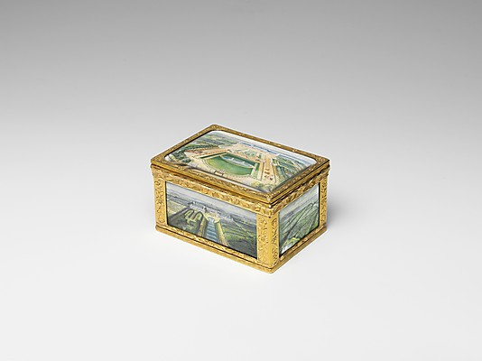
Snuffbox
Possibly by Pierre-François Delafons (master 1732, died 1787)
Artist: Miniatures by Louis Nicolas van Blarenberghe (French, Lille 1716–1794 Fontainebleau) Date: 1748/49, miniatures 1767 Culture: French, Paris Medium: Gold, vellum Dimensions: Overall: 1-3/4 x 3-1/8 x 2-1/4 in. (4.4 x 7.9 x 5.7 cm) Classification: Metalwork-Gold and Platinum Credit Line: Gift of Mr. and Mrs. Charles Wrightsman, 1976 Accession Number: 1976.155.22

Slide 24
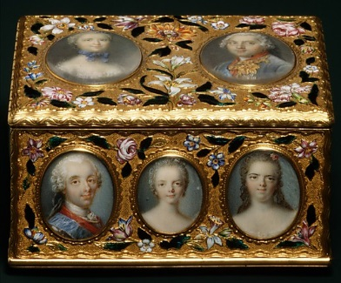
Double snuffbox
Jean Ducrollay (born 1709, master 1734, recorded 1760)
Date: 1749–50 Culture: French, Paris Medium: Gold, enamel, vellum, gouache, glass Dimensions: H. 1-3/4 × W. 3-3/16 × D. 2-1/4 in. (4.4 × 8.1 × 5.7 cm) Classification: Metalwork-Gold and Platinum Credit Line: Gift of Mr. and Mrs. Charles Wrightsman, 1976 Accession Number: 1976.155.21

Slide 25
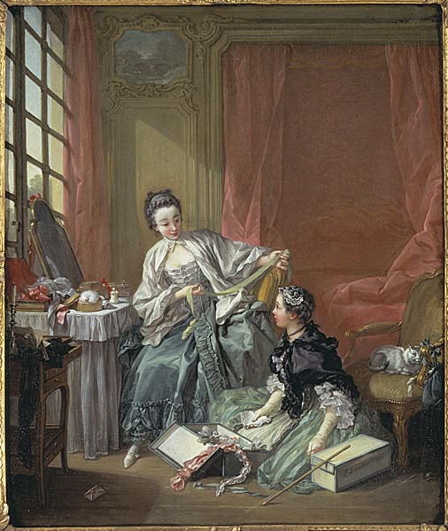
The Milliner
Oil on canvas
DimensionsDimensions: (h x b) 64 x 53 cm
Frame: (h x b x dj) 90 x 80 x 12 cm
DatingSign. 1746
Artist/MakerArtist: François Boucher, French, born 1703, dead 1770
CategoryPaintings, Paintings
Inventory No.NM 772
National Museum Stockholm

Slide 26
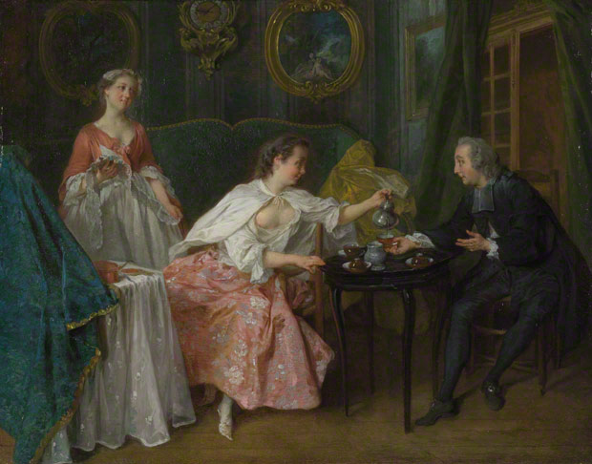
The Four Times of Day: Morning
Nicolas Lancret
1739
Oil on copper
28.3 x 36.4 cm
National Gallery NG5867

Slide 27
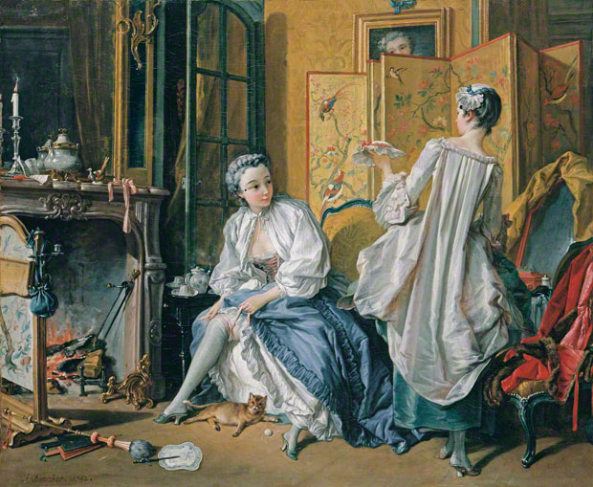
François Boucher
La toilette
1742
Oil on canvas. 52.5 x 66.5 cm
Museo Thyssen-Bornemisza, Madrid
INV. Nr. 58 (1967.4)

Slide 28
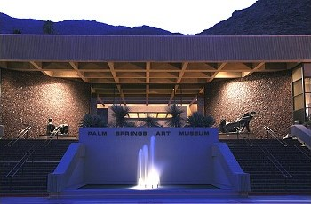
Palm Springs Art Museum

Slide 29
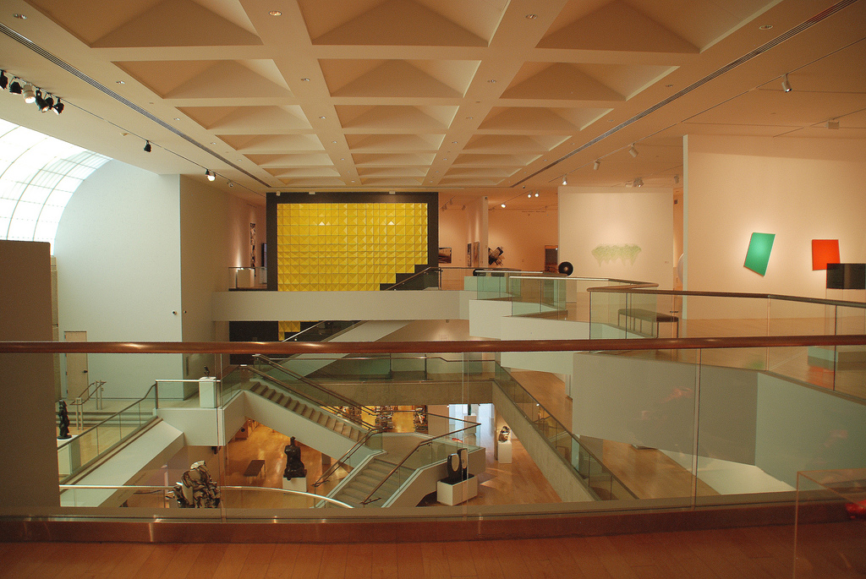

Slide 30
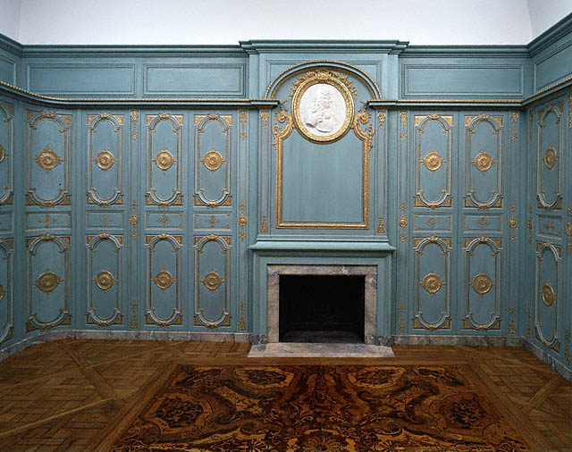
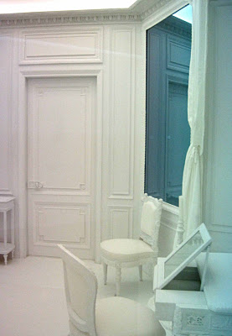
Room 1
Attributed to Jules Degoullons (French, 1671 - 1738, active 1720)
Paneling, about 1720, Oak, carved, painted and gilded
Object: H: 305 cm (H: 10 ft. )
The J. Paul Getty Museum, Los Angeles
Katrin Sigurdardottir’s “Boiserie” at the Met

Slide 31
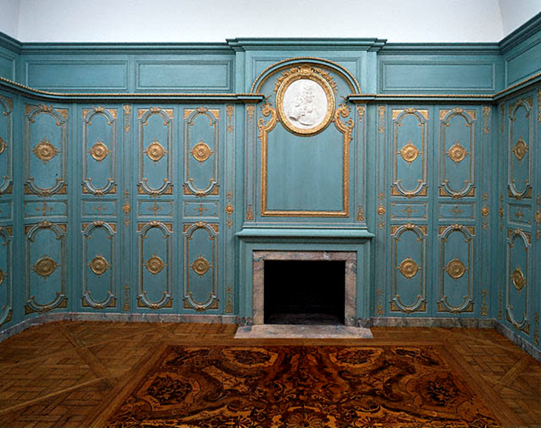
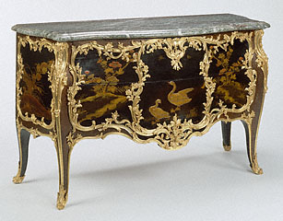
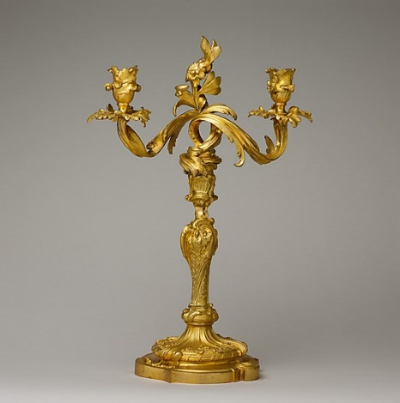
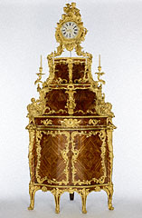
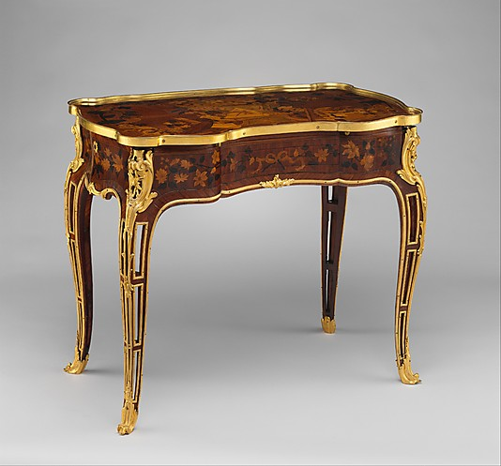

Slide 32
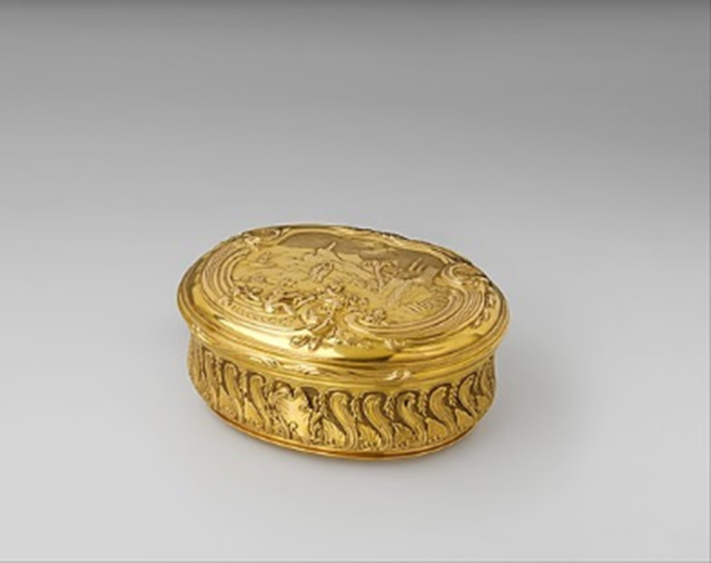
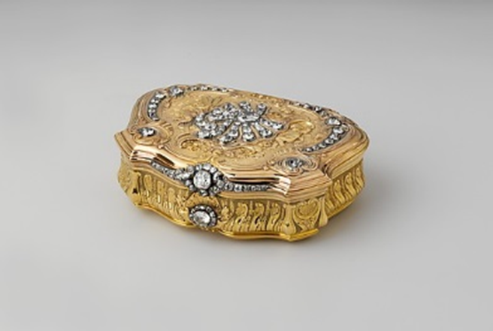
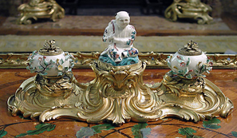

Slide 33
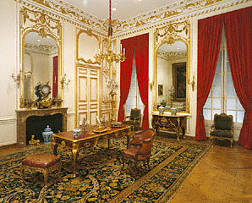
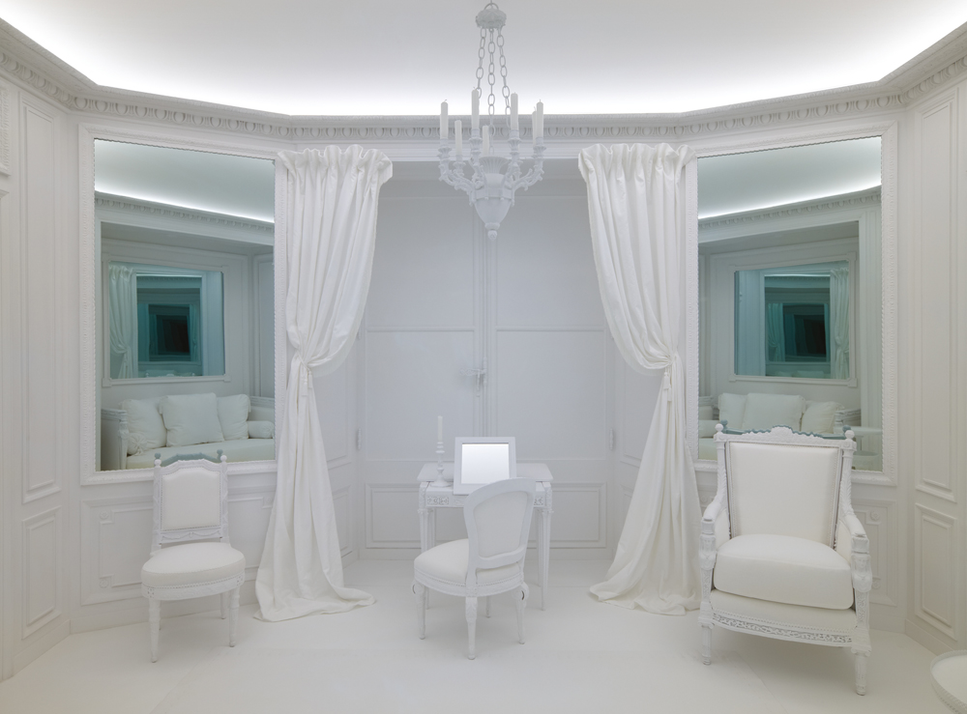
Room 2
Unknown
French, Paris, about 1719
Painted and gilded oak; modern plaster plaque
H: 10 ft.
97.DH.2

Slide 34
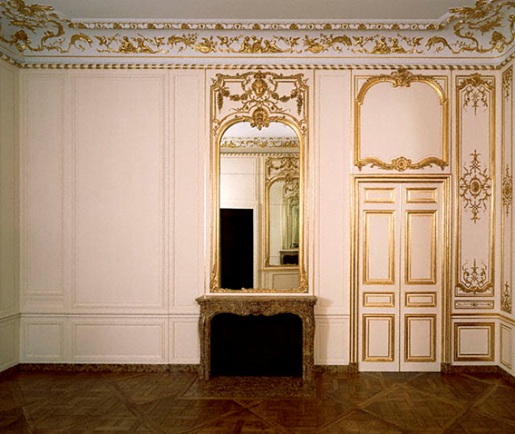
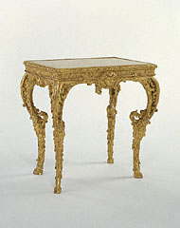
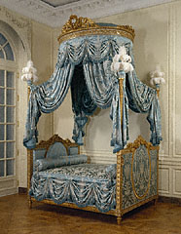
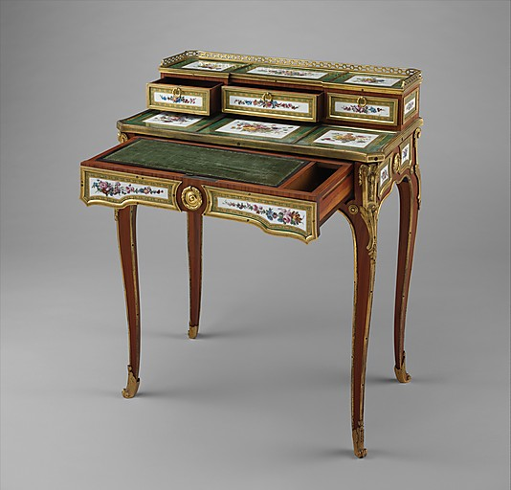
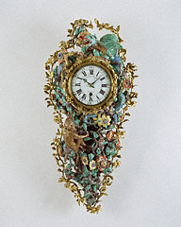

Slide 35
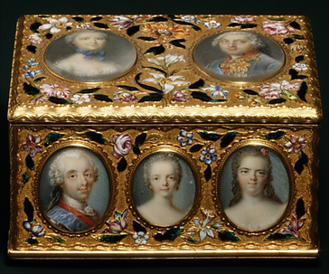
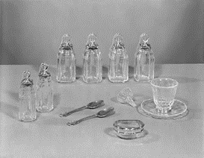

Slide 36
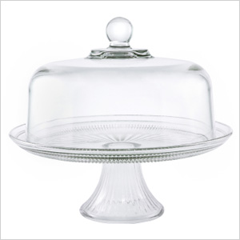
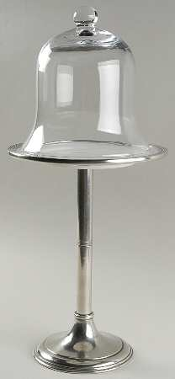
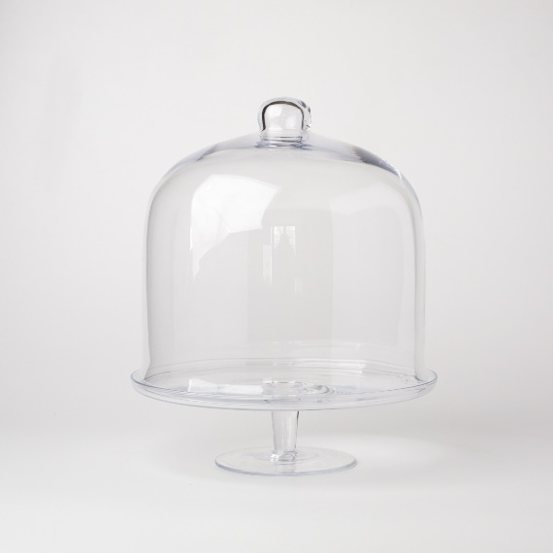
Stuffbox display

