Slide 1
SOCIAL MEDIA
CHRISTIAN, XAVIER, FRANCY, LANYU.

Slide 2
What is social media?
What is social media?
Any website and/or mobile application that allows users to create, interact and share content. Enables people to participate in social networking.
Any application or website dedicated to forums. For example blogging, social networking and wikis are different types of social media platforms.
The most dominating and prominent social media networks are:
Twitter, Instagram, Facebook, LinkedIn, and SnapChat

Slide 3
Facebook
- Founded by Mark Zuckerberg in January of 2004
- Initially designed for Harvard University students
- By December of that same year, Facebook had already grown to 1 million users
- The Social Network Movie
- Over 1 BILLION users! #1 Website in the WORLD since 2013
- 66% of millennials use Facebook
- 31% of senior citizens

Slide 4
Do’s and Don’ts of Facebook
- Have a decent/professional profile picture and header photo
- Assume your Facebook is a professional profile: showcase your professional interests
- Complete the ‘About Me’ section, have a strong summary that includes keywords and phrases for skills employers would look for in your industry
- Add photos to give a better visual, i.e. Volunteer work, events, involvement with organizations and appropriate activities
- Use Facebook socially, i.e. communicating with family and friends and keeping the content appropriate
- Proofread. It takes just a few seconds, and it can make the difference between a status update that makes sense and one that doesn’t.
- Vary your posts. Curate your content, and offer your readers an assortment of your own personal comments, information shared from other sources, images, and questions to spark discussion.
- Don’t post anything confidential or private anywhere on Facebook
- Don’t share anything about friends or family on Facebook that they would not want known publicly. You’re responsible for protecting their privacy as well as your own.
- Be very cautious of how you interact with others and what you say
- Post inappropriate photos, i.e. containing drugs, alcohol, or inappropriate behavior
- Un-tag yourself on photos you do not want showcasing on your profile
- Use your wall/or some else’s wall for private conversations

Slide 5
How to network with Facebook
Using Facebook Groups/Pages for networking
Find groups based on your professional interest and join
Introduce yourself to group, maintain interactive with group members, and actively post relatable content
Monitor what you share
Share articles, topics, or stories that you believe your friends will find interesting
It’s okay to post personal pictures of family and friends, as long as you keep it professional
If you have a separate professional blog share all your content on your Facebook wall
Post any and all content relevant to your career.
Share visuals (videos, articles, pictures) of your professional interest
Share your course work, anything you have written/created
Split Facebook by using lists
Keep your social life and professional life separate
Find coworkers
Stay in touch professionally with your co-workers, managers
Remember just because it's off the clock, doesn’t mean it won’t affect you!! Be careful of what you post!

Slide 6
Instagram
April, 2012, FB acquires Instagram for 1 Billion Dollars
Instagram has about 400 million active daily users
Over half of all 18- to 29-year-olds in the U.S. are on Instagram
Adult users in the U.S. have doubled since 2012
56 percent of Instagram users make $50,000/year or more
The most popular photo on Instagram has close to 6 million likes
48.8 percent of brands are on Instagram
One of the hottest social networks, made for sharing photos and videos from a smartphone.
31 percent of female internet users are on Instagram, compared to 21 percent of male internet users

Slide 7
Do’s and don’ts of Instagram
Do’s
DO Curate Your Content
Do find creative ways to include your branding
Do make sure the image has a strong focal point so it sends a clear message.
Create content with your target audience in mind.
Do obtain permission to use both image and video content that someone else has taken if you plan you use them in an ad. focus on engagement not follower numbers
Do put people in your photos.
Do have fun with it
Don’t
Don’t use images that are busy or complex in composition. Don’t post content that is copyrighted.
Don’t just randomly post anything
Don’t post more than 5 images to an album.
Selfies are not always required for posting.
Don’t post crappy photos
Before posting, ask yourself “what If my boss sees this?” “what if my grandma see this”

Slide 8
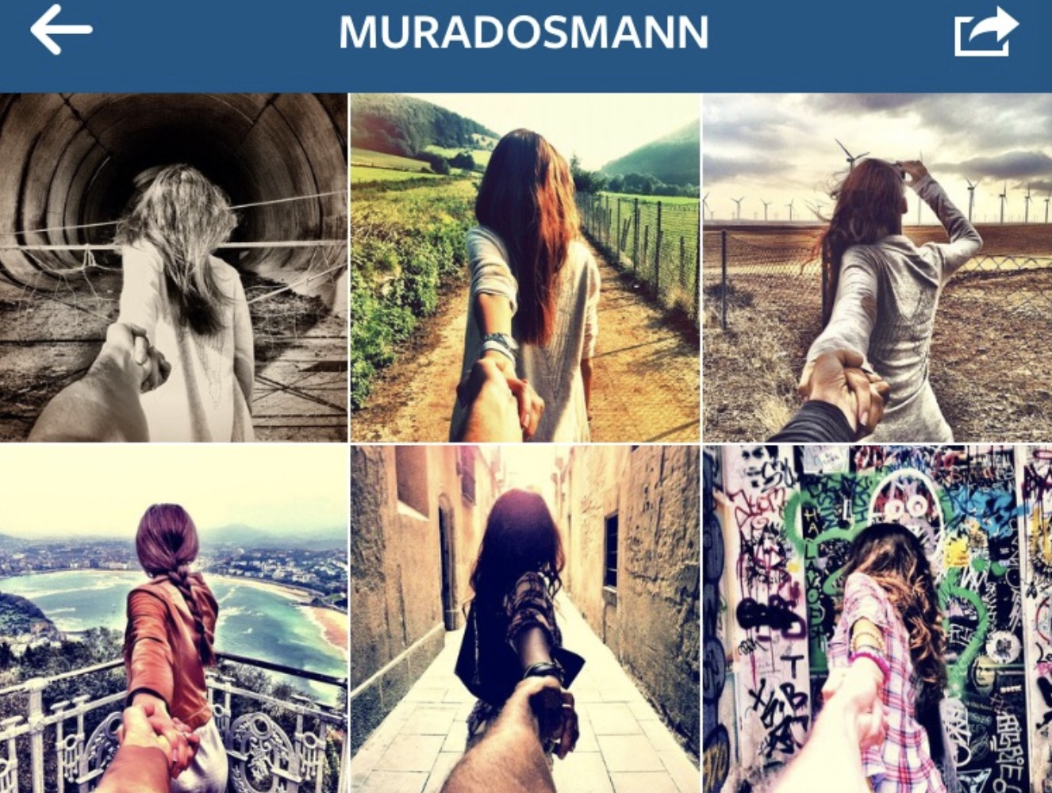
Special Example
One of the best – and most extreme – examples of this is Murad Osmann (@muradosmann), whose account is dedicated almost exclusively to his “Follow Me” series.
￼

Slide 9
How to network with Instagram
Post interesting, colorful photos and videos, take a picture while attending the event.
Try not to overdo it with the filter effects
Upload photo with a description to give the image some context.
Check in to your location (this might be tough given your networking event).
Hashtag, hashtag, and hashtag.
Post often to keep followers interested
Use the Explore tab (popular page) to find great new content
Network with Instagram Direct
Create Deeper Connections
Connect with Industry Influencers
Get Feedback
Find New Connections
Stay on top of the latest Instagram trends

Slide 10
It can happen to anyone...

Slide 11
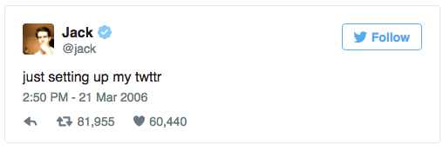
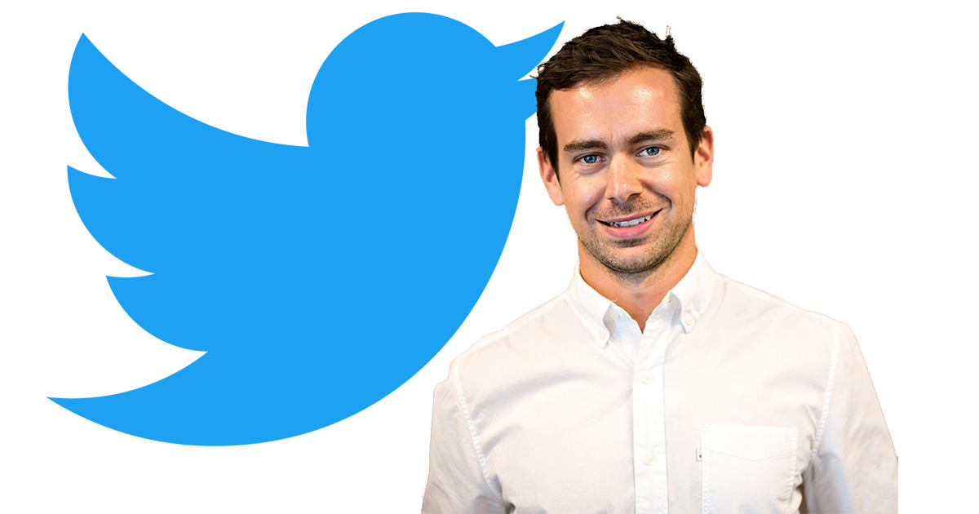
Twitter
Founded by Jack Dorsey
Started in 2006
First Tweet, March 21 2006
Open to public, July 15 2007
Introduced to the hashtag in 2007
328 million active users
500 million tweets sent out per day

Slide 12
Do’s and don’ts of Twitter
Do’s
DO include media (photos/videos)
DO retweet others & favorite others
DO geo-search and save searches for keywords surrounding your brand
DO follow people
DO use relevant hashtags
Don’ts
DON’T overuse hashtags
DON’T protect your tweets
DON’T link your Facebook account to your Twitter account.
DON’T engage just with your followers
DON’T be self-centered

Slide 13
How to network with Twitter
Find the right people to follow
Show your followers who you are
Don’t make newbie mistakes
Think about you actions from follower point of view
RETWEET!
Ask questions
Share your network

Slide 14
What is really happening to us?

Slide 15
Snapchat
Mobile photo messaging and multimedia sharing app
Founded by Evan Spiegel, Bobby Murphy, and Reggie Brown in September of 2011
Built to share impermanent pictures via private message called 'snaps' that can be viewed for a user-specified length of time before becoming inaccessible.
Fun Fun Fun! Snaps can consist of a photo or a short video, and can be edited with text, filters, or stickers
During the first quarter of 2017, Snapchat reported 166 million daily active users worldwide.

Slide 16
Do’s and dont’s of Snapchat
Don’t
Post long stories
Overuse the filters
Snap while driving
Be generic/boring
Get too personal
Accept followers with weird names
Do
Show personality/ be creative
Follow everyone in your contacts
Engage with your followers
Use filters
Promote your snapchat in your other social media platforms (i.e. Facebook, Twitter, Instagram)
Pay attention when opening snaps, remember they disappear!
Create your own geofilter

Slide 17
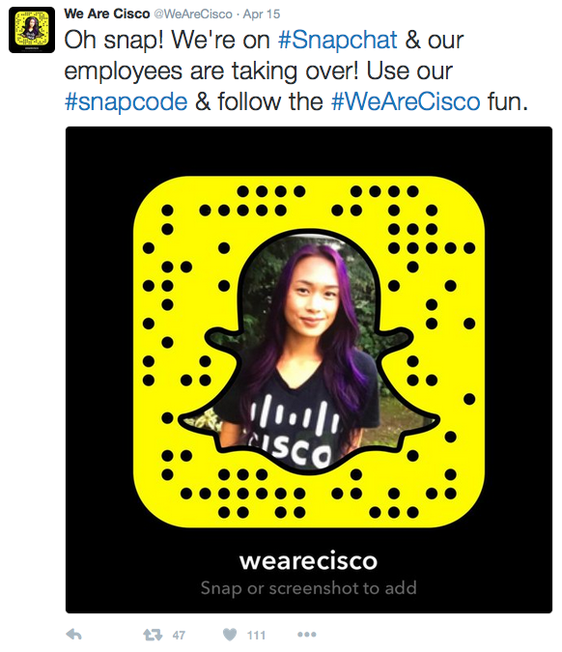
How to Network with Snap -
Share your professional work through the day, show your product in action
Share your volunteer work
Share tutorials/valuable thoughts/knowledge
Promote your business/company/organization
Invite people of mutual interest to follow you on Snap, share your snap code
Keep your story eye-catching and interactive. Use filters, draw and/or write on your pictures.

Slide 18
LinkedIn
LinkedIn began in con-founder Reid Hoffman's living room in 2002 and was officially launched in May of 2003.
It’s the world's largest professional network with more than 530 million users in more than 200 countries and territories worldwide.
LinkedIn is for anybody and everybody who's interested in promoting their business, taking their professional lives seriously by finding new opportunities to grow in their careers, looking for new job hires and sharing internships and job opportunities, and to network with other professionals.
Linked profiles act as online resumes featuring experience, skills, link to work, and recommendations.

Slide 19
LinkedIn
Fore each second, 2 members are joining LinkedIn
LinkedIn now has 3 million active job listings on their website
92% of hiring professionals surveyed said they used social media platforms during the hiring process. 87% of hiring professionals reported they use LinkedIn to find more candidates.

Slide 20
The Don’t of LinkedIn
Profile picture: No empty profile picture, selfies and no random objects
Don’t leave a connection request empty.
Don’t leave anything blank.
Eliminate past jobs or volunteer work.
Post anything that is not related to your field or that others may find unpleasant.

Slide 21
Do’s of LinkedIn
Keep it crisp and clean. Free from grammatical and spelling errors
Have a professional photo
Use and place keywords strategically throughout your profile

Slide 22
Do’s of LinkedIn
Interact with your homepage on a daily basis.
Update a weekly post your on your achievements or interests.
Add new contacts
Update your profile monthly.
Participate in a group related to your job profession.

Slide 23
How to network with LinkedIn
Show them what you have to offer. Having a well detailed and completed profile will increase your opportunities for a job offer.
LinkedIn Groups: Join career related groups and join Pace University Alumni.
Connect with suggested individuals
Once you’re connected with another person. Have a nice small chat.
Be helpful with other individuals in your shoes.

Slide 24
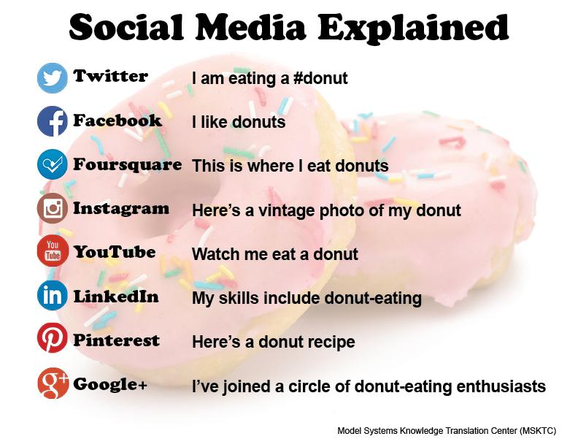
Helpful Tips
Create a plan for each social media channel
Have to be active and post consistently
Be picky about what you share
Post images and videos often
Join in on communities
Watch your competitors
Give people a reason to follow you
Target your social media posts

Slide 25
This is why you should be careful...

Slide 26
What to do when...
Live Streaming
Video, and more video
Client Support
Increased focus on privacy
Different types of groups
Users will pay for peace

Slide 27
Summary
On a scale from 1-5 we have ranked which social media networking site is the most professional:
LinkedIn
Twitter
Facebook
Instagram
Snapchat
All social media networks can be used in a professional matter
LinkedIn is the #1 networking site for professional use
Facebook has the highest number of active users
Have a profile photo (head shot, professional)
Always monitor what you post and what you are tagged in; always act as if your boss is watching
Use social media to expand your professional and personal interest
Spark conversation based on mutual interests
Stay active! Stay relative!

Slide 28
Citation
https://www.huffingtonpost.com/laura-m-brown/facebook-etiquette_b_5268789.html
https://www.huffingtonpost.com/laura-m-brown/facebook-etiquette_b_5268789.html
https://www.statista.com/topics/2882/snapchat/
https://www.socialmediaexaminer.com/how-to-use-snapchat-for-business/
http://curious.stratford.edu/2017/08/03/dos-and-donts-of-instagram/
More citations……..
https://theundercoverrecruiter.com/instagram-networking-tool/

