Slide 1
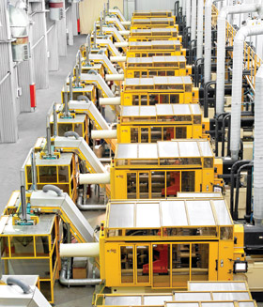
Husky Injection Molding Systems
By: Team Baldwin
Sarah Hsiao, Jaehee Lee, Al Li, Amanda Sorrentino and Meg Burke
Notes:
We are team Baldwin, and we will discuss Husky’s strategy in the early 1990’s to compete in the injection mold machinery and mold making industry.

Slide 2
Agenda
Purpose
Non-economic
Economic
Scope and Emphasis
Resources and Competencies
Organization and Tradition
Notes:
We will get into the purpose of the business, the organization and tradition, scope and emphasis, and also resources and competencies.

Slide 3
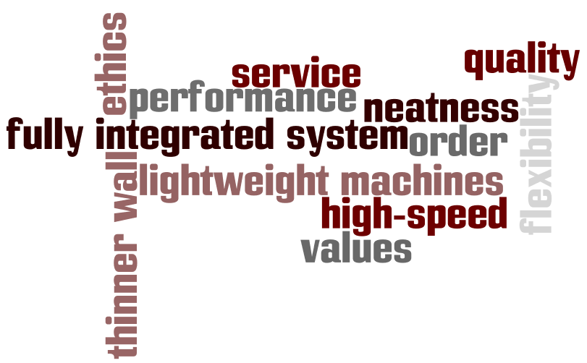
Non-economic Purposes of Husky
Produce molds and injection molding machines
Add value to the plastics industry
-“a supplier of complete factory solutions for the plastics industry”
-plan injection molding facilities
-train customers
abide by core values → human fulfillment
Notes:
-Husky provided the customer with a better product than competitors. Its innovative machines allowed for faster cycle times and thinner walls
-This organization provided the public with equipment, but prided itself in its service sector, where its consumers benefit from planning services and training services
-provided the public with a fully integrated system, so it was not just the molds. It was also the machines, and product- handling equipment
-core values will be discussed in tradition part of presentation (make a contribution, environmental responsibility, drive to do things much better, genuine care for all stakeholders, honesty)

Slide 4
Economic Purposes of Husky
Achieve growth and profitability through
-expansion of product lines
-globalization
-using the latest tools and technologies
-forming alliances with other mold makers
-achieving operational effectiveness
creates value, increases customer’s willingness to pay
Notes:
-consumers are willing to pay a premium for Husky products

Slide 5
Scope and Emphasis
Horizontal
offer a fully integrated systems of machines, molds, hot runners, and robots
a supplier of complete factory solutions for the plastics industry
Vertical
sell and service exclusively via internal sales forces
purchase components from outside vendors
build Technical centers to provide local technical support and training

Slide 6
Geographical
concentrate manufacturing, development, and support facilities on two campuses in Canada
sell and service via internal sales force in 24 regional offices in 17 countries
build Technical Centers across the world, a distribution center and spare parts shipping system

Slide 7
Resource and Competences
Policies about Resource and Competences develop a second set of means to achieve corporate purpose.
A. Principal Policies
B. Resources Important for Sustainability
C. Sustainable Competitive Advantage
Notes:
Principal polices that guide the develop of value chain activities
Resources that require years or decades to develop usually are more important for sustainability
Sustainable competitive advantage usually results from a unique and integrated combination of resources and competences : superior

Slide 8
A. Principal Policies
Value Chain | Policies of Supporting Activities
Firm Infrastructure | Ownership Finance: Maintain modest debt 15% of total asset and have interest coverage ratio under control
Human Resources | Focus on values (Schad’s) and employ according to it
Research and Development | Establish “Quick Series of Innovations” Track the production methods and products of rivals closely Outspend rivals and introduce newer model through the Advanced Manufacturing Center (AMC)
Procurement | Achieve economies of scale by utilizing suppliers in Bolton campus
Operations | Sophisticated machines: Design and assemble customized machines Smaller machines: Automate mold production Produce 200-400 machines per year, 20 -60% lower than minimum efficient scale industry standard Involve engineers by utilizing geographically clustered facilities
Notes:
Policies influence decision → resource capabilities

Slide 9
A. Principal Policies
Value Chain | Policies of Primary Activities
Sales & Marketing | Pricing: Charge higher premium 20% ($200K) more than the rivals Maintain current reputation for quality service by servicing through in-house employees Provide services to existing customers and consultation to the potential customers utilizing offices in different geographical region Sell through in-house sales representatives Integrate sales and service: Have sales and service people report to regional manager not top management

Slide 10
A. Principal Policies: Resources & Competences
Financial Asset
Physical Asset
Intangible Asset
Resources
Financial Asset
Ownership: Husky was a privately held.
Co retained 65% of stock
Key employees(Sr.Mgr): only non-voting stock: 25%
Komatsu Japanese equip maker: 10%
Financials:
Long term debt: 15% of total asset
Interest coverage ratio: 10-20%.
Physical Asset
Bolton Campus
Advanced Manufacturing Center(AMC)- built with $25 million investment
24 Regional offices in 17 different countries for customer service
Technical Centers for local technical support and training (ATL, LA, LUX, JP, etc)
Distribution Center (Buffalo, NY)
Intangible Assets
Value, Know-hows, Reputation
Notes:
AMC- within this building, molding systems operated in a controlled 24 hour production environment. High partitions kept secrets from leaking out. No other competitors had the similar resources.

Slide 11
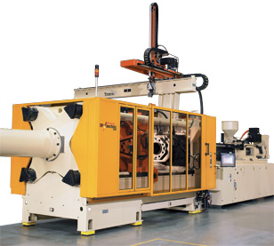
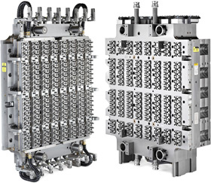
B. Sustainable Resources
Machine Business
Molds Business
Nestal
Other Boutique Makers

Slide 12
B. Sustainable Resources: Strengths and Weaknesses compared to the competitors
 | The Mannesmann Group –Nestal | Cincinnati Milacron | Engel | Husky | Electra Form | R&D Tool Engineering
Positioning | Variety base | Needs Base | Needs Base | Needs + Access | Needs Base | Variety Base
Financial Resources
Technology | Swiss Engineering |  | Austrian High Tech |  | Refurbish | Less Automozted
Pricing (Cost Adv)
Service & Support
Reputation
Strong
Moderate
Weak

Slide 13
C. Sustainable Competitive Advantage
Fit
Sustainability
Competitive Advantage
Husky’s Purpose: Differentiator
Intangible: Reputation
First Mover’s Advantage
Value Communication: “supplier of complete factory solutions”.
Perceived Quality and Differentiation justified higher price
Fit
Simple Consistency, Reinforcing Activities, Optimization Effort
Notes:
Sustainable competitive advantage usually result from a unique and integrated combination of resources and competences which establish a position that is valued by customers, superior to competitors. (Dory) The essence of strategy is in the activities and performing them differently than rivals.(Porter)
FIT: Fit drive both competitive advantage and sustainability.
Simple consistency: Firm infrastructure of ownership, employment tactics, drive for precision,
Reinforcing Activities: continuous buying of fixed assets and being accessible to the customers in different geography
Optimization of effort: Sales and marketing done through service people and technicians, operational effectiveness through Bolton campus

Slide 14
Tradition of Husky in the early 1990s
Values
Concern for environment
Devotion to personal health
Dedication to hard work, egalitarianism, and perfectionism
Management & Employee Characteristics
Leader: “An inspiration, a visionary, a task master.”
Atmosphere: “Intense, driven, unsentimental”

Slide 15
Tradition of Husky in the early 1990s
Mold Maker: Competitors “Mom & Pop Artisans” | Mold Manufacturer: Husky
Small, owner operated machine shops → less automated Longer mold production times Thicker product walls Sales people don’t give the best customer service & consultation | Latest tools and technology → automated process Science of design and assembly Speed and flexibility Recruit knowledgeable sales/service people Best performance → Price premium

Slide 16
Organization of Husky in 1990s
Description
Organization: Husky | Products Production Technology Development & Commercialization Sales &Service Ownership & Finance

