Slide 1
Proposed Play.It Podcast Categories | 3 – 6 MONTH PLAN OF ACTION
Your
Network
Reach out to fellow podcasters for cross promotion, guest appearances, and episode ideas
NEW & NOTEWORTHY
TOP
CHARTS
FASHION
HEALTH & LIFESTYLE
SOCIETY & CULTURE
GAMES & HOBBIES
NEWS & POLITICS
BUSINESS & INDUSTRY
ENTERTAINMENT
COMEDY
TECHNOLOGY

Slide 2
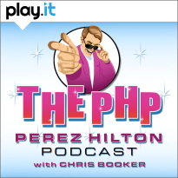
TOP CHARTS
1.
Top Of The Charts: Feature Podcasts that are ranking highest
2.
Top Episodes: Feature episodes that are ranking highest
Featured Collections: Feature podcasts of similar interest
3.

Slide 3
Proposed Play.It Podcast Categories | 6+ MONTH PLAN OF ACTION
Your
Network
Reach out to fellow podcasters for cross promotion, guest appearances, and episode ideas
TV &
FILM
RELIGION&
SPIRITUALITY
SCIENCE & MEDICINE
ARTS
LOCAL
MUSIC
KIDS &
FAMILY
GOVERNMENT & ORGANIZATIONS
EDUCATION

