Slide 1
Culture in the Workplace: Italy
By: Ian, Nick, Jolene, & Samantha

Slide 2
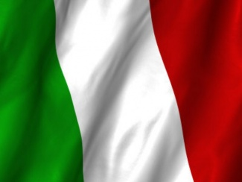
Background
• Population: 61.3 million people live in Italy (2013)
• Capital: Rome
• Government: Democracy, Republic
• Language: Italian as well as German, French and Ladin in some regions in Northern Italy.
• Religion: mainly Christians (Roman Catholics 90%)
• Currency: 1 Euro=100 cents, before 2001 Italian Lira
• Flag: The colors represent these virtues: hope (green), faith (white), and charity (red).

Slide 3
High - Context

Slide 4
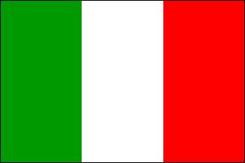
Individualist VS Collectivist Culture
Similarity: Individualist > Collectivist
1.The balance between work and life
The Italian culture appreciates individual thinking and creativity. Nonetheless, individual decisions are expected to take into account family interests.
U.S. has been the most overworked developed nation in the world.
In Italy, occasionally, lunches are used to build a personal relationship.
Americans conduct business over breakfast, lunch and dinner. Some socializing may start off the meal, but often the conversation will revolve around business.

Slide 5
2. How to develop a business relationship?
Italians are often guided by their feelings and trust is very important in establishing a good business relationship. You should make small talk and demonstrate your interest in Italian food, art, fashion or sports.
In the US, business relationships are formed between companies rather than between people. Americans do business where they get the best deal and the best service.

Slide 6
3.The characteristics of business Relationship
Italians, generally establish relaxed personal relationships, often from the very first acquaintance. Be aware, however, that this does not necessarily mean that you and your business have gained their trust.
Friendships between Americans tend to be shorter and less intense than those between people from many other cultures, because Americans are taught to be self-reliant and live in a very mobile society.

Slide 7
4. Management structure and style
Italian companies tend to have a pyramidal hierarchy; final decisions are centralized and taken by the persons positioned in the upper levels of the pyramid. Employees also have a great respect for their bosses and they tend to look for consensus with their colleagues.
American management style can be described as individualistic in approach, in so far as managers are accountable for the decisions made within their areas of responsibility. Although important decisions might be discussed in open forum, the ultimate responsibility for the consequences of the decision lies with the boss.

Slide 8
5. Importance of meetings
Italians are relationship-oriented. Meetings are one of the best ways to get a deeper and common understanding of an issue. Establishing a reciprocal climate of trust and respect is important.
In the US, meetings are primarily used for giving or collecting information, and also for presenting proposals to be examined and ratified. Meetings are generally informal and relaxed in manner, but serious in content.
6.Teamwork
In Italy, teams work best under the supervision of an authoritative leader who can generate enthusiasm and a sense of loyalty to the team as well as giving a clear focus and direction for each team member.
The US has a tendency towards a project—oriented style. Roles and responsibilities are clearly defined and divided among team members.

Slide 11
Gender Roles
Pre WWII: Men went to work and Women took care of the home.
Men were the ‘head’ of the family, and Women were supposed to stay at home and care for the children.
Men were expected, which still holds true, to do little of the housework, and leave it to the Women to clean etc.
Post WWII: Women in Italy started to become much more independent.
Currently Women and Men in Italy share the same roles.
Italian Women are viewed as the most liberated in Europe.

Slide 12
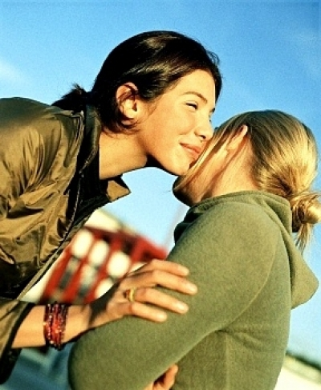
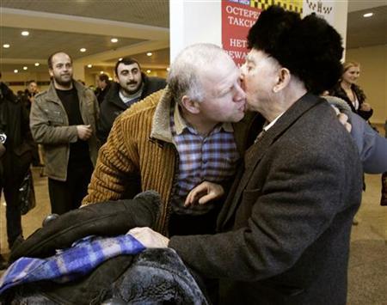
Social Customs
Notes:
Upon first meeting someone, be very polite!
Friends and family members will give kisses when they see each other, regardless of gender.
Headed to dinner? Do not bring wine!
“Italians must look good and be seen in the best light”.

Slide 13
Dress for success

Slide 14
SOurces
family.jrank.org/pages/979/Italy-Education-Gender-Roles.html
http://www.everyculture.com
http:///Ge-It/Italy.html
http://www.justlanded.com/english/Italy/Articles/Culture/Social-customs-in-Italy
Sources:
Priest, M. (n.d.). Italy Business Etiquette, Culture, & Manners. Retrieved October 5, 2014, from http://www.cyborlink.com/besite/italy.htm
Italian Language. (n.d.). Retrieved October 7, 2014, from http://www.university- world.com/italian/italian_language.html
Italian Communication Style. (n.d.). Retrieved October 7, 2014, from http://www.worldbusinessculture.com/Italian-Business-Communication-Style.html
Italy - Language, Culture, Customs, and Etiquette. (n.d.). Retrieved October 8, 2014, from http://www.kwintessential.co.uk/resources/global-etiquette/italy-country-profile.html
Source:
http://psychology.wikia.com/wiki/Collectivist_and_individualist_cultures
http://businessculture.org/southern-europe/business-culture-in-italy/
http://www.worldbusinessculture.com/American-Management-Style.html
http://www.worldbusinessculture.com/American-Management-Style.html
http://lizprovasi.wordpress.com/2012/04/09/high-context-versus-low-context/

