Slide 1
How to Produce A Pop Song In 30 Minutes or Less!
By: Christopher Acevedo, Sylvia Auguste, Iliana Collado , Nicole Freeman, Lou Guarneri

Slide 2
The History of Pop Songs
Over the past forty years, many pop songs have followed a similar structure, mainly in their chord progression, which is an organization of chords into a pattern.
Some songs that fit into this progression are:
Don’t Stop Believin’ – Journey
Under the Bridge – The Red Hot Chili Peppers
When I Come Around – Green Day
Poker Face – Lady GaGa
Can You Feel the Love Tonight – Elton John
And hundreds more!
Notes:
http://www.ehow.com/facts_5159356_chord-progression.html

Slide 3
Melodyne and Auto-tune
Auto-tuning is a very popular trend in the music industry today, and whether you realize it or not, most artists are somewhat auto-tuned, or pitch corrected.
In Melodyne, a vocal line is converted to MIDI, or Musical Instrument Digital Interface, and placed onto a piano roll. There you can simply drag the phrase, or word to the appropriate note value.
In Antares Autotune, an entire vocal line is tuned according to the key of the song. In other words, Antares is less specific, and faster, while Melodyne is more in depth..

Slide 4
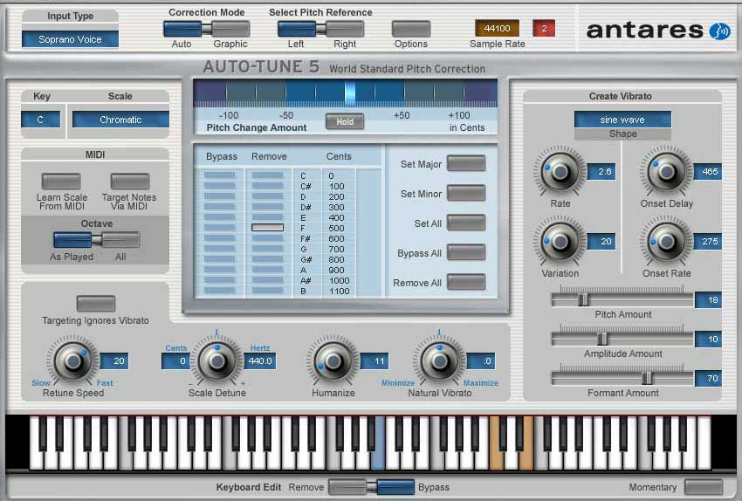
Melodyne and Autotune

Slide 5
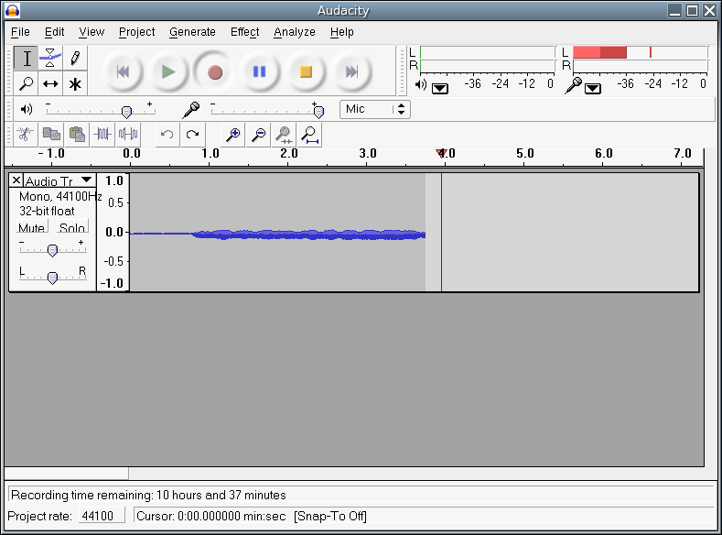
Audacity and other DAWs
DAW, or Digital Audio Workstation.
Audacity is one of the simplest and user friendly DAWs on the market.
Any user can download it for free from their website, http://audacity.sourceforge.net/
Notes:
http://audacity.sourceforge.net/

Slide 6
Class Demonstration…

Slide 7
Step 1 Download & Open Audacity

Slide 8
Step 1 Download & Open Audacity

Slide 9
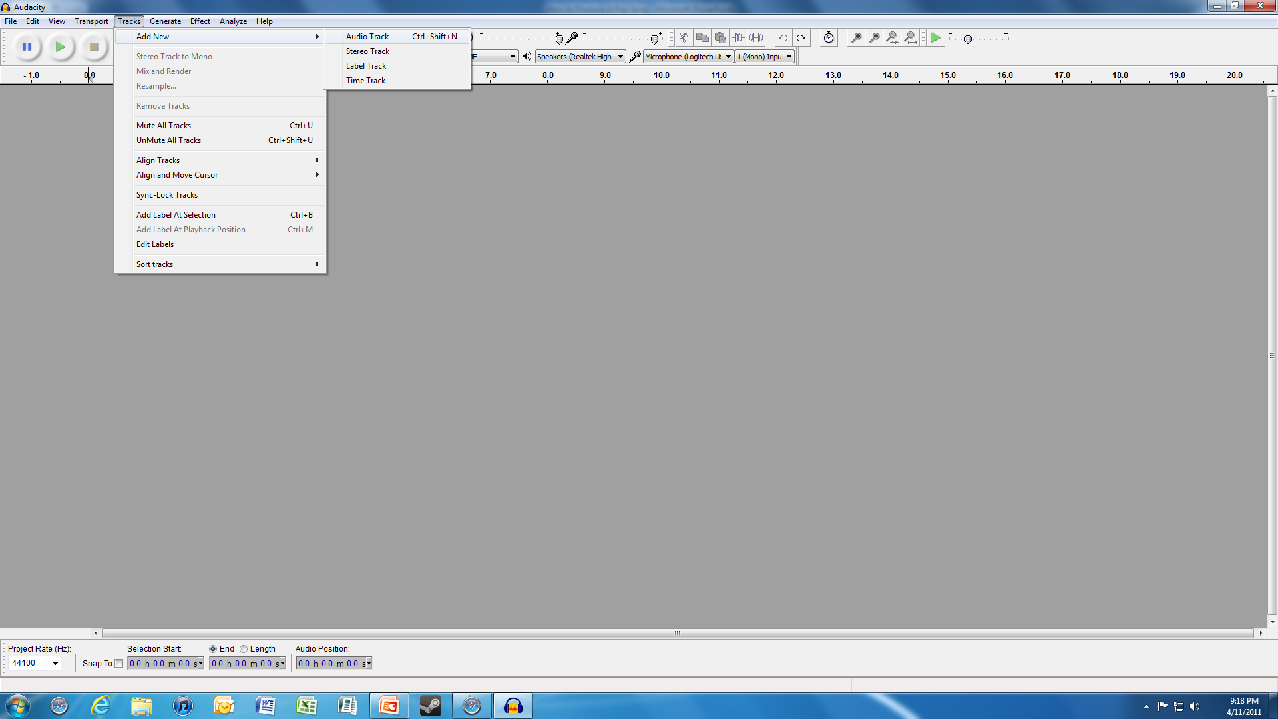
Step 2 Introduce Melody Track

Slide 10
Step 2 Introduce Melody Track

Slide 11
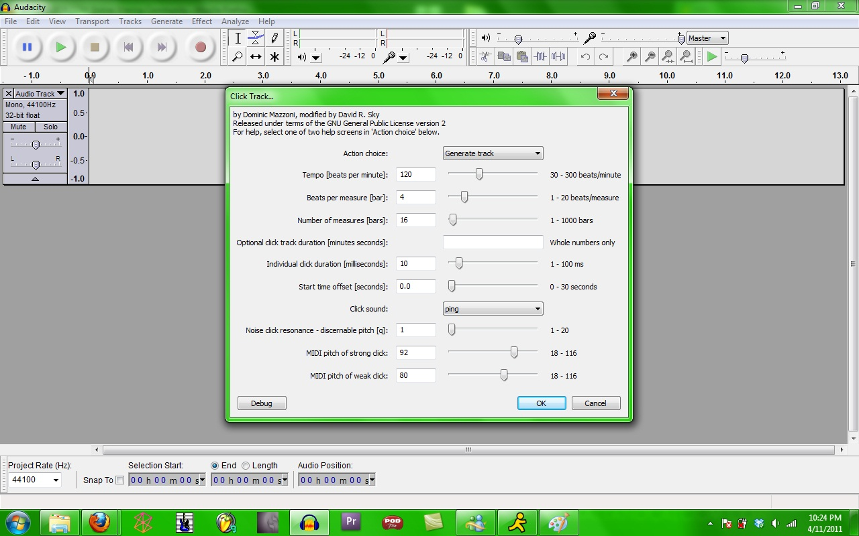
Step 2 Introduce Melody Track
Insert Metronome or Click Track
Generate → Click Track

Slide 12
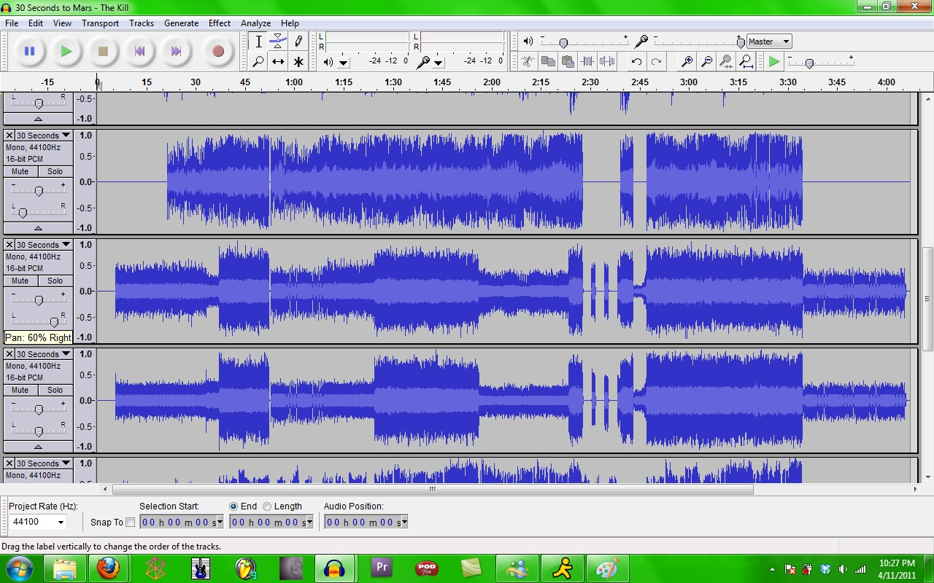
Step 2 Introduce Melody Track
*We Imported Our Melody Track Using Fruity Loop Studio MIDI

Slide 13
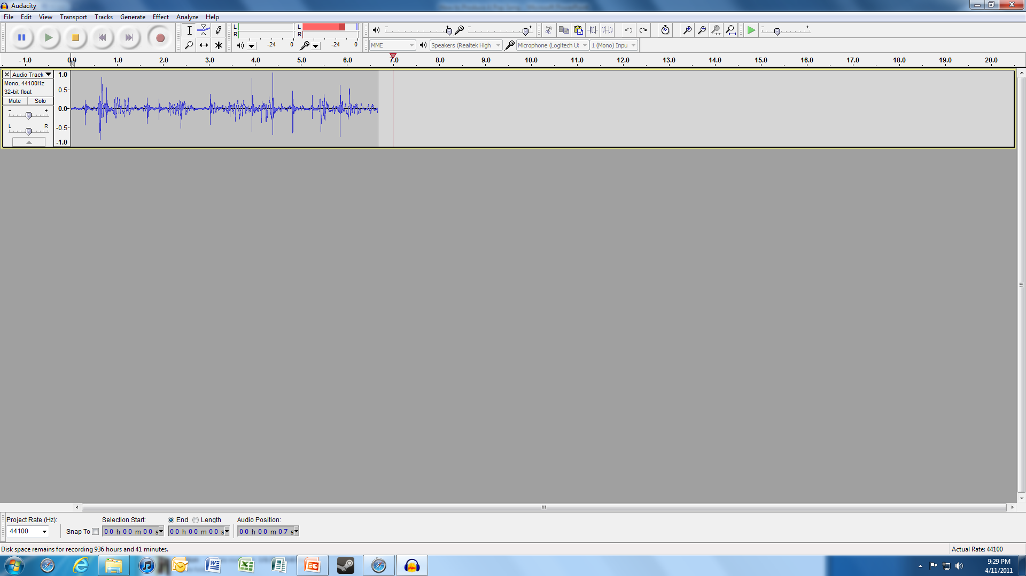
Step 3 Sing!

Slide 14
Step 4 Mix It Up!

Slide 15
Step 5 Enjoy & Share!

