Slide 1
Red Stripe
Brianna perriello, Jen Cusack, danielle wisdom, daniel smith, rebecca sewkarran

Slide 2
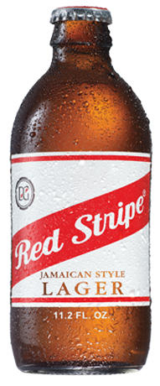
Table of contents
Table of contents
Executive summary
Research
target audience
Competitive analysis
ONLINE TV
Radio
Social media
Out of home
Promotions
Media breakdown
Budget
Measuring success
Conclusion

Slide 3
Pop di cap executive summary
Opportunity:
Red stripe has the opportunity to gain popularity worldwide and become the official drink for a good time
tARGET MARKET
SINGLE WORKING CLASS MEN AND WOMEN THAT EARN APPROXIMATELY $50,000+ A YEAR
LIFESTLYE:
Positive energy

Slide 4
Research objective
gain knowledge and insights into red stripes competition, brand perception, and communication:
Top competitors
Success or failure of other campaigns
Consumer buying behavior
Consumer knowledge of red stripe

Slide 5
Research findings & implications
Top competitors:
Heineken, corona
Strong communication with consumers
Online television: hulu
Social media
Apply the strengths to the campaign
Build brand awareness
Effective and engaging advertising and promotion

Slide 6
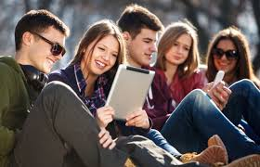
Target audience
Men and women between the ages of 25-44

Slide 7
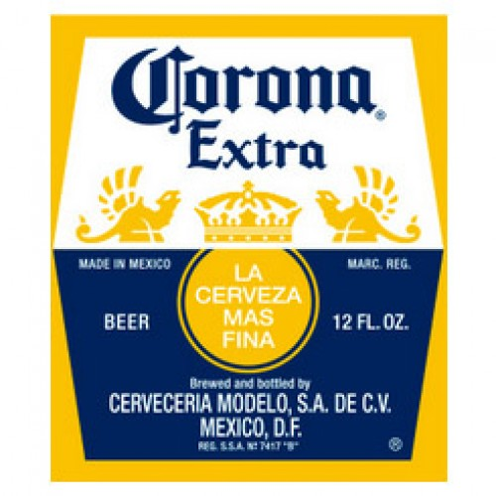
competition is brewing competitive analysis
Strengths- global availability, advertising and market leadership
Weaknesses- increased distribution costs because of limited brewing locations
Strengths- good advertising and brand recognition
Weaknesses- man brand image so harder to target women

Slide 8
The first sip marketing strategy
Objective:
To make red stripe a more well-known and purchased brand nation wide
Tactics:
Online TV
Radio
Social Media
Out of Home
Key insight:
The consumer will appreciate life, and experience good times and happy sensations when enjoying this beer

Slide 9
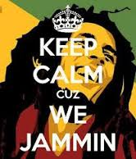
Time to reggae creative strategy
Creative objective
Improve brand awareness and interest
Target audience
Between the ages of 25-44 of both male and female
Desired action
Red stripe will become more of a household brand instead of being such a local beer in Jamaica. Consumers will choose this beer over Heineken and corona

Slide 10
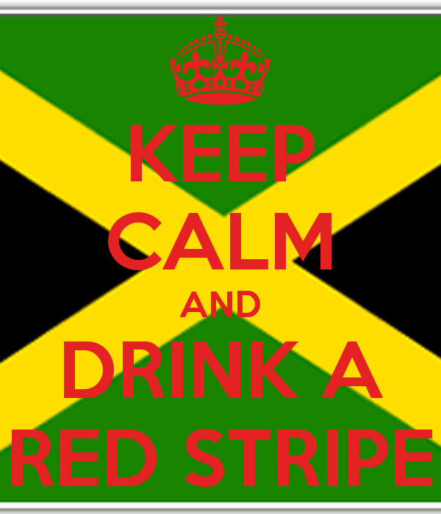
barriers:
Competition
Availability
Personality:
Chill
Diverting
Easygoing
Good vibes
Reward:
When I drink Red Stripe, I find my Jamaican escape because good vibes, just a bottle away!

Slide 11
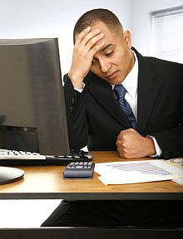
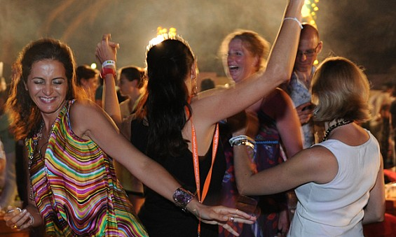
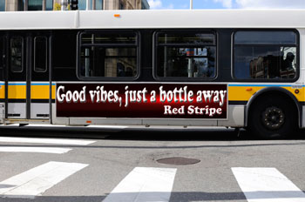
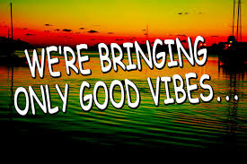
Only the good vibes Online tv

Slide 12
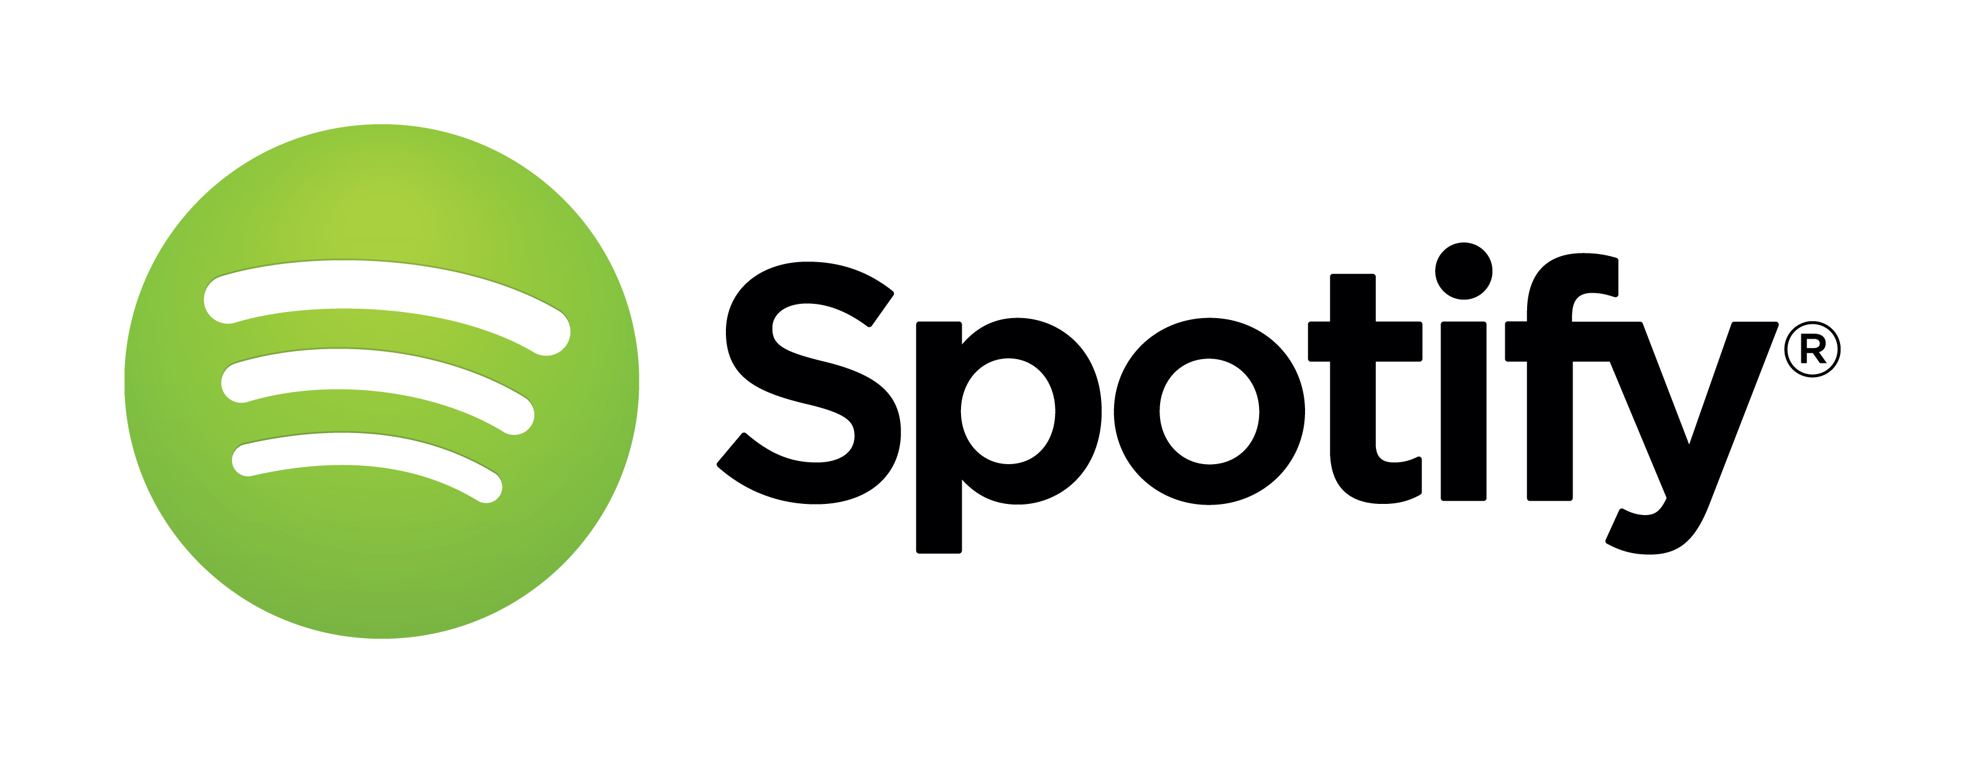
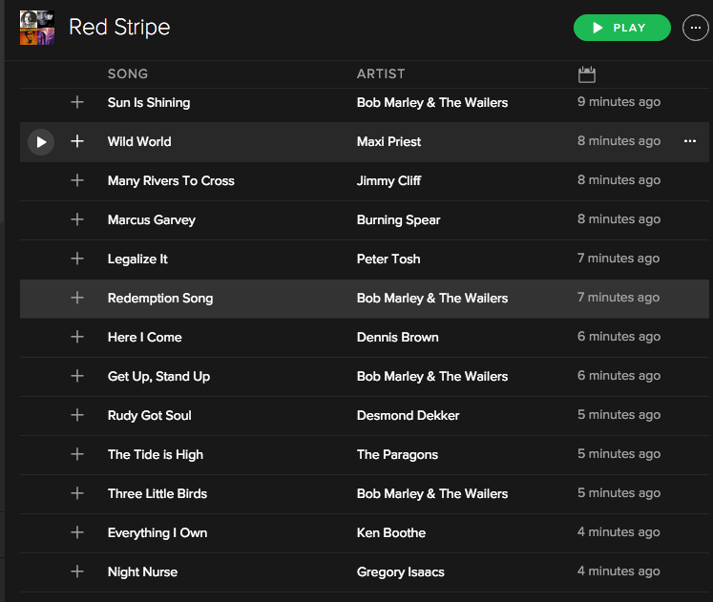
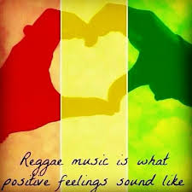
Get up, stand up radio

Slide 13
Share the vibes Social media
Facebook page where users can like monthly posts for ideas of seasonal labels
Post videos of beach parties or people enjoying Red Stripe:
Sundaze
Monday Blue’s
Wednesday Hump Day
Thirsty Thursday
10 seconds of how you Reggae
Sponsors a sport league such as Jamaican football league

Slide 14
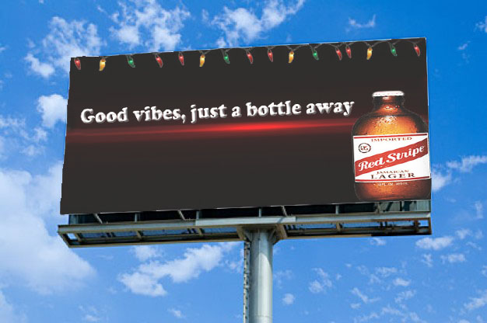
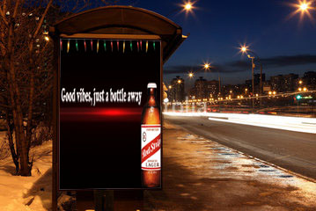
Spread the love Out of home
Billboards Bus Stops

Slide 15
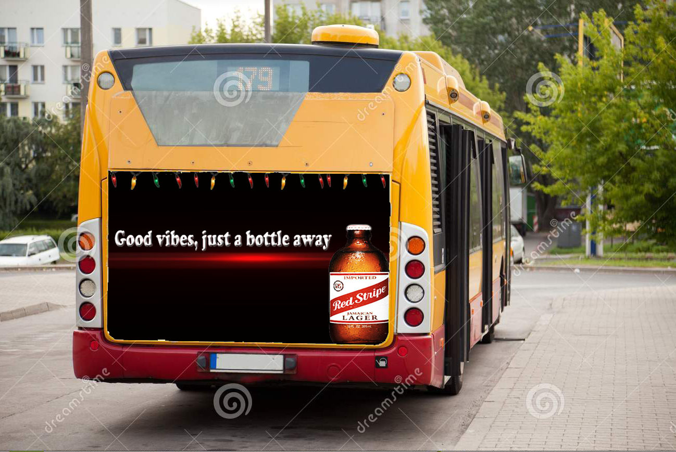
Reggae nights promotions
Red stripe bus
Go to local beaches and have reggae music playing from the bus with a dance floor outside providing a chill and fun Jamaican environment
Night time beach parties for adults
Have a local beach party at night hosted by red stripe with reggae music and raffles to win red stripe surfboards

Slide 16
Media breakdown
12pm-4pm
4pm-9pm
9pm-12am

Slide 17
don’t worry man budget

Slide 18
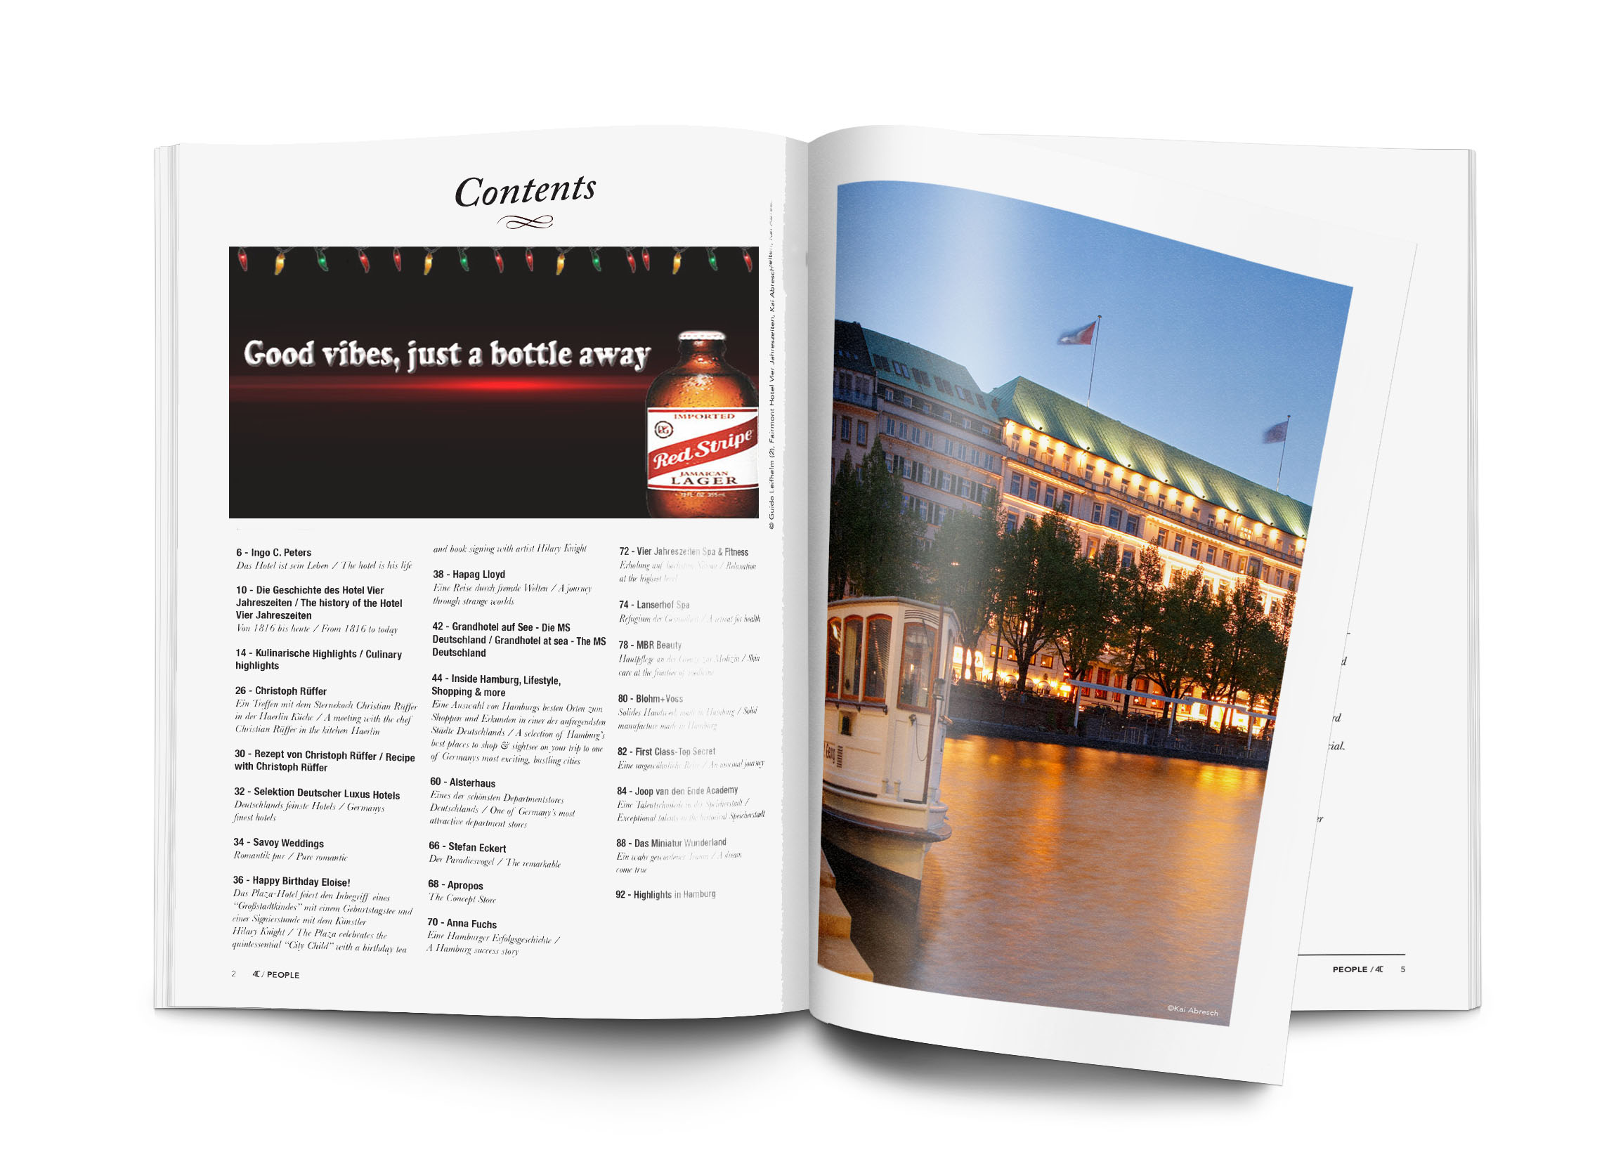
Oh what a night Measuring success
Research
Qualitative
Focus groups and interviews
quantitative
Surveys

Slide 19
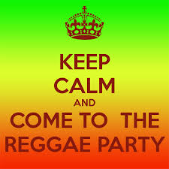
The last sip conclusion
Jamaican vibes will surround consumers with an array advertisements
Attracting the target market
good vibes will bring awareness to consumers about red stripe

Slide 20
https://vimeo.com/148327214

Slide 22
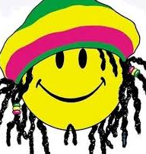
Thank you! Go grab a red stripe man

